Slide 1




YOLO Swag
Aug, 2^{ed} ,2019
김.남.우

Slide 2
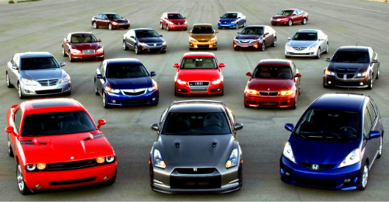


YOLO Swag
Car Model Classification

Slide 3
YOLO Swag
Topic selection
environment development
Feature Engineering
Pre – Training
Deep Learning
Submission
day1
day2 – day3
day3 – day5

Slide 4
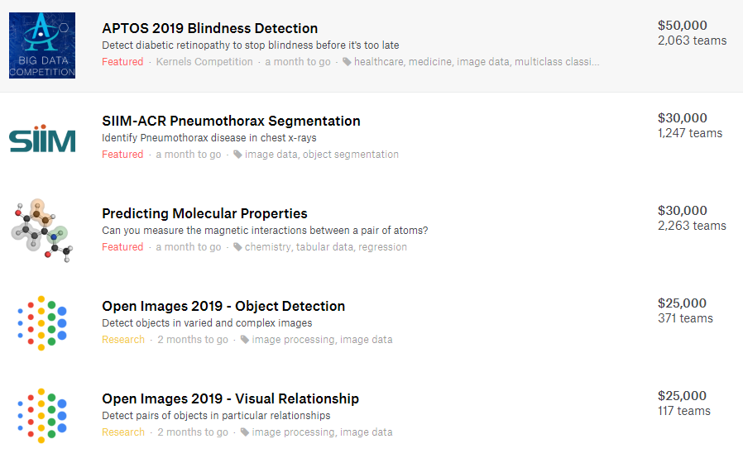
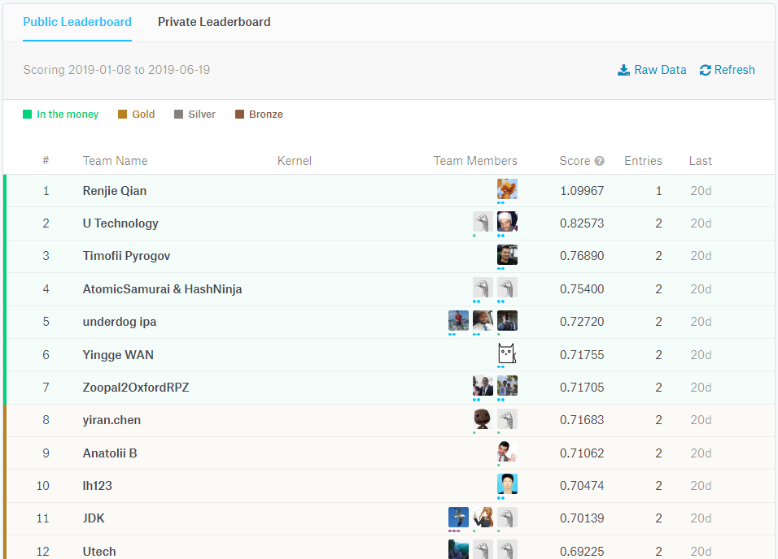
YOLO Swag

Slide 5
YOLO Swag

Slide 6
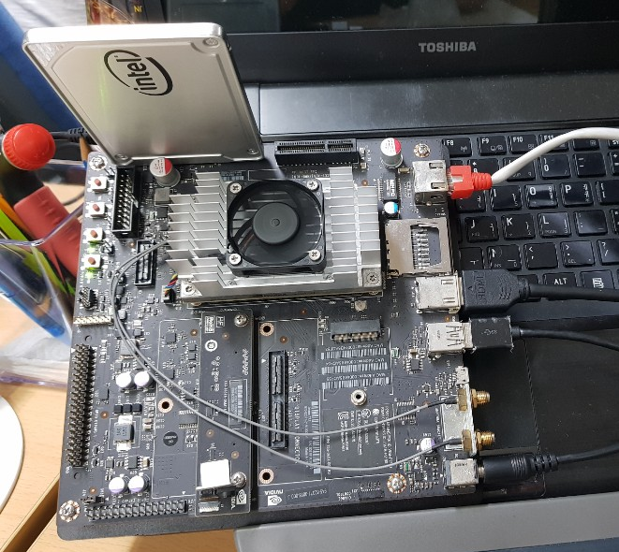
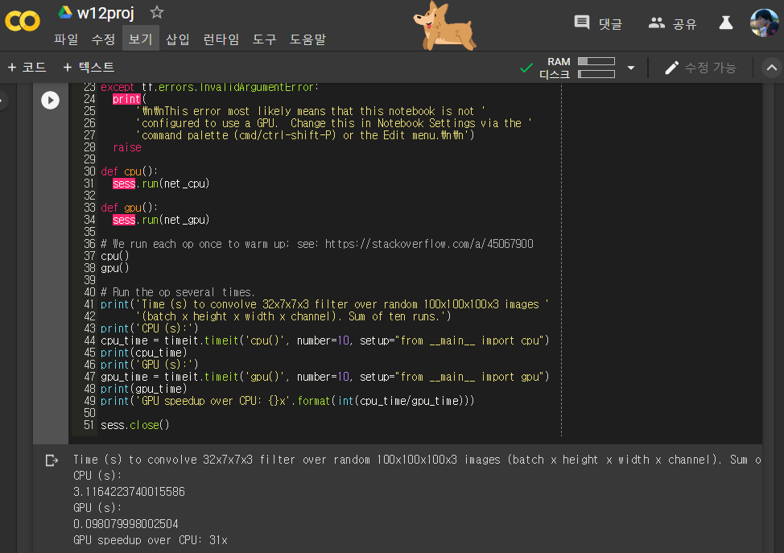

YOLO Swag
개발환경 구축
NVIDIA JETSON TX1
SSD 250GB mounted
Google Colab
YOLO v3-320
https://www.youtube.com/watch?v=ZpQgRdg8RmA

Slide 7
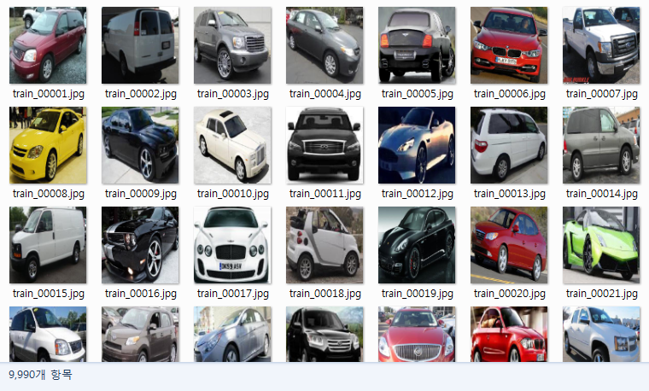
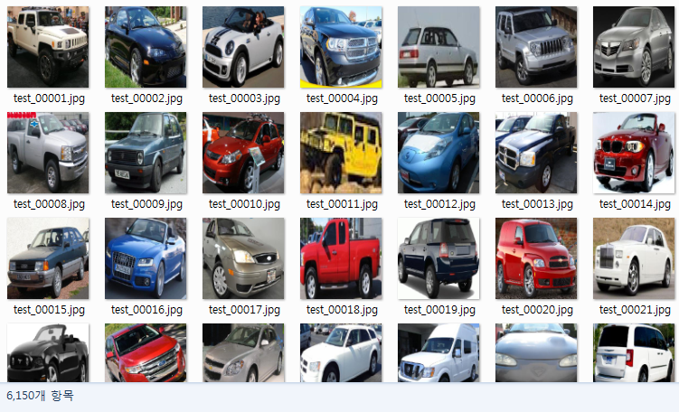
YOLO Swag
Train set
9990
Test set
6150

Slide 8

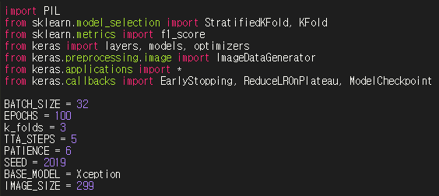
YOLO Swag
Google drive 연동
Import module
& Hyperparameter

Slide 9
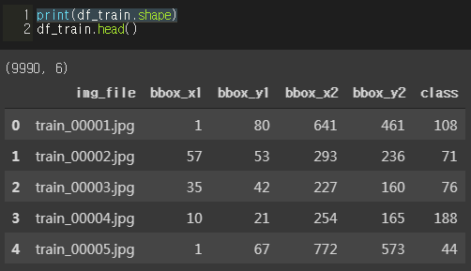
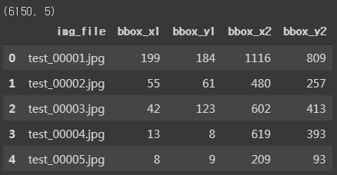
YOLO Swag
Train set
9990
Test set
6150

Slide 10
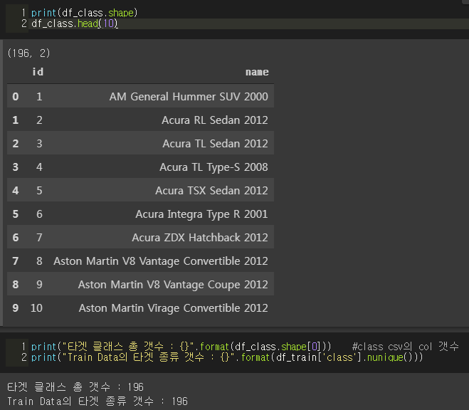
YOLO Swag
id / name

Slide 11
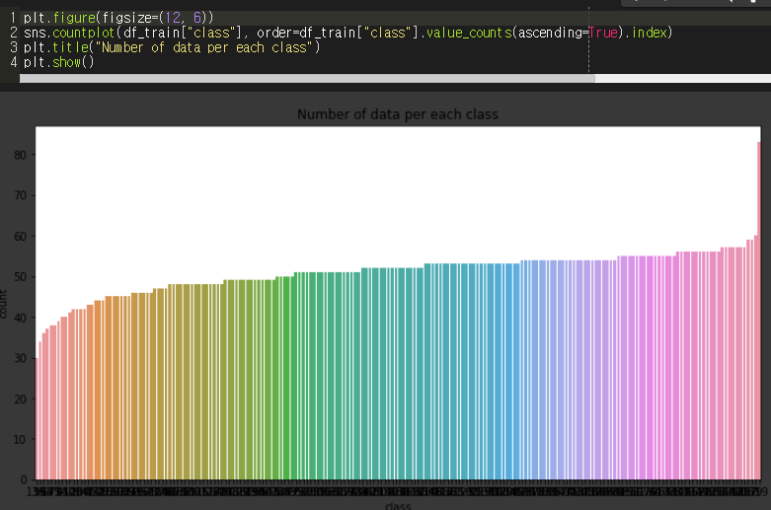
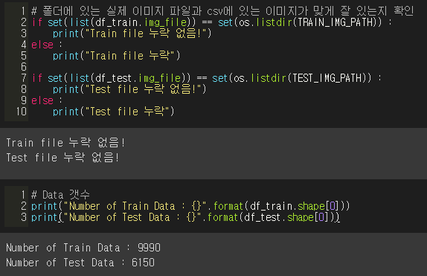
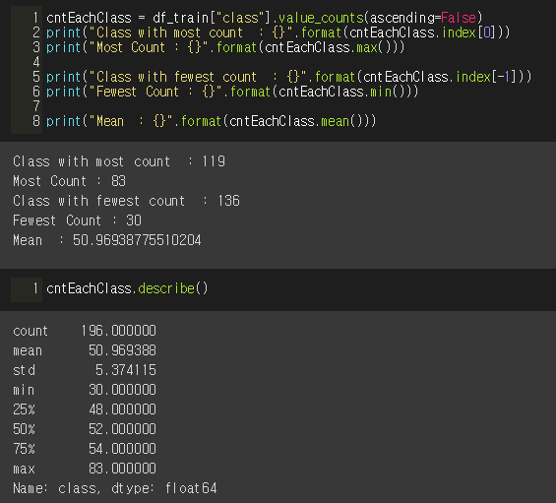
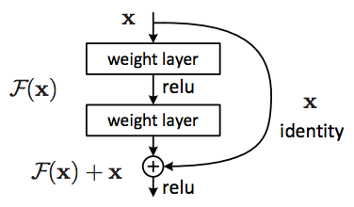
YOLO Swag

Slide 12
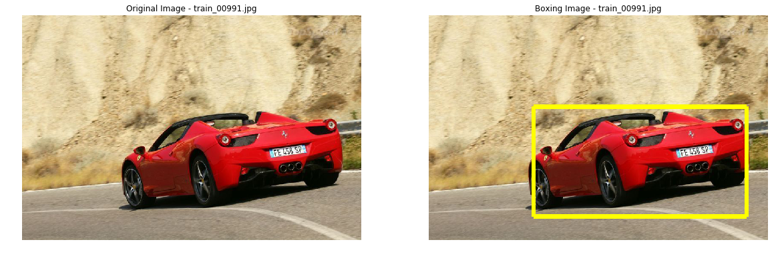
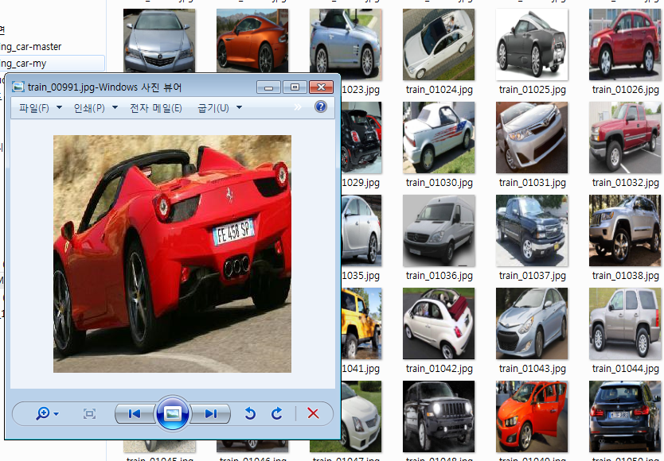
YOLO Swag

Slide 13
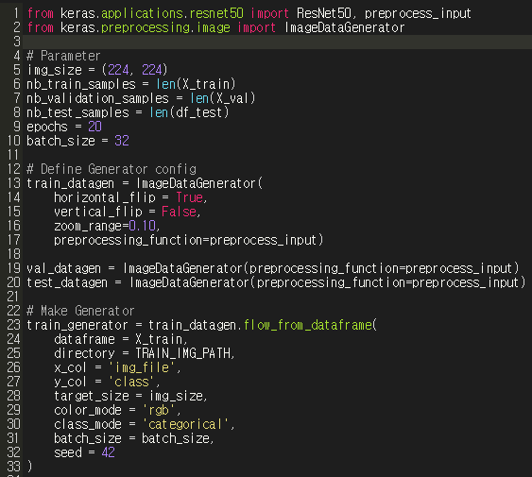
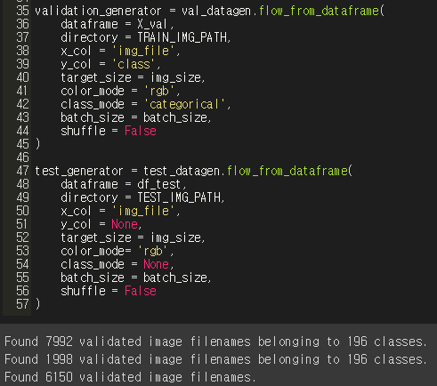
YOLO Swag
Generator
https://keras.io/preprocessing/image/

Slide 14
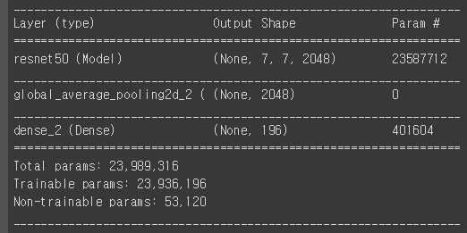
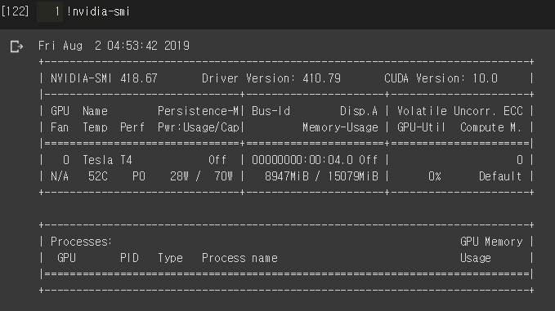
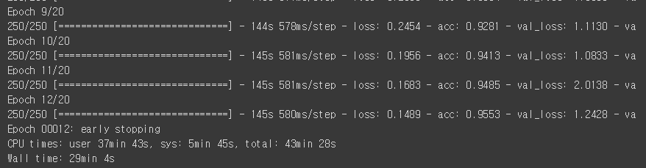
YOLO Swag
학습중 …

Slide 15
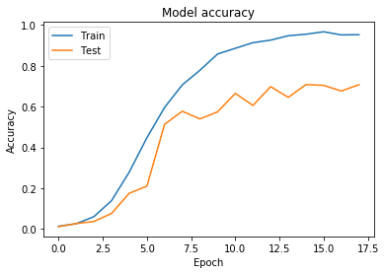
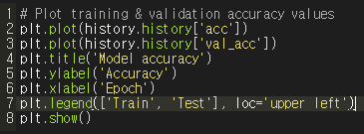
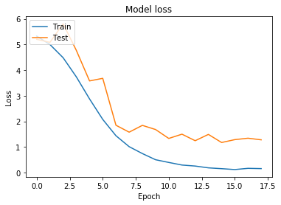
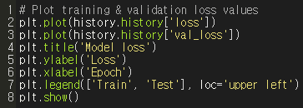
YOLO Swag

Slide 16
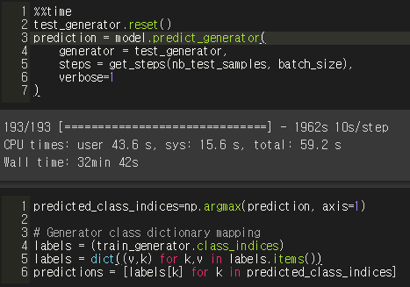
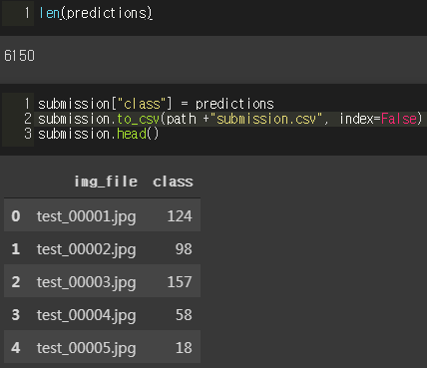
YOLO Swag

Slide 17
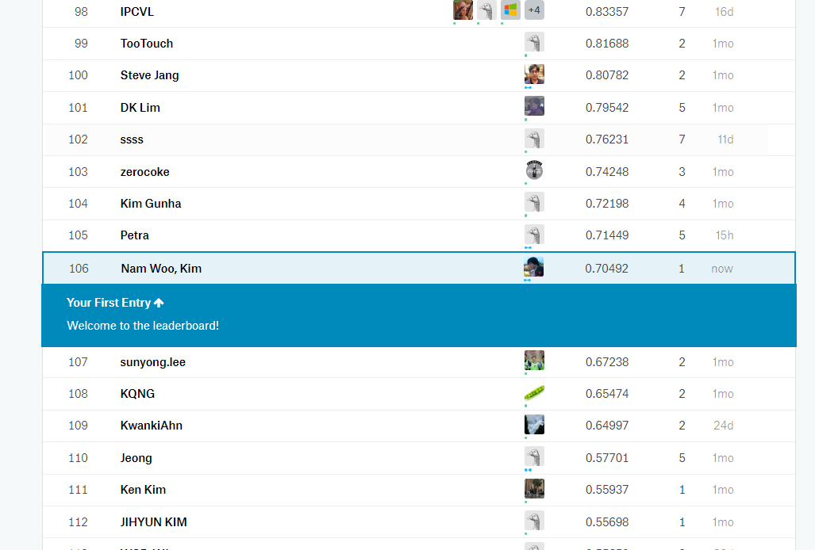
YOLO Swag

Slide 18
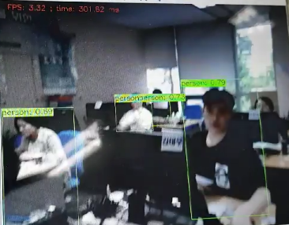
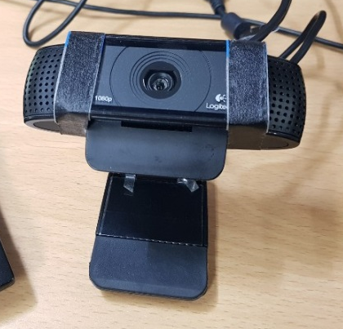

YOLO Swag
앞으로 할 일
제가 만든 모델로 움직이는 Yolo Swag NW
& Kaggle & Tensorflow …
Ubuntu16
OpenCV2
Python3
ROS kinetic
Yolo
QT
C920 Logitech

Slide 19
Vielen Dank

