Slide 1
Janis
Workshop 1 - Peter Mac
Michael Franklin
February 12th, 2020

Slide 2
Workflows
Task A
Sequence of steps or processes through which a piece of work passes ^{[1]}
Steps may be dependent on other tasks to complete
Task B
Task C1
Task C2
Task D
[1] https://www.lexico.com/definition/workflow

Slide 3
Fastq
$fastq=BRCA1_R*.fastq.gz
bwa mem $fastq [...] | samtools view [...] > aligned.bam
gatk SortSam -I aligned.bam [...] -O aligned.sorted.bam
gatk MarkDuplicates -I aligned.sorted.bam [...] \ -O aligned.sorted.marked.bam
gatk HaplotypeCaller --input aligned.sorted.marked.bam
configStrelka.py [...] --bam aligned.sorted.marked.bam
gatk GatherVcfs \ --INPUT gatk_variants.vcf.gz \ --INPUT strelka_variants.vcf.gz \ --OUTPUT variants.vcf.gz
$output=variants.vcf.gz
Alignment
Mark Dups
Call Var 1
Call var 2
Merge Vars

Slide 4
Removing intermediate files?
Fastq
$fastq=BRCA1_R*.fastq.gz
bwa mem $fastq [...] | samtools view [...] > aligned.bam
gatk SortSam -I aligned.bam [...] -O aligned.sorted.bam
gatk MarkDuplicates -I aligned.sorted.bam [...] \ -O aligned.sorted.marked.bam
gatk HaplotypeCaller --input aligned.sorted.marked.bam
configStrelka.py [...] --bam aligned.sorted.marked.bam
gatk GatherVcfs \ --INPUT gatk_variants.vcf.gz \ --INPUT strelka_variants.vcf.gz \ --OUTPUT variants.vcf.gz
$output=variants.vcf.gz
Alignment
Mark Dups
Call Var 1
Call var 2
Merge Vars
rm aligned.bam rm aligned.sorted.bam rm gatk_variants.vcf.gz rm strelka_variants.vcf.gz

Slide 5
#SBATCH --job-name=alignment #SBATCH --time=10:00 #SBATCH [...more]
$fastq=BRCA1_R*.fastq.gz
bwa mem $fastq [...] | samtools view [...] > aligned.bam
gatk SortSam -I aligned.bam [...] -O aligned.sorted.bam
gatk MarkDuplicates -I aligned.sorted.bam [...] \ -O aligned.sorted.marked.bam
gatk HaplotypeCaller --input aligned.sorted.marked.bam
configStrelka.py [...] --bam aligned.sorted.marked.bam
gatk GatherVcfs \ --INPUT gatk_variants.vcf.gz \ --INPUT strelka_variants.vcf.gz \ --OUTPUT variants.vcf.gz
$output=variants.vcf.gz
multi-threaded; high memory
Fastq
multi-threaded; low memory
Alignment
single-threaded; high memory
Mark Dups
single-threaded; low memory
multi-threaded; high memory
Call Var 1
Call var 2
single-threaded; high memory
Merge Vars

Slide 6
$fastq=BRCA1_R*.fastq.gz
sBWAid=$(sbatch [.] --wrap “bwa mem $fastq [...] \
| samtools view [...] > aligned.bam“)
sSORTid=$(sbatch [.] --dependency=afterok:$sBWAid --wrap \
“gatk SortSam -I aligned.bam [...] \
-O aligned.sorted.bam“)
sMARKid=$(sbatch [.] --dependency=afterok:$sSORTid --wrap \ “gatk MarkDuplicates -I aligned.sorted.bam [...] \ -O processed.bam“)
sHAPLid=$(sbatch [.] --dependency=afterok:$sMARKid --wrap \ “gatk HaplotypeCaller --input processed.bam“)
sSTRKid=$(sbatch [.] --dependency=afterok:$sMARKid --wrap \ “configStrelka.py [...] --bam processed.bam“)
sbatch [.] --dependency=afterok:$sMARKid,afterok:$sHAPLid \ --wrap ”gatk GatherVcfs \ --INPUT gatk_variants.vcf.gz \ --INPUT strelka_variants.vcf.gz \ --OUTPUT variants.vcf.gz“)
$output=variants.vcf.gz
Fastq
Alignment
failed previously & need to resume from here
Mark Dups
Some other steps -I aligned.sorted.bam [...] -O processed.bam
Call Var 1
Call var 2
Merge Vars

Slide 7
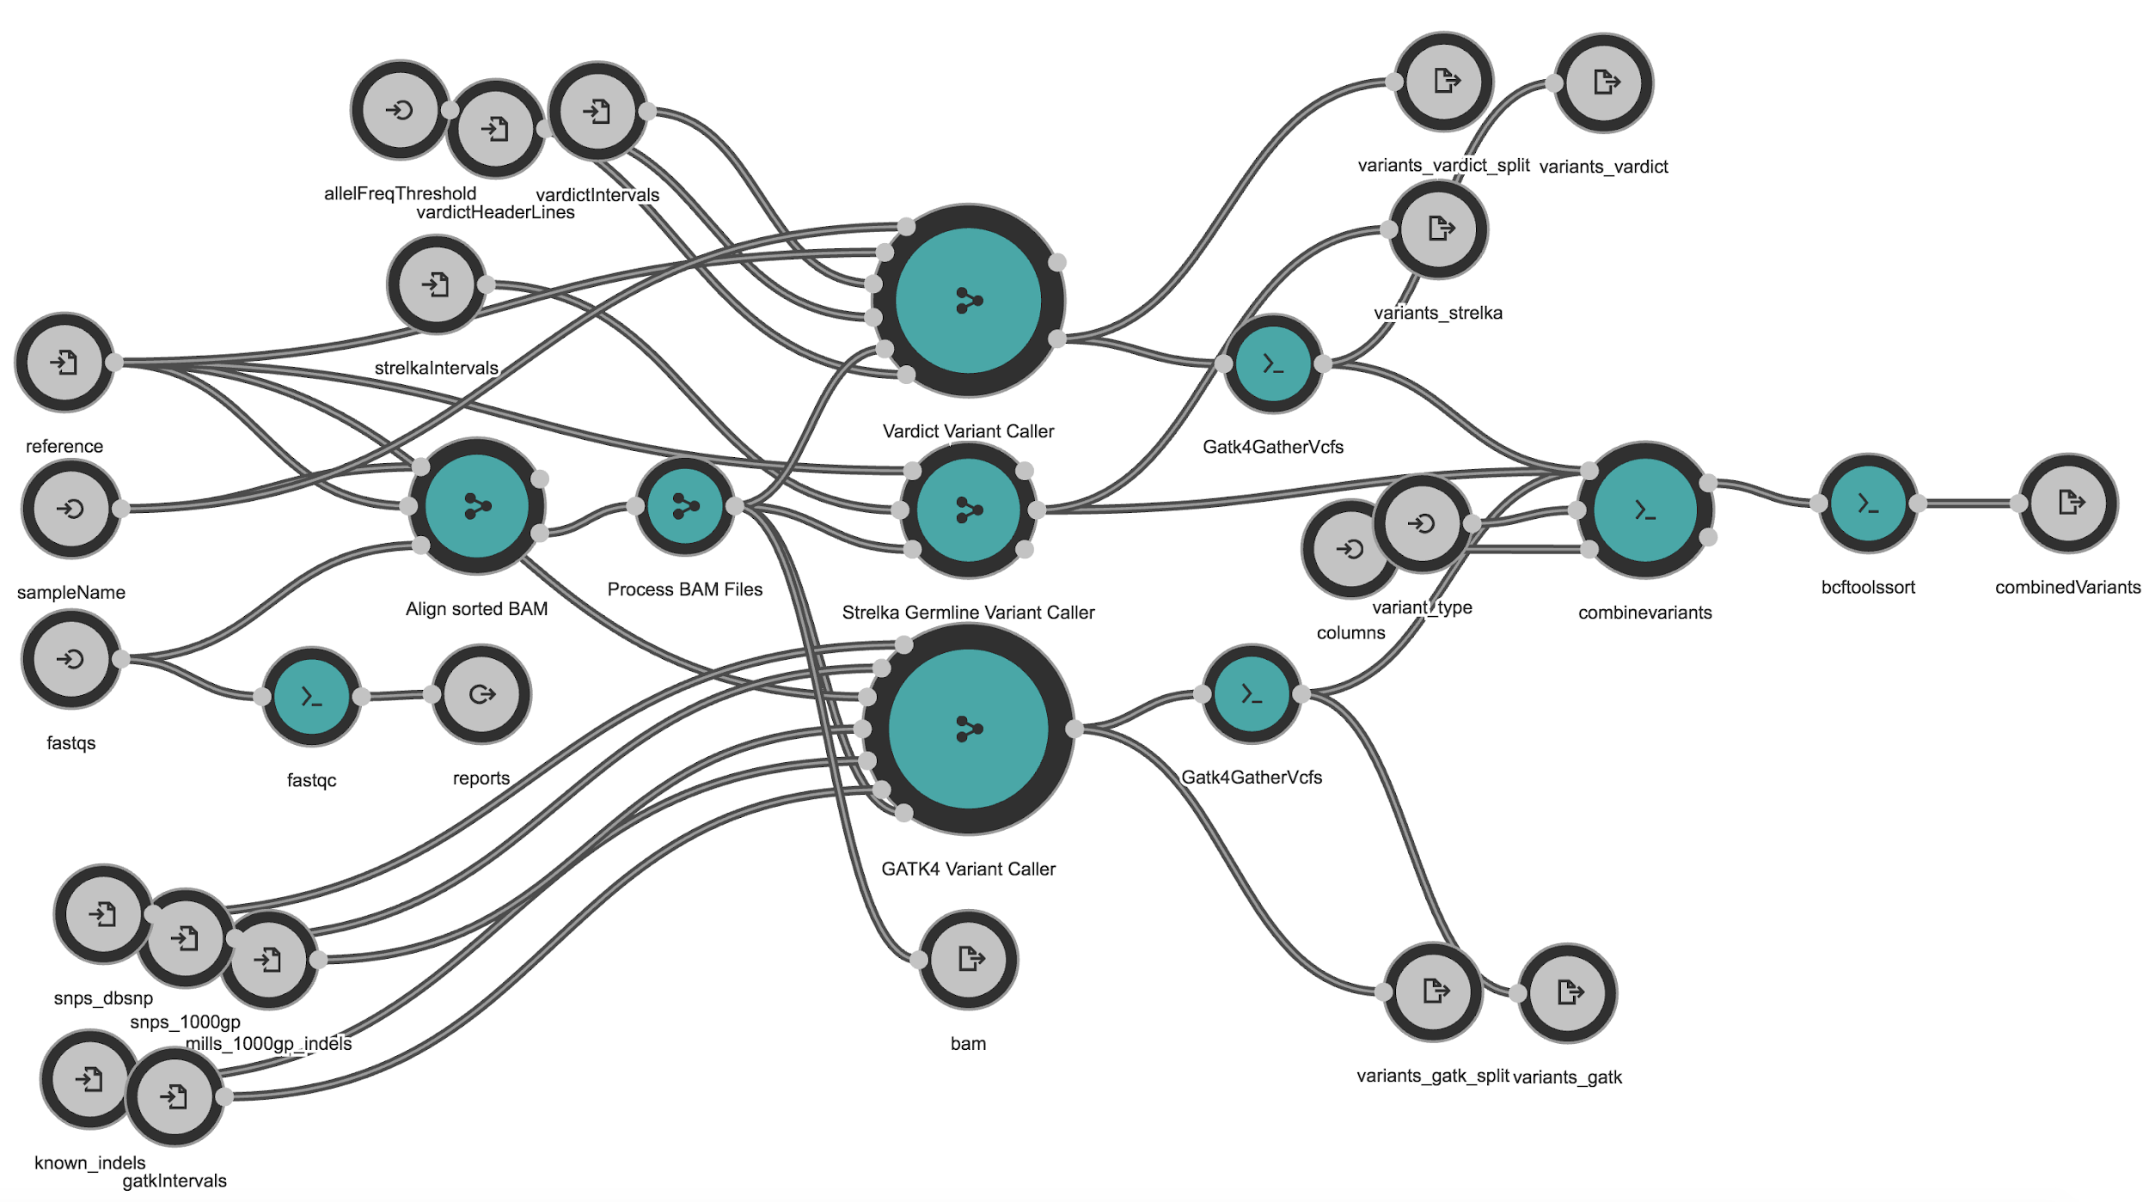
Using a workflow engine
Benefits
easy subworkflows
easy parallelism
input / output checking
restart / continue / rerun
audit trail
notifications
Disadvantages
learning curve
extra complexity in debugging
Visualisation of variant-calling workflow from Rabix Composer

Slide 8
bpipe / seqliner
bwa = {
transform (“bam”) {
exec “bwa mem ${input.fastq} | samtools view -B > ${output.bam}”
}
}
sortsam = {
filter (“sorted”) {
exec “gatk SortSam -I ${input.bam} -o ${output.bam}
}
}
markdups = {
filter (“markdups”) {
exec “gatk MarkDuplicates -I ${input.bam} -o ${output.bam}
}
}
haplotypecaller = {
transform (“vcf”) {
exec “gatk HaplotypeCaller -I ${input.bam} -o ${output.vcf}
}
}
strelka = {
transform (“vcf”) { exec “configStrelka.py -I ${input.bam} -o ${output.vcf}
}
}
gatherVcf = {
produce (“vcf”) {
exec “gatk GatherVcfs -I ${input1.vcf} -I ${input2.vcf} -o ${output.vcf}”
}
}
Bpipe.run {
bwa + sortsam + markdups + [ strelka, haplotypecaller ] + gatherVcf
}
Fastq
Alignment
Mark Dups
Call Var 1
Call var 2
Merge Vars

Slide 9
Limitations
bpipe / seqliner
bwa = {
transform (“bam”) {
exec “bwa mem ${input.fastq} | samtools view -B > ${output.bam}”
}
}
sortsam = {
filter (“sorted”) {
exec “gatk SortSam -I ${input.bam} -o ${output.bam}
}
}
markdups = {
filter (“markdups”) {
exec “gatk MarkDuplicates -I ${input.bam} -o ${output.bam}
}
}
haplotypecaller = {
transform (“vcf”) {
exec “gatk HaplotypeCaller -I ${input.bam} -o ${output.vcf}
}
}
strelka = {
transform (“vcf”) { exec “configStrelka.py -I ${input.bam} -o ${output.vcf}
}
}
gatherVcf = {
produce (“vcf”) {
exec “gatk GatherVcfs -I ${input1.vcf} -I ${input2.vcf} -o ${output.vcf}”
}
}
Bpipe.run {
bwa + sortsam + markdups + [ strelka, haplotypecaller ] + gatherVcf
}
Portability
locked to shared infrastructure
Limited engine support
DNANexus, Terra, SevenBridges
Inefficient with resources
scale for complex pipelines
Written in Groovy language
limited skill in this field

Slide 10
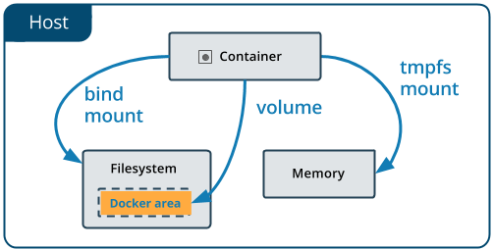
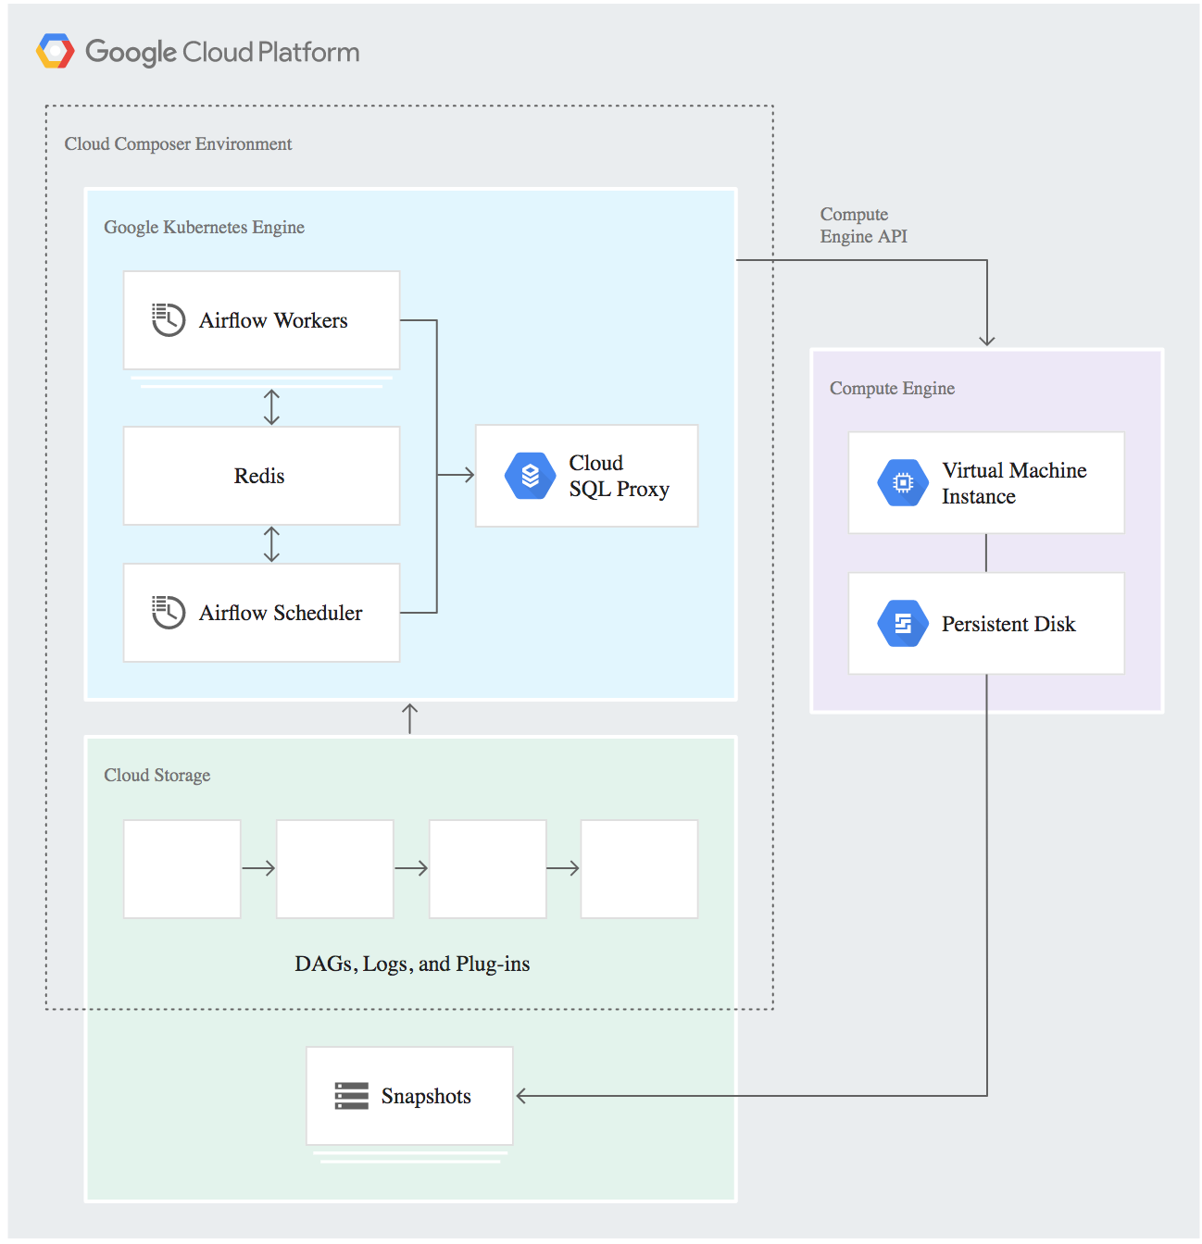
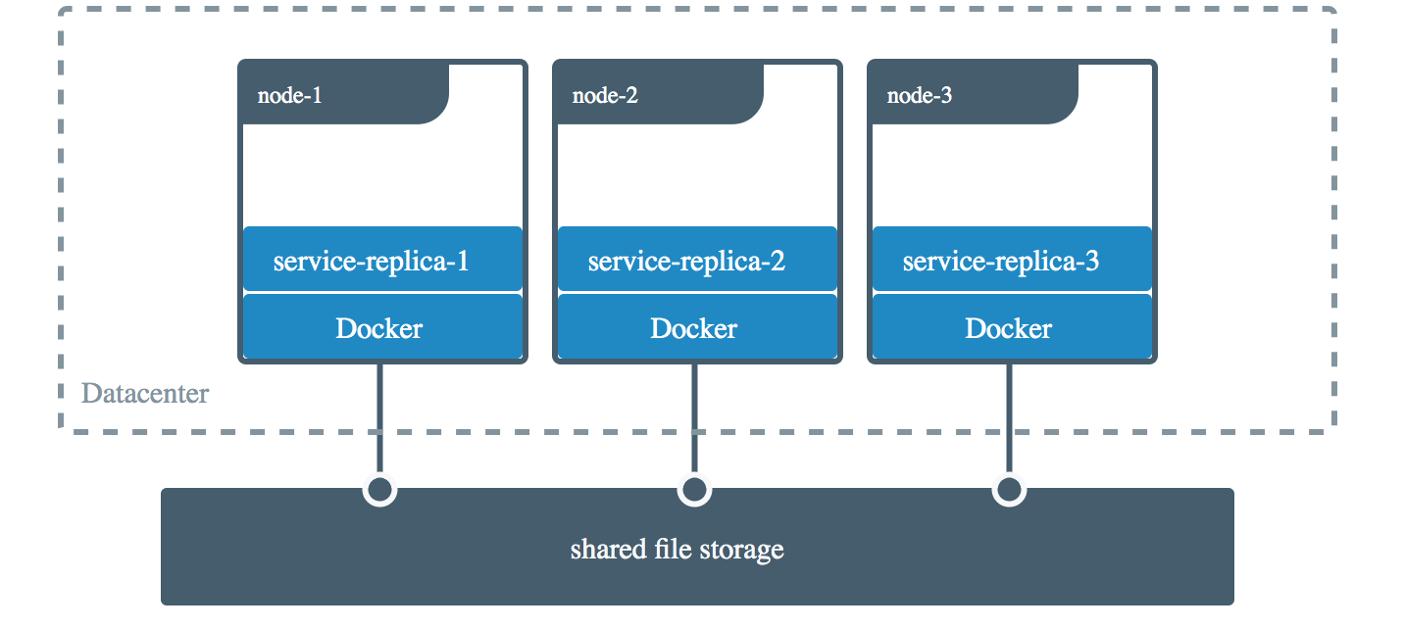
Containers & Cloud Storage
[1]
[2]
[1] https://docs.docker.com/storage/volumes/
[2] https://cloud.google.com/solutions/automating-infrastructure -using-cloud-composer

Slide 11



Existing specifications
Common Workflow Language (CWL)
YAML specification (key-value pairs)
hard to write, easy to parse
Workflow Description Language (WDL)
custom DSL, easier to write, hard to parse
initially by Broad Institute
Cromwell execution engine
Nextflow, Snakemake, Bpipe, ...more

Slide 12

Why portable pipelines?
Bring pipeline to data
Characterised by:
Data locality (local / external)
Compute availability
Pipeline source

Slide 13
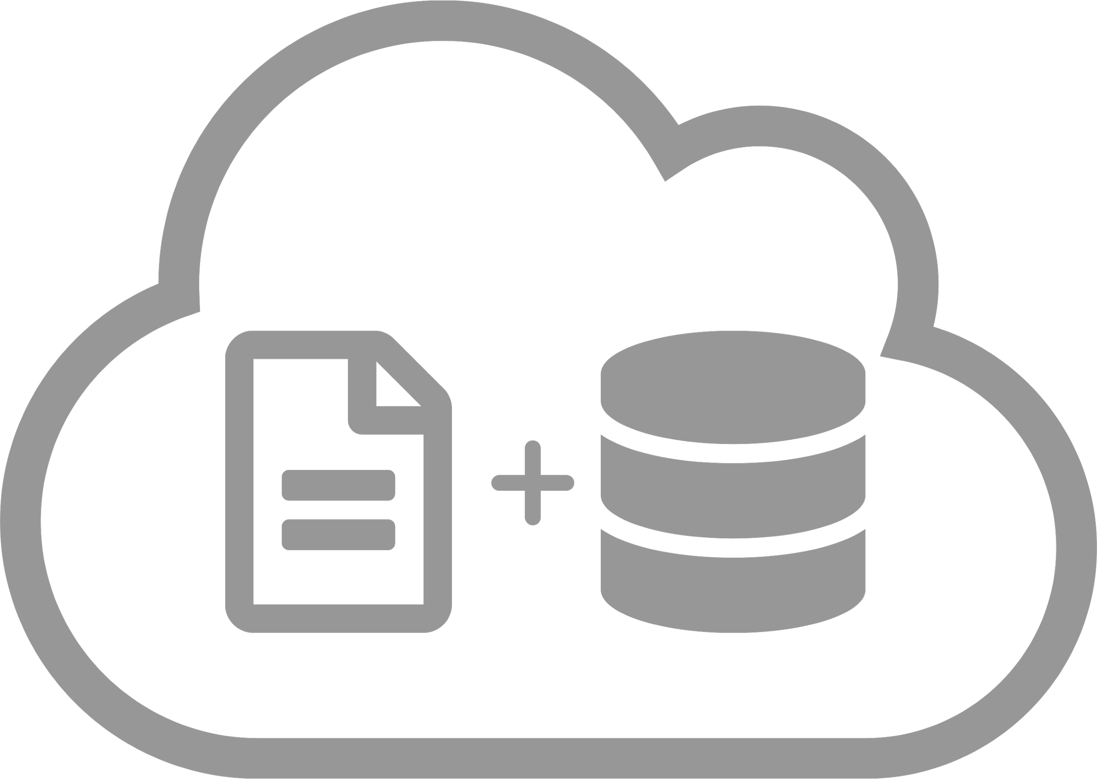

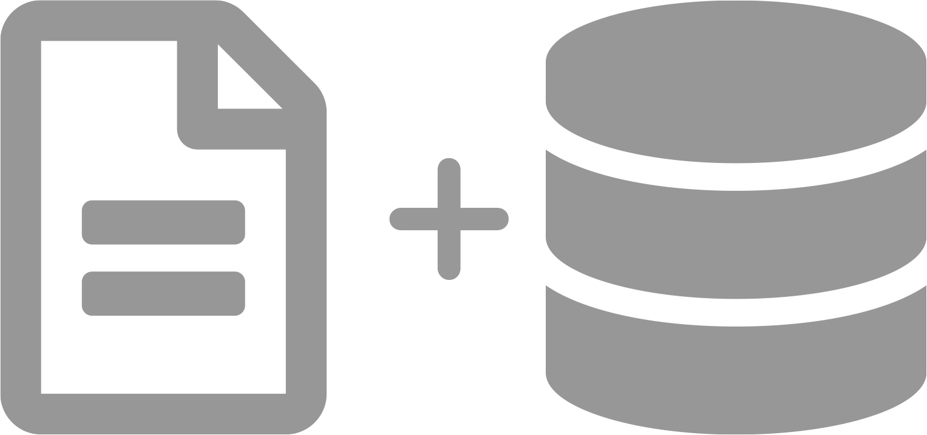
Common scenarios
OR
local
cloud
( preferred )
Data + Compute in same place
Move data to compute

Slide 14
Use case 1 - analysis @ Peter Mac
Data | available locally
Compute | available locally
Solution | run at Peter Mac
Notes:
Researchers have data to be analysed
Computing / storage resources are available
Analysis:
Initial data explorations
Using pre-built Janis pipelines.
Quick setup; useful for getting early results
Most parameters are default; not disease or panel specific
E.g. QC pipeline (FASTQ -> BAM -> QC tools) to check if sequencing result was ok before doing more downstream analysis (or if re-sequencing needs to be arranged)
E.g. VariantCalling (FASTQ -> VCF) to check if certain variants present in datasets for diagnostic purposes
Build own pipelines through Janis
Can be customised to panel / cancer-type / study specific parameters
Add more tools
Extend pre-built pipelines
Solution: Run at Peter Mac’s cluster

Slide 15
Use case 2 - no compute
Data | available locally
Compute | not available
Solution | upload data to compute institute HPCs NCI / Pawsey / Nectar AWS / GCP / Azure
Notes:
Researchers have data to be analysed
Computing / storage resources are not available
Analysis: pipelines are already in Janis
Solution: Use other computing environments
Send data to other HPCs (WEHI / Spartan / NCI / Pawsey / Nectar / AWS / Google Cloud / etc)
Setup Janis (some will be pre-installed elsewhere)
Setup pipelines (if not part of pre-built pipelines)
Run analysis
Transfer results back to Peter Mac

Slide 16
Use case 3 - external collaborations
Data | available at both institutes
Compute | available at both institutes
Solution | traditional solution transfer data to single institute
 | new solution share portable pipeline
Institute 1
Institute 2
Notes:
Researchers and external collaborators have their own sets of data to be analysed
Computing / storage resources are available at both institutes
Analysis: pipelines are already in Janis
Solution 1 [traditionally]:
Transfer one of the datasets to another institute (assumption: no geo-fencing / data locality problem re: geolocations)
Run pipelines
Share results
Solution 2 :
Share Janis pipeline to the other institute
Data is analysed with the same pipeline on different computing infrastructure (each keep their own raw data)
Share results

Slide 17

Use case 4 - publication
Data | published
Compute | flexible
Solution | download pipeline (eg from dockstore) (a) run compute next to data, or (b) download (egress) data to institute
Aim | reproduce published results
Notes:
Researchers have analysed data through pipelines (or series of analysis steps) and results are included for publication
Data / methods / results will be published
What about the reproducibility of the analysis?
How does reviewer / other users normally reproduce the results of a paper?
Potential solution:
Publish the pipeline used for analysis
Janis pipeline
Translated CWL / WDL
Or through service such as Dockstore
Reviewers / other users can download data + pipeline and re-run analysis on their own computing environments, if required.

Slide 18
Use case 5 - public datasets
Data | public
Compute | flexible
Solution | download data run pipeline locally
 | bring pipeline to data source run pipeline on GCP / AWS / other
Example | confirm hypothesis through use of public datasets like TCGA
Notes:
Researchers have no data
Need to confirm hypothesis through the use of public datasets (e.g. TCGA / ICGC / PCAWG )
Have a reliable pipeline (familiar with the results structure) from previous study
Solution 1 (traditionally):
Request access to datasets
Download raw data (storage + egress cost)
Run pipeline
Solution 2 (portable pipeline):
Request access to datasets
Bring pipeline to where data resides (AWS / GCP etc)
Run pipeline
Download results
==
Researchers have no data
Need to confirm hypothesis through the use of public datasets (e.g. TCGA / ICGC / PCAWG )
Researchers have no pipeline
Solution:
Request access to datasets
Request pipeline from Dockstore
Run pipeline in DNANexus / SevenBridges / AWS / GCP / Azure
Download results

Slide 19
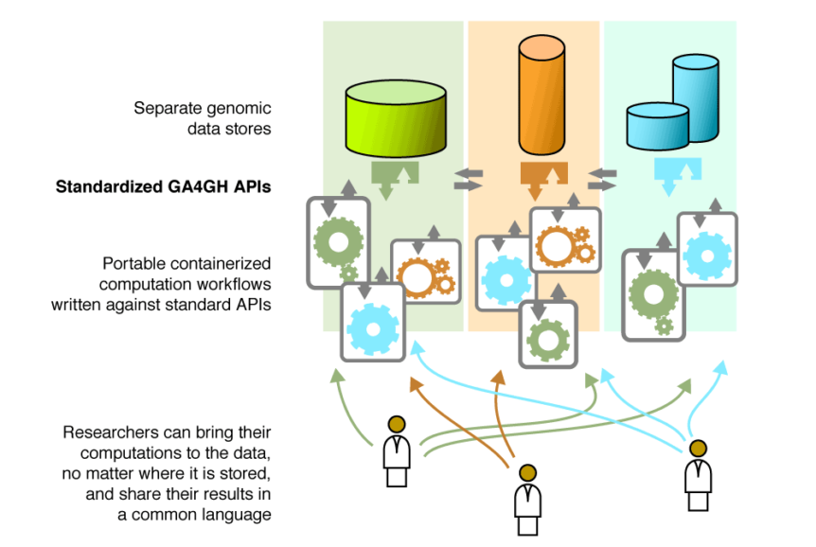
Global Alliance for Genomics & Health
https://ucscgenomics.soe.ucsc.edu/global-alliance-for-genomics-health-integration-group/

Slide 20

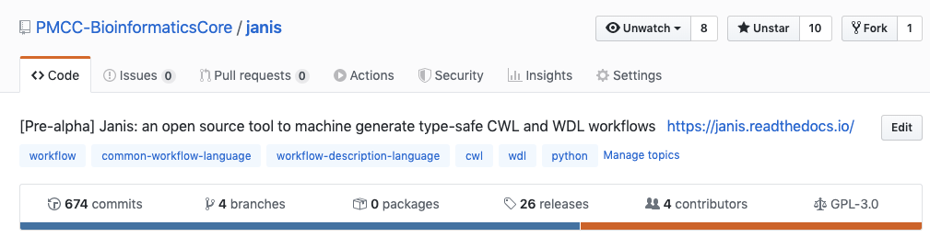
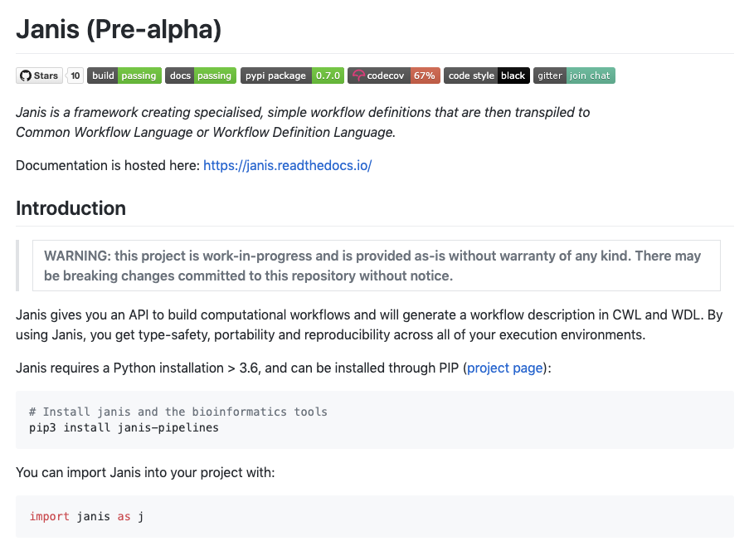
Python framework
for workflow specification
simple API
build workflow using Janis
type-safe connections
Generates CWL and WDL
Registry of tools and types
unix
bioinformatics

