Slide 1
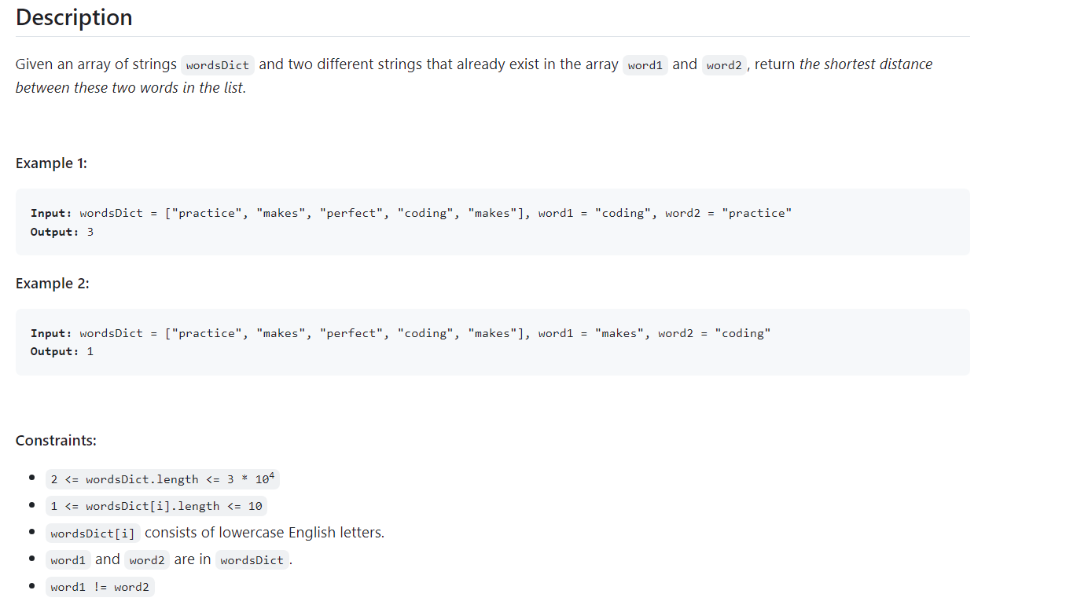
Level of Problem -: Easy
Topics include – Array , string
Company Tags -: Microsoft- 2 , LinkedIn -11 , Amazon – 3 , Facebook – 2 , salesforce - 2
243. Shortest Word Distance 🔒

Slide 2
Solution
Python
class Solution:
def shortestDistance(self, wordsDict: List[str], word1: str, word2: str) -> int:
i = j = -1
ans = inf
for k, w in enumerate(wordsDict):
if w == word1:
i = k
if w == word2:
j = k
if i != -1 and j != -1:
ans = min(ans, abs(i - j))
return ans

Slide 3
Java
class Solution {
public int shortestDistance(String[] wordsDict, String word1, String word2) {
int ans = 0x3f3f3f3f;
for (int k = 0, i = -1, j = -1; k < wordsDict.length; ++k) {
if (wordsDict[k].equals(word1)) {
i = k;
}
if (wordsDict[k].equals(word2)) {
j = k;
}
if (i != -1 && j != -1) {
ans = Math.min(ans, Math.abs(i - j));
}
}
return ans;
}
}

Slide 4
C++
class Solution {
public:
int shortestDistance(vector<string>& wordsDict, string word1, string word2) {
int ans = INT_MAX;
for (int k = 0, i = -1, j = -1; k < wordsDict.size(); ++k) {
if (wordsDict[k] == word1) {
i = k;
}
if (wordsDict[k] == word2) {
j = k;
}
if (i != -1 && j != -1) {
ans = min(ans, abs(i - j));
}
}
return ans;
}
};

