Slide 1
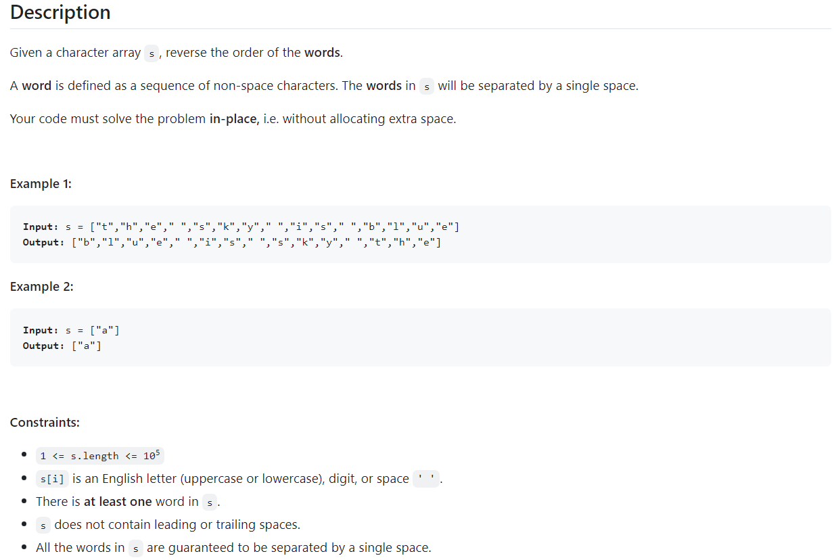
Level of Problem - : Medium
Topics include – Two pointers , string
Company Tags -: Microsoft 4

Slide 2
Solutions - :
Python
class Solution:
def reverseWords(self, s: List[str]) -> None:
def reverse(i: int, j: int):
while i < j:
s[i], s[j] = s[j], s[i]
i, j = i + 1, j - 1
i, n = 0, len(s)
for j, c in enumerate(s):
if c == " ":
reverse(i, j - 1)
i = j + 1
elif j == n - 1:
reverse(i, j)
reverse(0, n - 1)

Slide 3
Java
class Solution {
public void reverseWords(char[] s) {
int n = s.length;
for (int i = 0, j = 0; j < n; ++j) {
if (s[j] == ' ') {
reverse(s, i, j - 1);
i = j + 1;
} else if (j == n - 1) {
reverse(s, i, j);
}
}
reverse(s, 0, n - 1);
}
private void reverse(char[] s, int i, int j) {
for (; i < j; ++i, --j) {
char t = s[i];
s[i] = s[j];
s[j] = t;
}
}
}

Slide 4
cpp
class Solution {
public:
void reverseWords(vector<char>& s) {
auto reverse = [&](int i, int j) {
for (; i < j; ++i, --j) {
swap(s[i], s[j]);
}
};
int n = s.size();
for (int i = 0, j = 0; j < n; ++j) {
if (s[j] == ' ') {
reverse(i, j - 1);
i = j + 1;
} else if (j == n - 1) {
reverse(i, j);
}
}
reverse(0, n - 1);
}
};

