Slide 1
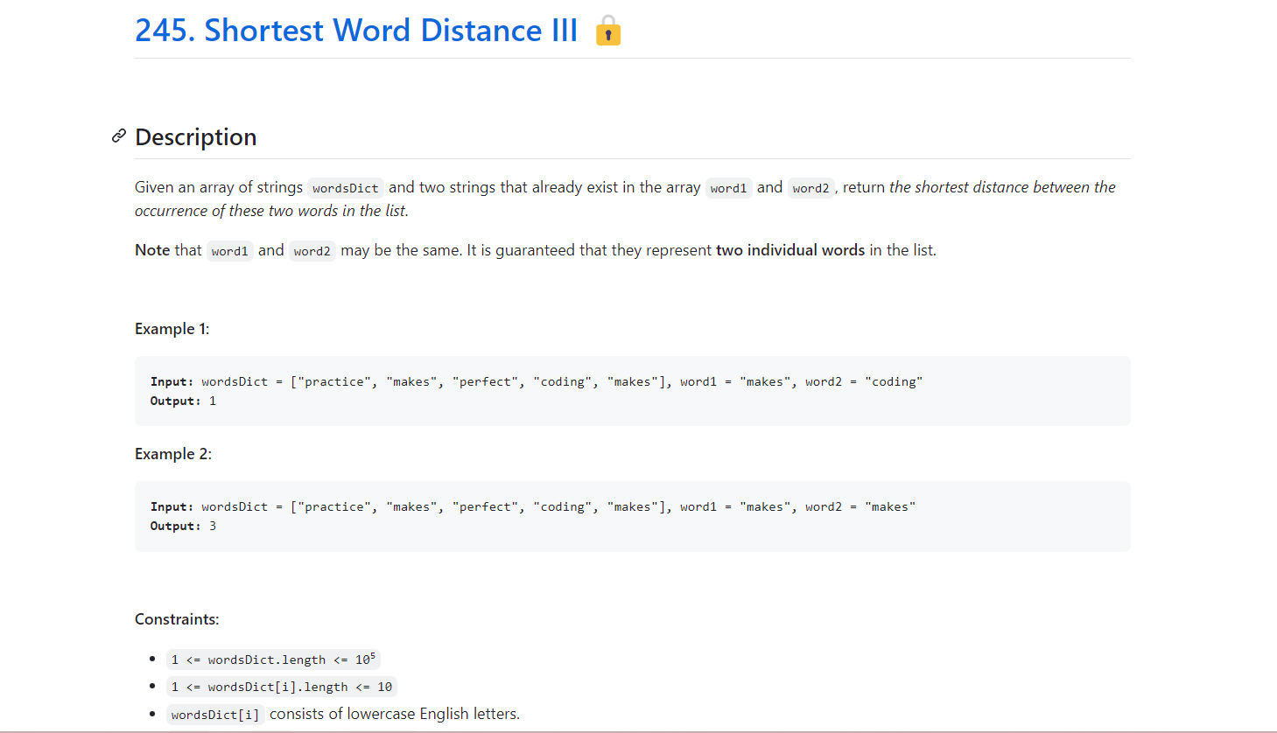
Leetcode Premium Problems
Level of problem - Medium
Company Tags – LinkedIn 2 , Amazon 2

Slide 2
Solution
Python
class Solution:
def shortestWordDistance(self, wordsDict: List[str], word1: str, word2: str) -> int:
ans = len(wordsDict)
if word1 == word2:
j = -1
for i, w in enumerate(wordsDict):
if w == word1:
if j != -1:
ans = min(ans, i - j)
j = i
else:
i = j = -1
for k, w in enumerate(wordsDict):
if w == word1:
i = k
if w == word2:
j = k
if i != -1 and j != -1:
ans = min(ans, abs(i - j))
return ans

Slide 3
class Solution {
public int shortestWordDistance(String[] wordsDict, String word1, String word2) {
int ans = wordsDict.length;
if (word1.equals(word2)) {
for (int i = 0, j = -1; i < wordsDict.length; ++i) {
if (wordsDict[i].equals(word1)) {
if (j != -1) {
ans = Math.min(ans, i - j);
}
j = i;
}
}
} else {
for (int k = 0, i = -1, j = -1; k < wordsDict.length; ++k) {
if (wordsDict[k].equals(word1)) {
i = k;
}
if (wordsDict[k].equals(word2)) {
j = k;
}
if (i != -1 && j != -1) {
ans = Math.min(ans, Math.abs(i - j));
}
}
Java

Slide 4
}
return ans;
}
}
C++
class Solution {
public:
int shortestWordDistance(vector<string>& wordsDict, string word1, string word2) {
int n = wordsDict.size();
int ans = n;
if (word1 == word2) {
for (int i = 0, j = -1; i < n; ++i) {
if (wordsDict[i] == word1) {
if (j != -1) {
ans = min(ans, i - j);
}
j = i;
}
}
} else {
for (int k = 0, i = -1, j = -1; k < n; ++k) {
if (wordsDict[k] == word1) {

Slide 5
i = k;
}
if (wordsDict[k] == word2) {
j = k;
}
if (i != -1 && j != -1) {
ans = min(ans, abs(i - j));
}
}
}
return ans;
}
};

