Slide 1
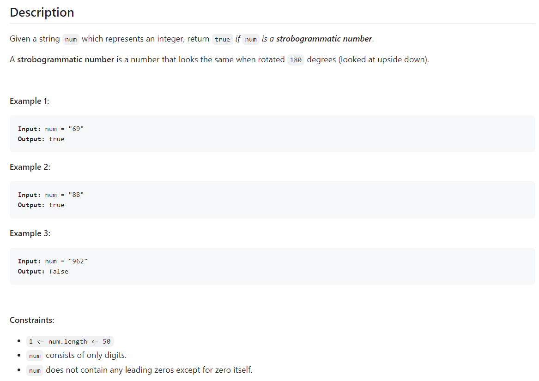
246. Strobogrammatic Number 🔒
difficulty: Easy
topics: - Hash Table - Two Pointers - String
Company Tags -: Facebook 19 , Uber 2

Slide 2
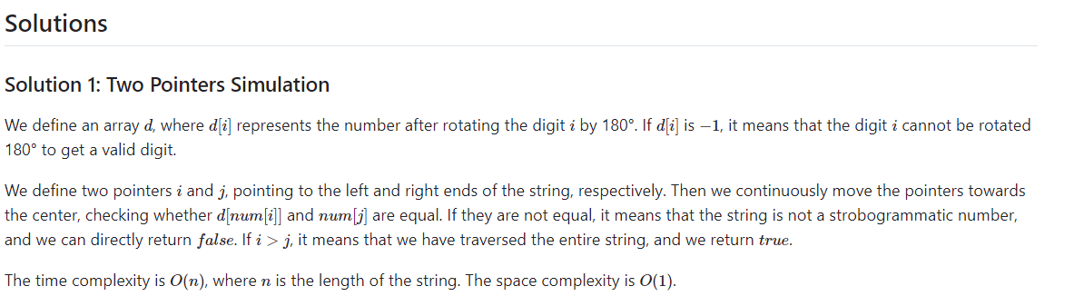
Python
class Solution:
def isStrobogrammatic(self, num: str) -> bool:
d = [0, 1, -1, -1, -1, -1, 9, -1, 8, 6]
i, j = 0, len(num) - 1
while i <= j:
a, b = int(num[i]), int(num[j])
if d[a] != b:
return False
i, j = i + 1, j - 1
return True

Slide 3
Java
C++
class Solution {
public boolean isStrobogrammatic(String num) {
int[] d = new int[] {0, 1, -1, -1, -1, -1, 9, -1, 8, 6};
for (int i = 0, j = num.length() - 1; i <= j; ++i, --j) {
int a = num.charAt(i) - '0', b = num.charAt(j) - '0';
if (d[a] != b) {
return false;
}
}
return true;
}
}
class Solution {
public:
bool isStrobogrammatic(string num) {
vector<int> d = {0, 1, -1, -1, -1, -1, 9, -1, 8, 6};
for (int i = 0, j = num.size() - 1; i <= j; ++i, --j) {
int a = num[i] - '0', b = num[j] - '0';
if (d[a] != b) {
return false;
}
}
return true;
}
};

