Slide 1
An Idea Model of the Immune System
(As described by 9 year olds)
Justin Hall and George Boujaoude

Slide 2
Motivation and Hypotheses
We wanted to observe the relationship between macrophages and lymphocytes in immune system response
Hypothesis: Macrophages will fail to contain a reasonably sized virus attack by themselves
Hypothesis: Lymphocytes who patrol the immune system will be more effective than Lymphocytes who do random walk

Slide 3

Macrophage - The Great Guardian
Cell body - can engulf viruses, signal an infected cell to self-destruct, and release cytokines to recruit lymphocytes
Outer perimeter (“feels” the world around it)
Responsible for patrolling the liver for intruders
Calls for backup if its perimeter indicates that it is being overwhelmed

Slide 4

Lymphocyte - Powerful attacker
Very few in liver that can act as first responders (~25)
Can be activated or summoned to the liver by the cytokines released by a macrophage
Cell body - can intercept incoming cytokines, destroy a virus or signal an infected cell to self-destruct

Slide 5
Cytokines - Information relay
Contains information about an area in space (every cytokine is different!)
Periodically duplicates itself as it moves through the liver (this creates the trail)
Small - the size of a virus in our idea model

Slide 6
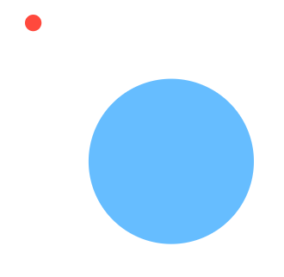

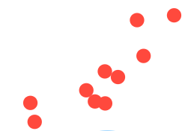
Viruses
Virus
Healthy cell
TIME →

Slide 7
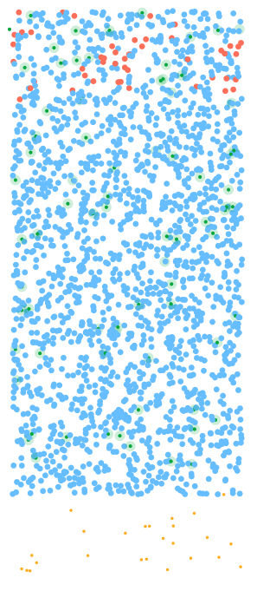
Viruses enter here
Default Configuration
2000x7000 unit grid
75 initial macrophages
2000 initial healthy liver cells
25 initial lymphocytes
100 initial viruses
Liver cell/macrophage layer
Lymphocyte layer

Slide 8
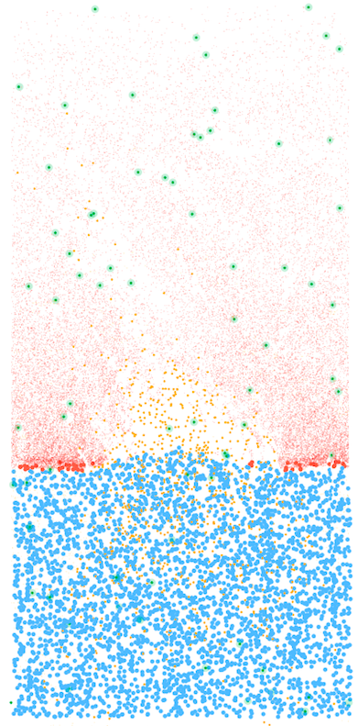
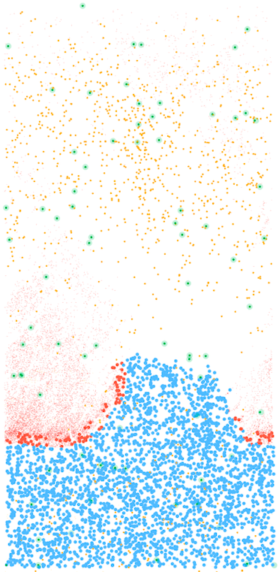
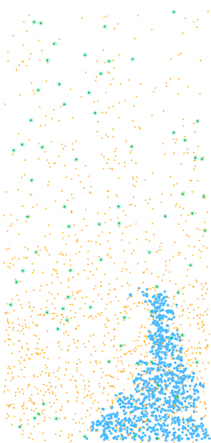
Immune Response On A Scaled-Up Grid
Much more computationally expensive than the default configuration!
29000 viruses
1000 lymphocytes
10500 viruses
1167 lymphocytes
0 viruses
1500 lymphocytes

Slide 9
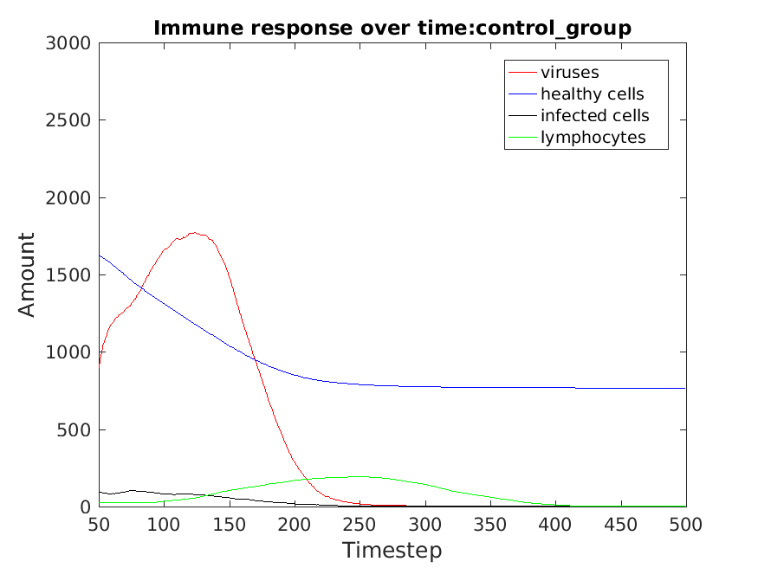
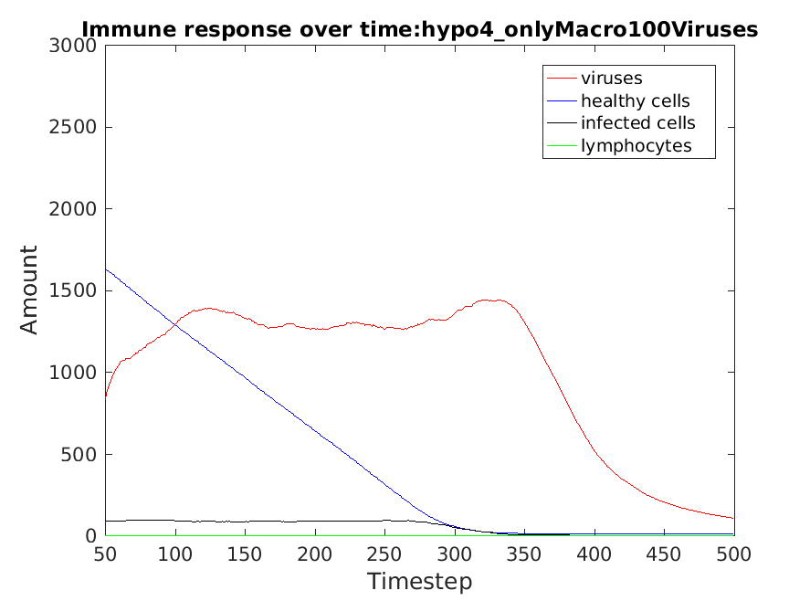
Observations From Data
Lymphocytes are critical to containing a virus attack.

Slide 10
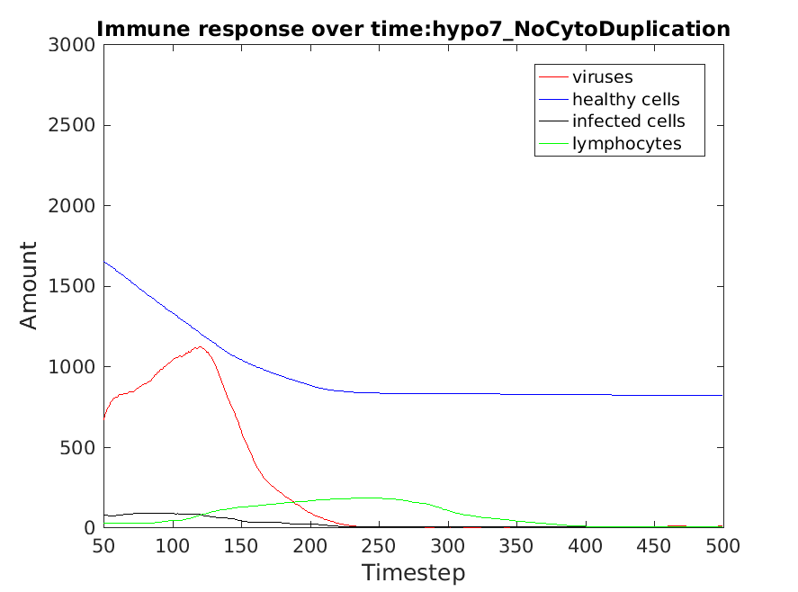
Observations From Data
Lymphocytes with patrolling behavior contain virus attacks quicker.

Slide 11
Questions?

