Slide 1
Game Technology
Lecture 13 – 30.01.2015
Dipl-Inf. Robert Konrad
Dr.-Ing. Florian Mehm

Slide 2
Preliminary timetable
Lecture No. | Date | Topic
1 | 17.10.2014 | Basic Input & Output
2 | 24.10.2014 | Timing & Basic Game Mechanics
3 | 31.10.2014 | Software Rendering 1
4 | 07.11.2014 | Software Rendering 2
5 | 14.11.2014 | Basic Hardware Rendering
6 | 21.11.2014 | Animations
7 | 28.11.2014 | Physically-based Rendering
8 | 05.12.2014 | Physics 1
9 | 12.12.2014 | Physics 2
10 | 19.12.2014 | Procedural Content Generation
11 | 16.01.2015 | Compression & Streaming
12 | 23.01.2015 | Multiplayer
13 | 30.01.2015 | Audio
14 | 06.02.2015 | Scripting
15 | 13.02.2015 | AI

Slide 3

Sound Waves
Sound waves
Air compression
Longitudinal Waves
~343 m/s
20 to 17000 Hz

Slide 4
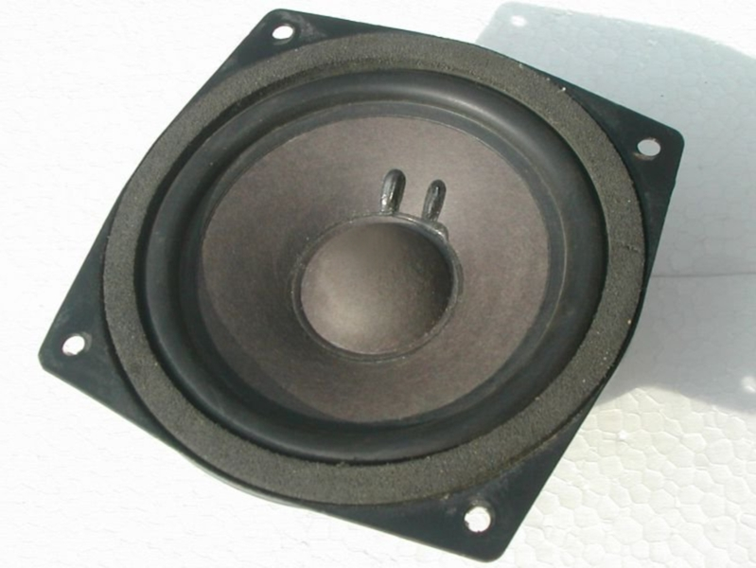
Loudspeakers
Converts electrical signals to sound waves
Using an acoustic membrane

Slide 5

Ears
Two identical audio sensors
Measures actual wave forms
Using the eardrum

Slide 6
Computer -> Speaker
Small ring buffer
Discretely sampled waveform
Pointer to last sample written
Pointer to next sample to read

Slide 7
Sound Mixing
Superpositioning
Adding waves
Again physically accurate
Actual danger of superposition effects
Avoid mixing identical sounds

Slide 8
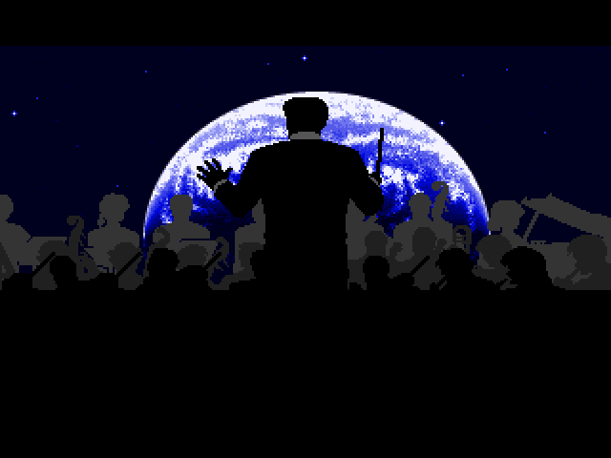
Music

Slide 9
Music
Long files
Played/Streamed in the background
Mostly not influenced by gameplay

Slide 10

Sound Effects

Slide 11
Sound Effects
Short files
Triggered by gameplay
Modified according to position, environment,…

Slide 12
No Sound Effects

Slide 13
Speech
Sometimes more like sound effects
„Ouch“
Sometimes more like music
„lalalalalala“
„blablablabla“

Slide 14
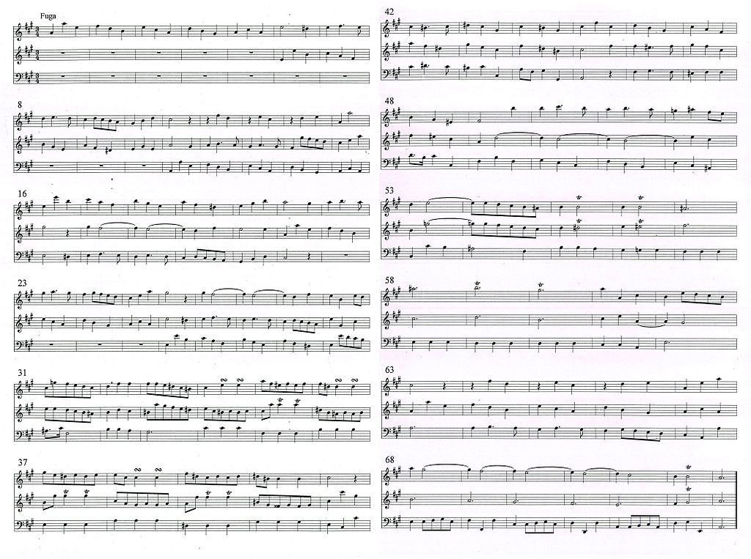
Music

Slide 15
Music
Pitch
Frequency
c d e f g a h c
Duration
Duration
Loudness
~Amplitude
Tone Color
Wave form
Instrument

Slide 16
Early 80s Music
Early games used simple wave forms
Square waves
Triangle waves
Sawtooth waves
Plus noise
NES
Game Boy
Master System
…
http://studio.substack.net
Notes:
return function (t) {
function sin (x) { return Math.sin(2 * Math.PI * t * x) }
function square (x) { return (Math.floor(x) % 2 == 0) ? -1 : 1; }
function saw (x) { return (-x % 1 - 0.5) * 2; }
function triangle (x) { return 2 * Math.abs(2 * (x - Math.floor(x + 0.5))) - 1; }
//return sin(441);
//return square(t * 200) / 20;
//return saw(t * 240) / 10;
return triangle(t * 440) / 3;
}
Silius in Audacity

Slide 17
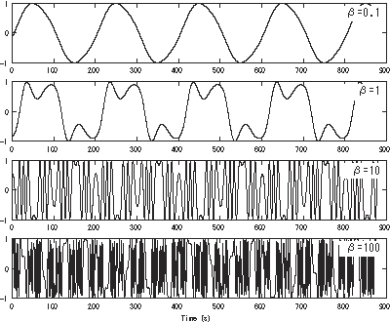
Late 80s Music
FM-Synthesis
AdLib
Mega Drive
Also 80s synthie music

Slide 18
Early 90s
„Tracker Music“
„Module Files“
Use short sound samples to represent instruments
Change pitch as needed (or use more samples)
Amiga
SNES
(MT-32, MIDI)
Gravis Ultrasound

Slide 19
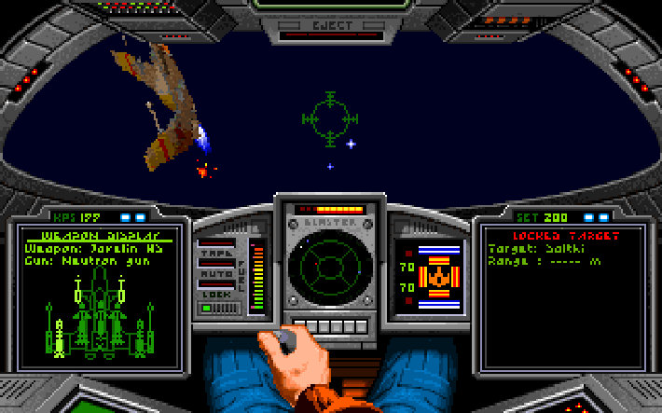
Dynamic Music

Slide 20
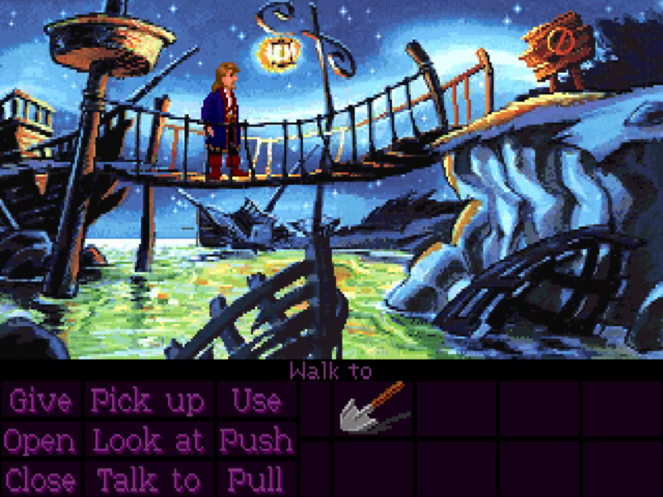
iMuse

Slide 21
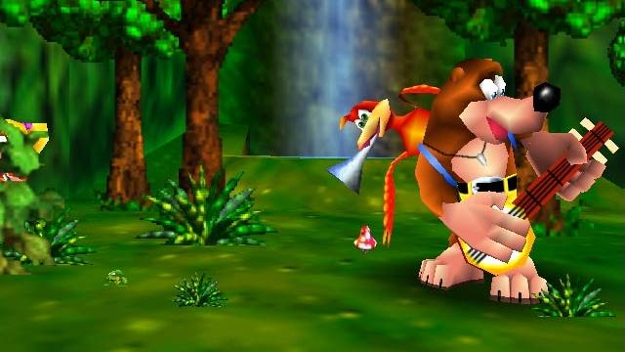
Banjo Music

Slide 22

CDs

Slide 23
CDs
Plays music
No application control
Apart from start/stop
No file loading while music plays

Slide 24
WAV, MP3,…
Play back large sound files manually
More flexible than CD audio
But not as flexible as previous methods
Today audio compression is widely used

Slide 25
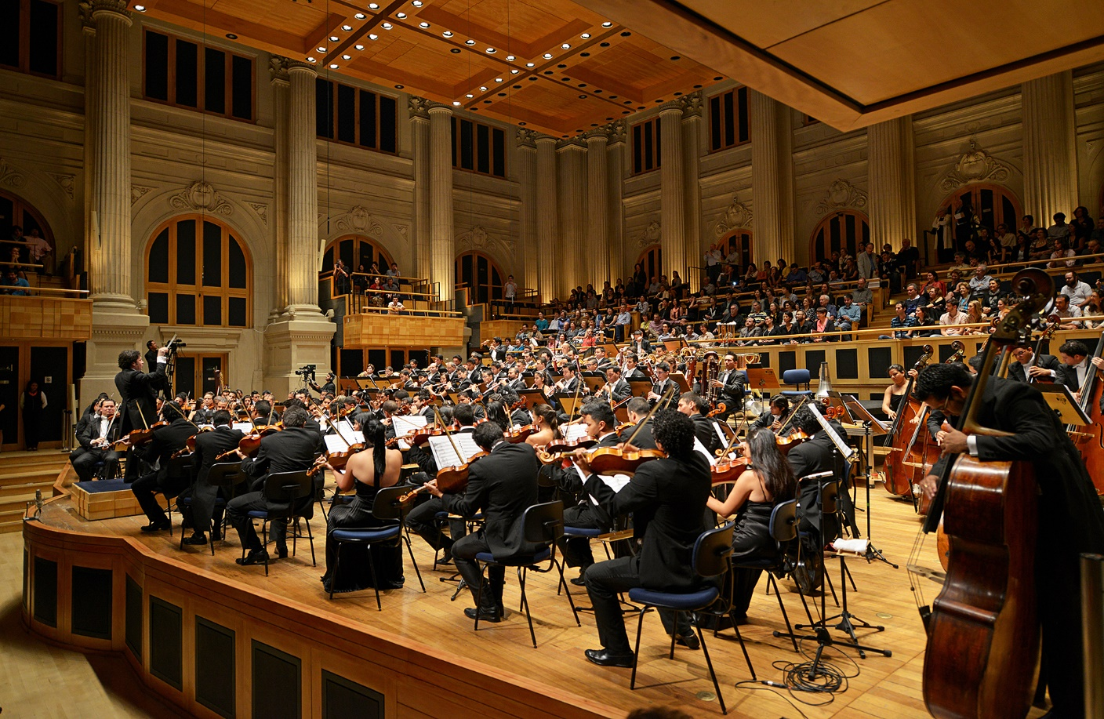
Orchestras

Slide 26
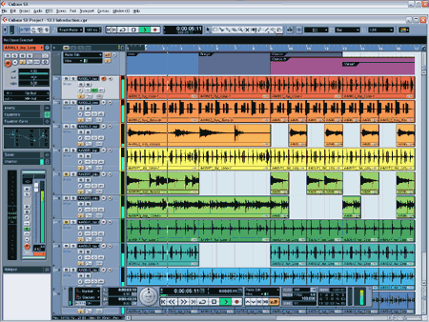
Sequencer

Slide 27
Sequencer
Basically works like old tracker programs
But more and bigger samples, more effects,…
But almost always export only to wav

Slide 28
Sound effects back then
Originally based on square waves,…
http://www.bfxr.net

Slide 29
Sound effects now
Recorded samples
Little to no hardware support
Number of simultaneously mixed samples usually limited

Slide 30
Sound Localization
Distance
Increased distance -> Decreased amplitude (amplitude *= 1 / distance)
(and slightly decreased frequency)
Direction
Interpolate between speakers
Better quality -> add more speakers

Slide 31
Sound Direction
Can also be simulated using headphones
Brain analyzes sounds to infer directions
https://www.youtube.com/watch?v=8IXm6SuUigI

Slide 32
Sound Localization Left/Right
Measure time differences between ears
Loudness differences between ears
Because of the head
Depends highly on frequency
Partly used for frequencies > 800 Hz
Exclusively used for frequencies > 1600 Hz

Slide 33
Sound Localization Front/Back
Analyzes frequency differences caused by the ear forms
Also to a lesser degree head, shoulders,…
Sadly somewhat individual
Analyzes changes due to head movements

Slide 34



Doppler Effect
Frequency increases/decreases when sound source/receiver moves
For increasing/decreasing distance
B: destination
S: source
c: speed of sound

Slide 35
Sound reflections
Highly dependent on surface structure and wavelength
Large surface, small wavelength
Direct reflection
Rough surface
Scatters sound

Slide 36
Effects
Echo, Reverb
Direct reflections
Replay sound with reduced amplitude
Damping
Occluders

Slide 37
Calculating Reflections
Requires 3D model of the scene
Geometry
Surface properties
Kind of like 3D graphics

Slide 38
A3D
3D audio API from Aureal
Supports modelling and simulating 3D environments for sound
Only supported on special hardware
From the late 90s

Slide 39
A3D today
Creative Labs bought Aureal in 2000
After they lost a patent war in court
A3D functionality mostly integrated in EAX
EAX deprecated
EAX functionality integrated in OpenAL (EFX)
OpenAL kind of deprecated -> OpenAL Soft

Slide 40
Sound Effects and Music today
Mostly primitive
Streaming prerecorded music
Basic sound effects playback
Maybe some simple environmental effects

Slide 41
Data Oriented Design
Focus on structure of data in memory
Because computations are fast but fetching data is slow
Game engines mostly transform data
Object oriented programming tends to spread data all over
Also makes multithreading hard

Slide 42
OOP
class Bot {
vec3 position;
float mod;
float aimDirection;
// lots of additional data
void updateAim(vec3 target) {
aimDirection = dot(position, target) * mod;
}
};
foreach (bot) {
bot.updateAim();
// more sruff
}
Notes:
Example from DICE

Slide 43
OOP
class Bot {
vec3 position;
float mod;
float aimDirection;
// lots of additional data <- loaded into cache line
void updateAim(vec3 target) { <- loaded into instruction cache
aimDirection = dot(position, target) * mod;
}
};
foreach (bot) {
bot.updateAim();
// more stuff
}

Slide 44
DOD
struct AimingData {
vec3* positions;
float* mod;
float* aimDir;
};
void updateAims(float* aimDir, const AimingData* aim, vec3 target, int count) {
for (int i = 0; i < count; ++i) {
aimDir[i] = dot(aim->positions[i], target) * aim->mod[i];
}
}

Slide 45
DOD
Splits code and data
Focuses on optimization for memory
Makes multithreading easy

Slide 46
OOP
Good fit for high level code
Aka the actual game
Mostly terrible for low level code
Aka the engine

