Slide 1
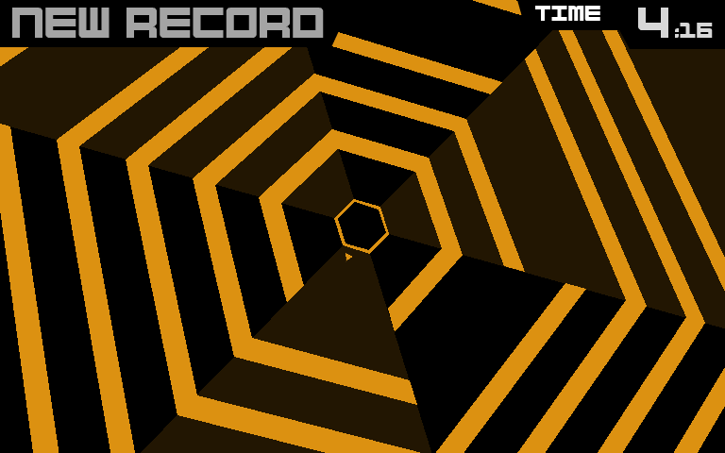
Game Technology
Lecture 2 – 24.10.2014
Timing & Basic Game Mechanics
Source: http://de.wikipedia.org/wiki/Super_Hexagon
Dr.-Ing. Florian Mehm
Dipl-Inf. Robert Konrad

Slide 2
Organization
Lecture (V2, weekly) – S311|08
Friday, 9:50 to 11:30, S103/9
Lecturers: Robert Konrad, Florian Mehm
Exercise (Ü2, weekly) – S103|100
Friday, after lecture, 11:40 – 13:20, S103/100
Theory and implemention (game programming)
Each week 1 exercise, 1 week to work on the task
Exam
90 Minutes
Date and location TBD

Slide 3
Preliminary timetable
Lecture No. | Date | Topic
1 | 17.10.2014 | Basic Input & Output
2 | 24.10.2014 | Timing & Basic Game Mechanics
3 | 31.10.2014 | Software Rendering 1
4 | 07.11.2014 | Software Rendering 2
5 | 14.11.2014 | Basic Hardware Rendering
6 | 21.11.2014 | Animations
7 | 28.11.2014 | Physically-based Rendering
8 | 05.12.2014 | Physics 1
9 | 12.12.2014 | Physics 2
10 | 19.12.2014 | Scripting
11 | 16.01.2015 | Compression & Streaming
12 | 23.01.2015 | Multiplayer
13 | 30.01.2015 | Audio
14 | 06.02.2015 | Procedural Content Generation
15 | 13.02.2015 | AI

Slide 4
Overview
Timing
Different timing options
Animations
Basic Game Mechanics
Game Loop
Multithreading
Collision
C++
Memory management
Strings

Slide 5
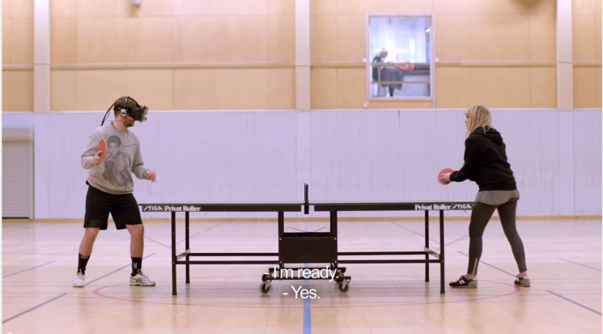

Timing
Monitors commonly run at 60 Hz
Games should provide a new frame every ~16 ms
Movies (used to) operate at 24 Hz (40 ms)
Why work harder than that?
Some people have been shown to be able to distinguish up to 90 Hz images
The frame rate determines how fast the game can react
Gamers want speed!
Virtual Reality

Slide 6

Timing
„"At Ubisoft for a long time we wanted to push 60 fps. I don't think it was a good idea because you don't gain that much from 60 fps and it doesn't look like the real thing. It's a bit like The Hobbit movie, it looked really weird.” Nicolas Guérin, World Level Design Director, Assassin’s Creed Unity http://www.techradar.com/news/gaming/viva-la-resoluci-n-assassin-s-creed-dev-thinks-industry-is-dropping-60-fps-standard-1268241
See also “black bars” discussion, e.g. around The Order 1886

Slide 7

Motion Blur
In a real camera, the filmed objects change during a frame
The movements are blurred
Fast moving objects more
More the longer the exposure time is
In a virtual camera, without additional measures, no blurring is present
All objects rendered at a perfect instant in time
Similar to the missing depth of field
Source: Wikipedia

Slide 8
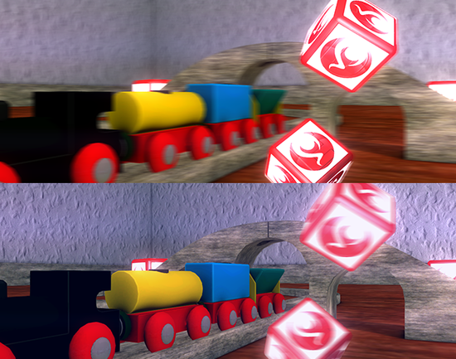
Motion Blur algorithm example
Directional blur along a pixel’s velocity
Introduces artifacts for fast-moving objects
Source: http://docs.unity3d.com/Manual/script-CameraMotionBlur.html

Slide 9
Multithreading
Cooperative Multithreading
Often used in games
Returning
Every (game) object is called
Carries out its calculations…
…and returns, saving its state
+ Synchronization easier to handle
- Can’t use multiple CPU cores
Preemptive Multithreading
Used in current operating systems
Returning
Every process is called
The scheduler takes control back
State is saved for the process
+ Stalled threads don’t stall the whole system
- Needs proper synchronization
- Additional costs (saving all state)
Used for whole systems (e.g. physics)

Slide 10
Timing
Which time to use?
Hardware timers vs. very coarse timers
Terrain.Render()
ObjectA.Render()
ObjectB.Render()
Frame n
t1
t2
t2

Slide 11
Virtual frame time
Calculate a time that is used throughout the frame
Further advantage: Can scale/pause this time
Terrain.Render()
ObjectA.Render()
ObjectB.Render()
Frame n
tframe
tframe
tframe
t1 = tframe

Slide 12

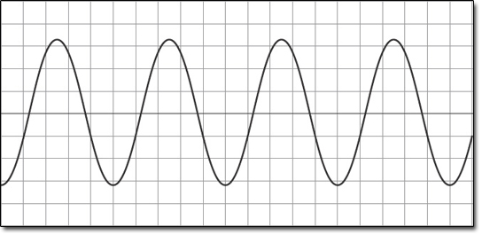
Procedural Animations
Calculate the state without information about the previous state
Based solely on parameters
Current time
Configuration parameters
Usually ranged [0-1]; later scaled to correct amount
Allows adding/multiplying using sine/exp/…
Example: Simple wind animation of trees

Slide 13
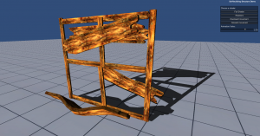
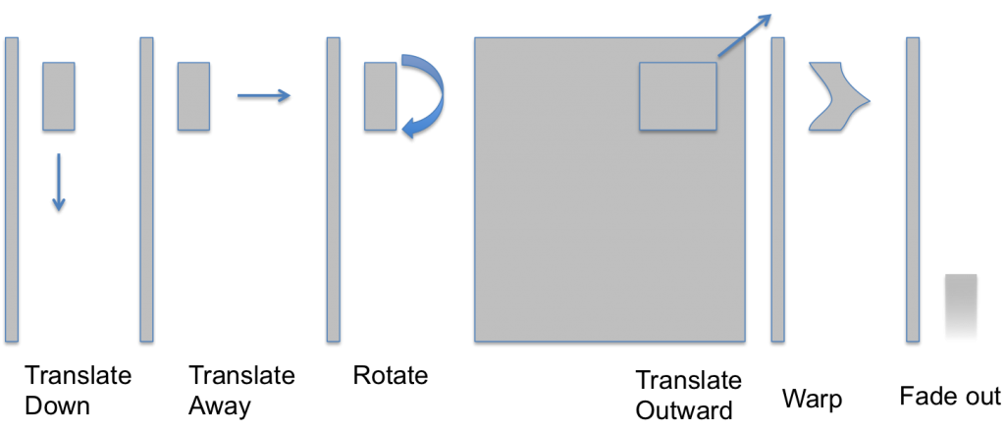
Procedural Animation Example
Original Source: “The Inner Workings of Fortnite’s Shader Based Procedural Animation” (Jonathan Lindquist, Epic, GDC Talk)
Effect for “self-building structures”
Composed of several components
See implementation at http://mehm.net/blog/?p=1278

Slide 14
Iterative Animations
Calculated based on previous states
Usually not from the beginning of the game
Instead, use a window of the last frames or a running average
Often combined with user input
Used for animations where a “closed” form is not possible or too complicated
Example: Physical animation
Very simple: Take the position and velocity of the last frame
Calculate a velocity for the current frame
Add the velocity to the object

Slide 15
Game Loop
Set up windowing system, OS callbacks, initialize libraries/devices, …
Do
Read data from input devices
Calculate new game state
Render frame
(Wait for Vsync)
While the game is active
Unload libraries, free memory, close window, …

Slide 16
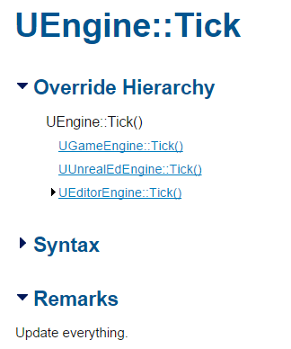
Hidden Game Loop
Unity
Actual game loop implemented in C++
Components provided by programmers compiled to .net (C#, JS, Boo)
Update()-functions on all active components are run
Unreal Engine
Found in UEngine::Tick()
Scripts provided by users can also be Blueprint
Engine core ←→ Scripts and components
Performance optimizations by the engine provider
Easier to handle for programmers
But less adaptable and transparent (→ Unity)

Slide 17
Game State
Usually handled as Game Object (or similar construct)
Saves all relevant game state
Handles relevant input
Updates state each frame
Component-Based Game Objects
Separate component for different tasks
Rendering
Position
Input handling
…
Avoid object-oriented hierarchies
GameObject
DynamicObject
StaticObject
NPC
Player
GameObject
Transform
MeshRenderer
Controller

Slide 18
Collisions
Intersection
Objects are overlapping each other
In reality, objects would deform/break/...
→Unwanted state
Collision
Objects ideally have only one contact point/edge/face
Calculate collision response based on this state
Collision Response
Separate bodies or
(Stable) contact

Slide 19
Collisions
x times per second
{
For each object
{
Move object
Check for collisions
If (collision detected) move back
}
}

Slide 20
Collisions and Timing
Exact collision will almost never happen
Due to floating point issues and discrete frame time
Different coping strategies
Ignore/Keep pushing objects out of each other
(Smaller time steps)
Find the exact time when collision happened and step to this time
Collision response for multiple objects
Often resolved one after the other
E.g. resolve b-c, then a-c, then a-b
But in reality, solved all at once
c
a
b

Slide 21
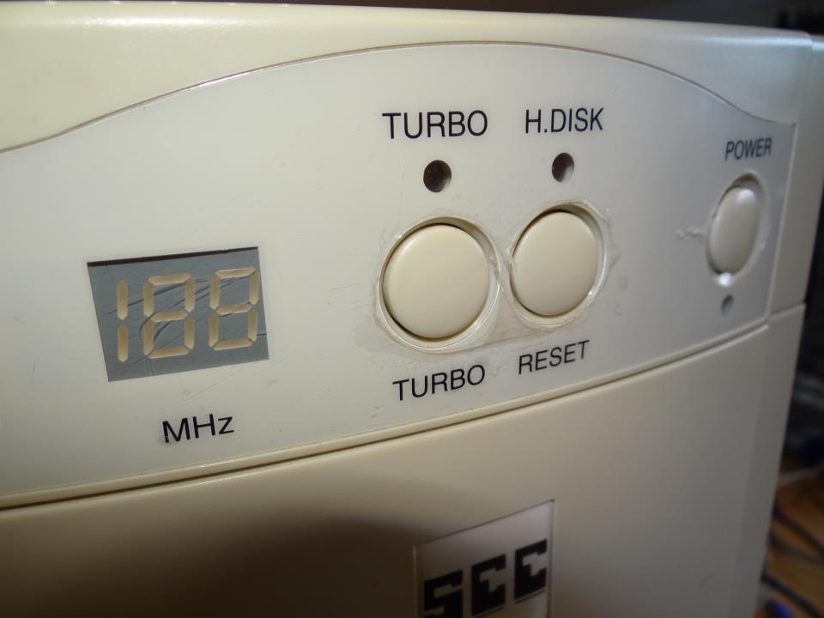
Game logic timing
Separate from actual frame rate
Keep timer for game logic
Update in periodic time steps
Rendering done at frame rate
Otherwise, dependent on performance of the hardware
Source: http://telkomgaming.co.za/old-versus-new-remembering-the-turbo-button/

Slide 22
Summary
Timing
Use a virtual time throughout the frame
Use smaller ticks for systems such as physics
Motion Blur
Multithreading
Animations
Procedural
Iterative
Game Loop
Game state
Collision detection

Slide 23
Memory Management
Static Memory
Global variables
Handled by the compiler, allocated and de-allocated automatically
Stack Memory
Semi-automatically handled by the compiler
Function parameters, local variables, implicit data (e.g. return addresses)
Heap Memory
All manually allocated memory

Slide 24
Heap Memory
Allocated dynamically
C++ handles nothing for us -> requests memory from the OS
Can be VERY slow and unreliable
Difference to Java
Java allocates a large block of memory at the beginning
Allocates memory to the program during runtime
Manages this memory
→ Can still be slow, e.g. if physical RAM is exhausted
Garbage Collection
Custom memory management
Utilize memory access patterns to optimize
Avoid allocating heap memory altogether in critical sections

Slide 25
Heap Memory Examples
Managing your own memory for often-used structures
Example: Allocate enough memory for all game objects of one type
Find typical numbers by testing or analysis
Manage the block by yourself
Stack vs Pool-based
Stack: Allocating and freeing using one pointer
Pool: Manage list of free blocks
Keeps data local
Can be better for cache efficiency

Slide 26
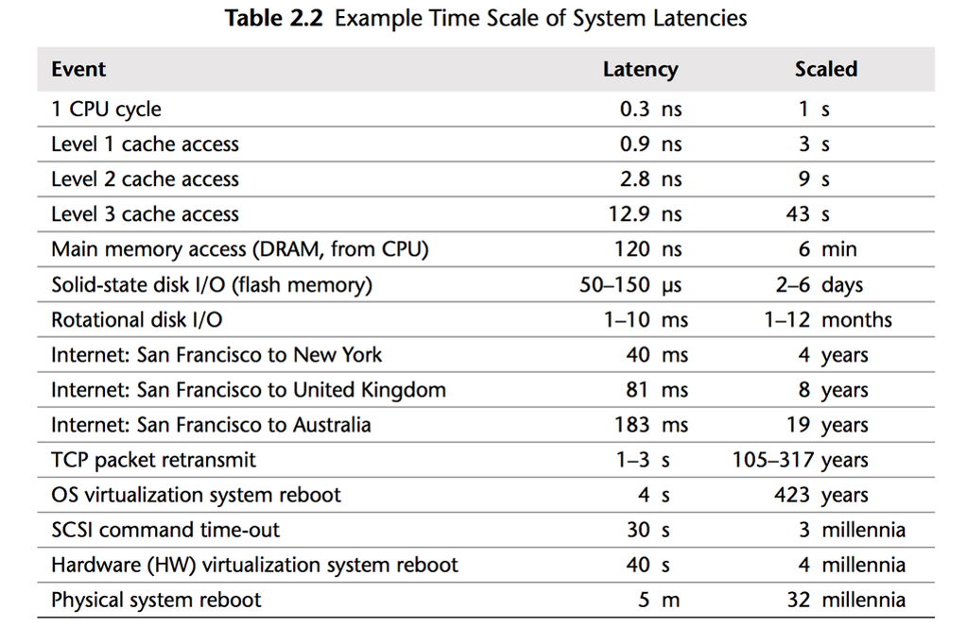
Effects of cache performance
Source: „Systems Performance: Enterprise and the Cloud”, Brendan Gregg

Slide 27
Pointers (Example: Integer value)
Variable on the stack
int foo;
Variable on the heap
int* foo;
Passing by value (using the stack)
void bar_val(int a, int b) { }
Values/objects copied onto the stack
Passing by reference (using the heap)
void bar_ref(int* a, int* b) { }
Only a pointer copied (32/64 bits)
Makes it possible to pass back values

Slide 28
Getting addresses and dereferencing points
Getting the pointer to a variable
int a = 3;
int b = 4;
bar_ref(&a, &b);
Warning: Don’t take the address of a local variable and pass unless you know what you are doing → the callee might save it until it is invalid!
Dereferencing a pointer (getting to the actual value)
void bar_ref(int* a, int* b) { *a = *a + *b; }
Before
After
a
5
a
7
b
2
b
2

Slide 29
Arrays
Allocated on the stack
int array[3];
Array on the heap
int* array = new int[3];
Deallocate using operator delete[]
delete[] array;
Mixing up leads to undefined behaviour
(Also important for calling destructors)

Slide 30
Referencing arrays
Referenced using their first element
int array[3];
int *a = &array;
a points to the first element of array
Also legal
bar_ref(&array, &array);
Pointer arithmetics
Pointers behave like ints
Addition, Subtraction, …
Evil to operate outside the allocated memory of the array
No bounds checking
a
1505
-5123
8
a + 1
a + 3
a
1505
-5123
8
?

Slide 31
Strings
Strings are just arrays of chars
char* f = “foobar”;
“foobar” is a 7-element array
Zero-terminated
Allows measuring the size in O(n) time
Encoding
On all common systems, sizeof(char) is 8 bits
char* can be an UTF8 string
every ANSI string is also a proper utf8 string
Commonly used chars encoded in 8 bits
Uncommon/other languages in several 8-bit blocks
Best practice: Use UTF8 even on systems that natively have other representations
f
f
o
o
b
a
r
0

Slide 32
Example UTF8 vs. UTF 16
„a“
ANSI: 61 (Hexadecimal)
UTF 8: 61
UTF 16: 00 61
„ä“
ANSI: E4
UTF 8: C3 A4
UTF 16: 00 E4

Slide 33
STL (Standard Template Library)
Offers template-based generic solutions for dynamic memory
Arrays: std::vector
Adaptive size
→ Can’t keep addresses to elements in the vector, as they might be invalid upon a change in size
Strings: std::string
Implemented as a std::vector for chars
Comfortable functions (trim, concatenate, operator+, …)
Game studios tend to avoid these libraries
Template overhead
Unpredictable behaviour

Slide 34
STL Complexity Guarantees
Container | Insertion | Access | Erase | Find | Persistent Iterators
vector / string | Back: O(1) or O(n) Other: O(n) | O(1) | Back: O(1) Other: O(n) | Sorted: O(log n) Other: O(n) | No
deque | Back/Front: O(1) Other: O(n) | O(1) | Back/Front: O(1) Other: O(n) | Sorted: O(log n) Other: O(n) | Pointers only
list / forward_list | Back/Front: O(1) With iterator: O(1) Index: O(n) | Back/Front: O(1) With iterator: O(1) Index: O(n) | Back/Front: O(1) With iterator: O(1) Index: O(n) | O(n) | Yes
set / map | O(log n) | - | O(log n) | O(log n) | Yes
unordered_set / unordered_map | O(1) or O(n) | O(1) or O(n) | O(1) or O(n) | O(1) or O(n) | Pointers only
priority_queue | O(log n) | O(1) | O(log n) | - | -
Source: http://john-ahlgren.blogspot.de/2013/10/stl-container-performance.html

Slide 35
Summary
Static, Stack and Heap Memory
Different allocation schemes
Different level of control for the programmer
Choose which is the most useful
Pointers
Allocation on the heap
Pass by value vs. Pass by reference
Arrays
Allocation on the heap
Referenced by pointer to first element
Strings
Arrays of chars
Pointer arithmetic
UTF8 vs. UTF 16

Slide 36
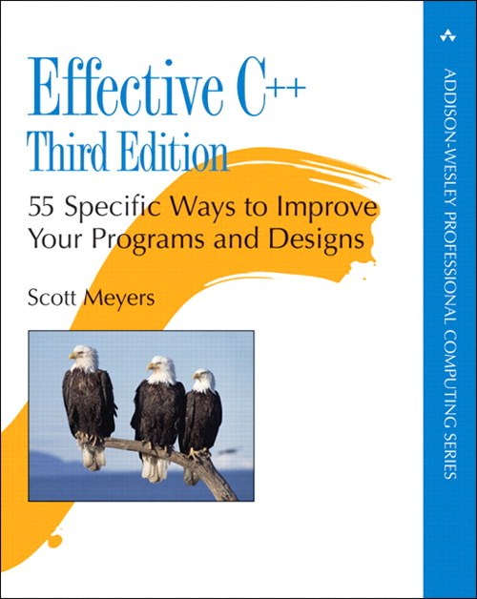
Book Recommendations
C++
„Effective C++“
Scott Myers
Performance tips
Pitfalls/Language Details
Functions a compiler silently adds to classes
Good use of const, pointers, references
Performance Considerations

Slide 37

Book Recommendations
Game Engine
„Game Engine Architecture“
Jason Gregory (Lead Programmer at Naughty Dog)
Fundamentals
C++
3D Math
Graphics, …
Practical Examples

Slide 38
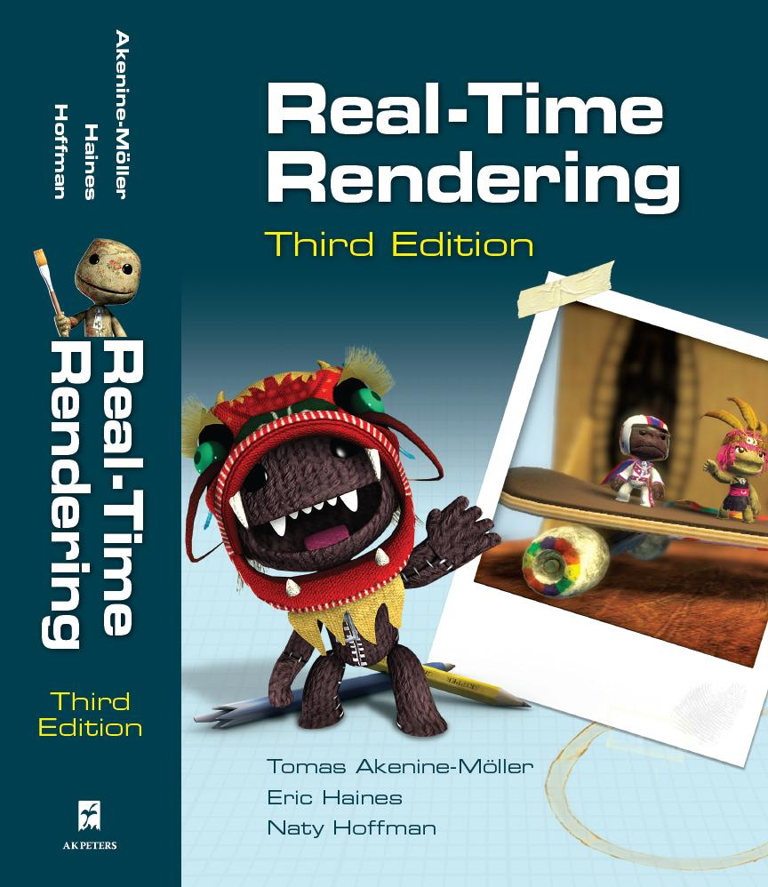
Book Recommendations
3D Graphics (next lectures)
„Real-time Rendering“
Tomas Akenine-Möller, Eric Haines
Very detailed look at graphics algorithms
Also includes further information, e.g. intersection tests and collision detection

Slide 39




Questions & Contact
RK
game-technology@kom.tu-darmstadt.de

