Slide 1
Game Technology
Lecture 3 – 31.10.2014
Dipl-Inf. Robert Konrad
Dr.-Ing. Florian Mehm

Slide 2
Preliminary timetable
Lecture No. | Date | Topic
1 | 17.10.2014 | Basic Input & Output
2 | 24.10.2014 | Timing & Basic Game Mechanics
3 | 31.10.2014 | Software Rendering 1
4 | 07.11.2014 | Software Rendering 2
5 | 14.11.2014 | Basic Hardware Rendering
6 | 21.11.2014 | Animations
7 | 28.11.2014 | Physically-based Rendering
8 | 05.12.2014 | Physics 1
9 | 12.12.2014 | Physics 2
10 | 19.12.2014 | Scripting
11 | 16.01.2015 | Compression & Streaming
12 | 23.01.2015 | Multiplayer
13 | 30.01.2015 | Audio
14 | 06.02.2015 | Procedural Content Generation
15 | 13.02.2015 | AI

Slide 3


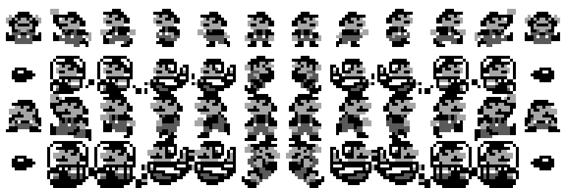
2D Rendering

Slide 4

Scaling
0/0
1/0
0/1

Slide 5
Rotations

Slide 6
Fonts
TrueType format
Line segments and Bézier curves
Kerning
VA
Pixel snapping
„TrueType systems include a virtual machine that executes programs inside the font”
Unicode
More than 110,000 characters

Slide 7

Subpixel Rendering

Slide 8
Bitmap Fonts

Slide 9
Font Libs
Freetype
http://www.freetype.org
stb_truetype
https://github.com/nothings/stb

Slide 10
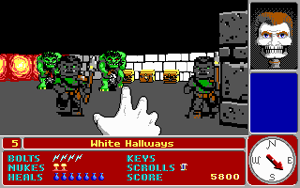
„Raycasting“

Slide 11
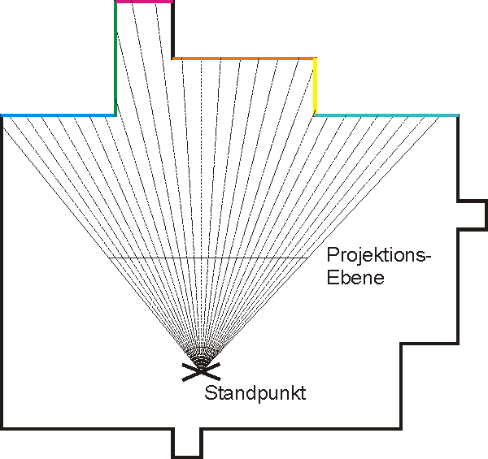
„Raycasting“

Slide 12

„Raycasting“

Slide 13
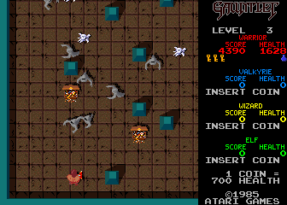
„Raycasting“

Slide 14
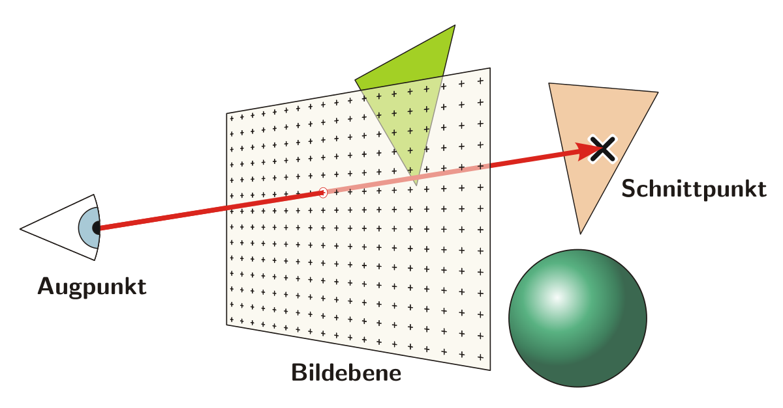
Raytracing

Slide 15
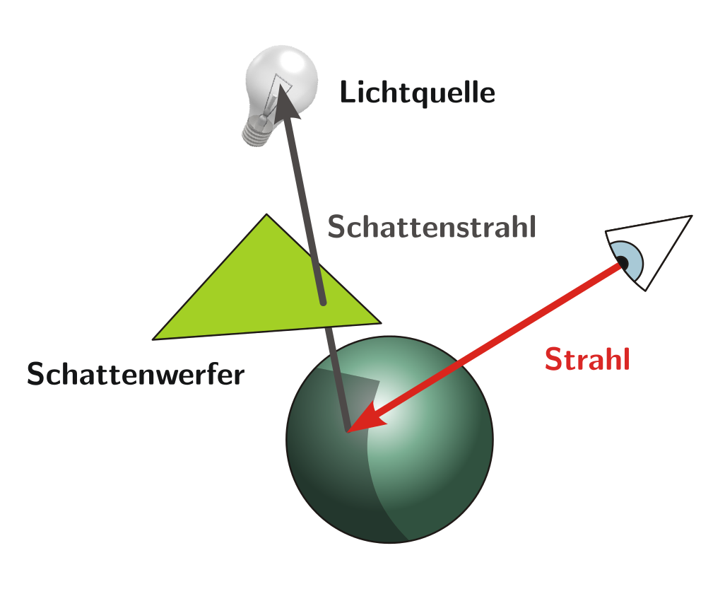
Raytracing

Slide 16

Raytracing

Slide 17
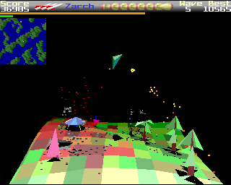
Rasterisierung

Slide 18

Rasterisation

Slide 19
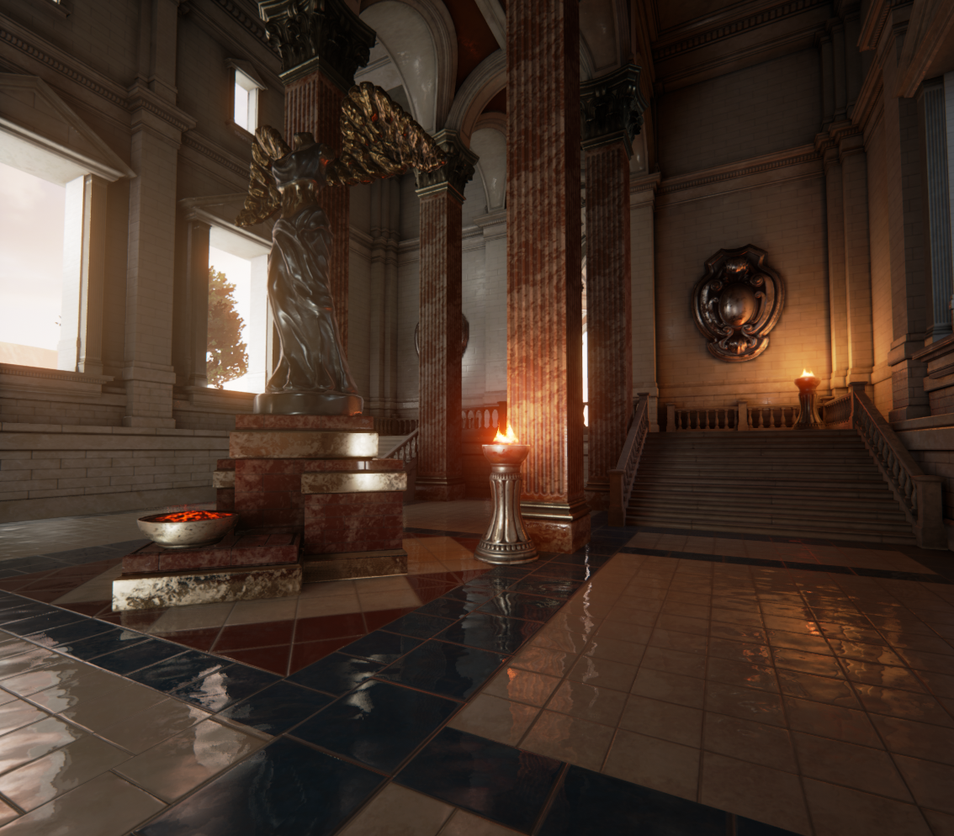
Rasterisation & Raytracing

Slide 20
Rasterisation
World defined by triangles
Each triangle -> 3 3D points
foreach (tri in world) { Point p1 = transform(tri._1); Point p2 = transform(tri._2); Point p3 = transform(tri._3); drawTriangle(p1, p2, p3); // 2D operation }

Slide 21
Perspective
h1 / a1 = h2 / (a1 + a2)
Doubled distance + doubled size -> same projection
Xp = (zmin / distance) * X

Slide 22
Offset from camera
Xp = (zmin / distance) * (X - camera.x) + screenWidth / 2
Yp = …

Slide 23
Camera Rotations
sin α
(0,1)
(-sin α, cos α)
α
cos α
(cos α, sin α)
sin α
α
(1,0)
cos α

Slide 24
Camera Rotations
Old Point
(x,y) = x(1,0) + y(0,1)
New Point
R(x,y,α) = x(cos α, sin α) + y(-sin α, cos α)
= (x cos α, x sin α) + (-y sin α, y cos α)
= (x cos α - y sin α, x sin α + y cos α)

Slide 25
Camera Rotations
float dx = X - camera.x;
float dy = Y - camera.y;
float dz = Z - camera.z;
float d1x = cos(camera.ry) * dx + sin(camera.ry) * dz;
float d1y = dy;
float d1z = cos(camera.ry) * dz + sin(camera.ry) * dx;
float d2x = d1x;
float d2y = cos(camera.rx) * d1y - sin(camera.rx) * d1z;
float d2z = cos(camera.rx) * d1z + sin(camera.rx) * d1y;
float d3x = cos(camera.rz) * d2x + sin(camera.rz) * d2y;
float d3y = cos(camera.rz) * d2y – sin(camera.rz) * d2x;
float d3z = d2z;
Xp = (zmin / d3z) * d3x + screenWidth / 2

Slide 26
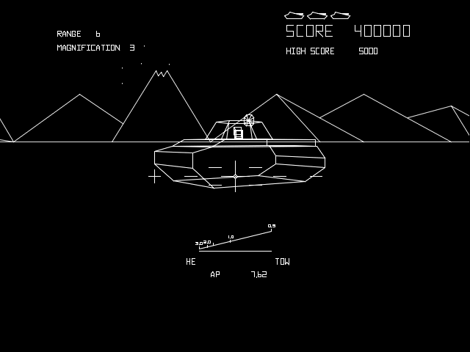
Lines

Slide 27
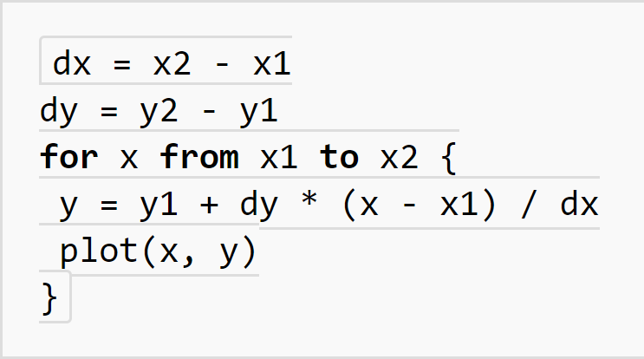
Digital differential analyzer

Slide 28
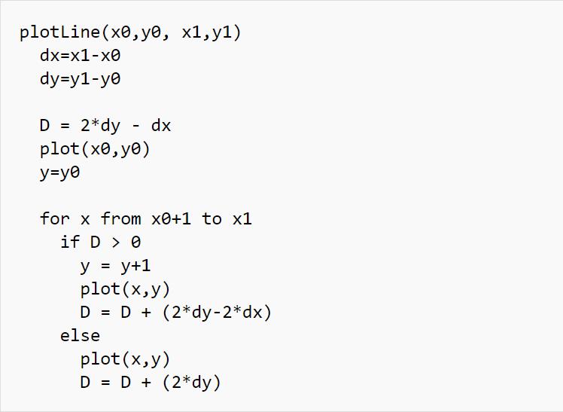
Bresenham

Slide 29

Triangles

Slide 30
Triangle Rasterisation
Find edge longest with biggest ydif
Fill lines between long edge and other edge 1
Fill lines between long edge and other edge 2

Slide 31
Mesh structure
Array of 3D positions
Often additional data
Array of indices
Three indices -> triangle

Slide 32
Backface Culling
Remove tris showing away from camera
Use tri winding
cross(b - a, c - a)

Slide 33
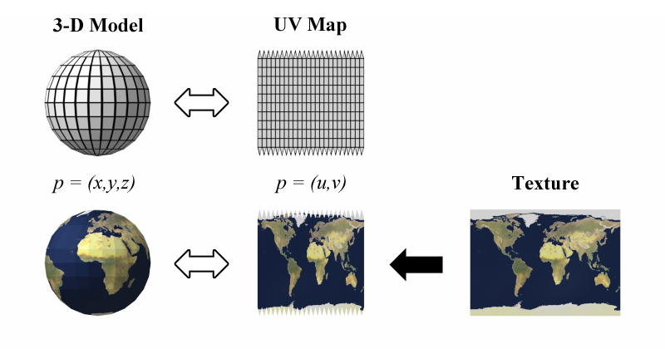
Textures
Add texture coordinates (uv) to mesh positions
Interpolate coordinates during rasterisation
Sample texture at interpolated coordinates

Slide 34
Depth Sorting
Sort only complete meshes
For performance reasons
Sort by distance from camera to object
Draw nearest objects last

Slide 35
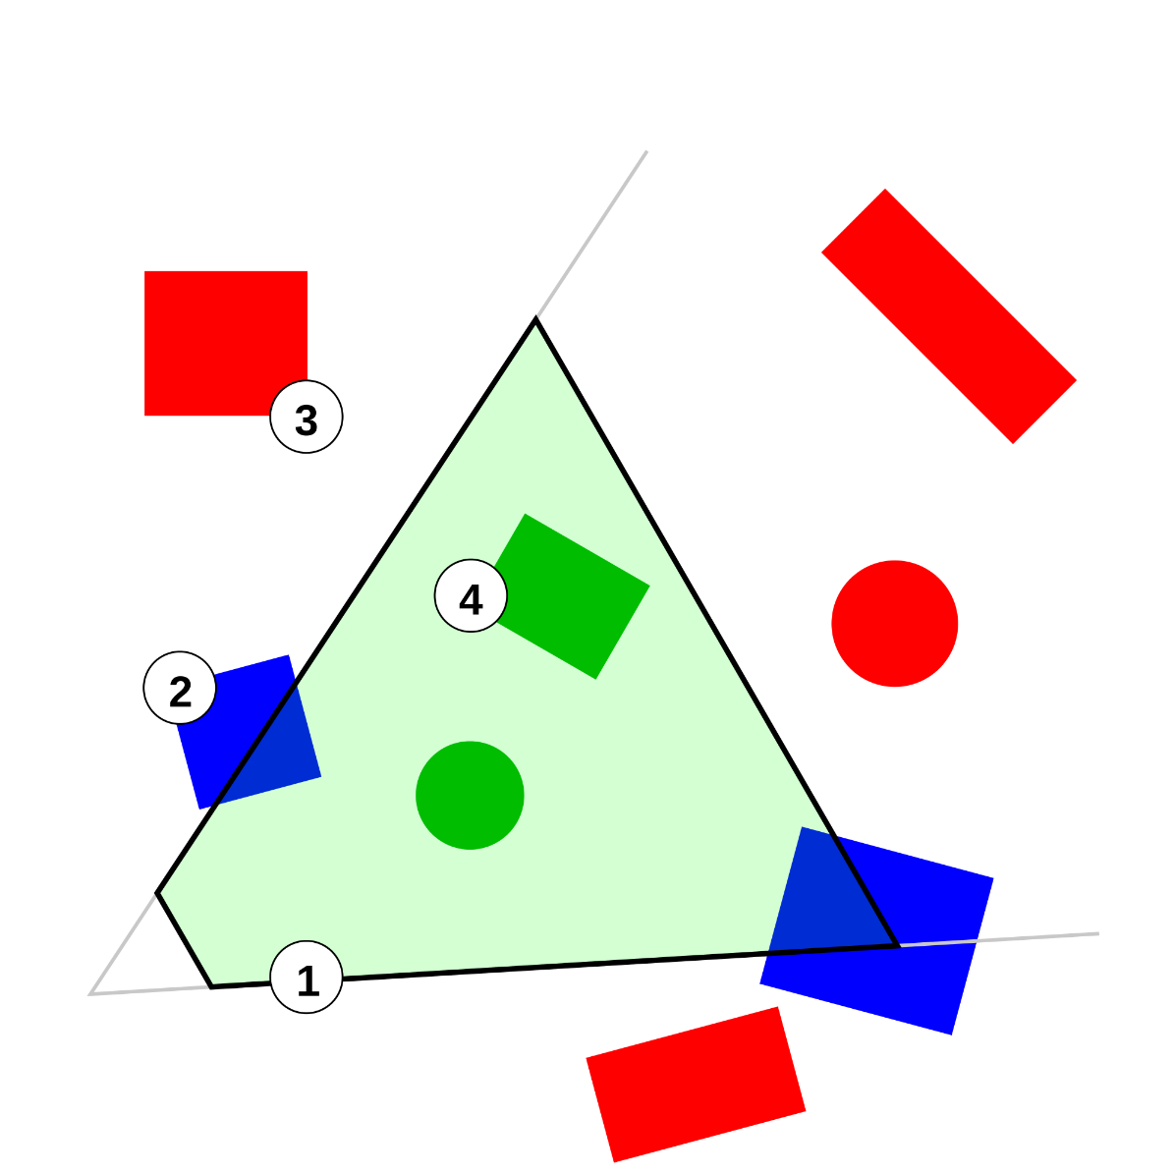
Frustum Culling
Notes:
http://www.flipcode.com/archives/Frustum_Culling.shtml

Slide 36
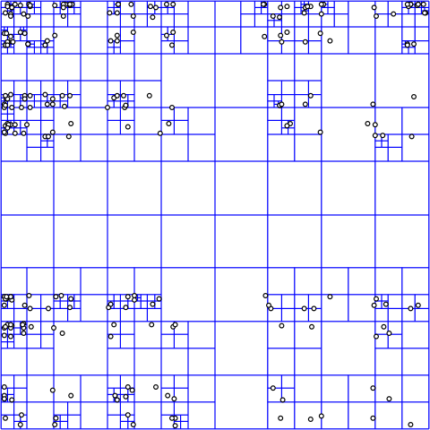
Hierarchical Scenes

Slide 37
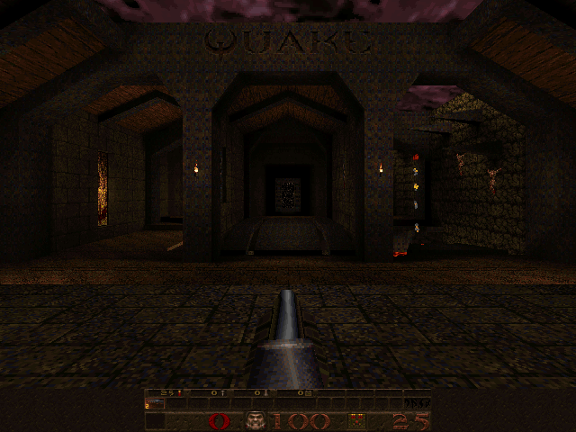
Quake

Slide 38
Optimization
foreach (object in world) { if (infrustum(object)) { render(object); }
}
Hierarchical structures slow on modern CPUs
Cache misses

Slide 39
Occlusion Culling
Computations can be expensive
Precompute
Unity
Rasterize in low resolution
Software Occlusion Culling from intel
Occulsion Query
Hardware feature
Deferred Rendering
Hardware feature
Remember: Games need steady performance

Slide 40
Operator overloading
class Number {
…
};
Number operator+(Number a, Number b) {
return …
}
Number a;
Number b;
Number c = a + b;

Slide 41
Operator overloading
class Number {
Number operator++(); // ++num;
Number operator++(int); // num++;
};
for (Number i = 0; i < 10; i++) { }
for (Number i = 0; i < 10; ++i) { } // maybe faster when ++ is overloaded

Slide 42
References
New name for existing variable
Same syntax for access
int a = 3;
Int& b = a;
b = 4;
// a == 4

Slide 43
References
void reference_test(int& b) {
b = 4;
}
int a = 3;
reference_test(a);
// a == 4

Slide 44
References
In theory just an unchangeable reference
Not a hardware level concept
Can often be removed by the optimizer
In practice works like restricted pointers
Added to support map implementations
class Map {
int& operator[](int index);
};

Slide 45

Constness
const int a = 3;
a = 4;

Slide 46
Constness
void bla(const int a) {
a = 4;
}

Slide 47
Constness
const char* bla1 = „bla“;
char* const bla2 = „bla“;
bla1 = „blub“;
bla2[0] = ‚g‘;

Slide 48
Constness
void bla(const int& a) {
…
}
Hint for the compiler: Do what you want
Copying a value can be faster than using a pointer

Slide 49
Constness
class A {
void method1() const {
a = 3;
}
void method2() const {
b = 3;
}
int a;
mutable int b;
};

Slide 50
Constness
class A {
void method1() const;
void method1();
};
A a;
a.method1();
const A b;
b.method1();

Slide 51
Templates
template<class T> class A {
void method1() {
}
void method2();
};
A<int> a;

Slide 52
Templates
template<int i> void bla() { … }
bla<3>();

Slide 53
static
// functions.h
void func1() { }
static void func2() { }
inline void func3() { }
namespace {
void func4() { }
}

