Slide 1
Game Technology
Lecture 4 – 07.11.2014
Dipl-Inf. Robert Konrad
Dr.-Ing. Florian Mehm

Slide 2
Preliminary timetable
Lecture No. | Date | Topic
1 | 17.10.2014 | Basic Input & Output
2 | 24.10.2014 | Timing & Basic Game Mechanics
3 | 31.10.2014 | Software Rendering 1
4 | 07.11.2014 | Software Rendering 2
5 | 14.11.2014 | Basic Hardware Rendering
6 | 21.11.2014 | Animations
7 | 28.11.2014 | Physically-based Rendering
8 | 05.12.2014 | Physics 1
9 | 12.12.2014 | Physics 2
10 | 19.12.2014 | Scripting
11 | 16.01.2015 | Compression & Streaming
12 | 23.01.2015 | Multiplayer
13 | 30.01.2015 | Audio
14 | 06.02.2015 | Procedural Content Generation
15 | 13.02.2015 | AI

Slide 3
Three Problems
Weird depth problems
Weird textures
Weird rotations

Slide 4
Weird Depth Problems
Backface culling & object sorting can not handle
Overlaping geometry
Intersecting objects

Slide 5
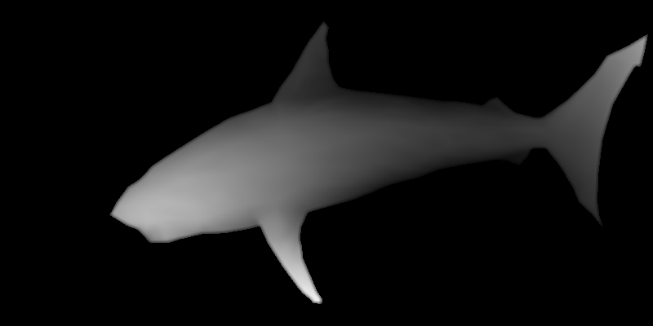
Depth Buffer
foreach (pixel) { if (framebuffer[pixel.x, pixel.y].z < z) continue; framebuffer[pixel.x, pixel.y].rgb = rgb; framebuffer[pixel.x, pixel.y].z = z; }

Slide 6
Depth Buffer
Dead Simple
Performance very bad
When done in software
Performance OK
When done in hardware
Does not help with partially transparent geometry

Slide 7
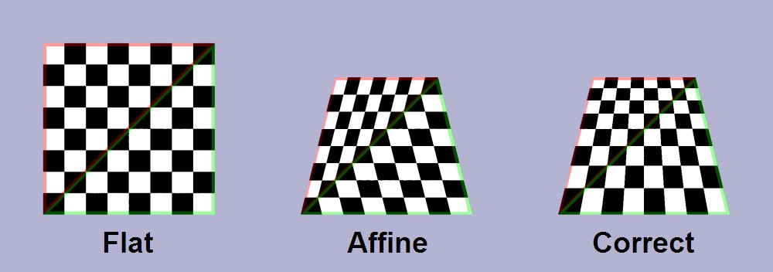
Weird Textures

Slide 8

Weird Textures

Slide 9
Perspective Texture Correction
Regular interpolation:
u = (1 - α) u0 + αu1
Perspective correct interpolation:
(1 - α) (u0 / z0) + α (u1 / z1) (1 - α) (1 / z0) + α (1 / z1)
Interpolate u / z
u =

Slide 10
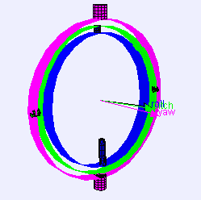
Weird Rotations

Slide 11
Dependent on order
Rotate around x-axis Rotate around y-axis Rotate around z-axis
or
Rotate around z-axis Rotate around y-axis Rotate around x-axis
or
…

Slide 12
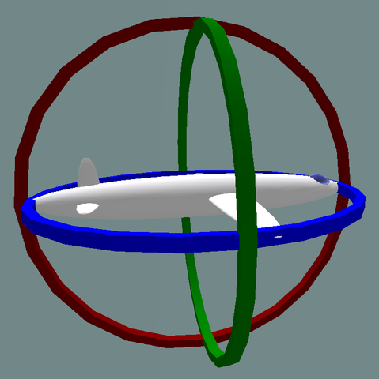
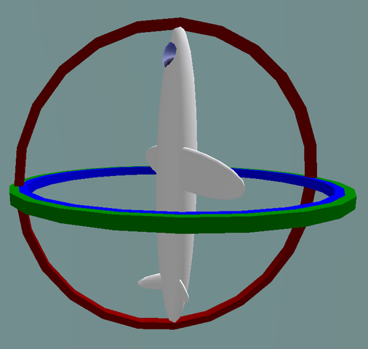
Gimbal Lock

Slide 13
Camera Rotations
sin α
(0,1)
(-sin α, cos α)
α
cos α
(cos α, sin α)
sin α
α
(1,0)
cos α

Slide 14
Camera Rotations
Old Point
(x,y) = x(1,0) + y(0,1)
New Point
R(x,y,α) = x(cos α, sin α) + y(-sin α, cos α)
= (x cos α, x sin α) + (-y sin α, y cos α)
= (x cos α - y sin α, x sin α + y cos α)

Slide 15
Camera Rotations
Old Point
(x,y) = x(1,0) + y(0,1)
1 0 x x 0 1 y y
New Point
R(x,y,α) = x(cos α, sin α) + y(-sin α, cos α)
= (x cos α, x sin α) + (-y sin α, y cos α)
= (x cos α - y sin α, x sin α + y cos α)
cos α -sin α x x cos α - y sin α sin α cos α y x sin α + y cos α
=
=

Slide 16

Matrix Multiplication

Slide 17
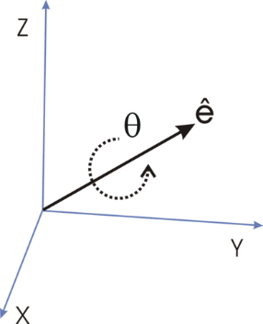
4 Coordinates
Euler's rotation theorem:
Any rotation or sequence of rotations of a rigid body or coordinate system about a fixed point is equivalent to a single rotation by a given angle θ about a fixed axis (called Euler axis) that runs through the fixed point.

Slide 18
Rotation Matrix
u = unit vector
Θ = rotation around u

Slide 19
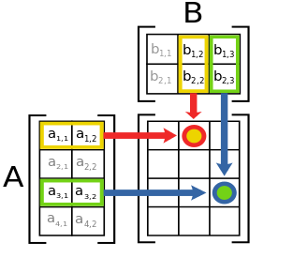
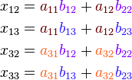
Matrix * Matrix
Concatenate Rotations
Save premultiplied matrices = Save calculations

Slide 20
Identity Matrix
1 0 0
0 1 0
0 0 1

Slide 21
Affine Transformations
„a function … which preserves points, straight lines and planes”
Translation
Scaling
Shearing
Rotation

Slide 22
Matrix Transformations
Dimension * Dimension matrices support all affine transformations
But Translations

Slide 23


Slide 24

Translation Matrix

Slide 25
Homogenous Coordinates
(x, y, z, w)
-> 3D: (x / w, y / w, z / w)
3D point -> 4D: (x, y, z, 1)
3D direction -> 4D: (x, y, z, 0)

Slide 26

Perspective Projection

Slide 27
4x4 Matrix
x-axis
y-axis
z-axis
translation
perspective
1

Slide 28
Typical Setup
projection * view * model * position
Projection
Kore::Matrix::perspectiveProjection
Field of view <
Aspect ration (width / height)
z near, z far
View
Kore::Matrix::lookAt
Eye vector
At vector
Up vector
Model
Translations, Rotations,…

Slide 29
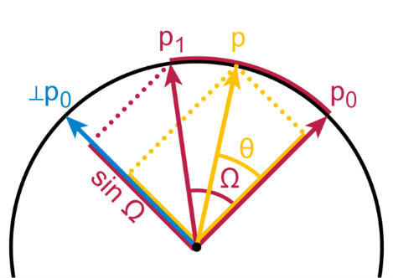
Rotation interpolation?
Euler angles
Easy for one rotation
Super weird for three rotations
Rotation matrices
Difficult

Slide 30
Quaternions
4D imaginary numbers
Three imaginary components
i² = j² = k² = ijk = −1
Can represent rotations
Rotation
rotated point = q * point * q^-1

Slide 31
Quaternions
[w, v] (w: real scalar, v: imaginary vector)
q1*q2 = [w1w2 - v1 · v2, v1 x v2 + w1v2 +w2v1]
q1*q2 != q2*q1
Inverse [w, v] = [w, -v] / (w² + x² + y² + z²)

Slide 32
Interpolation
Spherical Linear intERPolation (SLERP)
slerp(q1, q2, t) = sin(1 - t) θ sin t θ sin θ sin θ
θ = cos^-1(w1w2 + x1x2 + y1y2 + z1z2) |q1||q2|
q1+
q2

Slide 33
Quaternion to Matrix
1 - 2*y² - 2*z² | 2*x*y - 2*z*w | 2*x*z + 2*y*w
2*x*y + 2*z*w | 1 - 2*x² - 2*z² | 2*y*z - 2*x*w
2*x*z - 2*y*w | 2*y*z + 2*x*w | 1 - 2*x² - 2*y²

Slide 34

Lighting

Slide 35
Normals
Defined per vertex
Direction: (x, y, z, 0)
Translation * (x, y, z, 0) = (x, y, z, 0)
Rotation * (x, y, z, 0) = (…)

Slide 36

Vertex Splits

Slide 37
Super Basic Lighting
L*N
dot product
L = Light Direction
N = Normal

Slide 38
Per Vertex vs per Pixel
Per Vertex
Fast
Calculate lighting per vertex Interpolate colors
Per Pixel
Pretty
Interpolate normals Calculate lighting per pixel

Slide 39
Parallel Computations
Superscalar CPUs
SIMD Instructions
Multithreading

Slide 40
C/C++ Fail
No standardized support for SIMD instructions
Multithreading support since 2011

Slide 41
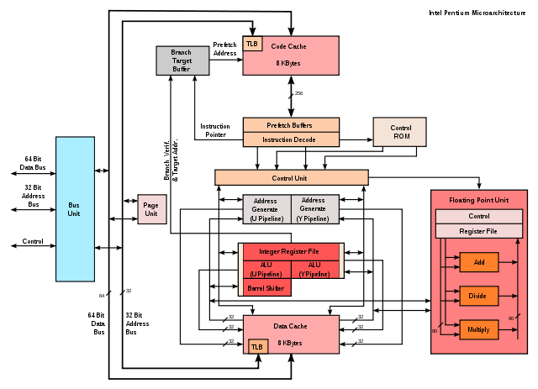
Superscalar CPUs

Slide 42
Superscalar Execution
c = a + b d = a + b // can be parallelized
c = a + b d = a + c // can not be parallelized

Slide 43
Superscalar Execution
No explicit support necessary (or even possible?)
Comiler can reorder instructions
Keep in mind when optimizing
Profiler can show < 1 ticks per instruction

Slide 44
SIMD Instructions
SIMD – Single Instruction Multiple Data
Apply same calculation to multiple values
Can easily be applied to Vector/Matrix math
Automatic compiler optimizations – very limited

Slide 45
x86
SSE – since Pentium 3 in 1999
128 bit registers
4 float numbers per register
SSE2, SSE3, SSE4, AVX,…
SSE2 supported by every x64 CPU
64 bit Operating Systems use SSE instructions for all floating point calculations

Slide 46
ARM
NEON
Since Cortex-A8 (but only optional)
128 bit registers
…

Slide 47
Intrinsics
#include <xmmintrin.h>
__m128 value1 = _mm_set_ps(1, 2, 3, 4); __m128 value2 = _mm_set_ps(5, 6, 7, 8); __m128 added = _mm_add_ps(value1, value2); float allAdded = added.m128_f32[0] + added.m128_f32[1] + added.m128_f32[2] + added.m128_f32[3];
Just like assembler programming
(minus register numbers)

Slide 48
Current Situation
No Standard
SSE and Neon – incompatible intrinsics
Different compilers – ~compatible instrinsics
Libraries of small functions of macros can help
http://www.gamedev.net/page/resources/_/technical/general-programming/practical-cross-platform-simd-math-r3068

Slide 49
Multithreading
Standard support since 2011
OS APIs since 1980s
Kore::Thread

Slide 50

Multithreading
Traditionally avoided in Games
Very important for multicore CPUs

Slide 51
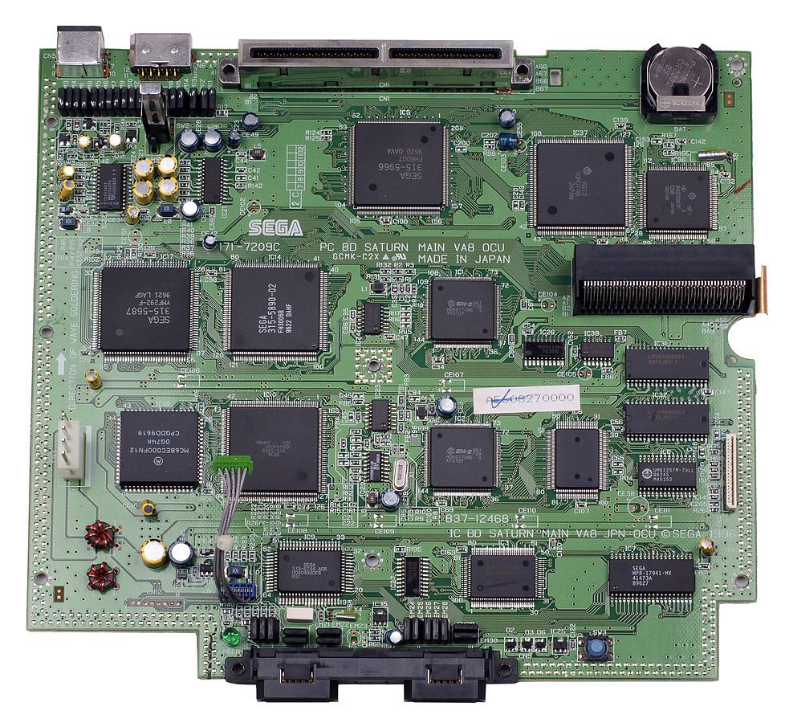
Multithreading

Slide 52
Multithreading
Independent execution threads
Same address space
Lots of problems
Use for speed
Number of threads = number of cores
Use for asynchronicity
Loading data from disk
Never use for convenience

Slide 53

Race Conditions

Slide 54
Race Conditions
Thread 1 | Thread 2 |  | Integer value
 |  |  | 0
read value |  | ← | 0
increase value |  |  | 0
write back |  | → | 1
 | read value | ← | 1
 | increase value |  | 1
 | write back | → | 2

Slide 55
Race Conditions
Thread 1 | Thread 2 |  | Integer value
 |  |  | 0
read value |  | ← | 0
 | read value | ← | 0
increase value |  |  | 0
 | increase value |  | 0
write back |  | → | 1
 | write back | → | 1

Slide 56
Race Conditions
Very difficult to debug
Might happen very rarely
Worst kind of bugs

Slide 57
Fun Example
Android
onKeyDown
UI Thread
onDrawFrame
„The renderer will be called on a separate thread”

Slide 58
Mutex
Kore::Mutex m; m.Create();
m.Lock(); // access shared state m.Unlock();
Mapped to mutex in Linux
Mapped to critical section in Windows
Windows Mutex is used for interprocess sync

Slide 59
Mutex
Can slow down program
Syscalls, cache flushes,…
Minimize sync points
Typical design a
CPU core 1 only for physics
CPU core 2 for everything else
Sync once per frame
Typical design b
Work package objects
Worker threads (one for each CPU core)
Work package manager assigns packages to threads

Slide 60
Lock Free Multithreading
Can speed up programs
Atomic operations
Arcane magic

