Slide 1
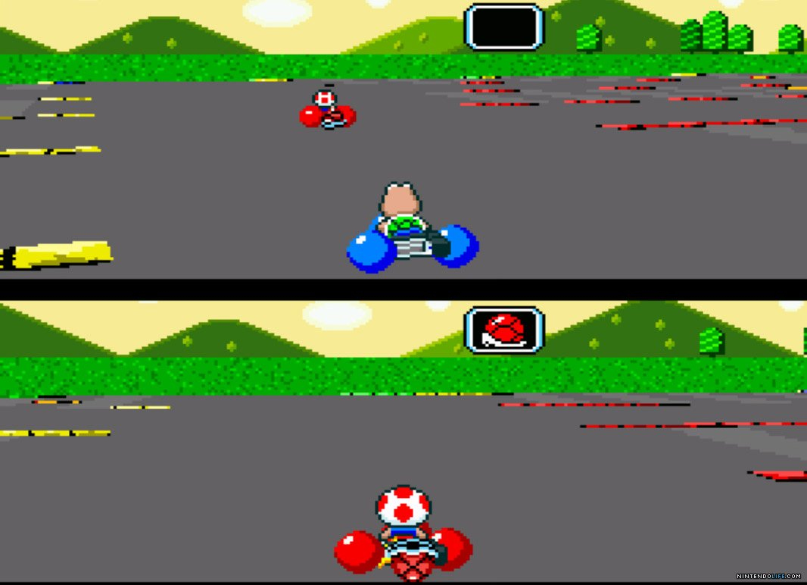
Game Technology
Lecture 12 – 23.01.2015
Dipl-Inf. Robert Konrad
Dr.-Ing. Florian Mehm

Slide 2
Preliminary timetable
Lecture No. | Date | Topic
1 | 17.10.2014 | Basic Input & Output
2 | 24.10.2014 | Timing & Basic Game Mechanics
3 | 31.10.2014 | Software Rendering 1
4 | 07.11.2014 | Software Rendering 2
5 | 14.11.2014 | Basic Hardware Rendering
6 | 21.11.2014 | Animations
7 | 28.11.2014 | Physically-based Rendering
8 | 05.12.2014 | Physics 1
9 | 12.12.2014 | Physics 2
10 | 19.12.2014 | Procedural Content Generation
11 | 16.01.2015 | Compression & Streaming
12 | 23.01.2015 | Multiplayer
13 | 30.01.2015 | Audio
14 | 06.02.2015 | Scripting
15 | 13.02.2015 | AI

Slide 3
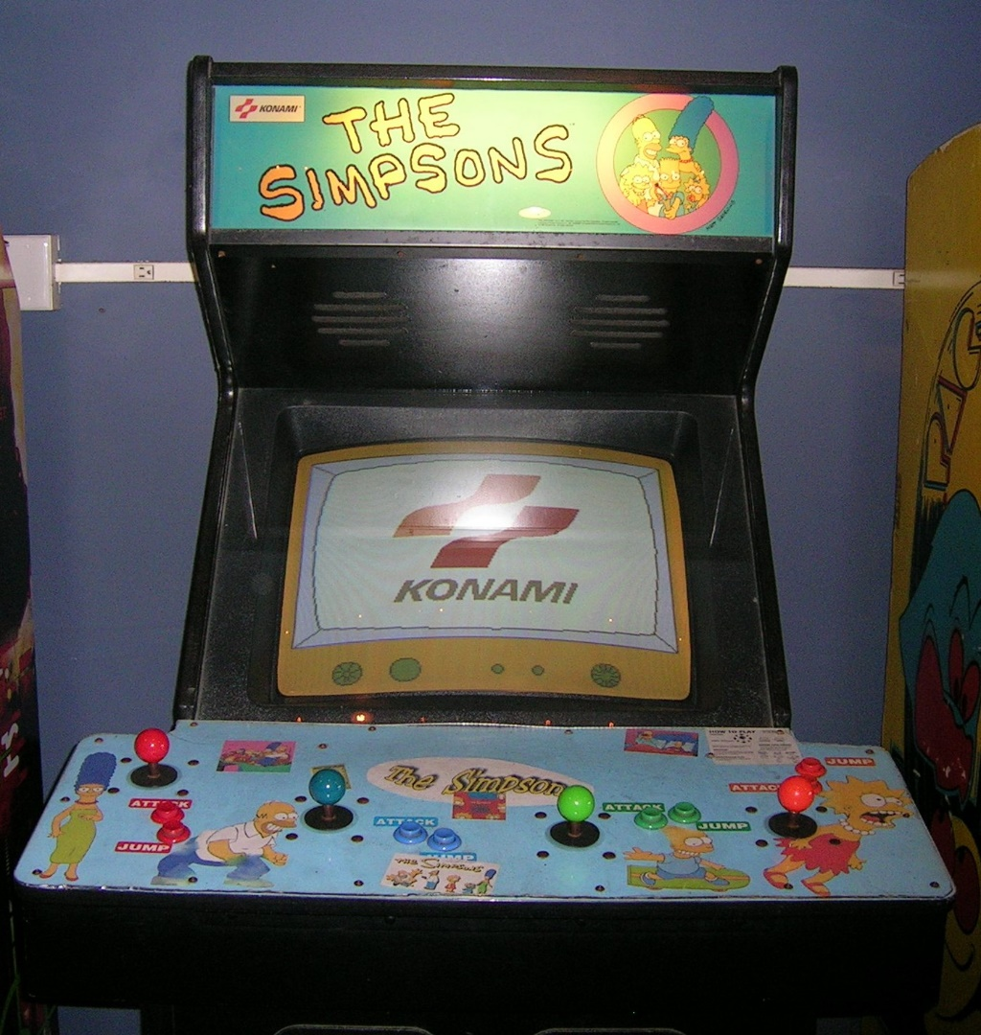

Slide 4
One computer, multiple players
Trivial implementation
No latencies
Uncompressed realtime 3D video chat

Slide 5
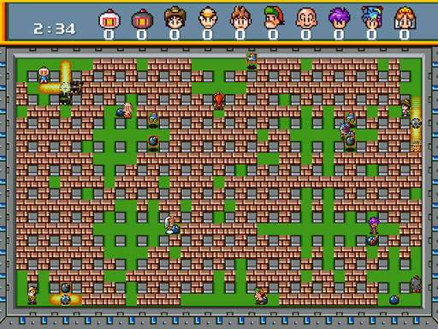
Saturn Bomberman

Slide 6
Local multiplayer
Screen space restricted
Number of controllers restricted
Number of locally available players who understand Bomberman severely restricted

Slide 7


Slide 8
Peer-to-Peer Lockstep
Synchronizes game step by step
Send command data (go forward, move unit,…)
Receive commands by all other players
Simulate game step on all computers
Repeat

Slide 9
Pro & Contra
Low data rate
Just high level game commands
Very fragile
Requires complete determinism
Requires every client to reliably send data
One client hangs -> the game hangs
Maximizes latency
Game has to wait for every one
Players can‘t join a running game
Would have to rerun all previous game commands

Slide 10
Determinism
Randomness
Save your seeds
Implement your own rand()
Done
Calculations
Integer calculations - easy
Floating point calculations – a little weird
Different optimizations on different compilers
There is usually a „strict IEEE 754“ option
Different CPUs
x86 calculates in 80bits, then rounds to 32/64 bit
…

Slide 11
Peer-to-Peer Lockstep Today
Still used in strategy games
Even realtime strategy
Not used in action games
Because the internetz

Slide 12
Peer-to-Peer Lockstep Today
Game design tricks used to hide latency
Play an animation/sound immediately
Move units after all clients agreed

Slide 13
Client/Server
Complete game runs only on the server
Clients send game commands
Server sends game state

Slide 14
Server
Simulates the comlete game
Everything that‘s relevant for the game state
Including physics
Not including cosmetics like particle effects
Does not depend on clients
Clients can hang
Clients can drop in and out
Does not result in problems for other clients

Slide 15
Client
Really dump client
Reads input, sends it to the server
Does not actually run the game
Just interpolates received game states
Might run some simulations for effects work
Menu animations
Particle effects
Physics which do not interfere with gameplay
…

Slide 16
Pro & Contra
Very robust
Clients can hardly cause any problems
Lags from one client do not propagate to other clients
No cheating
Very laggy
Everything lags
Even basic movement lags
The server simulates every player
Size of game state has to be rather small

Slide 17
Client/Server today
Outdated

Slide 18
Client/Server with Client-Side Prediction
Mix of Client/Server and a little bit of Peer-to-Peer
Server is still the boss
But clients predict the game state

Slide 19

Prediction

Slide 20
Prediction
Just run everything on the client and the server
But no client-client-communication
Determinism helps
Most of the time, predictions should be correct
At least for the player character himself
Makes controls snappy
For other players pure prediction
Often incorrect

Slide 21

Failed Predictions

Slide 22
Failed Predictions
Use the corrected data
Cause the server is the boss
Hide your mistakes
Interpolate visuals to avoid jumps
Or let stuff jump around when out of view

Slide 23
Failed Predictions
Clients receive only old data
Compare old received data and old predicted data
When prediction was wrong
Recalculate new current state based on received old state
Then interpolate

Slide 24
Failed Predictions
Can cause unfair situations
Visuals show that an enemy was hit but he really wasn‘t
No real solution possible
Virtual life is not fair :-(

Slide 25
Network Protocols
All IP based
Everything just works like the internet

Slide 26
IP
Internet Protocol
Packet based
No direct connections
Much like post packages
Unreliable

Slide 27
TCP/IP
Direct connections
Reliable streams of data
Super easy

Slide 28
TCP/IP
Builds on a package based protocol
Makes sure every package arrives
Makes sure all packages stay in the same order

Slide 29
TCP/IP
Reorders packages
Requests missing packages again
One missing package can cause huge delays

Slide 30
Missed packages
Unacceptable for most applications
Mostly not important for games
Positions from 30ms ago are outdated anyway
Gets new positions all the time anyway

Slide 31
UDP
Basically IP plus port numbers
Works with packages directly

Slide 32
UDP
Use packages directly for game state
Implement TCP like functionality for other stuff
Highscore lists,…

Slide 33
UDP
Has additional difficulties
Applications have to measure transfer rates
Typical packet sizes (< 512 Bytes) are hopefully enough for one piece of game state

Slide 34
The Future
More Predictions…

Slide 35
Game-Streaming
Run game on the server
Client sends input events
Server sends video stream

Slide 36
Game-Streaming Pro & Contra
Game works like a split-screen game on the server
Super easy development
Video compression can look ugly
But internet connections get faster all the time
Latency is as bad or worse than basic Client/Server

Slide 37
Latency
Speed of light is ~300000 km/s
Circumference of the earth ~40000 km
At least one data roundtrip necessary
> 0.1 seconds for far away servers
Too slow

Slide 38
Latency
Streaming Game providers try to place lots of server at different places
To minimize distance and therefore latency
Typically ends up at speeds that are ok for some persons
And some genres
Not acceptable for VR
Super low latency is critical for good VR

Slide 39
Shinra
Research project by Square-Enix
Wants to use streaming to create new types of multiplayer games
Current multiplayer games are restricted by the amount of data that can be transfered
Doesn’t matter when just streaming audio/video data
Plus want to just use more hardware per game
For more physics or whatever

Slide 40
Alternative strategies?
Maybe cleverly send compressed game state of close surroundings to individual clients

Slide 41
Debugging and Profiling GPU programs

Slide 42
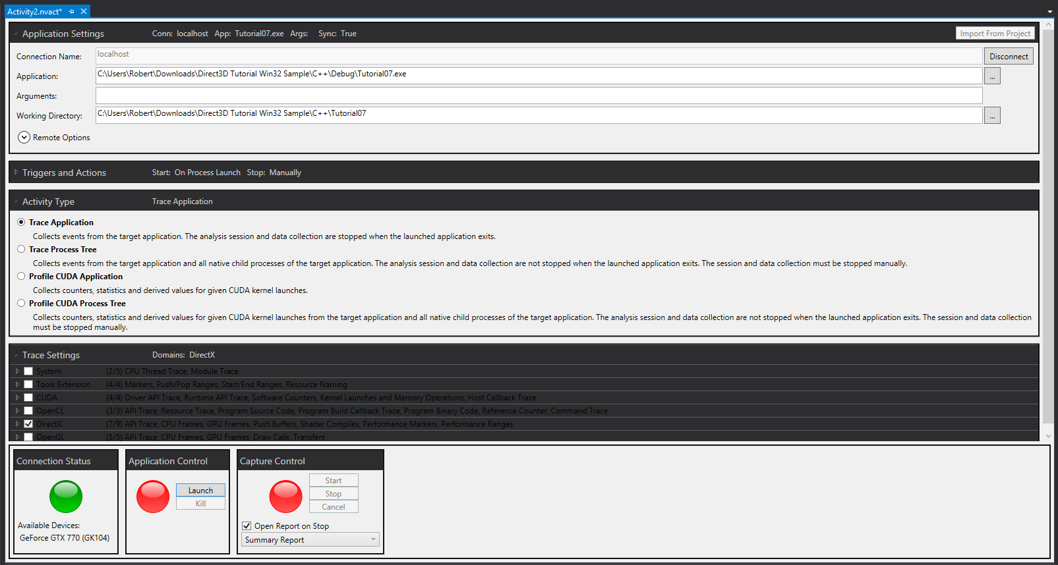
nSight

Slide 43
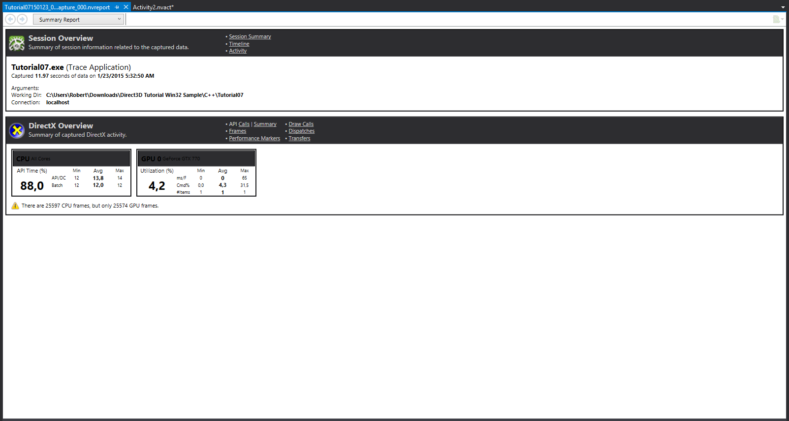
nSight

Slide 44
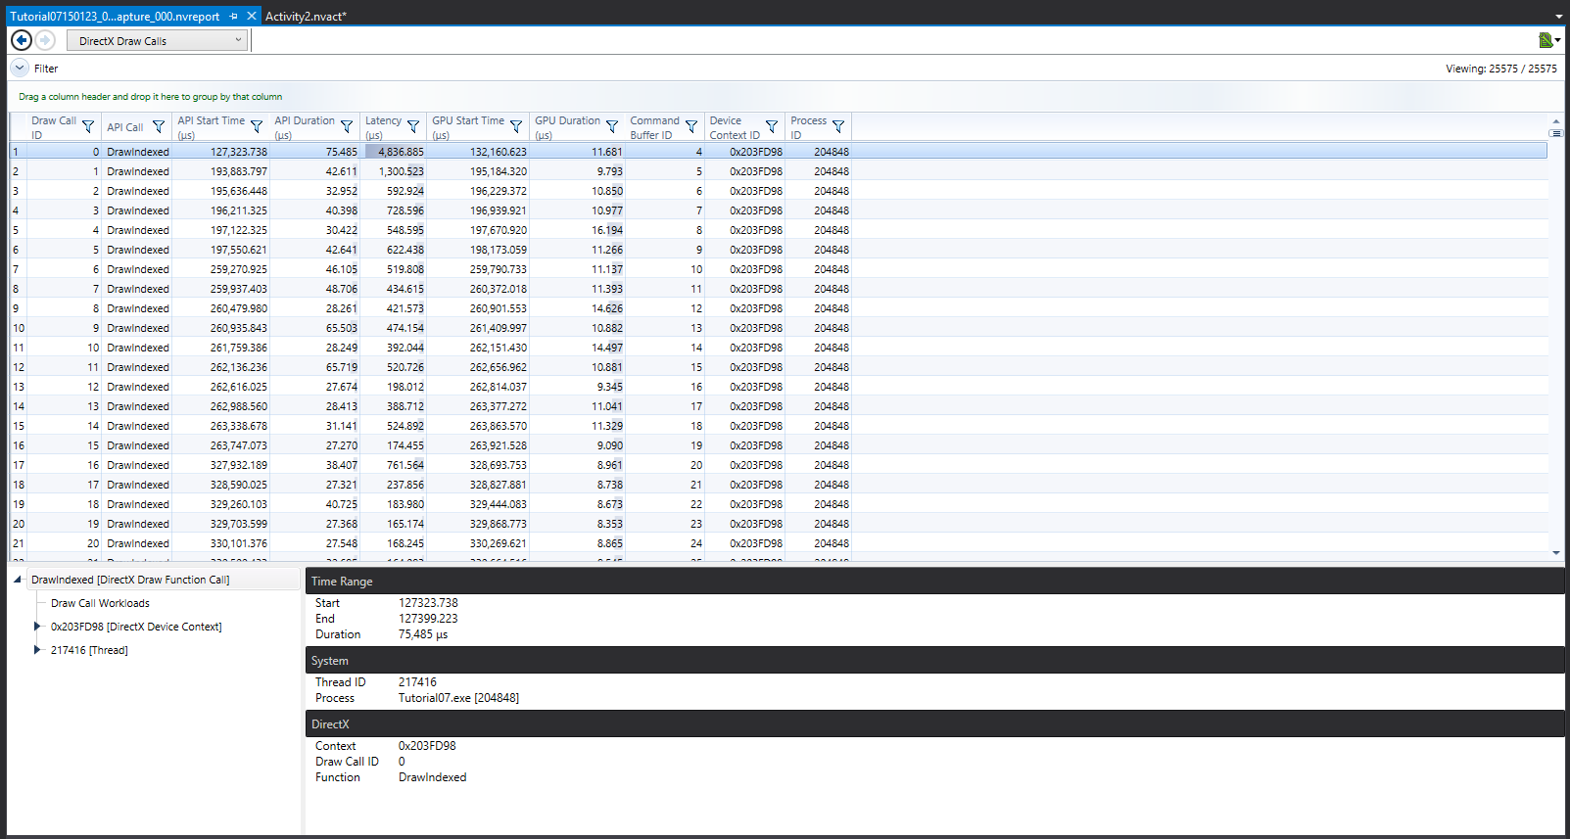
nSight

Slide 45
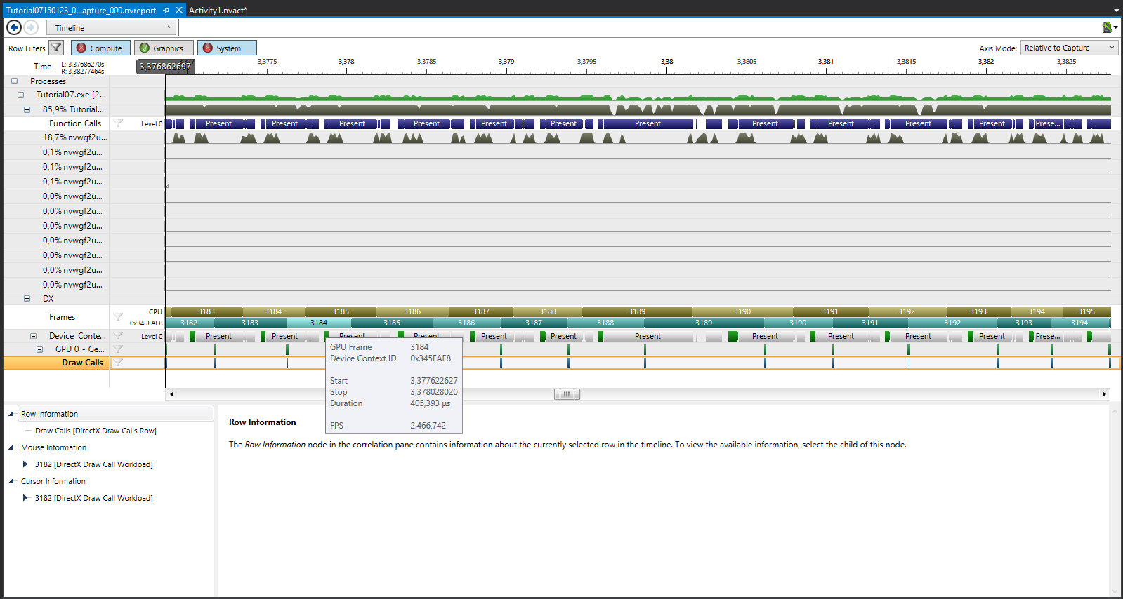
nSight

Slide 46
Direct3D11 and OpenGL now have performance query apis
ID3D11Query
ARB_timer_query

Slide 47
2.1 Hardware
What makes it so important that texture compression algorithms are directly supported by the hardware?
Reading pixels is the most fundamental and speed critical operation of GPUs.

Slide 48
2.2 Artifacts
ETC is a lossy texture compression algorithm. Describe what characteristics an image should have to make those losses clearly visible.
Big contrasts across block borders.

Slide 49
2.3 Tilemaps
Outline an algorithm to display tilemaps correctly in a 3D environment.
MegaTextures for example.

