Slide 1

Game Technology
Optional Lecture 15 – 13.2.2015
Scripting
Dr.-Ing. Florian Mehm
Dipl-Inf. Robert Konrad

Slide 2
Preliminary timetable
Lecture No. | Date | Topic
1 | 17.10.2014 | Basic Input & Output
2 | 24.10.2014 | Timing & Basic Game Mechanics
3 | 31.10.2014 | Software Rendering 1
4 | 07.11.2014 | Software Rendering 2
5 | 14.11.2014 | Basic Hardware Rendering
6 | 21.11.2014 | Animations
7 | 28.11.2014 | Physically-based Rendering
8 | 05.12.2014 | Physics 1
9 | 12.12.2014 | Physics 2
10 | 19.12.2014 | Procedural Content Generation
11 | 16.01.2015 | Compression & Streaming
12 | 23.01.2015 | Multiplayer
13 | 30.01.2015 | Audio
14 | 06.02.2015 | AI
15 | 13.02.2015 | Scripting - Optional

Slide 3
Exam
The exam is designed for 90 minutes
We are working on the remaining exercises and will announce the bonus points
Be there at 9 (latest), we will start around 9:15
Example exam questions
For each lecture, we will add a document with the most important points of the lecture and some example questions on the wiki
No solutions will be provided → questions might also be in the exam

Slide 4
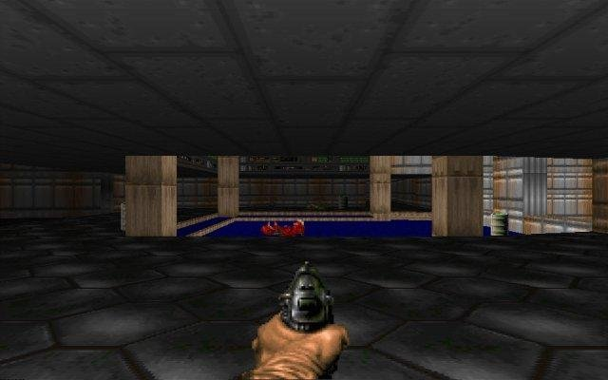
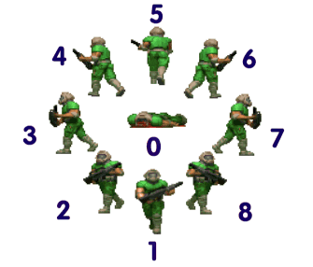
AI Recap: Doom (1993)
Source code available at https://github.com/id-Software/DOOM
Basics
Characters displayed as sprites with 8 directions

Slide 5
AI Recap: Doom (1993)
Movement → Kinematic
Basic moving
Character is given a move direction and a speed
If valid (no wall, no falling, …) character is moved
If bumps into an openable door, game opens it
Facing the move direction: adjusted in 90 degree steps
Chasing
Find a chase direction
Followed for a fixed number of frames (movecount), then re-evaluated
Direct path if available
If no direct path, try random

Slide 6
AI Recap: Doom (1993)
Pathfinding
Nada
Not implemented until Quake 3?
Decision Making
Finite State Machine
Also combined with the animation sprite handling
Callback to A_XYZ functions for actions
typedef struct
{
spritenum_tsprite;
longframe;
longtics;
// void(*action) ();
actionf_taction;
statenum_tnextstate;
longmisc1, misc2;
} state_t;
{SPR_POSS,0,10,{A_Look},S_POSS_STND2,0,0},// S_POSS_STND
{SPR_POSS,1,10,{A_Look},S_POSS_STND,0,0},// S_POSS_STND2
{SPR_POSS,0,4,{A_Chase},S_POSS_RUN2,0,0},// S_POSS_RUN1
{SPR_POSS,0,4,{A_Chase},S_POSS_RUN3,0,0},// S_POSS_RUN2
{SPR_POSS,1,4,{A_Chase},S_POSS_RUN4,0,0},// S_POSS_RUN3
{SPR_POSS,1,4,{A_Chase},S_POSS_RUN5,0,0},// S_POSS_RUN4
{SPR_POSS,2,4,{A_Chase},S_POSS_RUN6,0,0},// S_POSS_ATK2

Slide 7
AI Recap: Doom (1993)
Strategy
Nothing here yet
World Interface
Checking if player is visible
Distance, 180 degrees vision, Obstructed by geometry?
Activated by sounds
AI sounds alert them to the player, sound propagation approximated
Execution Management
„Thinkers“ for game objects (including AI) called once per tic
Content Creation, Scripting
Scripting implemented in Hexen
Content Creation: Doomed Editor, add objects with special relevance (triggering events), but event itself hardcoded

Slide 8
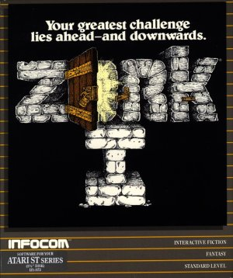
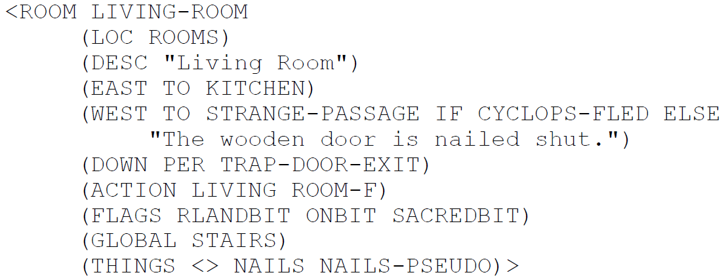
History
Zork Implementation Language (ZIL)
1979
Created by Infocom to facilitate the creation of interactive fiction titles
Compiles to code for a virtual machine → Z-Machine

Slide 9
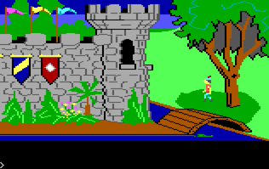
History
AGI – Adventure Game Interpreter
1984
Created by Sierra On-Line for graphical adventure games
First used fully in King‘s Quest
Superseded by SCI – Sierra Creative Interpreter
if (said("look","door")) {
if (posn(ego,0,120,159,167)) {
print("These doors are strongly built
to keep out unwanted visitors.");
}
else {
print("You can't see them from
here.");
}
}

Slide 10
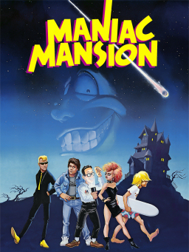
History
SCUMM – Script Creation Utility for Maniac Mansion
1987
Created by Lucasfilm Games for… Maniac Mansion
cut-scene {
...
actor nurse-edna in-room edna-bedroom at 60,20
camera-follow nurse-edna
actor nurse-edna walk-to 30,20
wait-for-actor nurse-edna
say-line nurse-edna "WHATS'S YOUR POINT ED!!!"
wait-for-talking nurse-edna
...
}

Slide 11
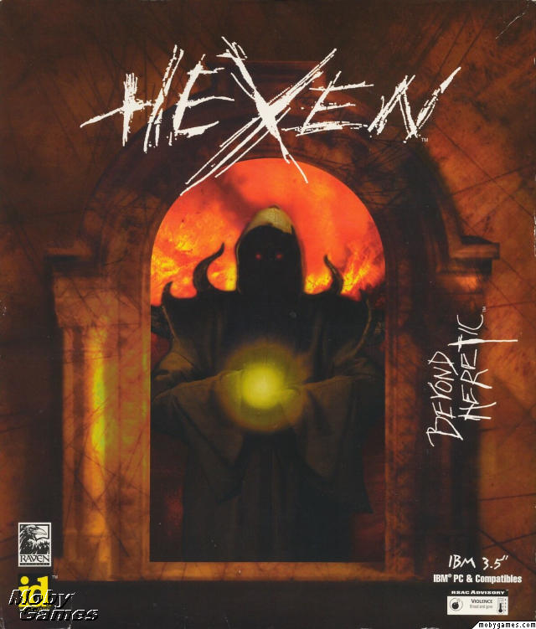
History
Action Code Script
1995
Created by Raven Software for Hexen, extending the original Doom engine
Allowed scripting events during a level
SCRIPT 4 (void)
{
suspend;
suspend; // The statements "absorb" the effect of the two first toggles, whichever they are
ambientsound("Chat",127);
printbold(s:"SEQUENCE COMPLETED!");
}

Slide 12

History
QuakeC
1996
Created by id Software to control Quake
void (float v) ai_berserk =
{
if (self.health > 25)
{
ai_run (v);
}
else
{
ai_run (v * 1.5); // adjust to your taste
self.nextthink = time + 0.075; // adjust to your taste
}
};

Slide 13

History
UnrealScript
Developed in 1998 for the first Unreal
Can extend the class hierarchy of Unreal
class HappyHUD extends HUD
config(Game);
//VARS
var String joyMessage;
var FONT joyFont;
…
function DrawHUD()
{
local string StringMessage;
//projection of ray hit location
local vector HitLocation, HitNormal;
//get origin and dir
Canvas.DeProject(MousePosition, WorldOrigin, WorldDirection);
StringMessage = "MouseX" @ MousePosition.X @ "MouseY" @ MousePosition.Y;

Slide 14
Advantages of Scripting Languages
Designer-Friendly
Designers, non-programmers are enabled to work on the game directly, without needing programmer resources (ideally…)
Quickly change values, …
Easy to learn
Often reduced complexity compared to C++ or similar languages
Often no memory management, pointers, …
Adaptable
Many scripting languages are flexible
E.g. Ruby or Lua allow adapting the language itself, e.g. to create a domain-specific language

Slide 15
Advantages of Scripting Languages
Concurrency
Coroutines
Functions that can be interrupted and continued
No compilation
No additional time during compiling the game (engine)
Can be switched during runtime
Downside: Often slower than compiled code
Mod-support
Allows players to change the game using the scripting language
Increases shelf-life

Slide 16
Runtime vs. Data Definition
Data-definition languages
Create data structures that control the game engine
E.g. LISP-dialect used by Naughty Dog
(define-export *player-start*
(new locator
:trans *origin*
:rot (axis-angle->quaternion *y-axis* 45)
))
Runtime scripting languages
Control the game during runtime
All examples in the history slides are of this kind

Slide 17
Common language properties
Interpreted
Flexibility, portability and rapid iteration
Virtual machine → port the VM to port the scripts
Lightweight
Simple, low memory footprints
Support for rapid iteration
Quicker turnaround time
See changes immediately/after a restart
Convenience
Tuned for the purpose in the game

Slide 18

Textual Languages
All languages we have seen so far
Special case: Natural-language Programming
Can be found in Inform 7 (interactive fiction tool)
The shower is here. It is fixed in place. "Opposite the mirror is the shower, which is closed." The description of the shower is "When it's open, you get in it to take a shower. Right now it's closed, keeping you from using it.”
Instead of opening or entering the shower, say "It is locked down until after the ship makes its jump to hyperspace."

Slide 19
Textual Languages
All languages we have seen so far
Special case: Natural-language Programming
Can be found in Inform 7 (interactive fiction tool)
The shower is here. It is fixed in place. "Opposite the mirror is the shower, which is closed." The description of the shower is "When it's open, you get in it to take a shower. Right now it's closed, keeping you from using it.”
Instead of opening or entering the shower, say "It is locked down until after the ship makes its jump to hyperspace."

Slide 20

Lua
http://www.lua.org/
Development started in 1993 at Pontifical Catholic University of Rio de Janeiro
Small language core
„Events“
Fired when operators/functions are called, …
Native code can register to handle them
Tags
Code called when events are fired
Allow Lua behaviour itself to be changed

Slide 21

Lua Example
Used in Grim Fandango
http://www.lua.org/wshop05/Mogul.pdf
– Dialogue
– Puzzle logic
– UI/controls
– Menus
Engine handles only animations, backgrounds, sound, rendering, choreography, etc etc etc... But those aren't Grim Fandango

Slide 22

Python
https://www.python.org/
Development started in 1989 by Guido van Rossum as a hobby project
Easier to learn for non-programmers than other languages
Disadvantages: Large size and speed
Relies on hash table lookups
Eve Online server almost completely written in Stackless Python

Slide 23
Visual Languages
Emerging trend in game tools
Designer-friendly, easy to debug/visualize scripts
Can become complex if the wrong level of abstraction is chosen

Slide 24
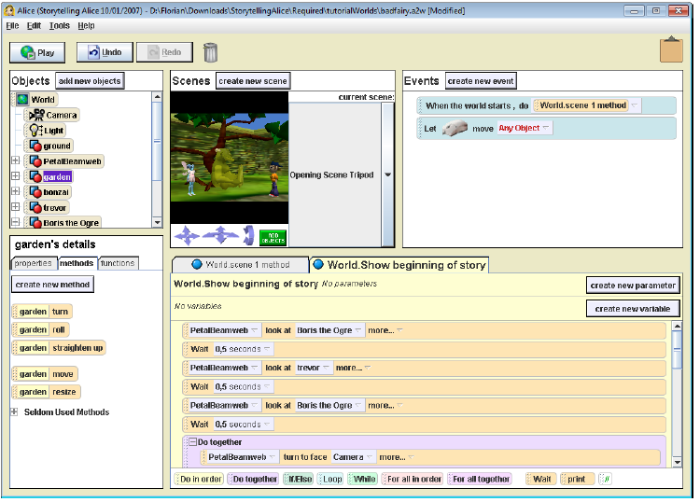
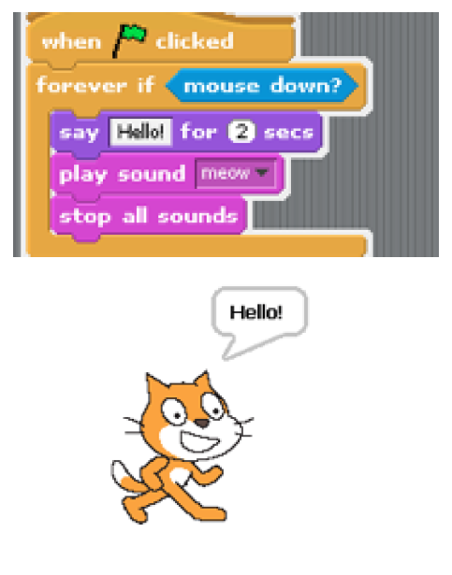
Visual Languages: Scratch, Storytelling Alice

Slide 25

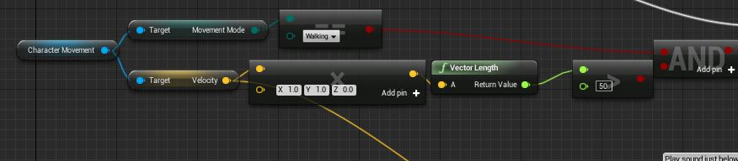
Visual Language: Unreal Blueprint
Added in Unreal Engine 4
Can modify almost everything in the game
Graph-based scripting language

Slide 26
Graph types for visual scripting languages
Single branch tree
Analogue to function without conditions or jumps
Easiest to implement, but very inflexible
Single branch tree with jumps
Uses in first version of Unity Adventure Creator
…probably out of necessity
Trees
Allow conditions to be visualized effectively

Slide 27
Graph types for visual scripting languages
Series-Parallel Digraphs
Source and Drain similar to electrical circuit
Always ends in a node
Advantage over tree: Can be be layouted well automatically, works for scripts with branches and a common end
Graph
No restrictions
Most often freely drawn by designer
Hard to layout automatically
→ Most common for visual scripting languages in games

Slide 28
Data in visual scripting languages
Passed around implicitly
Arguments to individual actions
Look up, e.g. from a blackboard architecture
Passed around explicitly in the graph
Exit slots for output variables
Input slots for input
Advantage: Can create nodes to change input

Slide 29
Architectures for Scripting
Scripted Callbacks
Most of the behaviour is hard-coded
Code calls hook functions that are implemented in scripting language
Scripted Event Handlers
Special case of callbacks
Allows game objects to react to certain types of events
Extending game object types/define new ones
Via inheritance or composition/aggregation
E.g. UnrealScript

Slide 30
Architectures for Scripting
Scripted Components or properties
In component-based game engine architectures
Define the component by the scripting language
Used in Dungeon Siege (2002)
Used by Unity
Script-driven engine systems
Whole sub-system created in scripting language
E.g. game object model in script
Only calls hard-coded parts when needed (e.g. performance-critical parts)
Script-driven games
Mainly script, game engine more of a library
E.g. Panda3D

Slide 31
Game Engine Integration
Embed the virtual machine (often written in C or C++)
Interface to/from native code
Functional language
Look up the function‘s byte code and run it, providing arguments
Object-oriented language
Create/destroy instances, call member functions
Two-way communication
Allow script functions to call native code
Often realized by registering functions with the scripting language
Can be automized if the native language supports RTTI (e.g. see Lua integration into C#)

Slide 32
Game Engine Integration
Referring to Game Objects
Numerical Handles
Simple to use/set up
Can be confusing
Strings with names
Easier to use
More memory used, string comparisons, miss-types names
Hashed string ids
Reduce to integer for the engine

Slide 33
Scripting Finite State Machines
As seen in the AI lecture, FSM are often at the core of AI and game logic code
Specific support in the scripting language
Custom syntax for states
Mirrored in the game object model
Example Uncharted Engine
Each script can have multiple states
Different event handlers, …

Slide 34
Multithreaded scripts
Usually done via cooperative multitasking
Scripts explicitly yield to other scripts
Wait for x seconds
Wait for x frames
Examples
Can be realized in Lua
Unity
Synchronized via signals
E.g. WAIT_UNTIL(signal)

Slide 35
Exercise 14 – Practical Part
1.2
neighbourhoodSize
Boids only look for other boids inside this radius – others are ignored
neighbourhoodMinDP
DP = dot product
Boids have a cone in which they can look
The size of the cone depends on the minimal dot product between the boid‘s direction and the compared boid
1.3
The state machine architecture is pretty complex
→ Adaptable to different needs, but needs a lot of glue code

Slide 36
Exercise 14 – Theoretical Part – 2.1
Steering behavior | Steering output (vec2)
Steer (kinematic) | Vector to target with max speed Normalize(3, -4) * 2
Flee (kinematic) | Vector away from target with max speed Normalize(3, -4) * -2
Steer (dynamic) | Vector to target with max accel. Normalize(3, -4) * 0.5
Flee (dynamic) | Vector away from target with max speed Normalize(3, -4) * -0.5
Pursue | How long do we take? Length of the way: Length of (3, -4) = 5 Time to get there? 5 / 2 = 2.5 New Position of B: (8, 2) + (3, 4) * 2.5 = (8,2) + (7.5, 10) = (15.5, 12) Steering output: Normalize( (15.5, 12) – (5, 6)) * 0.5
Evade | How long do we take? Length of the way: Length of (3, -4) = 5 Time to get there? 5 / 2 = 2.5 New Position of B: (8, 2) + (3, 4) * 2.5 = (8,2) + (7.5, 10) = (15.5, 12) Steering output: Normalize( (15.5, 12) – (5, 6)) * -0.5
Steering behavior | Steering output (vec2)
Steer (kinematic) | Vector to target with max speed Normalize(3, -4) * 2
Flee (kinematic) | Vector away from target with max speed Normalize(3, -4) * -2
Steer (dynamic) | Vector to target with max accel. Normalize(3, -4) * 0.5
Flee (dynamic) | Vector away from target with max speed Normalize(3, -4) * -0.5
Pursue | How long do we take? Length of the way: Length of (3, -4) = 5 How long do we take? 5 / 2 = 2.5 New Position of B: (8, 2) + (3, 4) * 2.5 = (8,2) + (7.5, 10) = (15.5, 12) Steering output: Normalize( (15.5, 12) – (5, 6)) * 0.5
Evade | How long do we take? Length of the way: Length of (3, -4) = 5 How long do we take? 5 / 2 = 2.5 New Position of B: (8, 2) + (3, 4) * 2.5 = (8,2) + (7.5, 10) = (15.5, 12) Steering output: Normalize( (15.5, 12) – (5, 6)) * -0.5

Slide 37
Exercise 14 – Theoretical Part – 2.2
Can A* be interrupted during its execution and continued at a later time? If yes, describe why. If not, give a counterexample.
Yes. If we put the data (open-node-list, …) on the heap, we can continue at another time.
b) Imagine that an interruptible pathfinding algorithm is interrupted and continues 1 second later. Are there problems to be expected in this case? If so, what could the problems be?
The path could be invalid (terrain or buildings changed/destroyed), the move command could be canceled by the player, weights can have changed, …
c) If a) is true, does this make A* an Anytime algorithm? (i.e. Would the implementation be able to provide a valid path after being interrupted?)
Not without changes. If the algorithm is interrupted before it finished, it does not have a valid path to the target. You can search for “Anytime A*” to find algorithms with such changes.

Slide 38
Exercise 14 – Theoretical Part – 2.3
Imagine a scene with many characters walking in random directions. In this scene, an AI LOD system is used. Nearby characters use collision avoidance, far away characters may freely interpenetrate.
What problems could arise if characters exploded when they collided?
If an AI stays in one of the LOD regions, everything is fine
If AI’s interpenetrate (= far LOD) and the player comes closer, they can suddenly explode as they get into the near LOD
Depending on the implementation, characters on the far-side could wander into those close to the border

Slide 39
„Exercise 15“
The exercise sheet will contain example projects you can undertake to increase your knowledge and skill with game technologies
We will not review or grade work you did for „Exercise 15“
but if you want to show us a great game you made, feel free to send us a link ;-)

Slide 40

Thank you!

Slide 41



Questions & Contact
RK
game-technology@kom.tu-darmstadt.de

