Slide 1

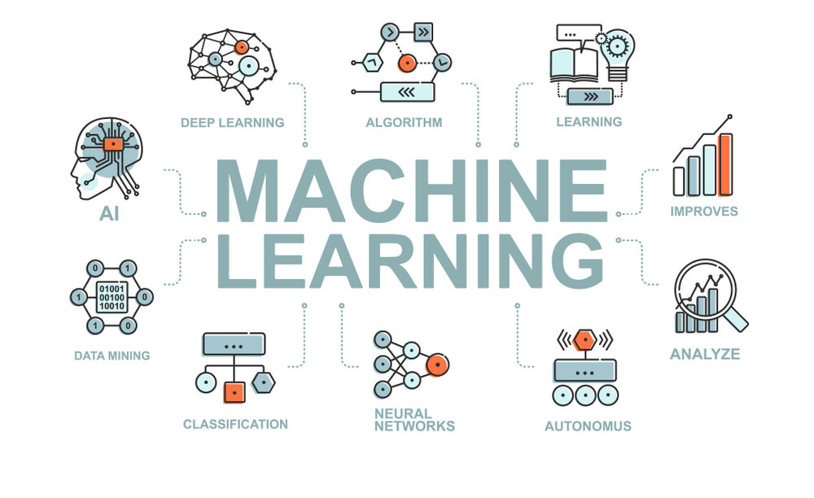
CS Summer Camp
Thursday Session 2

Slide 2
Outline
Reinforcement learning
Q-learning
Break
Start on Parent Presentation

Slide 3
Elements of Reinforcement Learning
Let’s define the Elements of Reinforcement Learning
The learning decision-maker is called the agent.
The agent interacts with the environment that includes everything outside the agent.
The agent has sensors to decide on its state in the environment and takes an action that modiﬁes its state.
Note: The agent only knows its state in the environment, not the environment’s state.
When the agent takes an action, the environment provides a reward.

Slide 4
Elements of Reinforcement Learning
The policy (π) deﬁnes the agent’s behavior.
The policy (π) deﬁnes the action to be taken in any state s_{t}:
a_{t}= π(s_{t}).
The optimal/goal policy π∗ is the policy that maximizes the reward.
Reinforcement learning is all about learning from the environment through interactions.
Finding the optimal policy (π*) is the key to solving reinforcement learning problems.

Slide 5
Reinforcement Learning Examples
 | Robot in a Maze | Card Game
Environment | Maze | Card game
What agent knows | Where it is at, but not where the exit is, or the path to the exit | Your own hand, but not the other player’s hands, or what’s in the deck of cards
State (s) | Current room or location | Your hand and any cards showing
Action (a) | Next move | Your next play
Time (t) | Move to next room | Next play in card game
Reward - at the end (R) | When robot leaves maze | When you win/lose hand
Policy (π) | For each room, what is the next room to go to | Your next play for each given state

Slide 6
Reinforcement Learning Algorithms
The algorithms for finding the optimum policy (π*) are divided into two types:
Model-Based means an agent tries to understand its environment and create a model for it based on its interactions with this environment.
Model-Free means an agent seeks to learn the consequences of their actions through experience via algorithms.
We will look at the Q-Learning algorithm which is
Model-Free
Off-Policy
Learn by trial and error

Slide 7
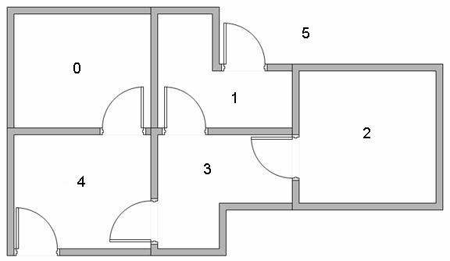
Q-Learning Example
We are going to learn about Q-Learning through an example.
The example describes an agent which uses Reinforcement Learning to learn about an unknown environment.
Suppose we have 5 rooms in a building connected by doors as shown in the figure below.
We'll number each room 0 through 4.
The outside of the building can be thought of as one big room (5).
Notice that doors 1 and 4 lead into the building from room 5 (outside).

Slide 8
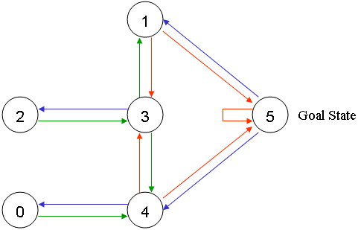
Q-Learning State Diagram
The general method of defining RL problems is with a directed graph, i.e., state diagram.
We can represent the rooms as a graph, each room as a vertex, and each door as an edge.

Slide 9
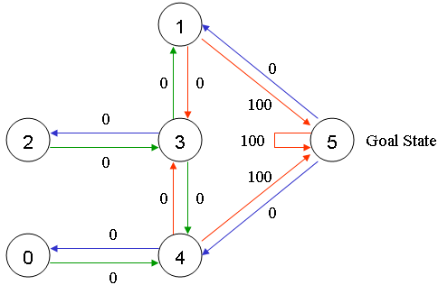
Q-Learning State Diagram
For this example, we'd like to put an agent in any room, and from that room, go outside the building (this will be our target room).
In other words, the goal room (or termination state) is number 5.
To set this room as a goal, we'll associate a reward value to each door (i.e. link between nodes).
The doors that lead immediately to the goal have an instant reward of 100.
Other doors not directly connected to the target room have zero reward.
Because doors are two-way (0 leads to 4, and 4 leads back to 0), two arrows are assigned to each room.
Each arrow contains an instant reward value, as shown.

Slide 10
Q-Learning State Diagram
We'll call each room, including outside, a “state”.
The agent's movement from one room to another will be an "action".
In our diagram, a "state" is depicted as a node, while "action" is represented by the arrows.

Slide 11
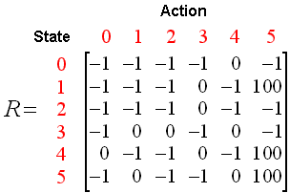
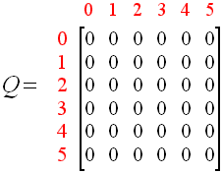
Q-Learning Equation
The transition rule of Q learning is a very simple formula:
Q(state, action) = R(state, action) + Gamma * Max[Q(next state, all actions)]
According to this formula, a value assigned to a specific element of matrix Q, is equal to the sum of the corresponding value in matrix R and the learning parameter Gamma, multiplied by the maximum value of Q for all possible actions in the next state.
This is equivalent to the typical formula shown for Q-Learning:

Slide 12
Q-Learning Equation
Q(state, action) = R(state, action) + Gamma * Max[Q(next state, all actions)]
The Gamma (γ) parameter has a range of 0 to 1 (0 ≤ Gamma ≤ 1).
If Gamma is closer to zero, the agent will tend to consider only immediate rewards.
If Gamma is closer to one, the agent will consider future rewards with greater weight, willing to delay the reward.

Slide 13
Q-Learning Algorithm
Q(state, action) = R(state, action) + Gamma * Max[Q(next state, all actions)]
The agent will explore from state to state until it reaches the goal.
We'll call each exploration an episode.
Each episode consists of the agent moving from the initial state to the goal state.
Each time the agent arrives at the goal state, the program goes to the next episode.

Slide 14
Q-Learning Algorithm
Q(state, action) = R(state, action) + Gamma * Max[Q(next state, all actions)]
The Q-Learning algorithm goes as follows:
Set the gamma parameter and environment rewards in matrix R.
Initialize matrix Q to zero.
For each episode:
Select a random initial state.
Do While the goal state hasn't been reached.
Randomly select one among all possible actions for the current state.
Using this possible action, consider going to the next state.
Get maximum Q value for this next state based on all possible actions.
Compute: Q(state, action) = R(state, action) + Gamma * Max[Q(next state, all actions)]
Set the next state as the current state.
End Do
End For

Slide 15
Q-Learning Algorithm
Q(state, action) = R(state, action) + Gamma * Max[Q(next state, all actions)]
The algorithm is used by the agent to learn from experience.
Each episode is equivalent to one training session.
In each training session, the agent explores the environment, receives the reward (if any) (represented by matrix R) until it reaches the goal state.
The purpose of the training is to enhance the 'brain' of our agent, represented by matrix Q.
More training results in a more optimized matrix Q.

Slide 16
Q-Learning Optimal Policy (π*)
Q(state, action) = R(state, action) + Gamma * Max[Q(next state, all actions)]
When we are done, matrix Q will represent the optimal policy (π*).
The agent simply traces the sequence of states, from the initial state to goal state using the policy:
Set current state = initial state.
From current state, find the action with the highest Q value.
Set current state = next state.
Repeat Steps 2 and 3 until current state = goal state.
The algorithm above will return the sequence of states from the initial state to the goal state.

Slide 17
Reinforcement Learning Project
Tic Tac Toe
Given game code
Implement aspects of Q-learning
Gridworld Problem

