Slide 1

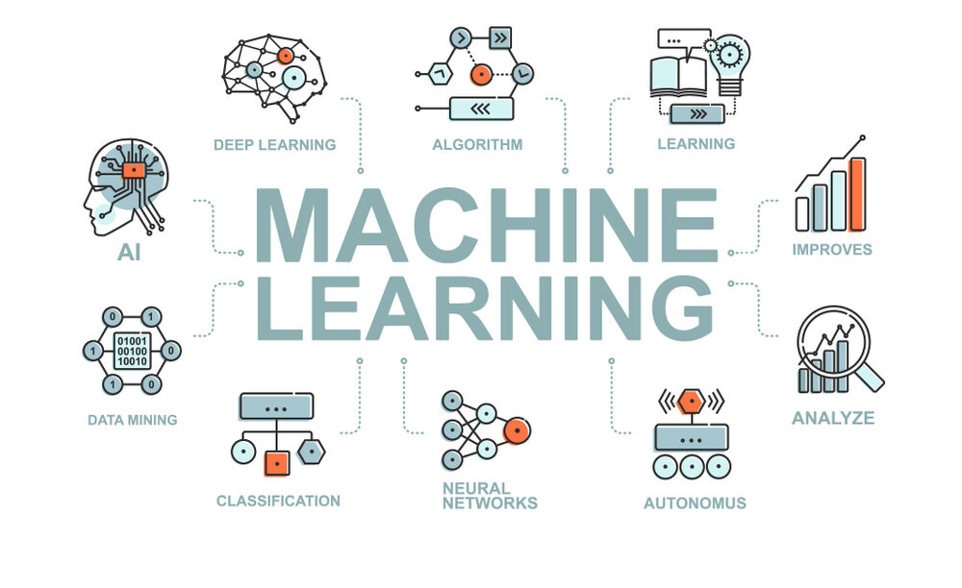
CS Summer Camp
Monday Session 1

Slide 2
Who am I?
My name is Abby Davidow
I am a graduate student here at KU
I also earned my Bachelor’s degree from KU
Currently working on cybersecurity research related to human factors
Worked as a software engineer intern at Cerner for 3 summers

Slide 3
Who are you?
Take 5 minutes to introduce yourselves to the others at your table:
Name
Where you are from
A fact about yourself (can be a hobby, cool talent, etc)
After these 5 min, I’ll ask that you share your name and fact with everyone

Slide 4
What are we going to do?
This camp provides an introduction to the basic methods of machine learning and how to apply them to software engineering problems.
Topics covered are:
Supervised machine learning
Unsupervised machine learning
Reinforcement learning
Feature selection techniques
Evaluation metrics
Write approximately 5-7 Python programs throughout the camp.

Slide 5
What Do You Know?
Have any of you written a program before?
Have any of you written code in Python?
Have any of you learned about machine learning?
Have any of you used machine learning in a project?

Slide 6
Schedule
 | Morning (9am-11:30am) | Afternoon (1:30pm-5pm)
Monday | Introduction Python Review Supervised Learning | Evaluation Metrics and Testing Classifiers (Naïve Bayesian, Regression, LDA, QDA, kNN, SVM) Coding Project(s)
Tuesday | Classifiers (Neural Network) Coding Project(s) | Classifiers (Recurrent Neural Network, Deep Learning) Coding Project(s)
Wednesday | Workshops | Workshops
Thursday | Feature Selection (PCA) Unsupervised Models Coding Project(s) | Reinforcement Learning Coding Project(s)
Friday | Presentation Prep | Greet parents and presentations

Slide 7
General Guidelines
Ask questions at any time. If I use a term you are unfamiliar with, please ask me about it.
Help each other out. Friends that solve errors and bugs together, stay together.
Google is a great resource for syntax and fixing errors. It is likely there is an online resource that has a solution to any error you come across.
Go at your own pace. Some people may have more experience than others, but this is an intro camp so take the time you need. If you finish the prepared project early, please work on another project that interests you! However, I ask that you make sure to keep any extra projects you choose to work on appropriate.

Slide 8
Outline
Introduction
Python Review
Python Exercises
Machine Learning Overview
Supervised Machine Learning

Slide 9
Common Programming Terms
Program
An organized collection of instructions (code), which when executed perform a specific task or function
You write code in a text editor and run it in a terminal with command prompts
Algorithm
A set of instructions or rules designed to solve a definite problem
API
Application Programming Interface
A set of pre-made rules, routines, and protocols to build software applications

Slide 10
Terminal
A simple command-line interface for running scripts and other operations
When you open a terminal, it will open up to the command prompt and originate in your home directory
You will mainly need to be able to change directories and run programs
Let’s walk through an example to see how terminal works
Notes:
To create a program, you write code in files using a text editor, but to run them you enter commands into a terminal

Slide 11
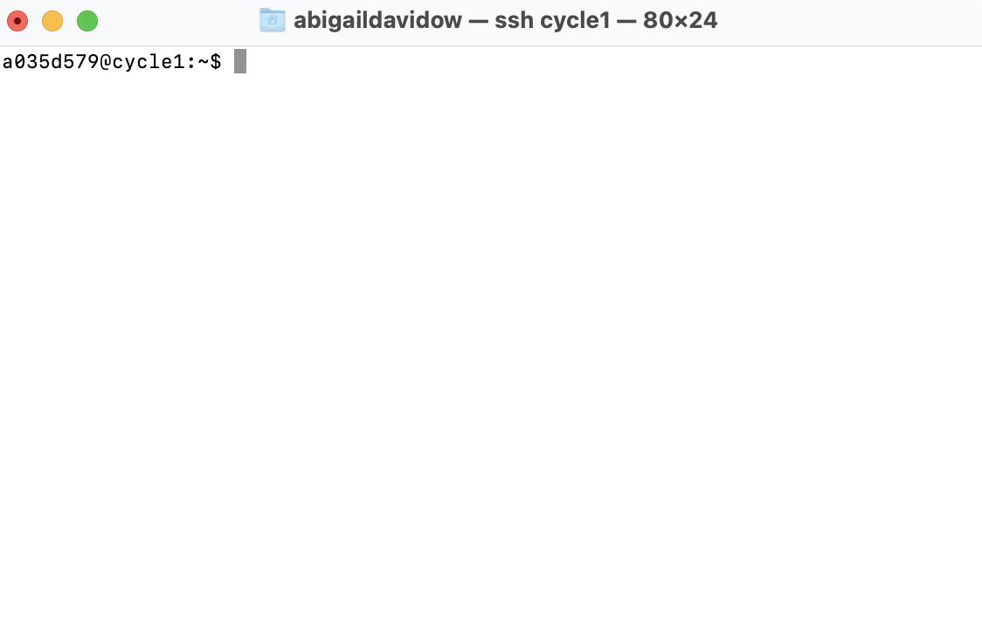
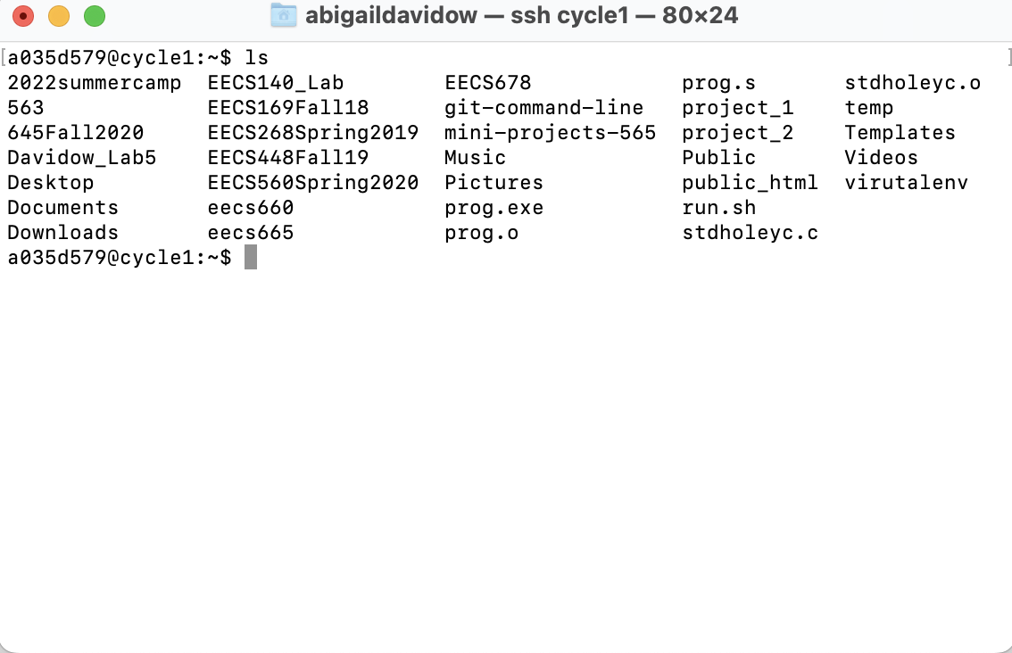
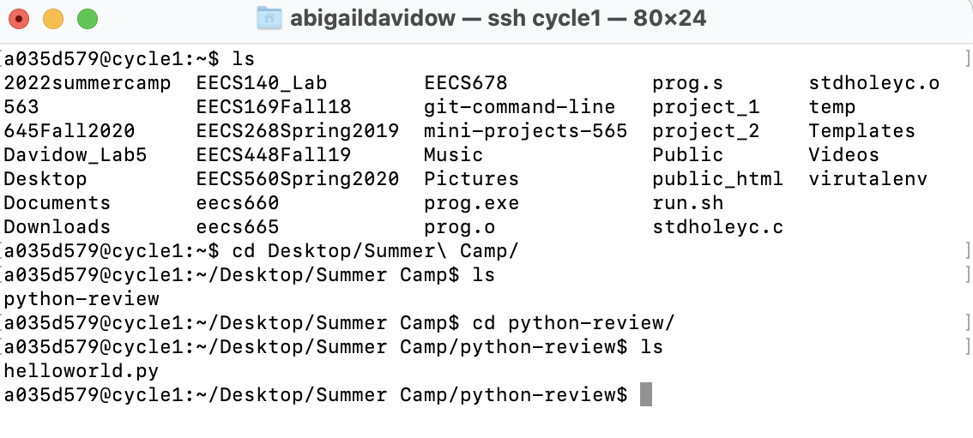
Terminal Walkthrough
1.
2.
3.
ls: List all files and directories
cd: Change directory
4.

Slide 12
Python Review
Very popular programming language
Interpreted language
Can be immediately run rather than compiled before running
Programs are run from the very first line of code.
We will go over a brief review of the most important types and data structures in Python
If you need more in-depth explanations, I can provide you with online resources to look at. Google is your best friend for syntax.

Slide 13
Python Review
Basic Types
Integers
1, 55, 39, 33+43, 9-3
Floats
0.1243, 12.245
Strings
‘hello’, “world”
Boolean
True or False
List/arrays
[‘list’, ‘of’, ‘strings’], [1 ,2, 3]
Operators
Relational
==, !=, <, <=, >, >=
Logical
and, or, not
Variables
Refers to an object of any type
Do not have pre-defined types
Define a variable in an assignment statement
var = 2
var2 = ‘hi’

Slide 14
Python Review
Print Statement
Produces text output on the terminal
Used a lot to visualize results of programs (you will see this shortly)
print(‘hello everyone’)
Indentation matters!!!!
Defines structure of the code (instead of braces)

Slide 15
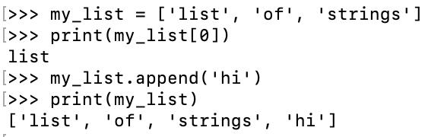
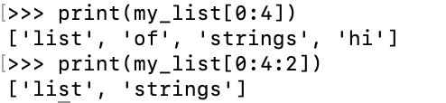
Python Review
Lists/arrays
Store multiple items in a single variable
Each item can be accessed by its index
Indexing starts at 0 (if you have 10 items, the indexes will be 0-9)
Can be strings, ints, etc
Creating, accessing, and adding:
my_list = [‘str1’, ‘str2’, ‘str3’]
my_list[index]
my_list.append(‘newstr’)
Slicing
List[start : stop : step]
Many other capabilities, refer to https://www.w3schools.com/python/python_lists.asp

Slide 16
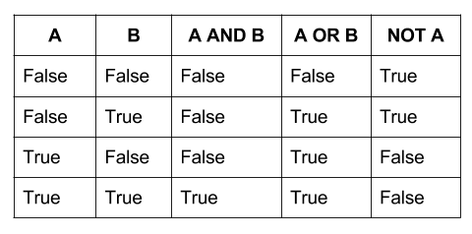
Python Review
Logical Operators
Relational Operators
==
1==1 is True
1==2 is False
!=
1!=1 is False
1!=2 is True
Conditional Statements
if-else statements
Evaluates condition (relational or logical) and if the condition is met, the following statements are run. If the condition is not met, the else statements are run.
if condition:
statements
else:
else statements
if x >2 :
print(‘greater than 2!’)
else:
print(‘less than 2!’)

Slide 17
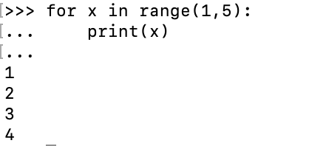
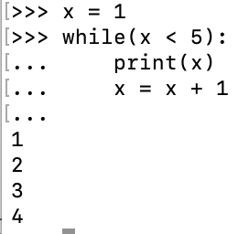
Python Review
Repeating
For loop
Repeats statements over a group of values (range or list)
If you use range(start:end:step), the end value is not included in the loop
for variableName in groupOfValues:
print(variableName)
While loop
Repeats statements while given conditional statement is true
x = 1
while( x < 5):
print(x)
x = x + 1

Slide 18
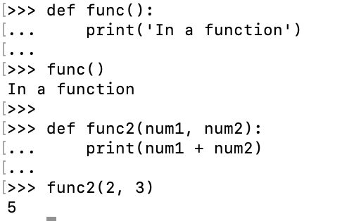
Python Review
Functions
Block of statements that run when called
Can pass in parameters to be used in the function

Slide 19
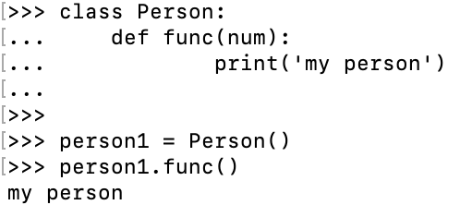
Python Review
Classes/Objects
A class is a blueprint for an object
Contains properties and functions for the object
An object can hold data or call class-defined functions
We will mainly use the syntax for using an object in our projects
To use pre-built modules, you have to initiate them in the same way as this object

Slide 20
Python Review
Now, it’s time for you all to try your hand at some Python coding with some exercises
I have created a website for this camp where all of the projects and powerpoints will be located:
https://ku-cs-camp.github.io
There are 4 exercises that I have prepared for you, but if you finish early, try to create some other programs!
Some ideas:
Guess the number game
Hangman
More listed on the website

Slide 21
Getting Started on the Computers
You each have a unique login, which I will now hand out
In order for all programs to run, you must use a virtual environment
This sounds fancy and complicated but all it will require you to do is run a single command every time you open a new terminal window.
The command is:
source 2022summercamp/bin/activate
Camp website:
https://ku-cs-camp.github.io

Slide 22
What is Machine Learning?
Artificial intelligence (AI) is a branch of computer science that aims to create computer software that emulates human intelligence.
John McCarthy, who coined the term in 1955, defines it as "the science and engineering of making intelligent machines."
AI software emulates many aspects of human intelligence, such as reasoning, knowledge, planning, learning, communication, perception, and the ability to move and manipulate objects.
There are a number of tools that AI uses to emulate these areas of human intelligence.
We will look at a set of these tools loosely called “machine learning.”
22

Slide 23
What is Machine Learning?
Early in the development of AI, “machine learning” was called pattern recognition.
The Machine Learning model (e.g., SVM, neural network, deep learning) predicts the class of an object based on features of the object.
The Machine Learning model is “trained” with examples of the objects to recognize the class of the object by the pattern of its features, in much the same way humans learn to classify things.
For example:
A 3-year old can recognize the difference between a truck and a car by its features.
Younger children learn to understand language by recognizing the different sounds of words.
training
Machine Learning Model
input (features of object)
output (class of object)
23

Slide 24
Types of Machine Learning
Supervised
The object classes are defined
Labeled training data
For example: identifying trucks vs. cars
Unsupervised
The object classes are not defined
Learns patterns from unlabeled data
Clustering: Grouping similar instances
For example: customer segmentation in marketing
Reinforcement Learning
Learning a policy: rewarding desired behaviors, trial and error
For example: teaching AI to play a game
24

Slide 25
Machine Learning Projects
A machine learning project may not be linear, but it has a number of well known steps:
Define the problem.
Acquire a data set (sometimes called a corpus) that represents what your application will encounter in the real world.
Evaluate several combinations of input features and Machine Learning models and select the best combination for your application.
Fine tune the selected model to get the best results.
Train the final model with the corpus and put the application into production.
We will spend most of this camp on the red highlighted steps.
training
Machine Learning
Model
input (features of object)
output (class of object)

Slide 26
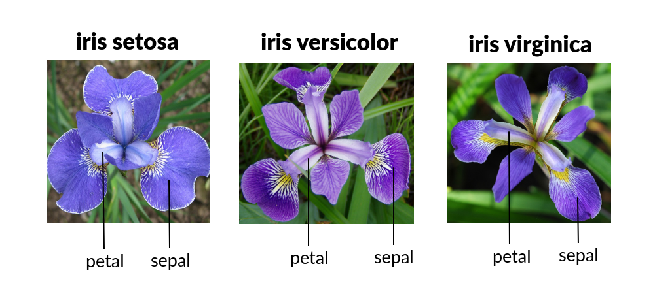
Supervised Machine Learning
The object classes are defined.
Binary Classification:
Trucks vs. cars
The word “Alexa” vs. “Siri”
We will use a database of Iris flowers as an example and in our first project
Multiple Classes (e.g., species of Iris):
Iris Setosa
Iris Versicolour
Iris Virginica

Slide 27
Supervised Machine Learning
The focus of a supervised machine learning software engineering problem is always a data set (sometimes called a corpus) with:
n (e.g., 150 for the iris data set) samples of the data where the class of each sample is known, e.g.:
Iris Setosa
Iris Versicolour
Iris Virginica
m (e.g., 4 for the iris data set) features for each of the samples, e.g.:
Length of sepal
Length of petal
Width of sepal
Length of petal
training
Machine Learning Model
input (features of object)
output (class of object)

