Slide 1

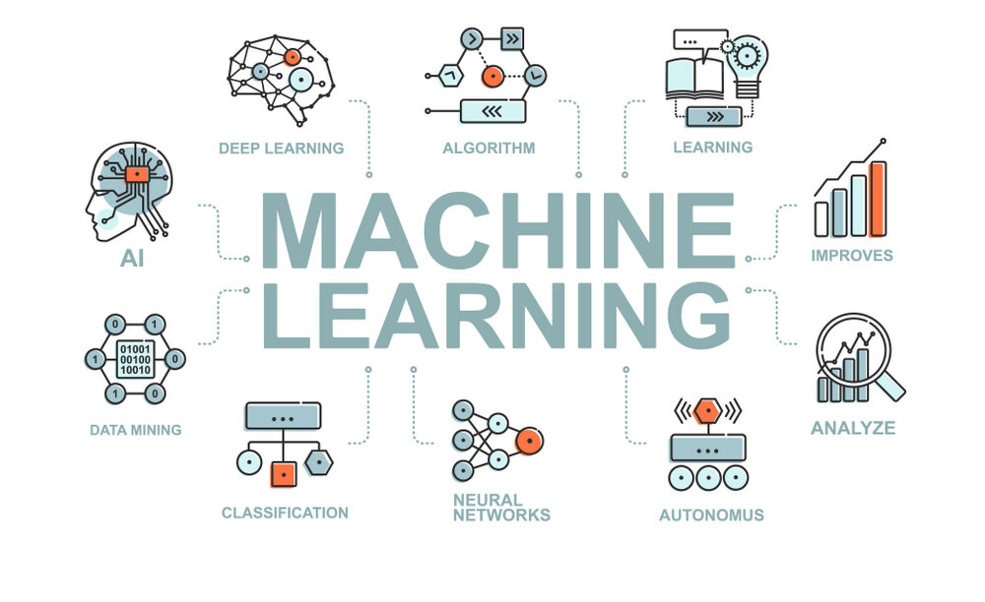
CS Summer Camp
Tuesday Session 2

Slide 2
Welcome Back!
Based on the session this morning, I can tell there is confusion on projects
I want to review the major parts of creating a model for a dataset

Slide 3
The Data
First, you need to understand the data you have
sepal-length | sepal-width | petal-length | petal-width | class
5.1 | 3.5 | 1.4 | 0.2 | Iris-setosa
5.7 | 2.8 | 4.1 | 1.3 | Iris-versicolor
6.3 | 3.3 | 6 | 2.5 | Iris-virginica
What are our features/input?
What is the output/class?
training
Machine Learning Model
input (features of object)
output (class of object)

Slide 4
Loading Data
In order to work with our data, we need to load it into our program
read_csv(‘filename.csv’)
A pre-made function that will load the data for us
If the data does not contain column names, you will have to add them
names=[‘sepal-length’,…..]
You may have to do some more cleaning or changing to the data, but if not, you can move on to preparing your arrays

Slide 5
Splitting into X and Y Arrays
Now that you have your data, we need to split it into two arrays: x (features) and y (output)
This is where slicing arrays comes in
This can be difficult to understand
We want only the columns corresponding to the features we discussed earlier in the x array
The y array should have only the output column
X = array[:,0:4]
y = array[:,4]
: by itself means we want every row
Since we have 5 columns, indexes are 0-4

Slide 6
Creating Training and Test Arrays
We need 4 arrays to continue:
X_train
List of features the models learns from
Y_train
List of corresponding outputs the model learns from
X_test or X_validation
Think of this like the model’s test
It has studied on the other data and needs to test its abilities on this array of new, never before seen data
Y_test or Y_prediction
Think of this as the answer key to the test
These are the correct values that the model aims to predict
X_train, X_test, Y_train, Y_test = train_test_split(X, y)
Pre-made function that will split the arrays for us

Slide 7
Create and Use Model
Initialize the model
model = DecisionTreeClassifier()
Train/fit the model
model = model.fit(X_train, Y_train)
Now that we have a trained model, we can use it to predict
predictions = model.predict(X_test)

Slide 8
Evaluate Model
To check our model, we can call various metric functions. We have been mainly using accuracy.
accuracy_score(Y_test, predictions)
At this point in real-life situations, you look at how your model performs with your metrics and decide how it needs to improve
Make adjustments and try again

Slide 9
Now Back on Schedule
I’ll now go over a specific type of deep learning
These topics can get confusing so I am only going to focus on one type

Slide 10
Sequence Classification
Up to now, our classifiers have identified single events:
Variety of an Iris flower
Picture of a cat, dog, or fox
Handwritten letter recognition
There is another category of supervised classifiers that recognize a sequence of events in time or space:
Speech recognition – sequence of sounds that make up a word
Natural language processing – part-of-speech tagging (e.g., nouns, verbs, adjectives)
Text processing – synthetic text generation
Handwriting recognition – pen movements
DNA sequencing – base pairs
We will look at a classifier that is commonly used in sequence classification:
Recurrent Neural Networks (RNN)

Slide 11
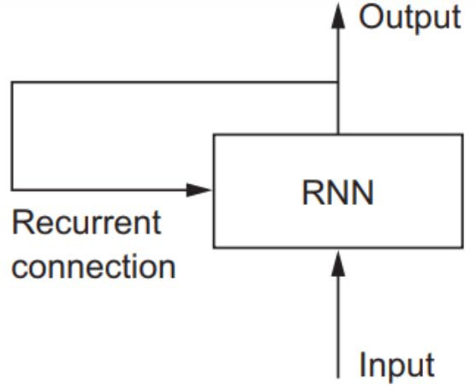
Recurrent Neural Network (RNN)
A recurrent neural network (RNN) classifies a sequence of events in time or space:
– For example: daily stock prices, sentences, or sensor measurements
A RNN processes one element at a time while retaining a memory (called a cell state) of what has come previously in the sequence.
Recurrent means the output at the current time step becomes the input to the next time step.
At each element of the sequence, the model considers not just the current input, but what it remembers about the preceding elements.

Slide 12
Recurrent Neural Network (RNN)
This memory allows the network to learn long-term dependencies in a sequence.
We will use LSTM layers which learn long-term dependencies between time steps
It takes the entire context into account when making a prediction, whether that be the next word in a sentence, a sentiment classification, or the next temperature measurement.
A RNN is designed to mimic the human way of processing sequences: we consider the entire sentence when forming a response instead of words by themselves.

Slide 13
Recurrent Neural Network (RNN)
For example, consider the following sentence:
– “The concert was boring for the first 15 minutes while the band warmed up but then was terribly exciting.”
A machine learning model that considers the words in isolation would probably conclude this sentence is negative.
An RNN by contrast should be able to see the words “but” and “terribly exciting” and realize that the sentence turns from negative to positive because it has looked at the entire sequence.

Slide 14
RNN Layers
A RNN is built of several layers in addition to the ones that “remember” output and input from previous time periods (e.g., LSTM).
Keras has a number of layers to build a RNN from.
https://keras.io/layers

Slide 15
Other RNN Layers
Core Layers:
Dense: Just your regular densely-connected NN layer.
Activation: Applies an activation function to an output.
SoftMax
ReLU
Tanh
Sigmoid
Etc.

Slide 16
Other RNN Layers
Core Layers (continued):
Output post-processing layers: Applies various functions to output.
Reshape
Input pre-processing layers: Applies various functions to input.
Dropout - Randomly setting a fraction of input units to 0 at each update during training time, which helps prevent overfitting.
Permute - Permutes the dimensions of the input according to a given pattern.
RepeatVector – repeats input vector
Lambda – applies any arbitrary function to input, e.g., x²
Masking - Masks a sequence by using a mask value to skip timesteps.
Regularization - applies an update to the cost function based input activity.

Slide 17
Other RNN Layers
Recurrent Layers:
SimpleRNN: Fully-connected RNN where the output is fed back to the input.
Gate Recurrent Unit (GRU): similar to LSTM, except it has fewer parameters than LSTM, as it lacks an output gate.
LSTM
ConvLSTM2D: Convolutional LSTM. It is similar to an LSTM layer, but the input transformations and recurrent transformations are both convolutional.
They also have cell versions of each of these.
And versions that run on the GPU.

Slide 18
Other RNN Layers
Embedding Layers:
Embedding:
Turns positive integers (indexes) into dense vectors of fixed size.
For example: [[4], [20]] -> [[0.25, 0.1], [0.6, -0.2]]
This layer can only be used as the first layer in a model.
Only one of these so far.

Slide 19
Other RNN Layers
Merge Layers:
Add: Layer that adds a list of inputs.
Subtract: Layer that subtracts two inputs.
Multiply: Layer that multiplies (element-wise) a list of inputs.
Average: Layer that averages a list of inputs.
Maximum: Layer that computes the maximum (element-wise) of a list of inputs.
Minimum: Layer that computes the minimum (element-wise) of a list of inputs.
Concatenate: Layer that concatenates a list of inputs.
Dot: Layer that computes a dot product between samples in two tensors.

Slide 20
Other RNN Layers
Normalization Layers:
BatchNormalization: Normalize the activations of the previous layer at each batch, i.e. applies a transformation that maintains the mean activation close to 0 and the activation standard deviation close to 1.
Only one of these so far.

Slide 21
Other RNN Layers
Noise Layers:
Regularization layer active at training time.
GaussianNoise:
Apply additive zero-centered Gaussian noise.
This is useful to mitigate overfitting (you could see it as a form of random data augmentation).
Gaussian Noise (GS) is a natural choice as corruption process for real valued inputs.
GaussianDropout:
Apply multiplicative 1-centered Gaussian noise.
AlphaDropout:
Applies Alpha Dropout to the input.
Alpha Dropout is a Dropout that keeps mean and variance of inputs to their original values, in order to ensure the self-normalizing property even after this dropout.
Alpha Dropout fits well to Scaled Exponential Linear Units by randomly setting activations to the negative saturation value.

Slide 22
Project Time!
There is one project covering RNN where you create a stock predictor for Tesla stocks
If you don’t feel ready to start this, please go back and work on/finish previous assigned projects
Hopefully the review helps clear up some concepts
Once you have finished everything I just mentioned, try creating games in Python
This will help you build up your skills in Python
We will also take a break and do an activity at 3 PM

