Slide 1

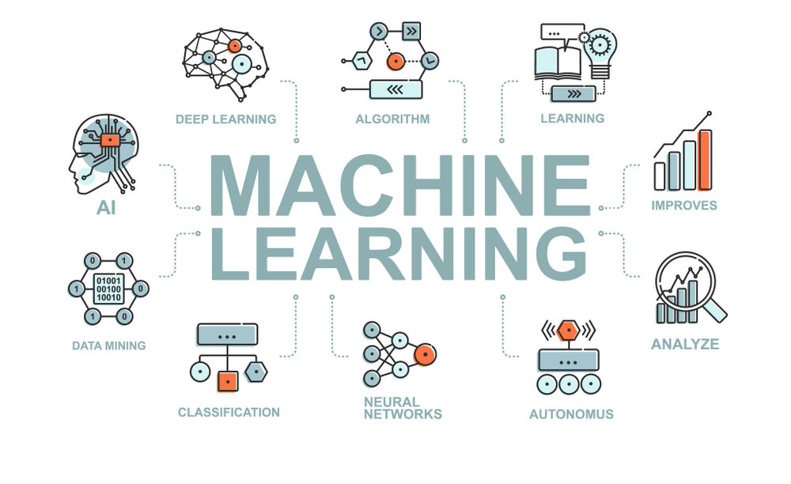
CS Summer Camp
Tuesday Session 1

Slide 2
Outline
Review of Basic ML Steps
Decision Tree Classifier
Neural Networks
Deep Learning

Slide 3
The Data
First, you need to understand the data you have
sepal-length | sepal-width | petal-length | petal-width | class
5.1 | 3.5 | 1.4 | 0.2 | Iris-setosa
5.7 | 2.8 | 4.1 | 1.3 | Iris-versicolor
6.3 | 3.3 | 6 | 2.5 | Iris-virginica
What are our features/input?
What is the output/class?
training
Machine Learning Model
input (features of object)
output (class of object)

Slide 4
Loading Data
In order to work with our data, we need to load it into our program
read_csv(‘filename.csv’)
A pre-made function that will load the data for us
If the data does not contain column names, you will have to add them
names=[‘sepal-length’,…..]
You may have to do some more cleaning or changing to the data, but if not, you can move on to preparing your arrays

Slide 5
Splitting into X and Y Arrays
Now that you have your data, we need to split it into two arrays: x (features) and y (output)
This is where slicing arrays comes in
This can be difficult to understand
We want only the columns corresponding to the features we discussed earlier in the x array
The y array should have only the output column
X = array[:,0:4]
y = array[:,4]
: by itself means we want every row
Since we have 5 columns, indexes are 0-4

Slide 6
Creating Training and Test Arrays
We need 4 arrays to continue:
X_train
List of features the models learns from
Y_train
List of corresponding outputs the model learns from
X_test or X_validation
Think of this like the model’s test
It has studied on the other data and needs to test its abilities on this array of new, never before seen data
Y_test or Y_prediction
Think of this as the answer key to the test
These are the correct values that the model aims to predict
X_train, X_test, Y_train, Y_test = train_test_split(X, y)
Pre-made function that will split the arrays for us

Slide 7
Create and Use Model
Initialize the model
model = DecisionTreeClassifier()
Train/fit the model
model = model.fit(X_train, Y_train)
Now that we have a trained model, we can use it to predict
predictions = model.predict(X_test)

Slide 8
Evaluate Model
To check our model, we can call various metric functions. We have been mainly using accuracy.
accuracy_score(Y_test, predictions)
At this point in real-life situations, you look at how your model performs with your metrics and decide how it needs to improve
Make adjustments and try again

Slide 9
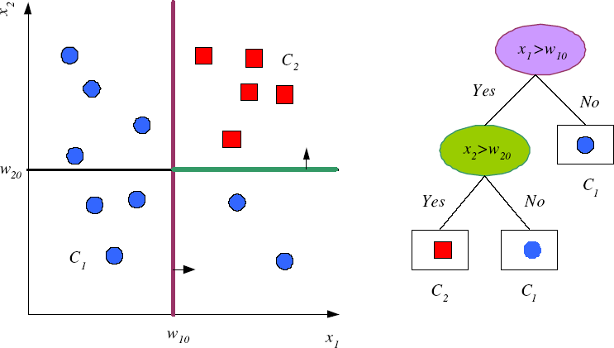
Decision Tree Classifier
Decision Tree classifiers are based on a decision support tool that uses a tree-like model of decisions and their possible consequences.
x₁ and x₂ are features.
w₁₀ is a decision value of x₁
w₂₀ is a decision value of x₂.
C₁ and C₂ are the classes.
The decision values are determined during training by the ML model.

Slide 10

Decision Tree Classifier
They are good at predicting classes when the boundaries between classes are non-linear.
And, they are also non-probabilistic because they do not assume any specific probability distribution or the independence or dependence of the input features.
x₁
L₁
x₂

Slide 11
Decision Tree Rule Base
A main advantage of decision trees is interpretability.
The decision nodes carry conditions that are simple to understand.
Each path from the root to a leaf corresponds to one conjunction of tests, as all those conditions should be satisﬁed to reach to the leaf.
These paths together can be written down as a set of IF-THEN rules, called a rule set.

Slide 12
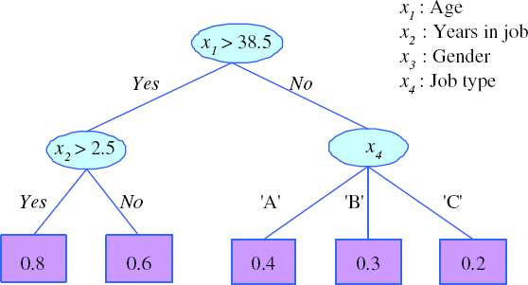
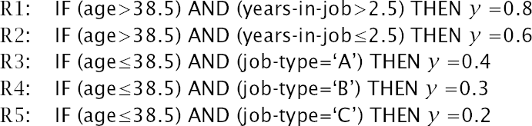
Rule Extraction from Trees

Slide 13
Neural Network (NN)
Neural Network (NN) machine learning classifiers were inspired by the biological neural networks that constitute animal brains.
A Neural Network works best when the dividing line between classes is not straight.
It is also non-probabilistic because it does not assume any specific probability distribution (e.g., Gaussian) or the independence or dependence of the input features.
x₁
L₁
x₂

Slide 14
















Neural Network (NN)
A Neural Network is composed of multiple layers of nodes:
an input layer
one or more hidden layers
an output layer
The figure shows one output, y, but a neural network may have more than one output.
The inputs to each node generate an output that is fed to the next node in the network.
The values of the features we are trying to classify, x₁ and x₂, are fed into the network as the initial inputs.
The output y determines how the features are classified.
input layer
hidden layer
output layer
x₁
y
x₂

Slide 15
Neural Network (NN)
The output of a node that is fed to the next node is usually calculated using a simple equation.
There are a variety of equations that are
used, but the simplest one is:
f(x) = wx + b
Each node (in any layer):
sums its inputs (x)
multiplies the sum (x) by a weight (w)
adds a bias (b)
feeds the results, f(x), to the next node
Each node has its own weight and bias.
The weights and biases are determined by running the training data through the neural network multiple times and adjusting them, until the output matches the training data as close as possible.
input layer
hidden layer
output layer
x₁
y
x₂

Slide 16
Neural Network (NN)
Different NN implementations use:
Different equations that each node uses to calculate its output
Different methods of adjusting the weights and biases with the training data
Differing number of hidden layers
Differing number of nodes in the hidden layers
The different NN implementations produced different results.
Deep learning classifiers (which we will discuss later) include feed back between the nodes.
input layer
hidden layer
output layer
x₁
y
x
2

Slide 17
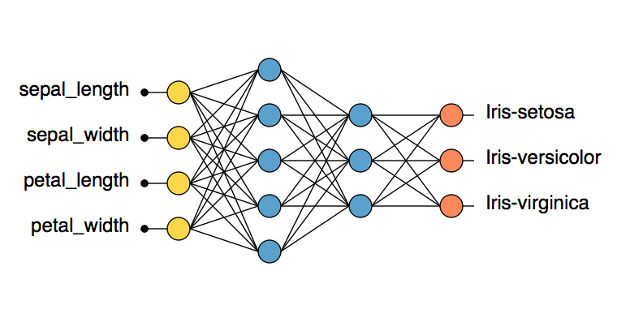
Neural Network for Iris Dataset

Slide 18
NN in Code
The base model of neural networks is Sequential()
After this initialization, various layers can be added to the network
These layers are called Dense layers
Model.add(Dense(units, activation))
Units are the number of neurons/outputs for that layer
The activation function transforms the input values to the neurons
The model then needs to be compiled
Requires loss function, optimizer, and metric
model.compile(loss='', optimizer='', metrics=[''])
Keras is a high-level neural networks API, written in Python and has a number of layers to build a NN from.
https://keras.io/layers
Notes:
dense layer - deeply connected neural network layer

Slide 19
ML Model Comparison
NN
Strengths:
Non-probabilistic, i.e., no assumption of Gaussian distribution or independence of input features
Capability to learn non-linear models.
Weaknesses:
Requires tuning a number of hyperparameters such as the number of hidden neurons, layers, and iterations
Sensitive to feature scaling
Susceptible to over-fitting.

Slide 20
Neural Network (NN)
Neural networks started out with a bang because:
Inspired by animal neurons like those in the human brain (true AI)
Classified both non-linear and non-probabilistic data
They lost popularity because:
Required tuning a number of hyperparameters such as the number of hidden neurons, layers, and iterations
Very susceptible to over-fitting
Non-deterministic (don’t always get the same results)
Recently (around 2015) they regained popularity in deep learning architectures.
Deep learning (also known as deep structured learning or differential programming) is part of a broader family of machine learning methods based on artificial neural networks with representation learning.
Deep learning architectures have been applied to fields including computer vision, speech recognition, natural language processing, audio recognition, social network filtering, machine translation, bioinformatics, drug design, medical image analysis, material inspection and board game programs,
where they have produced results comparable to and in some cases surpassing human expert performance.

Slide 21
Deep Learning Classifiers
Deep learning is a specific subfield of machine learning.
The deep in deep learning isn’t a reference to any kind of deeper understanding achieved by the approach.
Rather, it stands for this idea of successive layers of increasingly meaningful representations.
How many layers contribute to a model of the data is called the
depth of the model.
tens or even hundreds of successive layers of representations are used in deep learning
Machine learning with only one or two layers of representations of the data are sometimes called shallow learning.

Slide 22
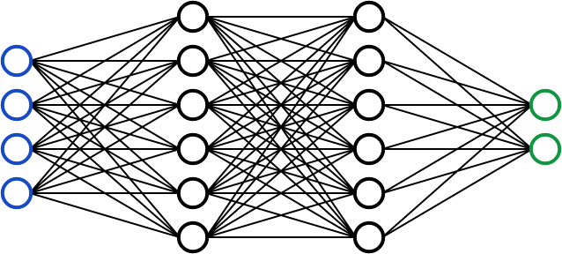
Deep Learning Classifiers
In deep learning, these layered representations are (almost always) learned via Neural Network models, structured with multiple hidden layers.
Like Neural Networks, deep-learning models are not models of the brain.
Although some of the central concepts in deep learning were developed in part by drawing inspiration from our understanding of the brain.
There’s no evidence that the brain implements anything like the learning mechanisms used in modern deep-learning or Neural Network models.

Slide 23
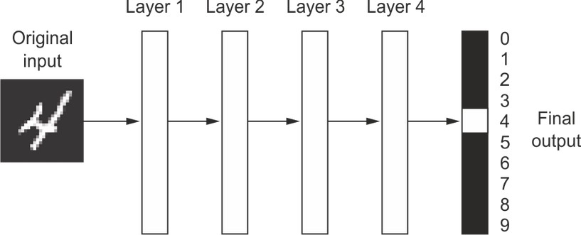
Deep Learning Classifiers
What do the representations learned by a deep-learning algorithm look like?
Let’s examine how a network several layers deep transforms an image of a digit in order to recognize what digit it is.

Slide 24
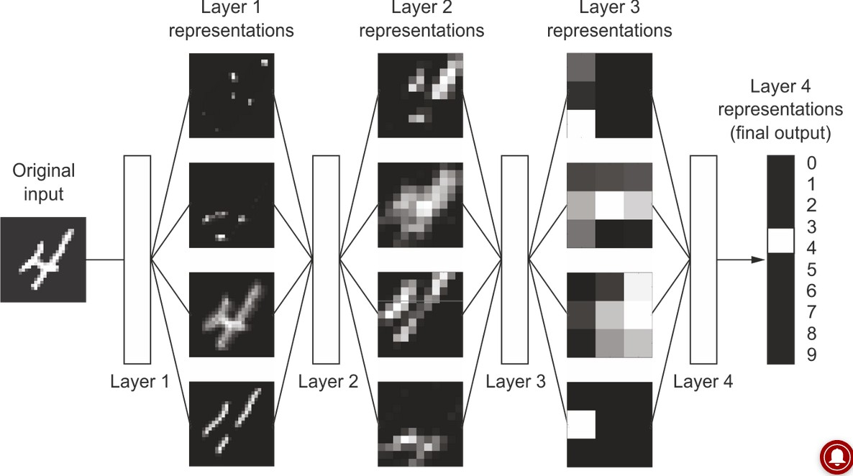
Deep Learning Classifiers
The network transforms the digit image into representations that are increasingly different from the original image and increasingly informative about the final result.
You can think of a deep network as a multistage information-distillation operation, where information goes through successive filters and comes out increasingly purified (that is, useful with regard to some task).

Slide 25
Deep Learning Classifiers
This was just a basic overview of deep learning
We will look into a more specific type of machine learning after lunch

Slide 26
Project Time!
Head back to the website:
https://ku-cs-camp.github.io
Two main projects
Decision tree project
Also act as a review of the processes we learned yesterday
Digit Identifier
Use the MNIST dataset containing pictures of digits to train and predict with a neural network model
If you finish these, work through the Python challenges I have listed

