Slide 1

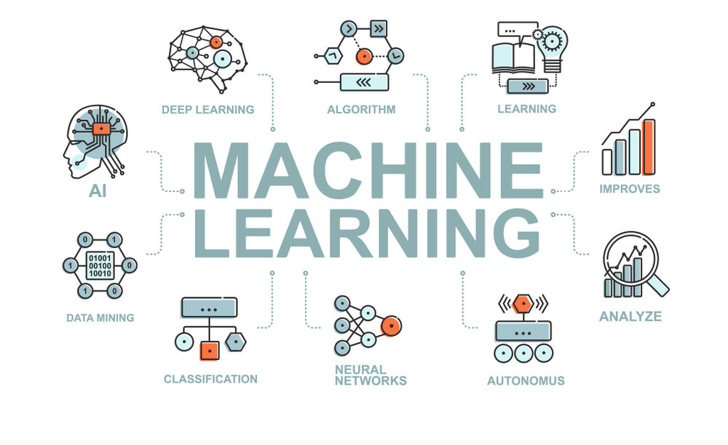
CS Summer Camp
Thursday Session 1

Slide 2
Outline
Unsupervised learning
K-Means clustering
Feature selection

Slide 3
Types of Machine Learning
Recall:
Supervised
The object classes are defined.
For example: trucks vs. cars
Unsupervised
The object classes are not define.
Clustering: Grouping similar instances
For example: customer segmentation in marketing
Reinforcement Learning
Learning a policy: A sequence of outputs
For example: sequence of sounds that make up a word

Slide 4
Types of Machine Learning
Recall:
Supervised
The object classes are defined.
For example: trucks vs. cars
Unsupervised
The object classes are not define.
Clustering: Grouping similar instances
For example: customer segmentation in marketing
Reinforcement Learning
Learning a policy: A sequence of outputs
For example: sequence of sounds that make up a word

Slide 5
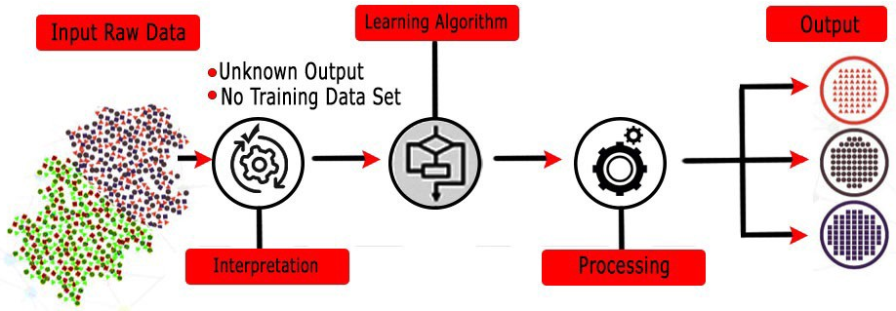
Unsupervised Learning
Now it is time to move on to Unsupervised Learning.
In Supervised Learning, the aim is to learn a mapping from the input to an output whose correct values are provided by pre-existing labeled data.
Unsupervised Learning is a type of machine learning that looks for previously undetected patterns in a data set with no pre-existing labels.
In statistics, this is called density estimation.
The most common unsupervised learning method is cluster analysis.

Slide 6
k-Means Clustering
One of the most widely used Unsupervised Learning models is k-Means Clustering.
k-means clustering, originally from signal processing, partitions n observations (or samples) into k clusters in which each observation belongs to the cluster with the nearest mean (cluster centers or cluster centroid).
I will explain how it works with an example.

Slide 7
k-Means Clustering
In our example, we have 10 samples with 2 features, x and y.
The samples are plotted to the right in feature space.
We do not know which class each point belongs to.

Slide 8
k-Means Clustering
The only input that the k-means clustering algorithm requires is the number of classes, which is defined as k.
For this example, we will assume k = 2.
Later, we will examine methods for determining the appropriate k.
The algorithm works essentially by trying different groupings, or clusters, of the points and finding the one where the points in each group are the closest to each other.
The figure to the right shows a possible grouping of the points in our example.

Slide 9
k-Means Clustering
The algorithm measures “closeness” by summing the average distances for the k clusters.
It then outputs the clustering that produces the smallest “closeness”.
The algorithm could try all possible combinations of clusters, but even for our simple example above that might take too long.
Most k-means clustering problems have hundreds of points, more than two features, and more than two clusters, making the problem impractical to solve by trying all possible combinations.
To get around this problem, implementations start by randomly distributing the centroids of the k-clusters as illustrated by the x’s in the k=2 example to the right.

Slide 10
Finding the Best k
The best k is found by plotting the reconstruction error as a function of k and looking for the “elbow” of the curve.
The “elbow” is easy to see when you look at the plot.
But, not so easy to calculate algorithmically.

Slide 11
k-Means Clustering with Python
Scikit-learn has a k-Means class:
fit(): computes k-means clusters
predict(): predicts the closest cluster each sample belongs to. You could use this after you determined the number of classes to classify other data (Supervised ML).
inertia: gives the Reconstruction Error for the final run.

Slide 12
Dimensionality Reduction
Now we are going to look at Dimensionality Reduction
Up until this point we have used all features as input to our ML models.
Now we are going to look at reducing the number of input features to our ML models.
Why?
Reduces time complexity: Less computation
Reduces space complexity: Fewer parameters
Saves the cost of observing the feature
Improves accuracy
How?
Eliminate redundant features that measure the same phenomenon
Eliminate features that really don’t matter – hair color doesn’t help you determine gender
Eliminate features that cancel other features out

Slide 13
Feature Transformation - PCA
One of the more popular Feature Transformation methods is Principle Component Analysis (PCA).
First, PCA projects x (vector of d input features) to z (also a vector of d input features).
The projection minimizes information loss by maximizing variance.
A high covariance means there is a strong relationship between the features
Then a subset of k features from z is used as the input to the ML model, where k < d.
training
d input
(features of object)
k input
(features of object)
Machine Learning
Model
output
(class of object)
PCA

Slide 14
Unsupervised Learning Project
Intro to k-Means clustering with an Old Faithful project
Use clusters to identify outliers
Customer segmentation using k-Means clustering
We will use a customer’s age, annual income, and spending score to create clusters
PCA will be used for feature selection
These clusters should help us understand some characteristics about these customers

