Slide 1

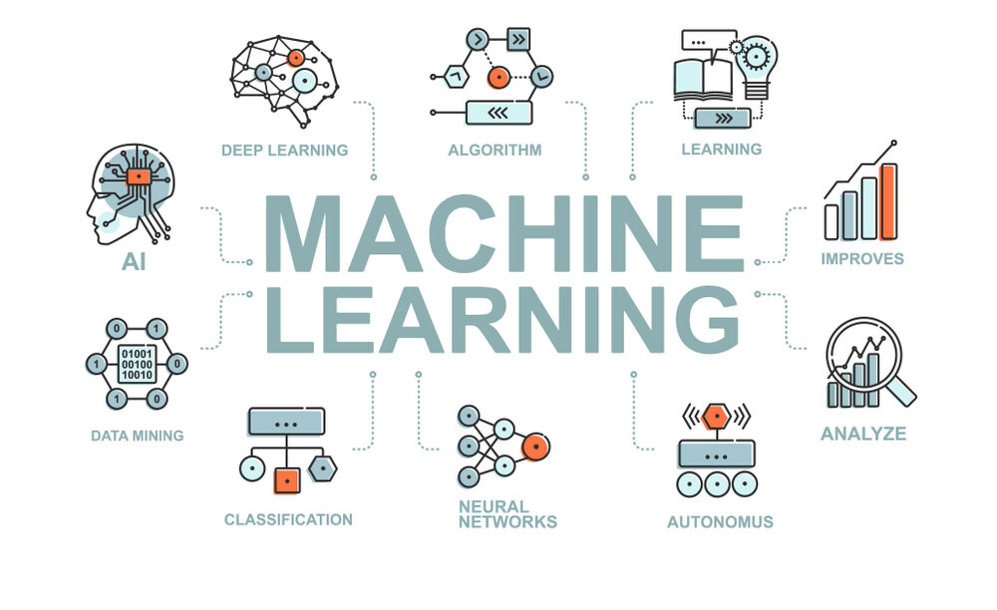
CS Summer Camp
Monday Session 1

Slide 2
Who am I?
My name is Abby Davidow
I am a graduate student here at KU
I also earned my Bachelor’s degree from KU
Currently working on cybersecurity research related to human factors
Worked as a software engineer intern at Cerner for 3 summers

Slide 3
Who are you?
Take some time to introduce yourselves to the others at your table:
Name
Where you are from
If you were a food, what food would you be and why?
Afterwards, I’ll ask that you share your answers with everyone, so we can get to know you!

Slide 4
What Do You Know?
Have any of you written a program before?
Have any of you written code in Python?
Have any of you learned about machine learning?

Slide 5
What are we going to do?
This camp provides an introduction to the basic methods of machine learning and how to apply them to software engineering problems.
Topics covered are:
Supervised machine learning
Unsupervised machine learning
Reinforcement learning
Feature selection techniques
Evaluation metrics
Write approximately 5-7 Python programs throughout the camp.

Slide 6
Schedule
 | Morning (9am-11:30am) | Afternoon (1:30pm-5pm)
Monday | Introduction Python Review | Supervised Learning Evaluation Metrics and Testing Classifiers (Naïve Bayesian, Regression, LDA, QDA, kNN, SVM) Coding Project(s)
Tuesday | Classifiers (Neural Network) Coding Project(s) | Classifiers (Recurrent Neural Network, Deep Learning) Coding Project(s)
Wednesday | Workshops | Workshops
Thursday | Feature Selection (PCA) Unsupervised Models Coding Project(s) | Reinforcement Learning Coding Project(s)
Friday | Presentation Prep | Greet parents and presentations

Slide 7
General Session Setup
Start with lecture
I will try to keep them as short as possible while still providing you with necessary information
Work on projects

Slide 8
General Guidelines
Ask questions at any time. If I use a term you are unfamiliar with, please ask me about it.
Help each other out. Friends that solve errors and bugs together, stay together.
Google is a great resource for syntax and fixing errors. It is likely there is an online resource that has a solution to any error you come across.
Go at your own pace. Some people may have more experience than others, but this is an intro camp so take the time you need. If you finish the prepared project early, please work on another project that interests you! However, I ask that you make sure to keep any extra projects you choose to work on appropriate.

Slide 9
Outline
Introduction
Python Review
Python Exercises

Slide 10
Common Programming Terms
Program
An organized collection of instructions (code), which when executed perform a specific task or function
Algorithm
A set of instructions or rules designed to solve a definite problem
API
Application Programming Interface
A set of pre-made rules, routines, and protocols to build software applications
Notes:
Many ways of sorting arrays, there are many algorithms with different approaches to solving

Slide 11
Basic Programming Steps
Create a new file with .py extension
Open file in Atom
Write your code
Open a Terminal window
Run program
(python file.py)

Slide 12
Terminal
A simple command-line interface for running scripts and other operations
When you open a terminal, it will open up to the command prompt and originate in your home directory
You will mainly need to be able to change directories and run programs
Let’s walk through an example to see how terminal works
Notes:
To create a program, you write code in files using a text editor, but to run them you enter commands into a terminal

Slide 13
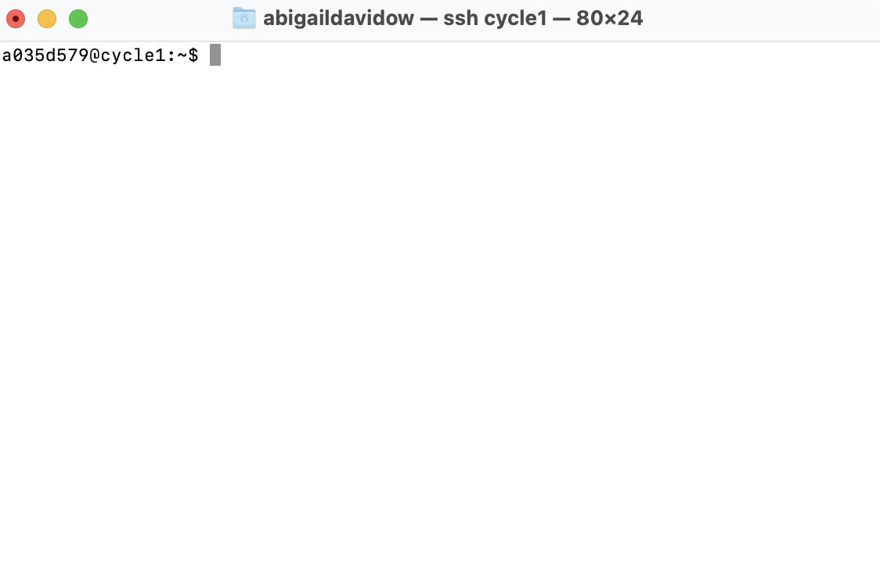
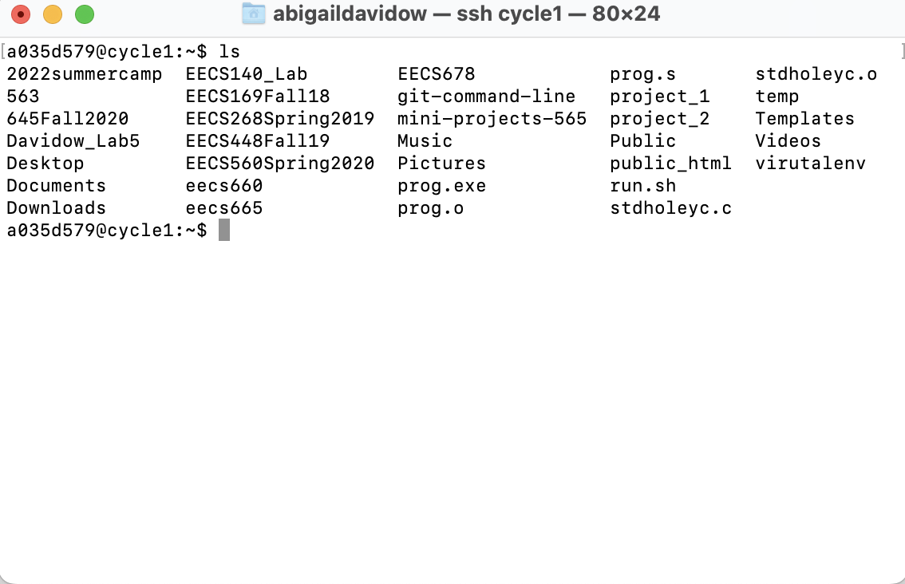
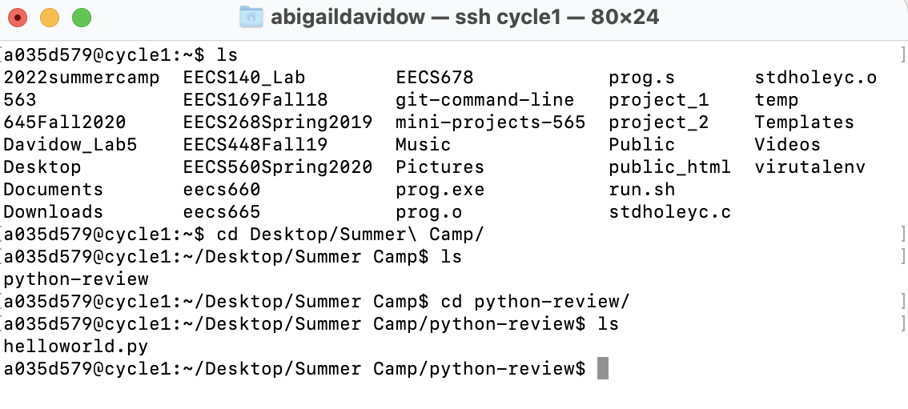
Terminal Walkthrough
1.
2.
3.
ls: List all files and directories
cd: Change directory
4.

Slide 14
Python Review
Very popular programming language
Interpreted language
Can be immediately run rather than compiled before running
Programs are run from the very first line of code.
We will go over a brief review of the most important types and data structures in Python
If you need more in-depth explanations, I can provide you with online resources to look at. Google is your best friend for syntax.

Slide 15
Python Review
Operators
Relational
==
!=
<
<=
>
>=
Logical
And
Or
Not
Math
+
-
*
/
**
Basic Types
Data types are the classification or categorization of data items.
It represents the kind of value that tells what operations can be performed on a particular data.
Integers
1, 55, 450
Floats
0.1243, 12.245
Strings
‘hello’, “world”
Boolean
True or False
List/arrays
[‘list’, ‘of’, ‘strings’], [1 ,2, 3]

Slide 16
Python Review
Variables
A variable is a label that you can assign a value to
The label ‘stores’ a value
Do not have pre-defined types
In other languages like Java:
int num = 1
Define a variable in an assignment statement using an equal sign
var = 2
var2 = ‘hi’
var3 = [1, 4, 5]
var4 = function()
Naming rules
Can only contain letters, numbers, and underscores.
Can’t start with a number
Can’t contain spaces
Can’t be the name of a keyword

Slide 17
Python Review
Print Statement
Produces text output on the terminal
Used a lot to visualize results of programs (you will see this shortly)
print(‘hello everyone’)
Indentation matters!!!!
Defines structure of the code (instead of braces)

Slide 18
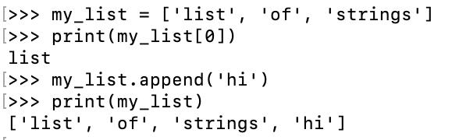
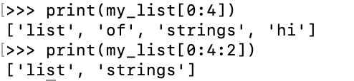
Python Review
Lists/arrays
Store multiple items in a single variable
Each item can be accessed by its index
Indexing starts at 0 (if you have 10 items, the indexes will be 0-9)
Can be strings, ints, etc
Creating, accessing, and adding:
my_list = [‘str1’, ‘str2’, ‘str3’]
my_list[index]
my_list.append(‘newstr’)
Slicing
List[start : stop : step]
Many other capabilities, refer to https://www.w3schools.com/python/python_lists.asp

Slide 19
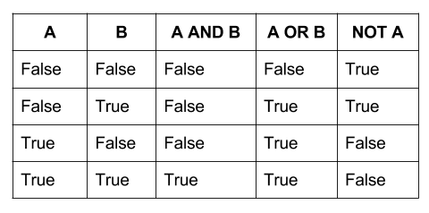
Python Review
Logical Operators
Relational Operators
==
1==1 is True
1==2 is False
!=
1!=1 is False
1!=2 is True
<=, >=, <, >
Conditional Statements
if-else statements
Evaluates condition (relational or logical) and if the condition is met, the following statements are run. If the condition is not met, the else statements are run.
if condition:
statements
else:
else statements
if x >2 :
print(‘greater than 2!’)
else:
print(‘less than 2!’)
if temp > 70:
print(‘It’s hot!’)
elif temp > 50:
print(‘It’s mild!’)
else:
print(‘It’s cold!’)

Slide 20
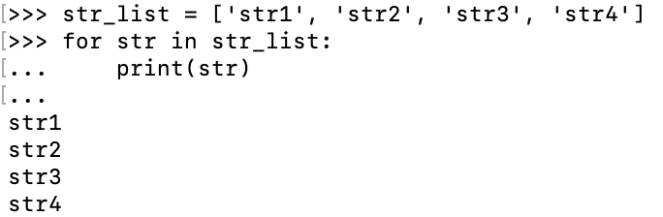
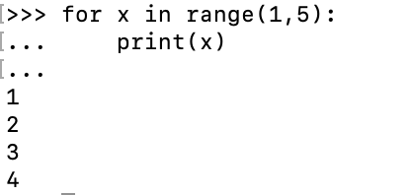
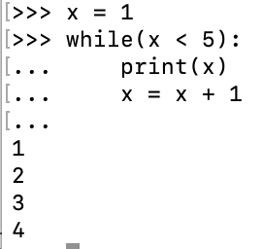
Python Review
Repeating
For loop
Repeats statements over a group of values (range or list)
If you use range(start:end:step), the end value is not included in the loop
for variableName in groupOfValues:
print(variableName)
While loop
Repeats statements while given conditional statement is true
x = 1
while( x < 5):
print(x)
x = x + 1

Slide 21
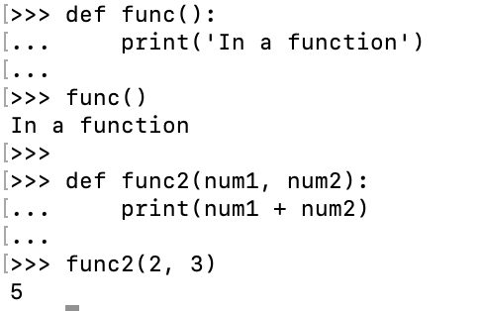
Python Review
Functions
Block of statements that run when called
Can pass in parameters to be used in the function

Slide 22
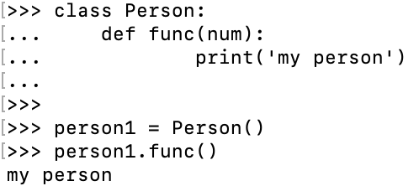
Python Review
Classes/Objects
A class is a blueprint for an object
Contains properties and functions for the object
An object can hold data or call class-defined functions
We will mainly use the syntax for using an object in our projects
To use pre-built modules, you have to initiate them in the same way as this object

Slide 23
Getting Started on the Computers
You each have a unique login, which I will hand out in a minute
If you login and see an error saying ‘Cinnamon crashed’, let me know. There is an easy fix for that.
In order for all programs to run, you must use a virtual environment
This sounds fancy and complicated but all it will require you to do is run a single command every time you open a new terminal window.
The command is:
source 2022summercamp/bin/activate

Slide 24
Common Errors
Some common errors
Spelling: check that you have spelled variable names, function names, etc correctly!
Capitalization: make sure your variable names match exactly including capitalization
Run the VM command: run the command I gave you in the terminal. This could fix version and import issues.

Slide 25
Python Review
Now, it’s time for you all to try your hand at some Python coding with some exercises
I have created a website for this camp where all of the projects and PowerPoints will be located:
https://ku-cs-camp.github.io
There are 4 exercises that I have prepared for you, but if you finish early, try to create some other programs!

