Slide 1

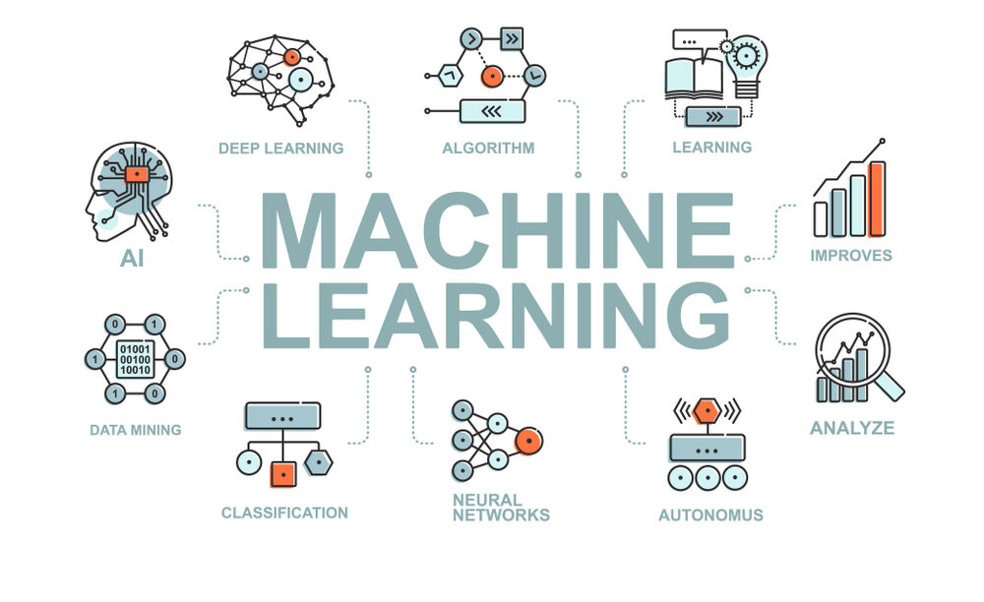
CS Summer Camp
Monday Session 2

Slide 2
Welcome back!
Hopefully, you all now feel like you have some understanding of how to code in Python
It’s ok if you are still not clear on some concepts
You will continue to learn as you work on projects
We will now move on to actual machine learning concepts!

Slide 3

Things I Forgot to Mention
Comments
Text in the file that will not run
In Python, use a single #
# this is a comment
Very helpful
Used to explain what code does for others to read
Can be used for debugging. Comment out a line and run to see if the program works without the line

Slide 4
Outline
Machine Learning
Supervised Machine Learning
Evaluation and Metrics
Classifiers
Naïve Bayesian
Regression
LDA and QDA
kNN
SVM

Slide 5
What is Machine Learning?
Artificial intelligence (AI) is a branch of computer science that aims to create computer software that emulates human intelligence.
John McCarthy, who coined the term in 1955, defines it as "the science and engineering of making intelligent machines."
AI software emulates many aspects of human intelligence, such as reasoning, knowledge, planning, learning, communication, perception, and the ability to move and manipulate objects.
There are a number of tools that AI uses to emulate these areas of human intelligence.
We will look at a set of these tools loosely called “machine learning.”
5

Slide 6
What is Machine Learning?
Early in the development of AI, “machine learning” was called pattern recognition.
The Machine Learning model (e.g., SVM, neural network, deep learning) predicts the class of an object based on features of the object.
The Machine Learning model is “trained” with examples of the objects to recognize the class of the object by the pattern of its features, in much the same way humans learn to classify things.
For example:
A 3-year old can recognize the difference between a truck and a car by its features.
Younger children learn to understand language by recognizing the different sounds of words.
training
Machine Learning Model
input (features of object)
output (class of object)
6

Slide 7
Types of Machine Learning
Supervised
The object classes are defined
Labeled training data
For example: identifying trucks vs. cars
Unsupervised
The object classes are not defined
Learns patterns from unlabeled data
Clustering: Grouping similar instances
For example: customer segmentation in marketing
Reinforcement Learning
Learning a policy: rewarding desired behaviors, trial and error
For example: teaching AI to play a game
7

Slide 8
Machine Learning Projects
A machine learning project may not be linear, but it has a number of well known steps:
Define the problem.
Acquire a data set (sometimes called a corpus) that represents what your application will encounter in the real world.
Evaluate several combinations of input features and Machine Learning models and select the best combination for your application.
Fine tune the selected model to get the best results.
Train the final model with the corpus and put the application into production.
We will spend most of this camp on the red highlighted steps.
training
Machine Learning
Model
input (features of object)
output (class of object)

Slide 9
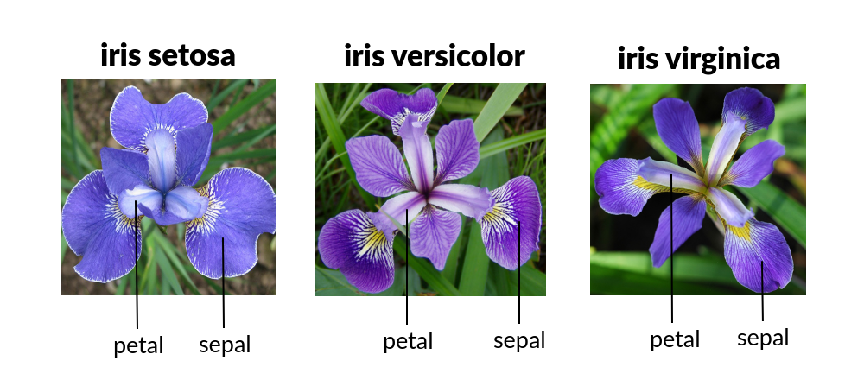
Supervised Machine Learning
The object classes are defined.
Binary Classification:
Trucks vs. cars
The word “Alexa” vs. “Siri”
We will use a database of Iris flowers as an example and in our first project
Multiple Classes (e.g., species of Iris):
Iris Setosa
Iris Versicolour
Iris Virginica

Slide 10
Supervised Machine Learning
The focus of a supervised machine learning software engineering problem is always a data set (sometimes called a corpus) with:
n (e.g., 150 for the iris data set) samples of the data where the class of each sample is known, e.g.:
Iris Setosa
Iris Versicolour
Iris Virginica
m (e.g., 4 for the iris data set) features for each of the samples, e.g.:
Length of sepal
Length of petal
Width of sepal
Length of petal
training
Machine Learning Model
input (features of object)
output (class of object)

Slide 11
Evaluation and Metrics
Before we start exploring classifiers, we have to go over how to evaluate models and determine how well they performed.
It’s important to have a plan for testing prior to building a model and training it.

Slide 12
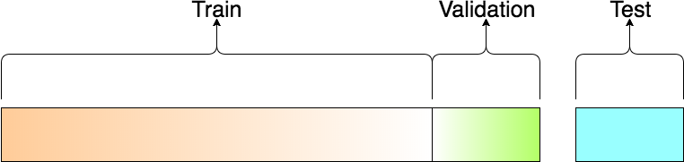
Training, Test, & Validation Data
In Supervised Learning, the sample data set is divided into 3 subsets:
Training Data
Test Data
Validation Data

Slide 13
Training Data
Training Data:
The set of data used to fit the model.
The actual dataset that we use to train the model
The model sees and learns from this data.

Slide 14
Test Data
Test Data:
The set of data used to provide an unbiased evaluation of a final model fit on the training dataset.
The Test dataset provides the gold standard used to evaluate the model.
It is only used once a model is completely trained.
The test set is generally what is used to evaluate competing models.

Slide 15
Validation Data
Some Machine Learning software uses a portion of the Training Data as Validation Data to fine tune internal parameters of the model during the training process.
The ML software may do this internally or it may require the programmer to specify the Validation Data.

Slide 16
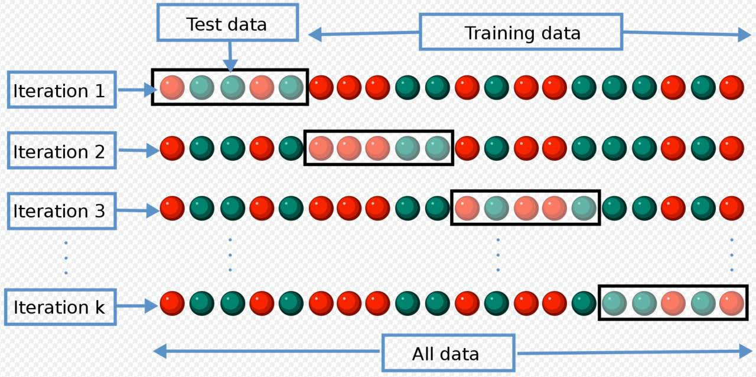
Cross-Validation
Cross-validation is a ML model validation technique for assessing how the results of a ML model will generalize to an independent data set.
Cross-validation involves:
partitioning a sample of data into subsets: Training and Test Data
training the model on one subset (called the Training Data), and validating the model on the other subset (called the Test Data)
To reduce variability, multiple iterations of cross-validation are performed using different partitions, and the validation results are combined (e.g. averaged) over the iterations to give an estimate of the model's predictive performance.

Slide 17
k-Fold Cross-Validation
Divide the data into k subsets
Test Data = 1 subset
Training (and Validation Data) = k-1 subsets
For example, let k = 10 & n = 100:
Test Data = 1 subset = 100/10 = 10 samples
Training Data = k-1 subsets = (10-1)·(10 samples) = 90 samples
You will see 10-fold cross-validation given as a typical value for k in lots of references

Slide 18
Evaluation Metrics
Why are metrics important?
Useful to quantify the “gap” between:
Desired performance and baseline (estimate effort initially).
Desired performance and current performance.
Measure progress over time.
Determining the best set of input features to use
Comparing different ML models for suitability to the software engineering problem at hand
Ideally the training objective should be the metric, but not always possible.

Slide 19



Test Results
The evaluation metrics are applied to the test results.
The test results are a list of ordered pairs of all the samples in the corpus, where the pair shows:
actual class of the object
class of the object predicted by the ML model
For example: Sample 1 = (Cat,Dog)
The test results are created by concatenating the results from each fold of a k-fold cross-validation experiment.
For example, k = 3
Sample | Actual Class | Predicted Class
1 | Cat | Dog
2 | Dog | Dog
3 | Fox | Fox
4 | Cat | Cat
5 | Dog | Dog
6 | Cat | Dog
7 | Dog | Dog
8 | Cat | Fox
9 | Cat | Cat
10 | Dog | Dog
11 | Cat | Dog
12 | Dog | Dog
13 | Fox | Fox
14 | Cat | Cat
15 | Dog | Cat
Sample | Actual Class | Predicted Class
1 | Cat | Dog
2 | Dog | Dog
3 | Fox | Fox
4 | Cat | Cat
5 | Dog | Dog
Sample | Actual Class | Predicted Class
6 | Cat | Dog
7 | Dog | Dog
8 | Cat | Fox
9 | Cat | Cat
10 | Dog | Dog
Sample | Actual Class | Predicted Class
11 | Cat | Dog
12 | Dog | Dog
13 | Fox | Fox
14 | Cat | Cat
15 | Dog | Cat

Slide 20
Confusion Matrix
The confusion matrix is the basis for the most widely used ML evaluation metrics.
The best way to explain a confusion matrix is with an example.

Slide 21
Confusion Matrix
Binary Classification: 1 of 2 classes
Classically (from medical diagnostic tests):
Results of test are POSITIVE
Results of test are NEGATIVE
Values from a diagnostic test (e.g., white blood cell count, level of a hormone in a sample of blood)
training
1. POSITIVE
2. NEGATIVE
Machine Learning Model
input (features of object)
output (class of object)

Slide 22
Confusion Matrix
True Positive (TP) = 9 True Negative (TN) = 8 False Positive (FP) = 2 False Negative (FN) = 1 Accuracy (ACC) =
(TP+TN)/(TP+TN+FP+FN) = (9+8)/(9+8+2+1)= 17/20 = 0.85
Precision (P) = TP/(TP+FP) = 9/(9+2) = 0.81
Recall (R) = TP/(TP+FN) = 9/(9+1) = 0.90
 | Actual POSITVE | Actual NEGATIVE
Predicted POSITIVE | 9 | 2
Predicted NEGATIVE | 1 | 8
 | Actual POSITVE | Actual NEGATIVE
Predicted POSITIVE | True-Positive (TP) | False-Positive (FP)
Predicted NEGATIVE | False-Negative (FN) | True-Negative (TN)
Notes:
Accuracy - how many were predicted correct out of all results
Precision – how many were actually positive out of those predicted positive
Recall – predicted positive out of how many total real positives that there should have been

Slide 23
Now On To Classifiers
Some terminology
Classifier is the algorithm we will be discussing
A model is the finished product of the classifier’s machine learning
Training/fitting is where the model learns. The terms are used interchangeably
Overfitting is a modeling error where a model is too closely aligned to a limited set of data points
A warning
This will be a lot of information
You do not need to remember all of this
I just want to give you an idea of what these classifiers are doing and where they come from

Slide 24
Naïve Bayesian Classifier
The Naïve Bayesian Classifier is the simplest ML classifier.
It is used as the “gold standard” for comparing ML models.
If you develop a new ML model that cannot perform as well (or poorly) as the Naïve Bayesian Classifier, then you better go back to the drawing board.
The Naïve Bayesian Classifier is based on some fundamental concepts of discrete probability.

Slide 25
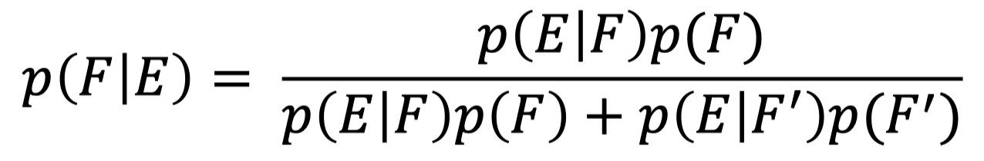
Bayes’ Theorem
There are many times when we want to assess the probability that a particular event occurs on the basis of partial evidence:
The probability that a person has a disease given that this person tests positive for a diagnostic test for the disease.
The probability that an incoming e-mail message is spam using the occurrence of words in the message.
The result that we can use to answer questions such as these is called Bayes’ theorem which dates back to the eighteenth century.
Bayes’ Theorem:
If:
E and F are events from a sample space S
– p(E) ≠ 0 and p(F) ≠ 0.
Then:

Slide 26
Naïve Bayesian Classifier
To “train” a Naïve Bayesian Classifier all you essentially need to do is:
Calculate one probability (P) for each class
Calculate n*m conditional probabilities (p), where:
n = number of classes (e.g. n=2 for positive/negative)
m = number of features (e.g. m=3 coughing, sneezing, fever)

Slide 27
ML Model Comparison
Naïve Bayes
Strengths:
Simple to train
Weaknesses:
Called Naïve because it assumes a Gaussian distribution, which is not always true in the real world.
Assumes features are independent, which is rarely true in the real world.
Based on probability theory, which is okay, except real- world probability distributions are much more complex than typical probability distributions (e.g., Gaussian).

Slide 28
Regression
We will look how we can use regression which comes from statistics to create a Machine Learning model.
We will look at the simplest form of regression:
Linear Regression

Slide 29
Linear Regression
Linear regression was developed in the field of statistics and is studied as a model for understanding the relationship between input and output numerical variables.
It has been borrowed by machine learning.

Slide 30
Linear Regression Model Representation
Linear regression is an attractive model because the representation is so simple.
The representation is a linear equation that combines a specific set of input values (x₁, x₂, …, x_{n}) to the solution which is the predicted output for that set of input values (y).
The linear equation assigns one scale factor to each input value or column, called a coefficient and represented by the capital Greek letter Beta (B).
One additional coefficient is also added, giving the line an additional degree of freedom (e.g. moving up and down on a two-dimensional plot) and is often called the intercept or the bias coefficient:
– y = B₀ + B₁x₁ + B₂x₂ + … + B_{n}x_{n}

Slide 31
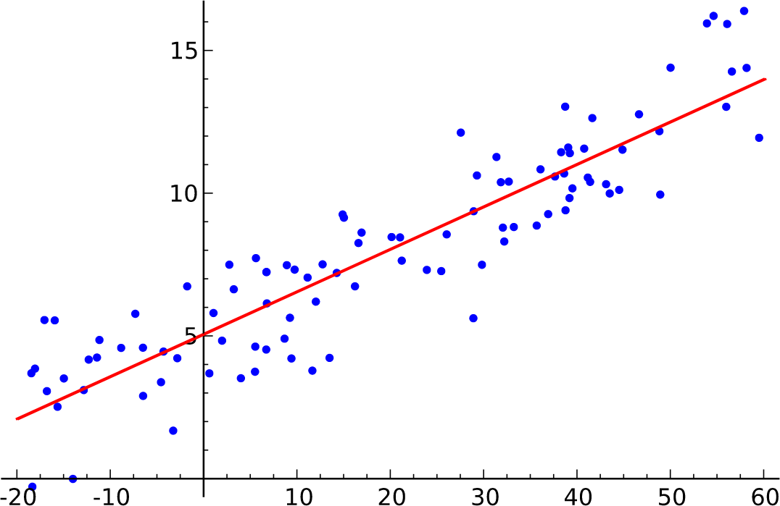
Linear Regression ML Model
Training a linear regression ML model means estimating the values of the coefficients (B₀, B₁, B₂, …, B_{n}) with the training data.
The figure to the right illustrates how “regression” fits the training data (blue dots) to the red line.
y = B₀ + B₁x
training
B₀, B₁, B₂, …, B_{n}
x₁, x₂, …, x_{n}
input (features of object)
y
output (class of object)
Machine Learning Model

Slide 32
Making Predictions with Linear Regression
Given the representation is a linear equation, making predictions is as simple as solving the equation for a specific set of inputs.
Let’s make this concrete with an example.
Imagine we are predicting weight (y) from height (x).
Our linear regression model representation for this problem would be:
y = B₀ + B₁x₁
or
weight = B₀ +B₁·height
Where:
B₀ = bias coefficient
B₁ = coefficient for the height
We use one of the regression methods to find a good set of coefficient values.

Slide 33
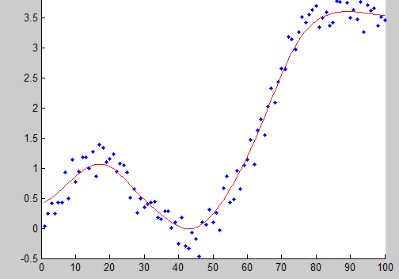
Polynomial Regression
Linear regression assumes that the relationship between the input and output is linear.
What if it is not?
Sometimes you can transform the data to make the relationship linear (e.g. log transform for an exponential relationship).
If that doesn’t work, you can use polynomial regression to fit the data to a curve.

Slide 34
Logistic Regression
We will be testing logistic regression in our project
Logistic regression predicts categorical variables compared to linear regression that predicts continuous variables
Our project will involve a fixed number of categories to predict, therefore logistic regression is better suited for the problem

Slide 35
Discriminant Analysis Classifiers
Linear Discriminant Analysis (LDA) and Quadratic Discriminant Analysis (QDA) are two classic classifiers, with, as their names suggest, a linear and a quadratic decision surface, respectively.
These classifiers are attractive because they have closed-form solutions (uses a finite number of standard operations) that can be easily computed, are inherently multiclass, have proven to work well in practice, and have no hyperparameters (a parameter whose value is used to control the learning process) to tune.

Slide 36
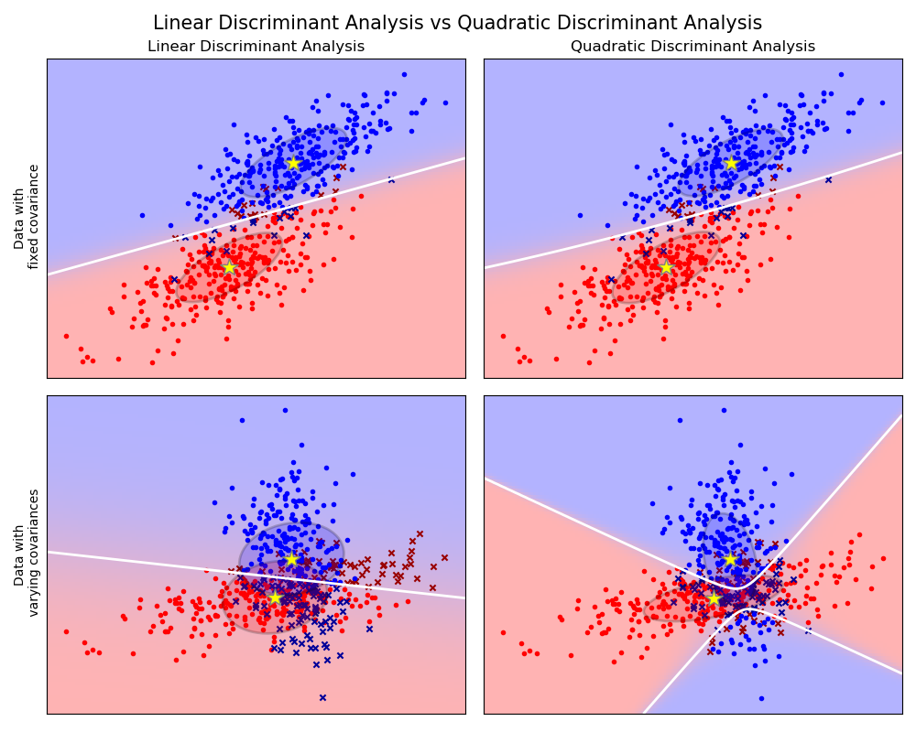
Discriminant Analysis Classifiers
The plot shows decision boundaries for Linear Discriminant Analysis and Quadratic Discriminant Analysis.
The bottom row demonstrates that Linear Discriminant Analysis can only learn linear boundaries, while Quadratic Discriminant Analysis can learn quadratic boundaries and is therefore more flexible.

Slide 37
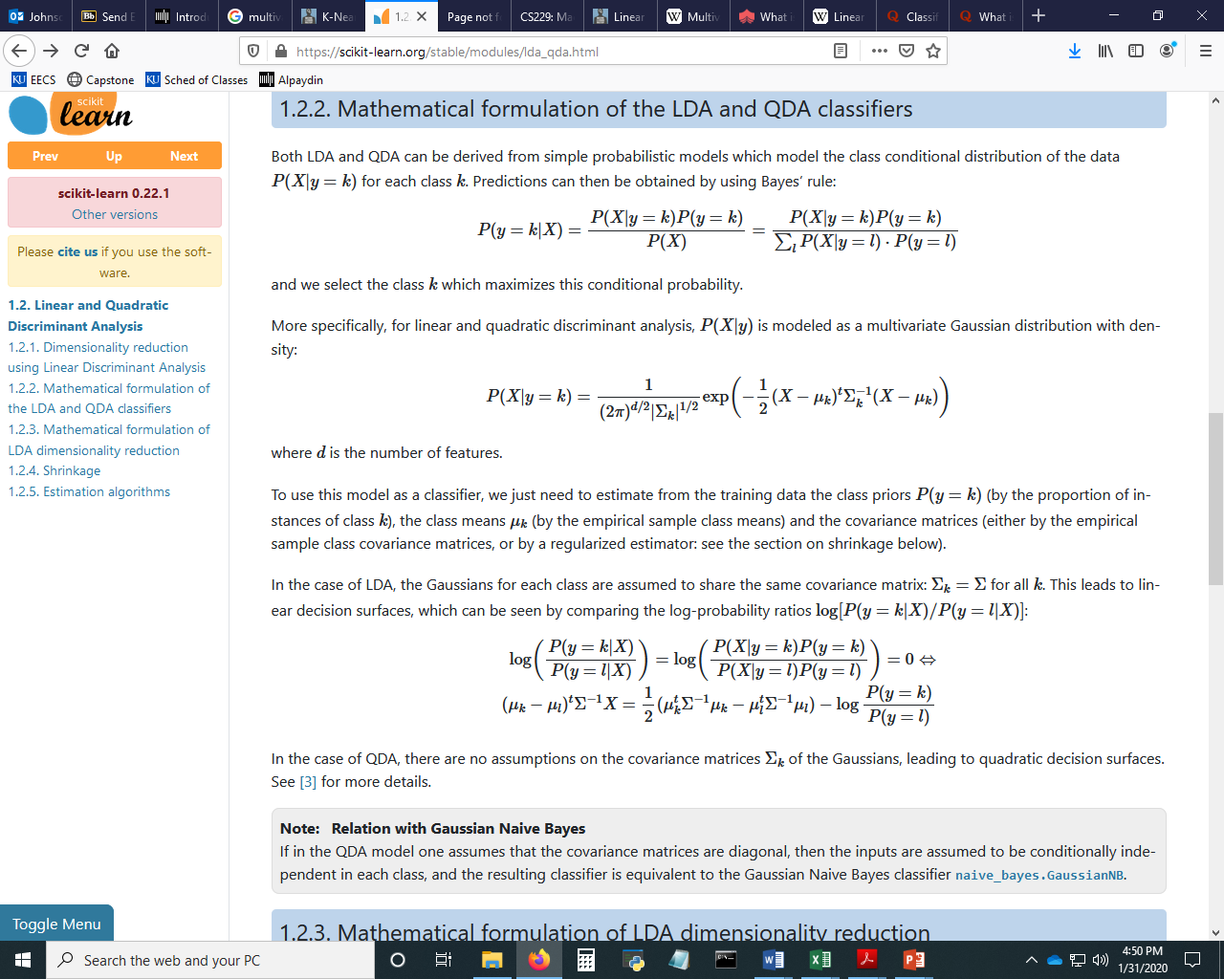
LDA and QDA Classifiers
Both LDA and QDA can be derived from simple probabilistic models which model the class conditional distribution of the data P(X|y=k) for each class k.
Predictions can then be obtained by using Bayes’ rule:
and we select the k class which maximizes this conditional probability.
More specifically, for linear and quadratic discriminant analysis, P(X|y) is modeled as a multivariate Gaussian distribution with density:
where d is the number of features

Slide 38
ML Model Comparison
Linear Discriminant Analysis (LDA)
Strengths:
Closed-form solution that can be easily computed
Inherently multiclass
Proven to work well in practice
No hyperparameters to tune
Use covariance to take into account interdependence of features
Weaknesses:
Assumes the data is Gaussian, i.e., each variable is shaped like a bell curve when plotted.
Assumes each feature has the same variance, i.e., values of each feature vary around the mean by the same amount on average.
Can only learn linear boundaries.

Slide 39
ML Model Comparison
Quadratic Discriminant Analysis (QDA)
Strengths:
Same as LDA plus more
Can learn quadratic boundaries and is therefore more flexible.
Does not assume each feature has the same variance, i.e., all features can be interdependent to varying degrees
Weaknesses:
Assumes the data is Gaussian, i.e., each variable is shaped like a bell curve when plotted.

Slide 40
k-Nearest Neighbors (kNN) Classifier
The model representation for kNN is the entire training dataset.
It is as simple as that.
kNN has no model other than storing the entire dataset, so there is no learning required.
Efficient implementations can store the data using complex data structures
Because the entire training dataset is stored, it is easy to update the model by:
Adding new training data
Removing erroneous data
Removing outlier data
A drawback of the kNN classifier is the storing of the large amount of training data.

Slide 41
k-Nearest Neighbors (kNN) Classifier
kNN makes predictions using the training dataset directly.
Predictions are made for a test sample (x) by searching through the entire training set for the k most similar instances (the neighbors).
The class of the test sample is determined by the most common (or mode) class value.
To determine which of the k instances in the training dataset are most similar to a to the test sample a distance measure is used.
The most popular distance measure is Euclidean distance.
Euclidean distance is calculated:
EuclideanDistance(x_{test}, x_{train,i}) = sqrt( sum( (x_{test,j} – x_{train,i,j})² ) )
where:
x_{test} = test sample vector of j features
x_{train,i} = i-th training sample vector of j features x_{test,j} = value of test sample feature j
x_{train,i,j} = value of i-th training sample feature j

Slide 42
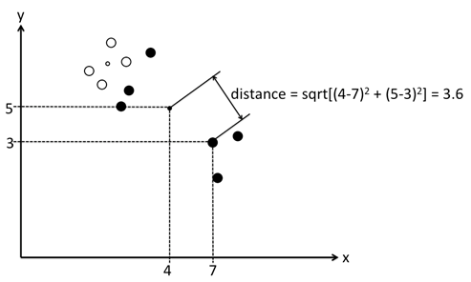
k-Nearest Neighbors (kNN) Classifier
Example (Euclidean Distance calculation, 2 features):
Features x and y represented as the ordered pair: (x,y)
•
x_{test} (little black dot) = (4,5)
EuclideanDistance(x_{test}, x_{train,i}) = sqrt( sum( (x_{test,j} – x_{train,i,j})² ) )
^{x}train,i
(big black dot) = (7,3)

Slide 43
k-Nearest Neighbors (kNN) Classifier
Example (Classification, k = 4):
Training Sample (i) | Class | Euclidean Distance from Test Sample | Rank by shortest Distance
1 | Cat | 3.93 | 2
2 | Dog | 12.51 | 6
3 | Cat | 7.46 | 3
4 | Chicken | 19.00 | 10
5 | Chicken | 15.67 | 8
6 | Cat | 0.91 | 1
7 | Chicken | 18.52 | 9
8 | Dog | 12.70 | 7
9 | Dog | 12.35 | 5
10 | Dog | 11.19 | 4
3 of the 4 (k) closest training samples are Cat, so test sample is classified as Cat

Slide 44
k-Nearest Neighbors (kNN) Classifier
The value for k can be found by algorithm tuning.
It is a good idea to try many different values for k (e.g., values from 1 to 21) and see what works best for your problem.

Slide 45
ML Model Comparison
kNN
Strengths:
Simple – the model is the training data.
Easy to update
It makes no assumptions about the distribution or independence of the data.
Weaknesses:
Memory-intensive
Performs poorly for high-dimensional data (i.e., many features)
Require a meaningful distance function to calculate similarity.

Slide 46
Support Vector Machines (SVM)
One of the easier machine learning classifiers to understand is the Support Vector Machine (SVM).
The SVM can be explained best with an example.
As an example, consider anticancer drug design.
One method of anticancer drug design is to create compounds and then test how well they kill cancer cells in laboratory petri dishes.
Thousands of compounds may be created and tested before one is found that kills cancer cells.
Clearly, the process of creating the compound and then testing it is a lengthy one.
Machine learning has been applied to speed this process up by identifying the compounds that are more likely to kill cancer cells.
Those compounds are then created and tested.

Slide 47
Support Vector Machines (SVM)
How is this done?
Before a compound is created the chemical attributes of it can be determined (e.g., is it an acid or a base?).
What the attributes are, do not really matter.
The idea is to find those compounds that have attributes similar to those of compounds known to kill cancer.
Thus, the features that are the input to the machine learning classifier are the attributes of the compounds, and the machine learning classifier predicts whether the compound will kill cancer cells or not.
training
chemical attributes of compound
kills cancer or does not kill cancer
output (class of object)
(e.g., is it an acid or a base?)
Machine Learning Model
input (features of object)

Slide 48
Support Vector Machines (SVM)
Assume each of the compounds we are going to classify has only two features: x and y.
We know the values of x and y for our training set, which contains both cancer killing compounds and ones that do not kill cancer.
First, we will plot the compounds using the two features x and y.
Black dots represent compounds that are known not to kill cancer.
White dots are known to kill cancer.
Clearly, the cancer killing compounds are clustered away from those that do not kill cancer.
y
Not cancer killing
Cancer killing
x

Slide 49

Support Vector Machines (SVM)
A SVM works by drawing a line between the two clusters and then using that line to predict if an unknown compound will kill cancer or not.
To predict an unknown compound’s cancer killing capability, we plot the features, x and y, of the unknown compound.
If the point from an unknown sample falls on the cancer killing side of the line, then we predict the unknown compound will kill cancer.
Otherwise, we predict it will not.
y
Not cancer killing
Cancer killing
x

Slide 50
ML Model Comparison
SVM
Strengths:
Non-probabilistic, i.e., no assumption of Gaussian distribution or independence of input features
Still effective in cases where number of features is greater than the number of samples.
Uses a subset of training points in the decision function (called support vectors), so it is also memory efficient.
Versatile: different Kernel functions can be specified for the decision function.
Weaknesses:
Over-fitting can occur, if the number of features is much greater than the number of samples.
Selection of the kernel function is critical in determining the “dividing line” between classes.

Slide 51
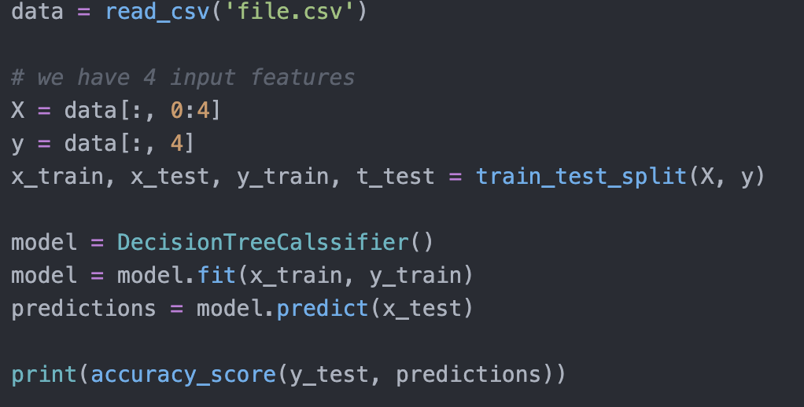
Basic ML Problem
This is an example, so your project solutions may look slightly different.

Slide 52
Project Time
There are times I give you exact code and some that you will need to change the parameters for in order to work
Watch out for formatted ‘quotes’
I also include a ‘Check your Code’ option when I ask you to try something yourself
This way if you encounter errors, you can check against my code (but please try first!)
Projects
Movie box office predictor
Iris model comparison
Text sentiment identifier
More Python exercises

Slide 53
Sources
This exercise was adapted from https://machinelearningmastery.com/machine-learning-in-python-step-by-step/
Slides were adapted from Dr. David Johnson’s EECS 690 course materials

