Slide 1

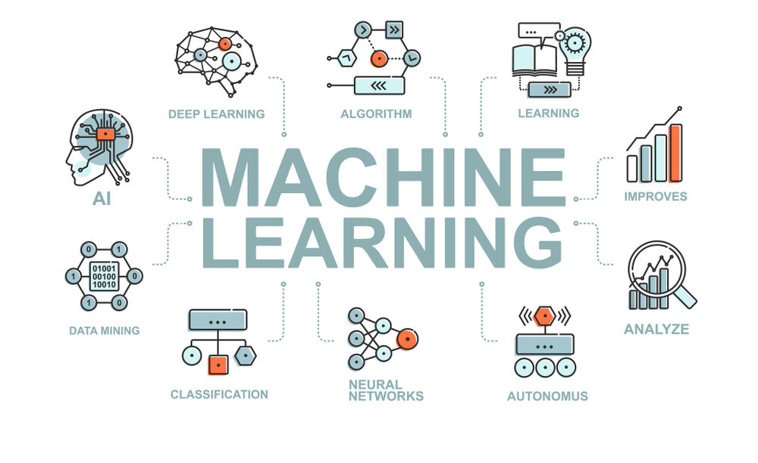
CS Summer Camp
Tuesday Session 2

Slide 2
Welcome Back!
We are going to continue with neural networks and learn a specific type called recurrent neural networks

Slide 3
Sequence Classification
Up to now, our classifiers have identified single events:
Variety of an Iris flower
Picture of a cat, dog, or fox
Handwritten letter recognition
There is another category of supervised classifiers that recognize a sequence of events in time or space:
Speech recognition – sequence of sounds that make up a word
Natural language processing – part-of-speech tagging (e.g., nouns, verbs, adjectives)
Text processing – synthetic text generation
Handwriting recognition – pen movements
DNA sequencing – base pairs
We will look at a classifier that is commonly used in sequence classification:
Recurrent Neural Networks (RNN)

Slide 4
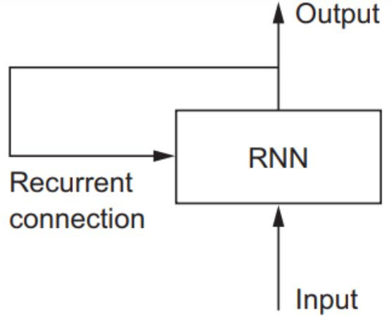
Recurrent Neural Network (RNN)
A recurrent neural network (RNN) classifies a sequence of events in time or space:
– For example: daily stock prices, sentences, or sensor measurements
A RNN processes one element at a time while retaining a memory (called a cell state) of what has come previously in the sequence.
Recurrent means the output at the current time step becomes the input to the next time step.
At each element of the sequence, the model considers not just the current input, but what it remembers about the preceding elements.

Slide 5
Recurrent Neural Network (RNN)
This memory allows the network to learn long-term dependencies in a sequence.
We will use LSTM layers which learn long-term dependencies between time steps
It takes the entire context into account when making a prediction, whether that be the next word in a sentence, a sentiment classification, or the next temperature measurement.
A RNN is designed to mimic the human way of processing sequences: we consider the entire sentence when forming a response instead of words by themselves.

Slide 6
Recurrent Neural Network (RNN)
For example, consider the following sentence:
– “The concert was boring for the first 15 minutes while the band warmed up but then was terribly exciting.”
A machine learning model that considers the words in isolation would probably conclude this sentence is negative.
An RNN by contrast should be able to see the words “but” and “terribly exciting” and realize that the sentence turns from negative to positive because it has looked at the entire sequence.

Slide 7
RNN Layers
A RNN is built of several layers in addition to the ones that “remember” output and input from previous time periods (e.g., LSTM).
Keras has a number of layers to build a RNN from.
https://keras.io/layers

Slide 8
Other RNN Layers
Core Layers:
Dense: Just your regular densely-connected NN layer.
Activation: Applies an activation function to an output.
SoftMax
ReLU
Tanh
Sigmoid
Etc.

Slide 9
Other RNN Layers
Core Layers (continued):
Output post-processing layers: Applies various functions to output.
Reshape
Input pre-processing layers: Applies various functions to input.
Dropout - Randomly setting a fraction of input units to 0 at each update during training time, which helps prevent overfitting.
Permute - Permutes the dimensions of the input according to a given pattern.
RepeatVector – repeats input vector
Lambda – applies any arbitrary function to input, e.g., x²
Masking - Masks a sequence by using a mask value to skip timesteps.
Regularization - applies an update to the cost function based input activity.

Slide 10
Other RNN Layers
Recurrent Layers:
SimpleRNN: Fully-connected RNN where the output is fed back to the input.
Gate Recurrent Unit (GRU): similar to LSTM, except it has fewer parameters than LSTM, as it lacks an output gate.
LSTM
ConvLSTM2D: Convolutional LSTM. It is similar to an LSTM layer, but the input transformations and recurrent transformations are both convolutional.
They also have cell versions of each of these.
And versions that run on the GPU.

Slide 11
Other RNN Layers
Embedding Layers:
Embedding:
Turns positive integers (indexes) into dense vectors of fixed size.
For example: [[4], [20]] -> [[0.25, 0.1], [0.6, -0.2]]
This layer can only be used as the first layer in a model.
Only one of these so far.

Slide 12
Other RNN Layers
Merge Layers:
Add: Layer that adds a list of inputs.
Subtract: Layer that subtracts two inputs.
Multiply: Layer that multiplies (element-wise) a list of inputs.
Average: Layer that averages a list of inputs.
Maximum: Layer that computes the maximum (element-wise) of a list of inputs.
Minimum: Layer that computes the minimum (element-wise) of a list of inputs.
Concatenate: Layer that concatenates a list of inputs.
Dot: Layer that computes a dot product between samples in two tensors.

Slide 13
Other RNN Layers
Normalization Layers:
BatchNormalization: Normalize the activations of the previous layer at each batch, i.e. applies a transformation that maintains the mean activation close to 0 and the activation standard deviation close to 1.
Only one of these so far.

Slide 14
Other RNN Layers
Noise Layers:
Regularization layer active at training time.
GaussianNoise:
Apply additive zero-centered Gaussian noise.
This is useful to mitigate overfitting (you could see it as a form of random data augmentation).
Gaussian Noise (GS) is a natural choice as corruption process for real valued inputs.
GaussianDropout:
Apply multiplicative 1-centered Gaussian noise.
AlphaDropout:
Applies Alpha Dropout to the input.
Alpha Dropout is a Dropout that keeps mean and variance of inputs to their original values, in order to ensure the self-normalizing property even after this dropout.
Alpha Dropout fits well to Scaled Exponential Linear Units by randomly setting activations to the negative saturation value.

Slide 15
Project Time!
There is one project covering RNN where you create a stock predictor for Tesla stocks
A bonus project is posted if you want to try an extra neural network project. It is an online tutorial.
I have also posted more Python programs for you to create once you have finished the machine learning project(s)
We will also take a break and do an activity at 3 PM

