Slide 1
Lab 11
Anahita Memar

Slide 2
SI Survey
Please check the class wiki after lecture for a link to the SI Survey
Even if you did not attend the SI session or office hour we still need your feedback

Slide 3
Reminder
Do not use any unauthorized aid, such sites like rentacoder or chegg or chatgpt to obtain answers
We have processed over double-digit casesthe past few semesters. Most cases leading back to chegg but now chatgpt is taking over.
If you need help, seek it from:
Me, Dr. Gibbons
Your lab TA.
ACM Tutoring. The schedule it on the home page
SI Leader sessions. The schedule is on the home page
Any GTA's office hour. The schedule is on the home page

Slide 4
Topics
Designing and using classes
Operator overloading
Lists of Objects
File I/O

Slide 5
Operator Overloading in Python
To make a new type, such as a class you make from scratch, compatible with standard operators (e.g. <, ==, +, *, etc.) or even standard operations (like printing or checking the length) all you have to do is find the right "magic method" to define in your class.
There is a list of methods that, if you add a definition to your class, you will make your class compatible with that specific operator. There are a LOT of these methods that you can choose, but we'll focus on the following:

Slide 6
Operator Overloading
When a developer makes a class there are several methods that can be defined to overload an operator.
Magic Methods
  These are methods that allow us to overwrite symbols in python
  Every operator has a method that can be defined as something else
  Lets look at some Examples

Slide 7
Magic Methods
Operators/Operation | Method | Notes
== | __eq__(self, other) | Should return bool
!= | __ne__(self, other) | Should return bool
< | __lt__(self, other) | Should return bool (also defining this makes a list useable with the built-in sort(iterable) method)
str() | __str__(self) | Should return a readable string with Class data. Makes your type compatible with print() function
Being printed while in a container | __repr(self) | Should return a string that could be used to recreate the object. This would be called if your object is in a container, such as a list

Slide 8
__str__ VS __repr__
These methods are very similar sounding at first, but convention has them serve two different roles. Let's look at this example class:
__str__
  This is for reading
  should create a readable representation of the object
  print(obj) should return something that is nice for the user
__repr__
should, when possible show the viewer how to recreate the object
  This is for an object dump
  All information to recreate the object should be included in __repr__

Slide 9
In Python, __str__ and __repr__ are two special methods that can be defined in a class to provide string representations of objects.
__str__ is used to define a readable string representation of an object, which is typically used for display purposes. It should return a string that describes the object in a human-readable format.
__repr__, on the other hand, is used to define an unambiguous string representation of an object, which can be used to recreate the object. It should return a string that, when executed, would create an identical object.

Slide 10
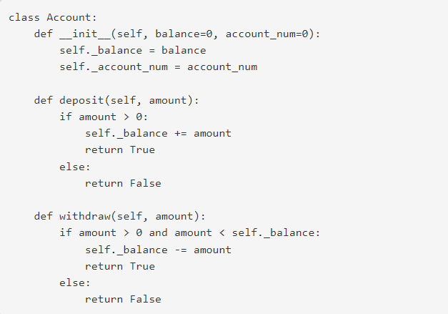
__str__ VS __repr__

Slide 11
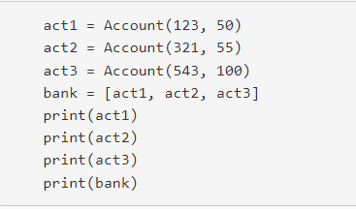
Now let's say we make a few accounts and try printing them in different ways:

Slide 12
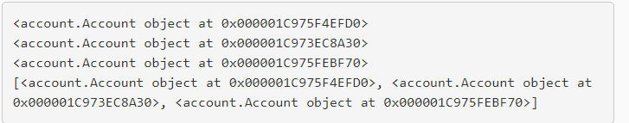
Without __str__ or __repr__ present then we'll see output, but it won't be very useful. You'll see something like

Slide 13
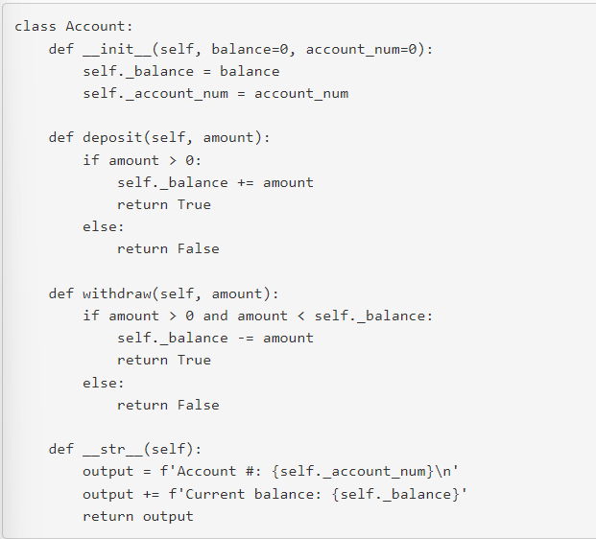
If we add a definition for __str__ then we can make those calls to print() be more readable:

Slide 14
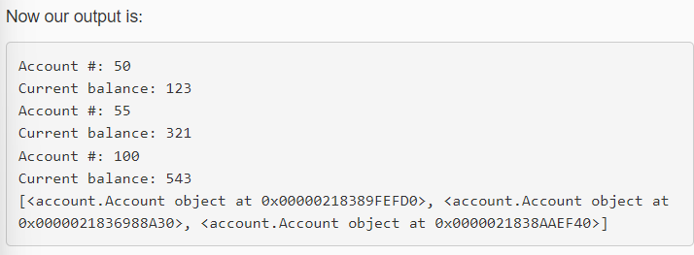

Slide 15
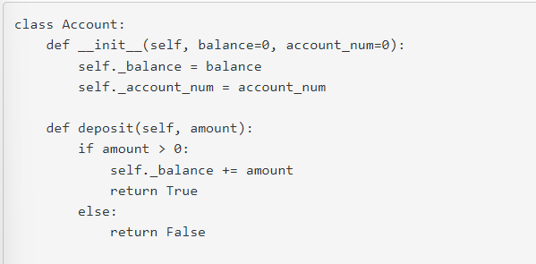
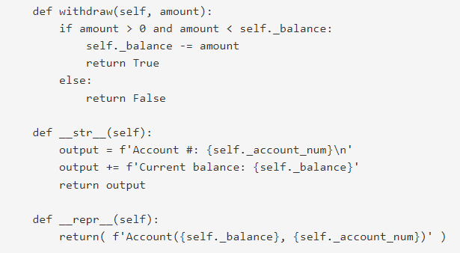
Notice how we still see the not-so-useful representations of our accounts in the list. That's because the list is having print() called on it, not each individual element. But, we can add a definition for __repr__ to make the output more meaningful.

Slide 16
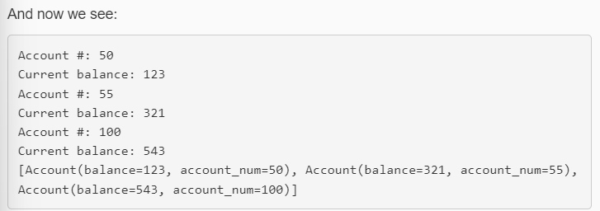
So why not just have the same definition for both? It's because the roles are different for each:
__str__ should create a readable representation of the object
__repr__ should, when possible show the viewer how to recreate the object
Notice how the __repr__ method essentially returns a string that shows how to recreate that object
Rules about in

Slide 17
DMV: Rules
What you are responsible for:
  Validating all iterations with the user that involve obtaining a menu choice
  Menu selections
  Ages
  Drivers license numbers
What you are NOT responsible for
  Validating any of the input from file
  Validating strings or any other type but int

Slide 18
Requirements
What's the most exciting thing you can think of? Exactly! The DMV! Today we're going to write a program that reads in Drivers License Records from file and then let's the user interact with the data.

Slide 19
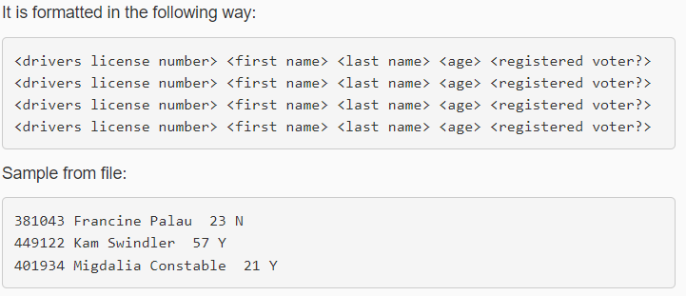
DMV: Data File
You can find the data file in wiki , It is formatted in the following way:

Slide 20
DMV: Classes
Two Classes
  Driver License Class
  DMV Class

Slide 21
DMV: Drivers License Class
Drivers have a first name, last name, age, voter status, and license number
All member variables should follow private conventions (start the name with an underscore)
Overload the following operators/methods (even if not all may be directly used)

Slide 22
DMV: Drivers License Class
__lt__ two DriverLicenses True if the left hand side has a smaller license number
__gt__ two DriverLicenses True if the left hand side has a larger license number
__le__ two DriverLicenses True if the left hand side has a smaller or equivalent license number
__ge__ two DriverLicenses True if the left hand side has a larger or equivalent license number
__eq__ two DriverLicenses are equal if they have the same license number
__ne__ two DriverLicenses are NOT equal if they do not have the same license number

Slide 23
DMV: Drivers License Class
__str__ returns a string that contains all drivers license data a user-friendly, readable way (see below for format)
NOTE: This class only contains data, it doesn't not interact with the user!
__repr__ returns a string that contains a string that could be used to recreate the Drivers License record

Slide 24
DMV: DMV Class
The DMV class will be in charge of...
Reading and storing the drivers license records
Interacting with the user
Print menus
Validate user menus choice
All I/O to the terminal

Slide 25
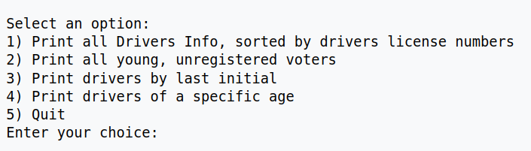
DMV: DMV Class
Here's the menu for the user:

Slide 26
DMV: DMV Class
1) Print all Drivers Info, sorted by drivers license numbers
  Creates a sorted listing of all Licenses
  NOTE: original list is unchanged), then prints all drivers and all their information in the following format:
    <last name>, <first name> (<age>): <drivers license number> <registration status>
  Example of a single entry (you'll print all entries)
    Johnson, Larry (67): 301288 registered

Slide 27
DMV: DMV Class
2) Print all young, unregistered voters
  Prints the driver information in the same format as the previous option, but only prints those who are between the ages of 18 and 24 (inclusive) AND not registered to vote
3) Print drivers by last initial
  Asks the user for single character, and print the information for all drivers that have a lasst name starting with that letter (case-insensitive) OR print "No record found." if no drivers have a first name starting with that character.
4) Print driver of a certain age
  Prompts the user for an age. Print all drivers with this age or print "No record found.“
  5) Quit
  Exits the program.

Slide 28
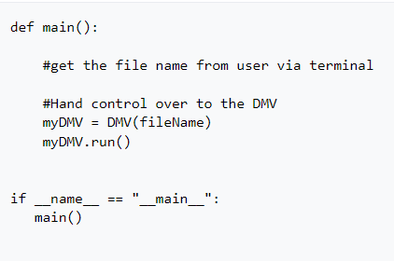
DMV: Main
Main will make sure that a file name was passed in, then hand control over to the DMV class.
Here's a skeleton of main:

Slide 29
Final Requirements
Add the following option to the menu:
Register to vote
  This option will prompt the user for a drivers license number
  If the drivers license number exists and they are not registered to vote, you register the driver
  If the driver doesn't exist, display "No record found"
  If the driver is already registered, display "Driver currently registered"
  When your program exits, the input file (whatever the name maybe) should have it's records updated.

Slide 30
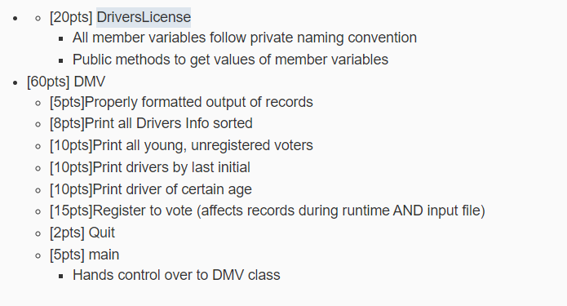
Rubric

