Slide 1
EECS 168 | Lab 1
Anahita Memar
Email : amemar@ku.edu

Slide 2
Due Date
Labs are due 1 week from when they are assigned before class begins
Wiki link for lab1 :
https://wiki.ittc.ku.edu/ittc_wiki/index.php?title=EECS168:Lab1

Slide 3
Lab Conduct
Do not use any unauthorized aid, such sites like rentacoder or chegg to obtain answers
Do not use code provided by another student
Do not reuse code (by you or anyone) from prior semesters
If you need help, seek it from:
  Me
  Dr. Gibbons
If equipment you don't own (e.g. cycle servers) needs attention or you're having account issues put in a ticket!

Slide 4
Objectives
Get familiar with Python interactive shell
Learn to make .py files
Write and run a couple of simple programs
Learn how to clone and commit code to a GitHub repository
Submit your work via GitHub

Slide 5
Resources
Python IDLE Shell
Create a GitHub Account
GitHub Desktop Client

Slide 6

Creating and running .py files
The interactive shell is great for really, really small snippets of code, but when we want to write a program with LOTS of instructions it's better to put all those instructions in a single file then execute that whole file.
Today we will create and run our first Python program. The source code for the program will look like this:

Slide 7
python
The first thing we need to do is to save the above source code to a file. The name of the file must can be hello.py. To create our source file, we will use a text editor. A text editor creates a file that contains nothing but plain text. Note that this is different from a word processor, which specializes in files that contain data for formatting, font choices, and other mark-ups that are unnecessary for source code (in fact, any non-text mark-up will prevent your code from compiling).

Slide 8
Python
Note: When you are printing text (also called strings) to the screen, you can use some special characters to affect your output. For example, try inserting the tab character in an output string to see the affect. You just need to put "\t" any place you want a tab. Try it out, but don't leave it in for now. We will use it in Exercise 2 later.

Slide 9
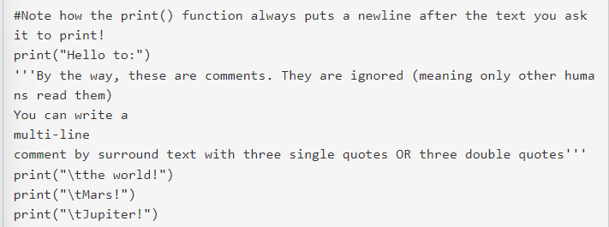
Python

Slide 10
Writing the source code using "nano"
Make a new file called hello.py to do this type the following command:
nano hello.py
This will open our trusty text editor in your terminal. You can use the arrow keys to move around (no mouse here). Some useful commands:
Exit: CTRL+X
Save: CTRL+O

Slide 11
The right text editor for you
I want you to find the text editor you like. You can use nano, vim, gedit (which has a GUI), or anything available on the lab machine.

Slide 12
Running your code
Now we are ready to run our program. The steps to run it are:
In the IDLE shell (or whichever IDE your using) select the "Run" command
Check the output of your program and see if it's doing what you expected
Fix any errors and/or bugs that come up
Repeat until it does what it's supposed to

Slide 13
Exercise 0
Since we'll be using GitHub to save your progress and submit your work, the first thing to do is...
Create a GitHub Account
Install the GitHub Desktop Client
Accept the Lab 01 Assignment
Clone the Lab 01 repository to your local machine

Slide 14
Exercise 0
When you click the link to "Accept the Lab 01 Assignment" you'll be shown a button to "Accept" the assignment. Once you click this, it will create a private repository (a place you can save code to) that only you, the TA, and the instructor can access. You may have to wait a couple of minutes after accepting the assignment for your repository to be create.
Refresh the page after a short pause.
Now, you should a new page with a LOT of different links and buttons. Don't worry. You should see a big green button labeled "Code" that you can click and select the option to open with "GitHub Desktop Client."
Now you'll have a local copy you work on.

Slide 15
Exercise 1
Write a python program to print the output on your screen. You should create a new folder and a new file called lab01-exercise01.py This is my first lab exercise!
After you complete this, make a commit using your GitHub desktop client to save your work to the assignment repository.

Slide 16
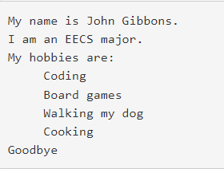
Exercise 2
Create a program to display your name, major, and hobbies. Print each statement on its own line. Your output should be similar to the output below. Remember to use "\t" in your output String to cause it to indent.

Slide 17
Runnable Requirement
This lab also introduces us to Python. All of your labs are required to run. You can assume good input unless otherwise stated, but your program should NOT crash while running.
If your code crashes while running it receives a zero!

Slide 18
Documentation Requirement
Each .py file you turn in should have the following at the top. Again, this is required for EACH .py FILE:
'''
Author: Your Name Here
KUID: 1234567
Date: Date file was created
Lab: lab##
Last modified: Date file was most recently modified
Purpose: Description of what this file does
'''

Slide 19
Ruberic
[10pts] Attendance
[20pts] Tarball created and named correctly and only source code files (.py) placed inside
[10pts] Exercise 0
Folders and files created through the terminal (Do this in lab)
[20pts] Exercise 1
Displays as directed
[30pts] Exercise 2
[15pts] Name, major, and hobbies displayed on separate lines
[10pts] Use of tab character
[10pts] Documentation
Name, date, file description at the top of every .py file

Slide 20
Submissions
Homework submissions will be through Canvas in a zip filee and the link for your GitHub
You are required to submit your .py files via the GitHub classroom assignment linked in wiki.

Slide 21
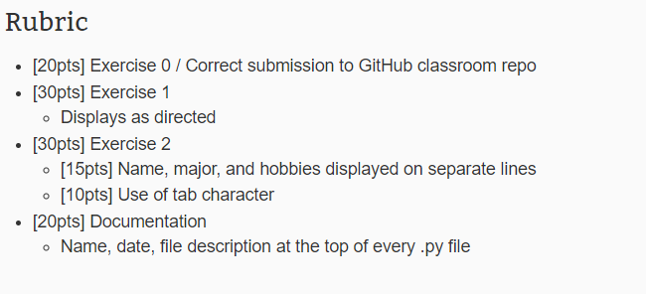
Rubric

