Slide 1
Lab 3
Anahita Memar

Slide 2
Due date
This lab is due one week from the start of your lab.

Slide 3
Objectives
Understand the while loop and for in loop
Learn builtin methods for strings
Use len() function

Slide 4
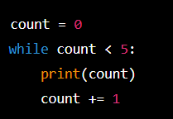
While Loops
while <logical condition>:
  <code>

Slide 5

while Loops Syntax
The while is a loop that will continue to run as long as the looping
condition is True. Your loop will need to include some kind of
progression that will cause the looping condition to result in False.
There is a break keyword that can take you out of a loop,
but I encourage you practice writing looping conditions that are
more complex than just while True:

Slide 6
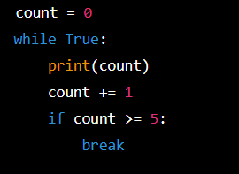
While Loops
When to use a while loop
  When number of code repeats is unknown
    User determines when to end code
    Logical condition must be met
The break keyword
  Exits loop
  Generally bad practice

Slide 7
For in loops
The for in loop allows you to traverse over an iterable.
The only two iterables you need to learn for this lab:
strings, which we've seen, and ranges. Ranges are a built-in way
to quickly generate a collection of numbers.
See some example of ranges below.
A for-in loop is specialized to take out one "piece" of an iterable,
or "collection" at a time. For strings a single piece is one character.
For ranges, it's one number in the range.

Slide 8
For In Loops
for <element> in <iterable>:
  <code>
  word = ‘computer’
  for letter in word:
    print(letter)
  for num in range(1,6):
    print(num)

Slide 9
For In Loops
When to use
  Known number of iterations
  Known data structure to iterate over

Slide 10
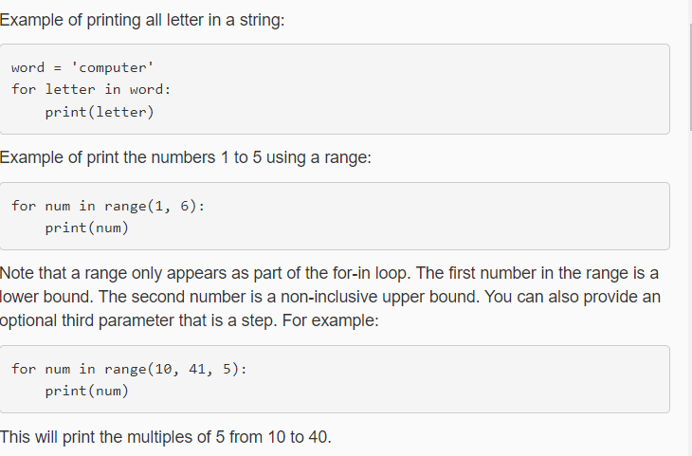

Slide 11
Count
Returns the number of times a specified value occurs in a string
txt = "I love apples, apple are my favorite fruit"
x = txt.count("apple")
print(x)

Slide 12
Find Searches the string for a specified value and returns the position of where it was found
txt = "Hello, welcome to my world."
x = txt.find("welcome")
print(x)

Slide 13
Lower. upper.
Converts a string into lower case
Converts a string into upper case
txt = "Hello my FRIENDS"
x = txt.lower()
print(x)
txt = "Hello my friends"
x = txt.upper()
print(x)

Slide 14
isnumeric
Returns True if all characters in the string are numeric
txt = "565543"
x = txt.isnumeric()
print(x)

Slide 15
Exercise 1: Sequence Search
Obtain a string from the user
Ask the user if they want their search to be case sensitive (y/n)
Ask the user for a sequence of characters
Print the number of times the sequence occurs in the string
Example
  Enter a string: ATGAATAATTAA
  Do you want case-sensitive match: n
  Enter a sequence to count: AAT
  In the string ATGAATTATTAA the sequence ‘AAT’ occurs 2 time(s)

Slide 16
Exercise 2: Secret Word Guess
Create a program where the user guesses a secret phrase
  We will hard code the secret phrase to be “bringcoffee”
The program will
  Obtain a guess
  If they have right letters say how many (not case sensitive)
  If they have the wrong number of characters tell them if they have too many or too few
Once they win
  Congratulate them
  Tell them how many guess it took

Slide 17
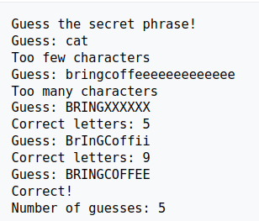
Exercise 2: Secret Word Guess

Slide 18
Exercise 3: Outbreak
Calculate the number of people who have the flu
  On day 1 : 1 person has the flu
  On day 2 : 4 people have the flu
  On day 3 : 64 people have the flu
  On day n : (n-3)+(n-2)+(n-1) people have the flu
This program will get a valid number from the user and display how many people have the flu

Slide 19
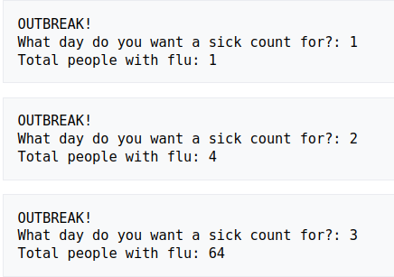
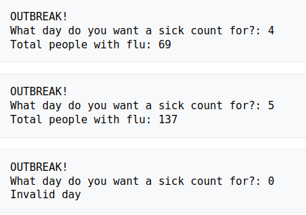
Exercise 3: Outbreak

Slide 20
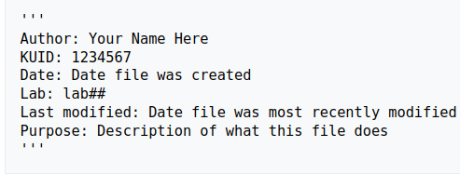
Documentation
Remember all files must have the following

Slide 21
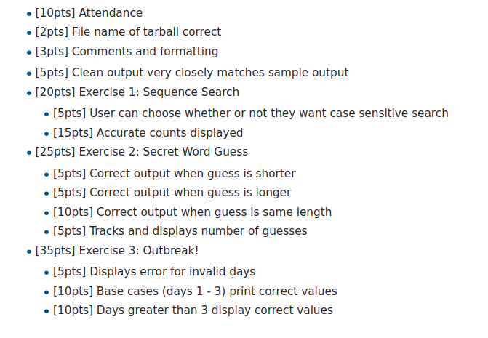
Rubric

