Slide 1
Lab 3
Anahita Memar

Slide 2
Objectives
Understand the while loop and for in loop
Learn built in methods for strings
Use len() function

Slide 3

while Loops Syntax
The while is a loop that will continue to run as long as the looping
condition is True.
Your loop will need to include some kind of progression that will
cause the looping condition to result in False.
There is a break keyword that can take you out of a loop,
but I encourage you practice writing looping conditions that are
more complex than just while True:

Slide 4
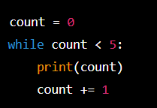
While Loops
while <logical condition>:
  <code>

Slide 5
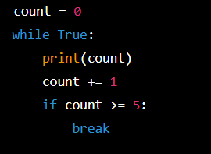
While Loops
When to use a while loop
  When number of code repeats is unknown
    User determines when to end code
    Logical condition must be met
The break keyword
  Exits loop
  Generally bad practice

Slide 6
For in loops
The for in loop allows you to traverse over an iterable. The only two iterables you need to learn for this lab: strings, which we've seen, and ranges. Ranges are a built-in way to quickly generate a collection of numbers. See some example of ranges below.
A for-in loop is specialized to take out one "piece" of an iterable, or "collection" at a time. For strings a single piece is one character. For ranges, it's one number in the range

Slide 7

For In Loops
for <element> in <iterable>:
  <code>
  word = ‘computer’
  for letter in word:
    print(letter)
  for num in range(1,6):
    print(num)

Slide 8

Note that a range only appears as part of the for-in loop.
The first number in the range is a lower bound.
The second number is a non-inclusive upper bound.
You can also provide an optional third parameter that is a step.
For example:
This will print the multiples of 5 from 10 to 40

Slide 9
For In Loops
When to use
  Known number of iterations
  Known data structure to iterate over

Slide 10

Nested For in loops
You can put anything we've learned in a loop, including another loop!
When you nest loops, the "inner loop", the loop inside of the other loop, will run in completely for each iteration of the "outer loop."
Here's an example:

Slide 11
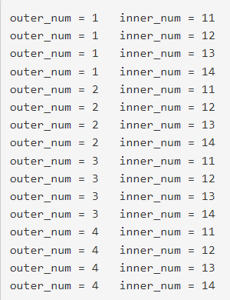
Output:

Slide 12
New String Topics
The type str a LOT of useful built in methods.
In particular, read up on:
count
find
lower
upper

Slide 13
Count
Returns the number of times a specified value occurs in a string
txt = "I love apples, apple are my favorite fruit"
x = txt.count("apple")
print(x)

Slide 14
Find
Searches the string for a specified value and returns the position of where it was found
txt = "Hello, welcome to my world."
x = txt.find("welcome")
print(x)

Slide 15
Lower. upper.
Converts a string into lower case
Converts a string into upper case
txt = "Hello my FRIENDS"
x = txt.lower()
print(x)
txt = "Hello my friends"
x = txt.upper()
print(x)

Slide 16
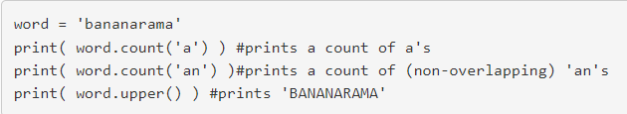
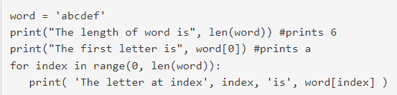
They way you can use a string method is easy. You simply take a string variable then say dot and the method you can to call. For example, let's count how many different sequences are in the word 'bananarama':
Another thing you can do with a string is access individual letters via an index. The first character in any string will be at index zero. The last will be at index length-1. How do we check its length? A built in tool called len() short for length.

Slide 17
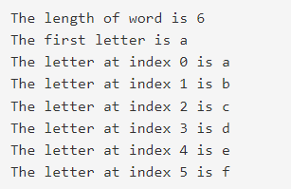
The output would be:

Slide 18
Exercise 1: Sequence Search
Obtain a string from the user
Ask the user if they want their search to be case sensitive (y/n)
Ask the user for a sequence of characters
Print the number of times the sequence occurs in the string
Example
  Enter a string: ATGAATAATTAA
  Do you want case-sensitive match: n
  Enter a sequence to count: AAT
  In the string ATGAATTATTAA the sequence ‘AAT’ occurs 2 time(s)

Slide 19
Exercise 2: Secret Word Guess
Create a program where the user guesses a secret phrase
  We will hard code the secret phrase to be “bringcoffee”
The program will
  Obtain a guess
  If they have right letters say how many (case sensitive)
  If they have the wrong number of characters tell them if they have
  too many or too few
Once they win
  Congratulate them
  Tell them how many guess it took

Slide 20
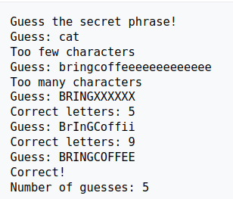
Exercise 2: Secret Word Guess

Slide 21
Exercise 3: Asterisk Triangle
Obtain a number from the user that represent a number of rows. Your program should prompt the user over and over until they enter a positive value.
Using this number you will print a triangle of asterisks, where the first row has 1 asterisk, the second row has 2, the the third has 3, and so on. The final row will have a number of asterisks equal to the number from the user.
HINT: Use a nest loop, where the inner loop builds up a row of asterisks by concatenating onto a string, and the outer loop controls which row you are currently printing.

Slide 22
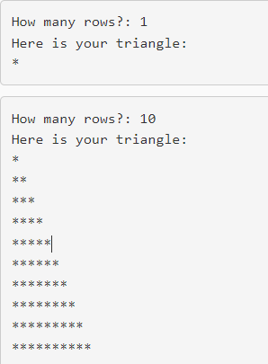
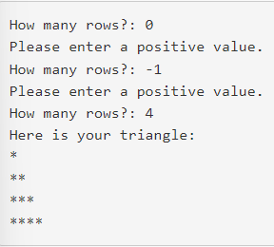
Exercise 3: Sample Runs:

Slide 23
Exercise 169: Advanced Secret Phrase
You will create an advance version
(please create a separate folder for this version) that will include
the following additions:
Before the game begins ask the user how many guesses they think
they can get the right answer in
Limit the user to that number of guesses
After each guess that has the correct number of letters,
tell the user which letters of that guess are in the correct position

Slide 24
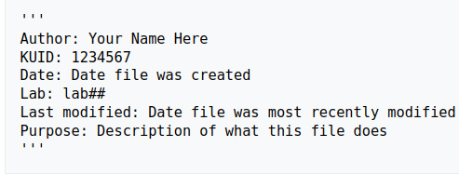
Documentation requirement
Each .py file you turn in should have the following at the top.
Again, this is required for EACH .py FILE:

Slide 25
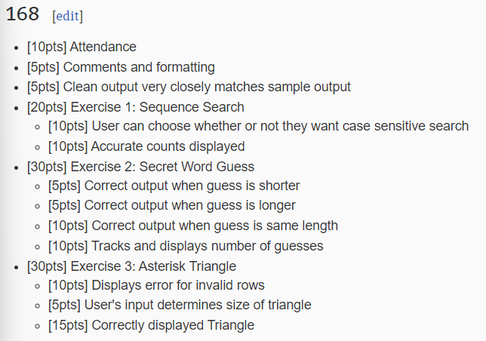
Rubric

Slide 26
