Slide 1
Lab 4: Lists and Files
Anahita Memar

Slide 2
Learning Objectives
Keep using while and for in loops
Keep using strings
Start using Lists

Slide 3
Creating Lists
Just like a variable
  my_list = [] #creates an empty list
  my_list = [1,2,3,4]
  my_list = [‘mint’, ‘ubuntu’,’arch’]
  my_list = [‘A’, 1, ‘String Cheese’, 3.14]
  my_list = list(‘taco’)

Slide 4
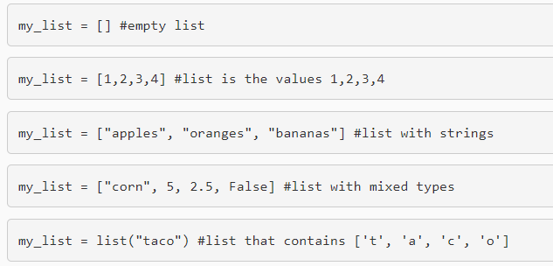

Slide 5
Useful List Methods
my_list.append() Adds item to the end of list
my_list.pop(index) Removes item at the index.
my_list.pop() If index isn't provided,it removes the last element of the list

Slide 6
my_list.insert(index,item) Inserts item at the index my_list.index(target_value) Returns the index of the target value.
WARNING: This will cause an error that ends your program if it is not in the list

Slide 7
Notes:
Lists are iterable, so they can be used in for-in loops
List are indexable, meaning you can access indices 0 to len-1 (examples: my_list[0])
List are mutable, so you can edit them at an index (example: my_list[index] = new_value)
You can check a list's length by using len(my_list) just like strings

Slide 8

List items are ordered, changeable, and allow duplicate values.
List items are indexed, the first item has index [0], the second item has index [1] etc.
Also, To determine how many items a list has, use the len() function:

Slide 9
String and List Operations
Read Index var[index]
Slice var[start:stop:step]
Temporary Reverse var[::-1]
Keyword in value in var
For in loops for element in var
len() function works just like a string

Slide 10


Read Index
Lists :
Strings:

Slide 11

SLICE VAR[START:STOP:STEP]
LISTS:
STRINGS:

Slide 12

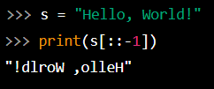
Temporary reverse var[::-1]
LISTS:
STRINGS:

Slide 13


Keyword in value in var
LISTS:
STRINGS:

Slide 14


Concatenate with + var1 + var2
LISTS:
STRINGS:

Slide 15

Write to index var[index]
LISTS:

Slide 16
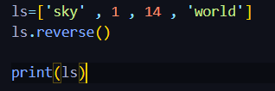
In place reverse var.reverse()
LISTS:

Slide 17

for in loops

Slide 18
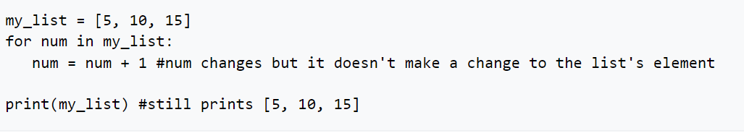
for in loops : for element in var:
LISTS:
IN SHORT, FOR IN LOOPS ARE GREAT FOR LOOKING AT VALUES, BUT IF WE WANT TO EDIT THE LIST, WE NEED TO GET TO THE INDEX.
WITH WHAT WE KNOW RIGHT, WE CAN USE RANGES.

Slide 19
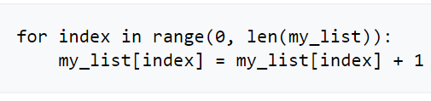
With what we know right, we can use ranges. It's not considered to be the most "pythonic" way but it uses what we've covered so far.
WARNING:
ALTHOUGH LISTS ARE COMPATIBLE WITH FOR IN LOOPS, PLEASE NOTE YOU SHOULD NOT ADD OR REMOVE ITEMS TO/FROM A LIST DURING A FOR IN LOOP. IT'S LEGAL, BUT CAN CAUSE UNEXPECTED BEHAVIOR. CHANGING VALUES IS FINE, BUT YOU SHOULDN'T DO ANYTHING THAT CHANGES THE LENGTH OF THE LIST.

Slide 20
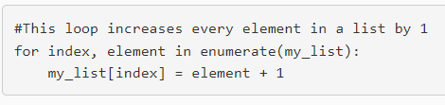
Will eventually learn enumerate, which you're allowed to use if you want, but it won't be expected until we learn about tuples.

Slide 21
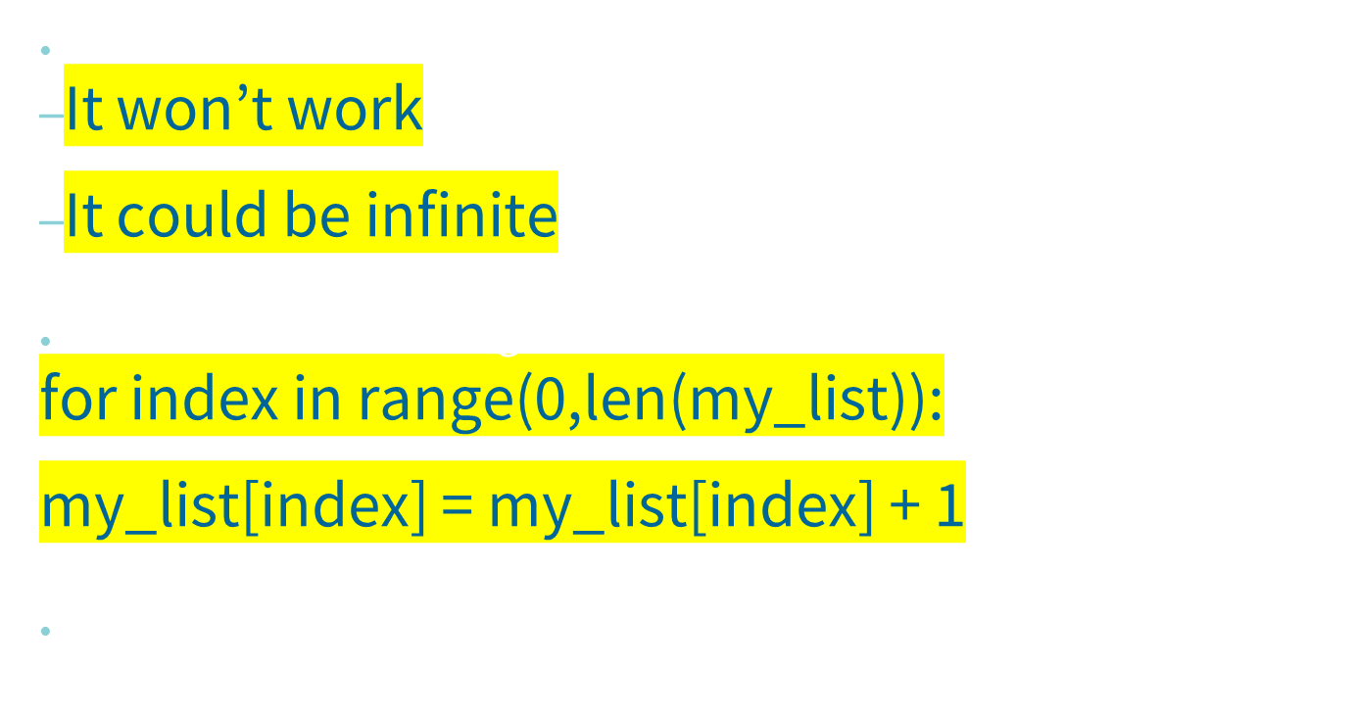
For in loops and lists

Slide 22
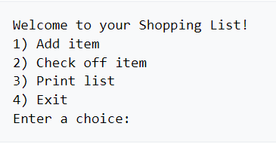
WE'RE GOING TO WRITE A PROGRAM TO HELP THE USER MAKE A GROCERY LIST, CHECK OFF THINGS THEY'VE GRABBED, AS WELL AS GET SOME PRACTICE MAKING A TEXT-BASED MENU.
LET'S START BY LOOKING AT THE MENU THE USER WILL SEE:

Slide 23
Exercise 1: Grocery Lists
  Add item
    Let the user enter an item to add to the list
  Check off item
    Prompt the user for the index of an item. NOTE: The user will input item numbers starting at 1 even though our lists start indexing at zero. Finds the item in the list, and replaces all but the first and last letters in that string with dashes, '-'
    Example "banana" would become "b----a"

Slide 24
Print List
  Print the list in the correct format
Exit
  Ends the program

Slide 25
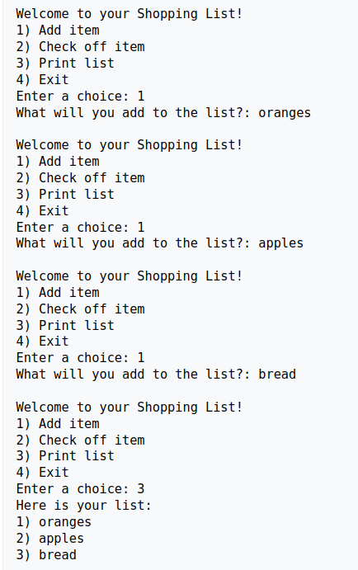
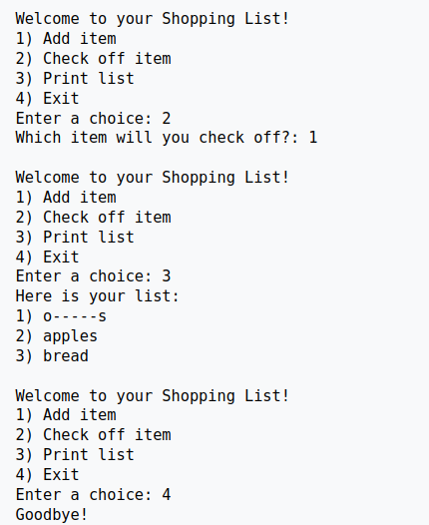
Exercise 1: Grocery Lists

Slide 26
Exercise 2: Captain's Log
You will ask the captain of a starship the names of the planets they visited on their last trip. The captain will provide the names of the planets in the order that he/she/they traveled to them. This repeats until a 'y' or 'Y' is entered indicating the mission is over (input must be a single letter, meaning 'yes', 'yep', and other words do not count).
You will then allow the captain to enter the name of a plant and you then provide the names of the neighboring planets. A planet will have at most two neighbors and as few as zero (a mission that only went to one planet).
This exercise will require you to access the list using indices, so be careful not to access an index that doesn't exist.
All matching should be case-insenitive, so make sure to the string methods of my_str.upper() OR my_str.lower().

Slide 27
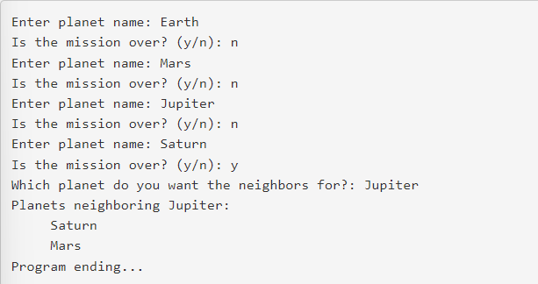
In this example Earth and Saturn only have one neighbor. All other planets have two.

Slide 28
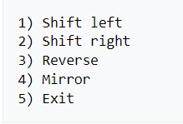
Exercise 3 (169 only): String shifter
CREATE A PROGRAM THAT ALLOWS THE USER TO ENTER A STRING THEN MANIPULATE THAT STRING IN VARIOUS WAYS.
HERE'S THE MENU THE USER WILL SEE:

Slide 29
AFTER EACH ACTION IS TAKEN (MINUS EXIT) PRINT THE RESULTING STRING. THE STRING SHOULD STAY IN THE MODIFIED STATE!
HERE'S A BREAK DOWN OF WHAT EACH OPTION DOES:
SHIFT LEFT
ALL CHARACTERS IN THE STRING ARE SLID ONE SPOT TO THE LEFT, WRAPPING AROUND AS NEEDED.
EXAMPLE: SHIFTING "CANDLE" LEFT WOULD RESULT IN "ANDLEC“
SHIFT RIGHT
ALL CHARACTERS IN THE STRING ARE SLID ONE SPOT TO THE RIGHT, WRAPPING AROUND AS NEEDED.
EXAMPLE: SHIFTING "CANDLE" LEFT WOULD RESULT IN "ECANDL"

Slide 30
REVERSE
THE STRING IS REVERSED. EXAMPLE: "CANDLE" WOULD BECOME "ELDNAC"
MIRROR
THE STRING IS MIRROR ACROSS THE MIDDLE. EXAMPLE: "CANDLE" BECOMES "CANNAC". THE STRING "RAT" BECOMES "RAR"

Slide 31
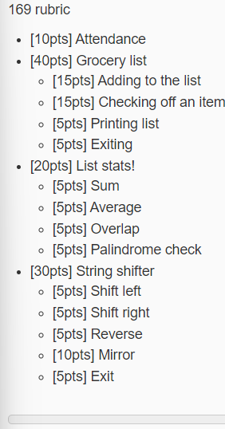
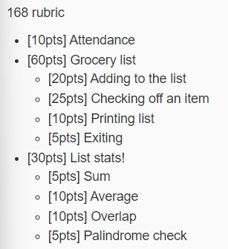
Rubric

