Slide 1
Lab 8
Anahita Memar

Slide 2
Due date
This lab is due 1 week from the start of your lab.

Slide 3
Topics
Modules
  Random
Continue using File I/O

Slide 4

Modules
Package code into an “easily” usable format
Import random
  Imports the random module
  Allows us to use all the methods associated with the random module
  The random module is a module already built into python, but must be imported. You can import random or any module using the import command. Typically, you would put all imports at the top of your .py file

Slide 5
Random Module
Once you have imported a module, you've gained access to a lot of new functions and/or types.
random.randint(lower,upper)
  Returns a random integer between lower and upper
random.choice(sequence)
  Returns a random element from the sequence
  Works will all the iterables we’ve talked about earlier
  random.choices(sequence, k=num)
  returns a list of k randomly chosen elements from the sequence
  elements in returned list can have repeats
  k can exceed the size of the sequence

Slide 6
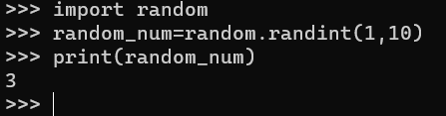
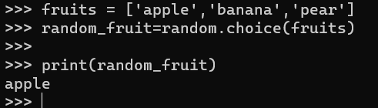
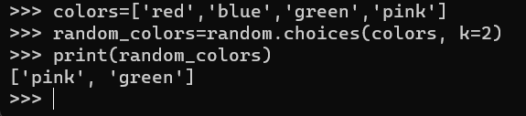

Slide 7
Random Module
random.sample(sequence, k=num)
  Returns a list of randomly chosen elements
  Elements in returned list are unique
  k cannot exceed the size of sequence
random.shuffle(list)
  Does an in-place shuffle on the list
  NOTE: the argument must be a list since it's editing in-place

Slide 8
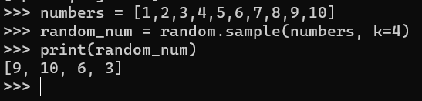
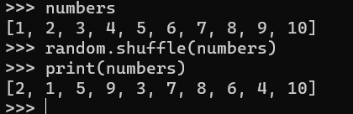

Slide 9
Default Parameters
Sharing code means that not everyone will use it correctly
Python functions can be given default parameters
  This means if a programmer doesn’t pass arguments to the method, the method will still work
  To do so is simple. In the function definition, after the parameter name, you assign it a default value. This value will be overridden is one is provided on the call.

Slide 10
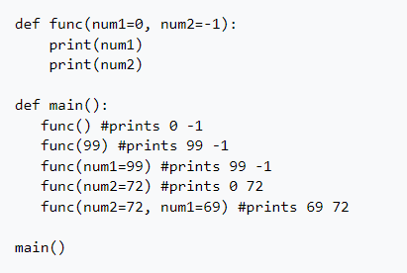
Default Parameters
Note: A default value doesn't affect whether an argument is positional, keyword, or both. Just remember, you choose default parameter values in the definition. You assign parameters

Slide 11
Exercise 1: Python_dex
This exercise will have you create a pokedex
In this lab, you will load a pokedex and allow the user to interact with it in various ways. You'll be able to create random teams, have random pokemon fight, look up translations from US names to JPN names, and more!
There is the Provided Files in the wiki.

Slide 12
Exercise 1: Menu
Print Pokedex
  Simply prints the pokedex with all US and corresponding JPN names in a well formatted way.
Translate
Asks the user for the US name they want translated into the JPN equivalent. If the pokemon name isn't in the pokedex, print a message explaining so
Pokemon translation quiz
Prompt the user with a randomly chosen Japanese translation of a Pokemon's name. Ask the user the user to guess the US translation and tell them if they are correct or not.

Slide 13
Exercise 1: Menu
Pokemon battle
Randomly build two teams of six unique pokemon, then the teams fight each other. Here's how a fight works:
Starting with the first pokemon on each team, randomly choose a winner
The winner stays and the loser is out of the fight
That winner fights the next pokemon on the other team and, again a winner is randomly chosen
Continue the fight until one team is completely defeated
Print the remaining roster of the winning team

Slide 14
Exercise 1: Menu:Pokemon Battle
The SOLIBEAR clause:
There is a special limited edition Pokemon available only in this lab named SOLIBEAR. SOLIBEAR cannot be beaten by any other pokemon except another SOLIBEAR, in which case it comes down to a coin flip as usual.
  Exit
  The programs ends

Slide 15
Exercise 1: Required Functions
build_pokedex(filename)
  returns a dictionary with the US pokemon name and their corresponding JPN names
  Assume the file is formatted correctly
build_team(pokedex, size = 6, is_unique = false)
  takes in a pokedex and optional team size and whether or not the team member need to be unique
  returns a list of the specified size of random chosen pokemon

Slide 16
Exercise 1: Required Functions
battle(team1, team2)
  takes two teams of pokemon and prints the fight information to the screen
  No return value

Slide 17
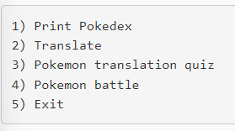
Exercise 1: Sample Menu

Slide 18
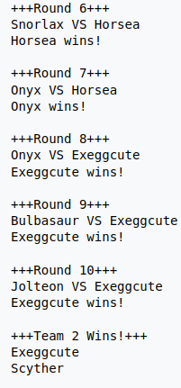
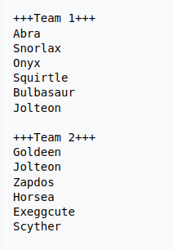
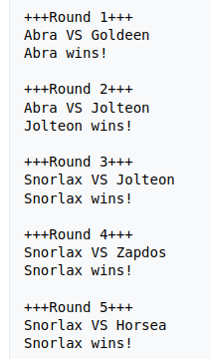
Exercise 1: Sample Battle

Slide 19
EECS 169 Exclusive DLC
You will add an additional option to the menu
`Save the fight log`
  You will prompt the user for the name of an output file. You will then output all fight messages to this file in addition to terminal.
  The way user might use this would go:
  Use option six to turn on "Fight log"
  Enter a file name
  The same text that you print to terminal for the next fight will also be written to that output file
  Once the fight is complete "Fight log" mode is off unless the user turns it on again for a future fight

Slide 20
