Slide 1
Lab 9
Anahita Memar

Slide 2
Due Time
This lab is due two weeks from the start of your lab session.

Slide 3
Objectives
Define classes.
Define instance variables (member variables) and implement member methods

Slide 4
Object Oriented Programming
Object Oriented Programming (OOP)
  Programmers can create their own data types
  Programmer defined data types are called classes

Slide 5
Classes
Object oriented programming (OOP) languages allows programmers to create user-defined data types by defining classes then creating objects of those type (or you could say instances of those types). Instances of these data types are objects. Each instance may contain member variables(AKA instance member) and member methods defined by the programmer.

Slide 6
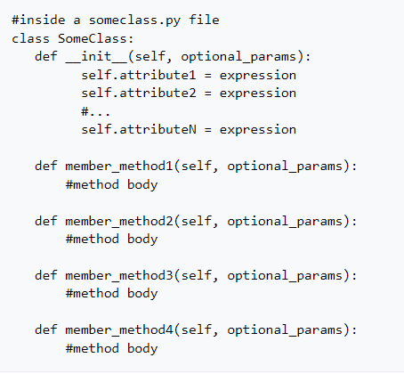
For 168, all of our Class definitions will follow this template:
Sample Class:

Slide 7
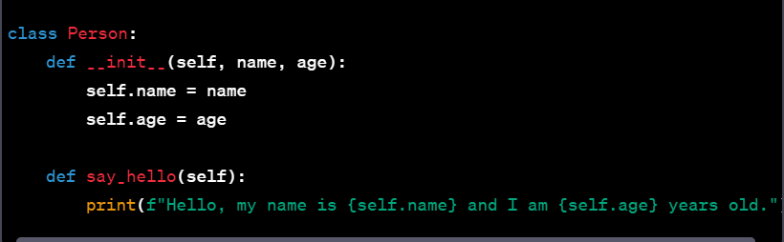
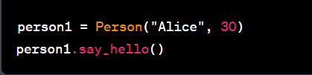
Example:

Slide 8
Notes about our class template:
Your module name (name of the .py file that contains the class definition) will be an all lowercase word
Your class name will follow CaptialCase, beginning with a capital letter capitalizing each new word instead of using underscores
The __init__ method is where we define what attributes our class will have. Or an even more accurate description would be we choose and initialize all our instance variables.
self is the first parameter to every method
self is NOT a keyword, but is the convention followed by python's authors

Slide 9
Class Vocab
member : a variable or function that belongs to a class (is inside the class definition)
member variable : a variable that belongs to class
instance variable : considered to also be a member, but its value can vary from instance to instance
instance : a single instantiation of a Class (e.g. word1 = 'doggy' is an instance of the string class)
object : in python, everything is an object, but more generally we use the word to describe a variable that is more complex than just a number or just a bool. Objects typically have several variables and/or methods built in
instance VS object : For now, we'll use these words nearly interchangeably. If word1 = 'doggy' then we could say "word1 is an instance of the str class" and we could also say that "word1 is an object of type str". Eventually, we'll qualify the difference more. In short, there are objects that aren't instances, but every instance is an object. Again, this is a bit difficult to grasp at this point.
method : a method is just a function that belongs to a class. It has normal function score (parameters and locally declared variables) but also has scope on other members

Slide 10
Class Vocab
Member
  A variable or function that belongs to a class
Member variable
  A variable that belongs to a class but its value can vary from instance to instance
Instance Variable
  Considered to be a member but it’s value can vary from instance to instance
Instance
  When a variable is declared as an object in code
Objects
  in python, everything is an object, but more generally we use the word to describe a variable that is more complex than just a number or just a bool.
  Objects typically have several variables and/or methods built in
Method
  A function that belongs to a class

Slide 11
Exercise 1: Defining Circle type and Creating a Driver
Imports
  from math import pi
Member Variables
  radius
  xpos
  ypos

Slide 12
Exercise 1: Member Methods
diameter(self)
get the diameter of the Circle. It returns a value, diameter.
area(self)
calculate the area of the Circle
circumference(self)
calculate the circumference of the circle
dist_to_origin(self)
returns the distance from the center of the circle to the origin
HINT: Find out how to calculate the distance between two points and recall the origin is at (0,0)

Slide 13
Exercise 1: Member Methods
dist_to_center(self, other)
Takes another Circle
returns the distance from the center of self to the center of the other circle
is_inside(self, other_circle)
Takes another Circle
returns True if the self circle is completely contained within the other circle. NOTE: if the two circles have the same center and same radius then we'll consider that to be contained
HINT: this will use your distance_to_center function
is_overlap(self, other_circle)
Takes another Circle
Returns True if the two Circles overlap. NOTE: Two circles that touch tangentially will be consider an overlap. Example two circle's that have a radius of 1 and their centers are two units apart.
NOTE: The Circle class should not do any input or output.

Slide 14
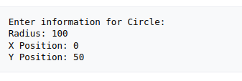
Exercise 1: Driver Module
Functions
    create_user_circle()
    Talk with the user to obtain the positions and radius for a Circle and return a new Circle with those values

Slide 15
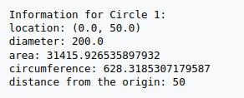
Exercise 1: Driver Module
print_circle_info(circ, name="Circle")
Takes a Circle and optional name (e.g. "Circle 1" or "Circle 2" or "plate" or "jupiter")
Prints the following information about each of the Circle to the screen:
The location of the Circle's center (xPos, yPos), the distance from the origin, each of area, circumference, diameter
Sample output from print_circle_info().

Slide 16
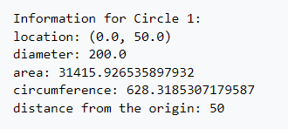
Sample output from print_circle_info().

Slide 17
Exercise 1: Driver Module
  main()
  Create two circles and let the user assign the information for them
  You will then print the info for both Circles
  Display how far apart the circles are
  Finally, you will tell the user whether or not the circles...
  overlap
  one contains the other (does not matter which one contains the other)
  You will display information on all these checks (even if the circles don't intersect, overlap, and one doesn't contained the other still tell the user all those facts)

Slide 18
Exercise 1: Deliverables
Two files
  driver.py
  circle.py

Slide 19
Exercise 2 (169 Only)
Add the following method to your Circle class:
intersect_count(self, other_circle);
returns the count of how many times the circles intersect, 0, 1, or 2 times.
0 times means they are too far away to intersect
1 time means they touch tangentially
2 times if they intersect twice
In your driver module, update the output information to include how many times the two circle's intersect.

Slide 20
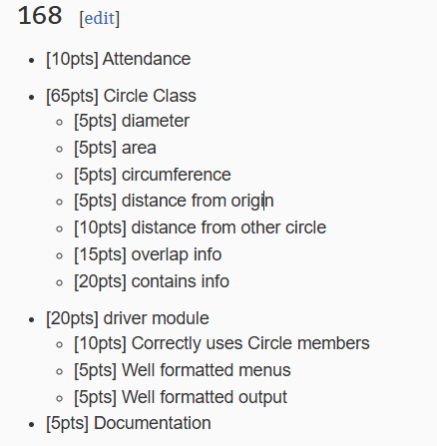
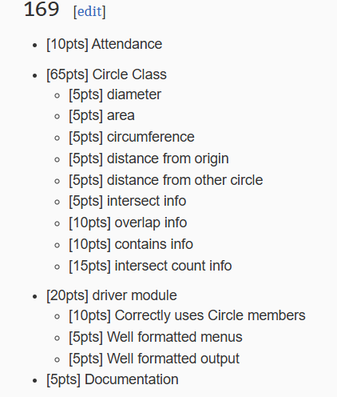
Rubric
This lab requires the building and use of classes. We'll only grade implementations that use the classes described in this lab.

