Slide 1

Lab 1 : Intro
Anahita Memar

Slide 2
TA : Anahita Memar
Email : amemar@ku.edu
Office : 2025
Office Hour : Wednesday 11:00-1:00 PM

Slide 3
Objectives
Get familiar with Python interactive shell
Learn to make .py files
Write and run a couple of simple programs
Learn how to clone and commit code to a GitHub repository
Submit your work via GitHub

Slide 4
Python
Live Shell
.py files
Running Files

Slide 5
Live Shell
Refers to an environment where python code is usually run line by line
To access the python shell on the lab computers use the command python3 in the terminal
Good for testing small amounts of code

Slide 6
You can launch the Python interactive shell by launching IDLE or in a terminal. All you do is open a terminal and type:$>python3
This will launch the interactive shell that we saw in lecture. Note: Just like in lecture, you won't do your lab work here. You'll need to create .py files that you can save.

Slide 7

Creating and running .py files
The interactive shell is great for really, really small snippets of code, but when we want to write a program with LOTS of instructions it's better to put all those instructions in a single file then execute that whole file.
Today we will create and run our first Python program. The source code for the program will look like this:

Slide 8
The first thing we need to do is to save the above source code to a file. The name of the file must can be hello.py. To create our source file, we will use a text editor. A text editor creates a file that contains nothing but plain text. Note that this is different from a word processor, which specializes in files that contain data for formatting, font choices, and other mark-ups that are unnecessary for source code (in fact, any non-text mark-up will prevent your code from compiling).

Slide 9
Note: When you are printing text (also called strings) to the screen, you can use some special characters to affect your output. For example, try inserting the tab character in an output string to see the affect. You just need to put "\t" any place you want a tab. Try it out, but don't leave it in for now. We will use it in Exercise 2 later.

Slide 10
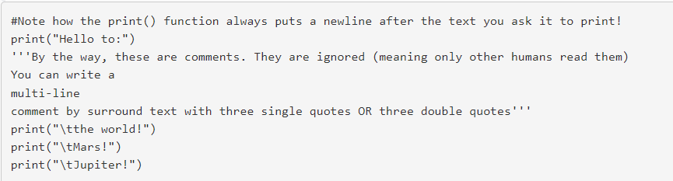

Slide 11
VIM
You can use whichever editor you want.
To create a python file in vim use the command vim <file name>
When you have entered vim press i to enter insert mode and begin typing.
To save and exit vim press esc and type :wq
The : means it’s a command and wq means write and quit

Slide 12
“nano”
Make a new file called hello.py to do this type the following command:
nano hello.py
Exit: CTRL+X
Save: CTRL+O
The right text

Slide 13

Running your code
Now we are ready to run our program. The steps to run it are:
In the IDLE shell (or whichever IDE your using) select the "Run" command
Check the output of your program and see if it's doing what you expected
Fix any errors and/or bugs that come up
Repeat until it does what it's supposed to
If you want to run your code in terminal you simply type:

Slide 14
GIT
What is Git
What is GitHub
Using GitHub

Slide 15
Git
Git is a piece of version control software that is free, open source, and used by millions of people every day
A brief aside on software engineering and why we’re using git

Slide 16
Github
Github is a hub for git repositories or repos
Allows for relatively easy use of git over the internet
For this class we will be using github classroom

Slide 17
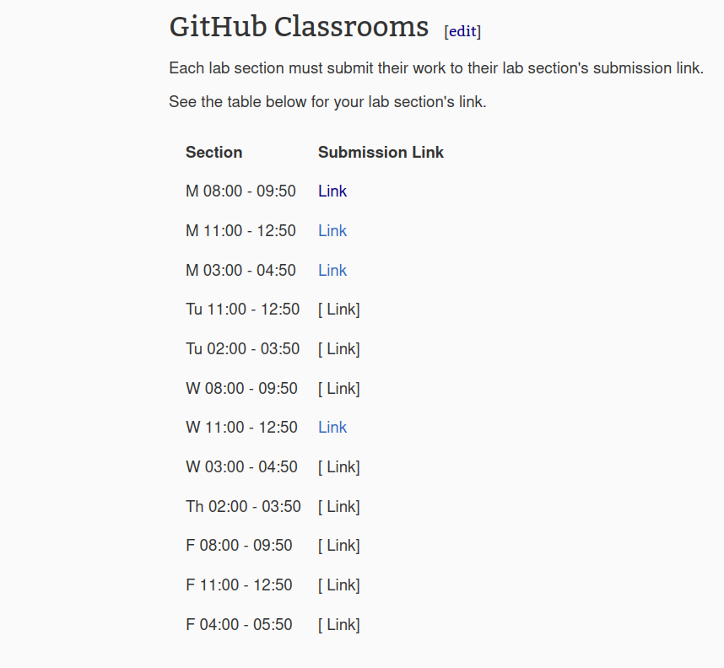
Exercise 0 (Using Github)
Create a GitHub Account
Accept the Lab 01 Assignment, which gives us an online repository
Clone the Lab 01 repository to your local machine so we can work on our lab machine/laptop
Optionally, if you want to install the GitHub Desktop client for your home machine (Windows/Mac Only) you can save your work and upload to GitHub even without a lab machine!

Slide 18
Creating a GitHub account
Got to GitHub and make an account.

Slide 19
Accepting the Assignment
Accepting the assignment just means telling GitHub to create a spot for you to upload your progress and overall submission.
When you click the link to "Accept the Lab 01 Assignment" you'll be shown a button to "Accept" the assignment. Once you click this, it will create a private repository (a place you can save code to) that only you, the TA, and the instructor can access. You may have to wait a couple of minutes after accepting the assignment for your repository to be create.
Refresh the page after a short pause.

Slide 20
Cloning your personal repository for local work
Now, you should a new page with a LOT of different links and buttons. Don't worry. You should see a big green button labeled "Code" which you can do one of two things with
1: Copy the URL which you can use to "clone" the repository to your lab machine via terminal. See below for authentication and cloning instructions.
2: click and select the option to open with "GitHub Desktop Client" if you're working on your laptop. This creates a clone of the repository on your local machine and you can begin creating files in it.

Slide 21

Authenticating via terminal
If you choose to use terminal to interact with GitHub, you'll need to log into GitHub via terminal before you continue. (Remember, you can also use the GitHub desktop on your personal machine or the GitHub web interface).
Open a terminal
type the following command

Slide 22
Authenticating via terminal
You'll be prompted with a menu that you can use the arrows keys to navigate. Once you're in the menus:
1. Choose to log into normal old GitHub.com
2. Choose that you want to authenticate Git with your GitHub account
3. Choose to authenticate HTTPS
4. Choose to launch a browser and simply log into GitHub
5. Copy the code it show (highlight and right click the paste it in a text doc, OR just type it in a text doc for later)
Once the browser launches, it will guide you through the rest of the process.
If you ever are without a browser, you can use a token instead of launching a browser. Follow these steps to create a personal access token

Slide 23
Cloning via terminal
1. Copy the URL (same URL from previous steps)
2. Create a folder on your local machine that you want to store this weeks lab in
3. Right-click on that folder and choose "Open in Terminal"
4. Type this command in terminal:
Now you'll have a local copy you work on.

Slide 24
Exercise 1
Write a python program to print the output on your screen. You should create a new folder and a new file called lab01-exercise01.py This is my first lab exercise!
After you complete this, you will commit your changes locally then push them up to the GitHub servers.

Slide 25


Making commits and pushes via terminal
1. Save your file(s)
2. Add the changed files to git's "staging area" by typing:
3. Commit the changes to your local repository by typing:

Slide 26

Remotes
Okay, now let's step back and look at what's we've done. Here is the situation:
We have a local repository with our work in it
We have an empty repository on github
Our goal: copy the local repository to github for the world to see. Here's what to do:
In your local repository:
Add a remote to your repository:

Slide 27

Example:
Notes:
origin is a naming convention to refer to the github remote
the URL will end in .git
You can obtain the URL from github
Adding a remote simply adds a remote label to git, we still need to copy our repository to github

Slide 28


Pushing
We have just added a remote to our repository. Now we will push our changes repository to github.
Example:

Slide 29
Depending on your Git install, the default might be "main" instead of "master". Just swap the names if that's the case.
At this point, you'll be prompted to provide your github credentials. If you asked to interact with KSSHPASS, you can just close the prompts that pop up. After you give your credentials, your repository will be copied to github.
After you push your local branch, go back to github to see your changes.
Note that push is NOT the same as cloning from your local repository to github. Cloning implies the copying of an entire repository. When you push, you push changes

Slide 30
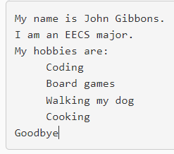
Exercise 2
Create a program to display your name, major, and hobbies. Print each statement on its own line. Your output should be similar to the output below. Remember to use "\t" in your output String to cause it to indent.
Sample output:
Commit your second exercise to the assignment repository.

Slide 31
Runnable requirement
This lab also introduces us to Python. All of your labs are required to run. You can assume good input unless otherwise stated, but if your program should NOT crash while running.
If your code crashes while running it receives a zero!

Slide 32
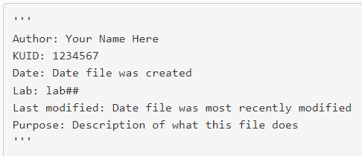
Documentation requirement
Each .py file you turn in should have the following at the top. Again, this is required for EACH .py FILE:
What's this? Well, it's documentation. It's a block of text that, yes, is ignored when ran but is very valuable to other humans that read your code. Or, more likely, to your future self. I encourage you include lots of comments in your code, but this header is the only one with points attached (for now...).
We'll learn more about the importance of documentation and other things to add to the headings of our files as the semester goes on.

Slide 33
Lab Submission
You are required to submit your .py files via the GitHub classroom assignment linked above.

Slide 34
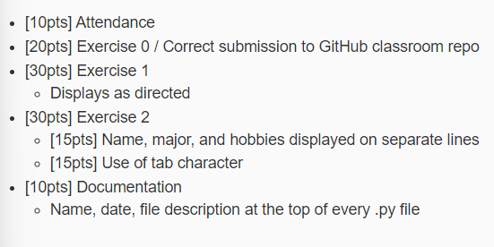
Rubric

