Slide 1
Lab 2
Anahita Memar

Slide 2
Objectives
Understand the while loop and for in loop
Learn builtin methods for strings
Use len() function

Slide 3

while Loops Syntax
The while is a loop that will continue to run as long as the looping
condition is True.
Your loop will need to include some kind of progression that will
cause the looping condition to result in False.
There is a break keyword that can take you out of a loop,
but I encourage you practice writing looping conditions that are
more complex than just while True:

Slide 4
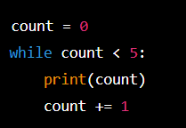
While Loops
while <logical condition>:
  <code>

Slide 5
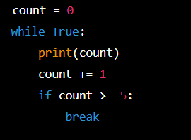
While Loops
When to use a while loop
  When number of code repeats is unknown
    User determines when to end code
    Logical condition must be met
The break keyword
  Exits loop
  Generally bad practice

Slide 6
For in loops
The for in loop allows you to traverse over an iterable.
The only two iterables you need to learn for this lab: strings,
which we've seen, and ranges. Ranges are a built-in way to quickly
generate a collection of numbers. See some example of ranges below.
A for-in loop is specialized to take out one "piece" of an iterable,
or "collection" at a time. For strings a single piece is one character.
For ranges, it's one number in the range.

Slide 7
For In Loops
for <element> in <iterable>:
  <code>
  word = ‘computer’
  for letter in word:
    print(letter)
  for num in range(1,6):
    print(num)

Slide 8

Note that a range only appears as part of the for-in loop.
The first number in the range is a lower bound.
The second number is a non-inclusive upper bound.
You can also provide an optional third parameter that is a step.
For example:
This will print the multiples of 5 from 10 to 40

Slide 9
For In Loops
When to use
  Known number of iterations
  Known data structure to iterate over

Slide 10
New String Topics
The type str a LOT of useful built in methods.
In particular, read up on:
count
find
lower
upper

Slide 11
Count
Returns the number of times a specified value occurs in a string
txt = "I love apples, apple are my favorite fruit"
x = txt.count("apple")
print(x)

Slide 12
Find Searches the string for a specified value and returns the position
of where it was found
txt = "Hello, welcome to my world."
x = txt.find("welcome")
print(x)

Slide 13
Lower.
upper.
Converts a string into lower case
Converts a string into upper case
txt = "Hello my FRIENDS"
x = txt.lower()
print(x)
txt = "Hello my friends"
x = txt.upper()
print(x)

Slide 14
isnumeric
Returns True if all characters in the string are numeric
txt = "565543"
x = txt.isnumeric()
print(x)

Slide 15
Exercise 1: Sequence Search
Obtain a string from the user
Ask the user if they want their search to be case sensitive (y/n)
Ask the user for a sequence of characters
Print the number of times the sequence occurs in the string
Example
  Enter a string: ATGAATAATTAA
  Do you want case-sensitive match: n
  Enter a sequence to count: AAT
  In the string ATGAATTATTAA the sequence ‘AAT’ occurs 2 time(s)

Slide 16
Exercise 2: Secret Word Guess
Create a program where the user guesses a secret phrase
  We will hard code the secret phrase to be “bringcoffee”
The program will
  Obtain a guess
  If they have right letters say how many (not case sensitive)
  If they have the wrong number of characters tell them if they have too many or too few
Once they win
  Congratulate them
  Tell them how many guess it took

Slide 17
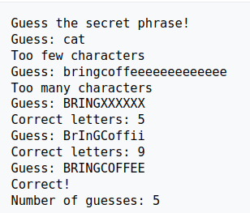
Exercise 2: Secret Word Guess

Slide 18
Exercise 3: Outbreak
Calculate the number of people who have the flu
  On day 1 : 1 person has the flu
  On day 2 : 4 people have the flu
  On day 3 : 64 people have the flu
This program will get a valid number from the user and display how many people have the flu

Slide 19
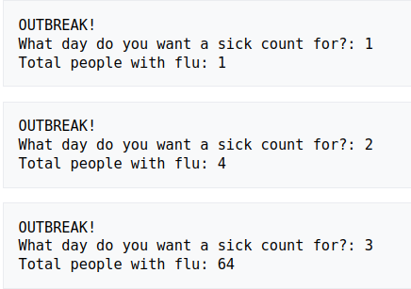
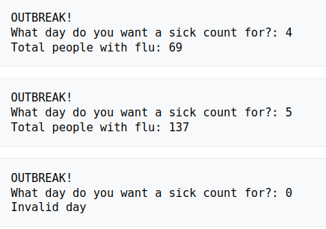
Exercise 3: Outbreak

Slide 20
Exercise 169: Advanced Secret Phrase
You will create an advance version
(please create a separate folder for this version) that will include
the following additions:
Before the game begins ask the user how many guesses they think
they can get the right answer in
Limit the user to that number of guesses
After each guess that has the correct number of letters,
tell the user which letters of that guess are in the correct position

Slide 21
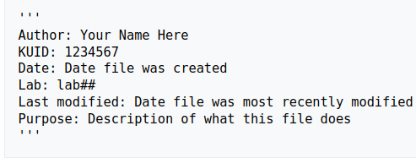
Documentation requirement
Each .py file you turn in should have the following at the top.
Again, this is required for EACH .py FILE:

Slide 22
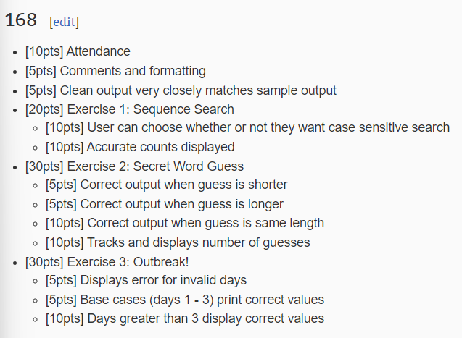
Rubric

Slide 23
