Slide 1
Lab 04
Anahita Memar

Slide 2
Due Time
This lab is due one week from the start of your lab.

Slide 3
Objectives
Continue learning about strings and lists

Slide 4
Lists Overview
For this lab you will manipulating strings and lists.
You can read up on the documentation on various list
methods on the Python Docs in the wiki.

Slide 5
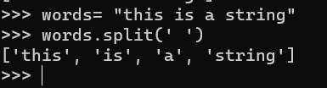
Split Method
your_string.split(delimiter)
Creates a list of strings from a single string delimited by the provided delimiter (or space if no delimiter is provided)

Slide 6
Join method
delimiter_string.join(list_of_strings)
Create a single string by joining the list of strings with the
delimiter (also a string) between all elements
los = [‘This’,’is’,’a’,’list’]
‘@’.join(los)
‘This@is@a@list’

Slide 7
A Brief Review of List Methods
. your_list.append(value)
Adds the value to the end of the list.
x = [‘a’,’b’,’c’]
  x.append(‘d’)
  print(x) # [‘a’,’b’,’c’,’d’]

Slide 8
your_list.insert(index, value)
Inserts the given value at the given index.
All values after the index a slid to the "right" of the insert point
x = [‘a’,’b’,’c’]
x.insert(2, ‘V’)
print(x) # [‘a’,’b’,’V’,’c’,’d’]

Slide 9
. your_list.remove(value)
Removes the first occurrence of the value in the list.
WARNING: If the value is not in the list this will throw an error
that crashes your program.
DO NOT call this without checking it's in the list first.
x = [‘a’,’b’,’c’]
x.remove(‘c’)
print(x) # [‘a’,’b’,’V’,’d’]

Slide 10
A Brief Review of List Methods
. your_list.pop(index)
Returns the value at the index, then removes it from the list
x = [‘a’,’b’,’c’ , ‘d’]
x.pop()
  d
len(val)
  len(x)
  4
+
  y = x + [‘d’,’e’]
  print(y) # [‘a’,’b’,’V’,’c’,’d’,’e’]

Slide 11
Don't forget about other useful tools with lists, such as slices, checking the
length of a list (using len()), and/or combining lists (using the + operator).

Slide 12

File I/O Basics
Python features the ability to read from and write to files with built-in
functions. Whether you are reading, writing, or appending a file,
you need to open the file first:
There are several modes you can choose from when
opening a file. The ones we'll use the most are reading and writing.
"r" - reading from file
"w" - writing to file

Slide 13

Reading from a sample file
Assume we have a file, named "input.txt", that is sitting in the same folder as
our python file and that it contains some data we want to read. Again, the file
"input.txt" already exists and contains the data of interests.
Now that we have the file open we can read the contents is various ways:
input_file.read() - read in the entire contents of the file as one big string
input_file.readline() - read a line of the file.
NOTE: this can be called multiple times to get the 2nd line, then the 3rd line, etc

Slide 14



If we want to easily and safely read in all the lines of a file one at a time we can do:
After we are done with a file (regardless of reading or writing) we need to close it:
NOTE: There is a best practice that is becoming the standard for using files that removes the need to
close it. But it uses a keyword and a concept (exceptions) we haven't been able to explore yet.
It would look like:

Slide 15


Writing to file
To write to a file you still have to open it, but you pick the write mode:
Since we are a writing to file, make sure to note:
If the file we open for writing does not exist it will be created
If the file already exists, it will be overridden, meaning its contents erased
To write something is simple enough (just make sure to write all characters you
want there, even new lines!):

Slide 16

Closing a file
Whether you are reading or writing to a file,
make sure to close it when you're done with it.

Slide 17
ONE EXERCISE Web History Simulator
For this lab we will write a program that simulates creating a web browser history.
The user will enter a file name that contains the instructions for you web broswer.
The commands will be able to enter URLs (web addresses), navigate forward and
backwards through the history, and print the current history.
The output must be written to a file name webhistory.txt.
The user will be able to
  Enter URLS (web addresses)
  Navigate forward and Navigate backward through the history
  Print the current history
  Exit the program

Slide 18
Details
All commands will come in the form of, well, commands.
Here's a table that lists out what they can do:
NAVIGATE <URL>
  Navigates the browser to the given URL.
  navigating to a URL retains all URLs accessible from going BACK,
  but any URLs that would have accessible from going FORWARD are now lost.
  You may assume a URL
  will always be given following the NAVIGATE command.

Slide 19
BACK
A command indicating the web browser is redirected to
the previous URL in the history.
If there is no URL further back,
then the browser stays on the current URL.

Slide 20
Details
FORWARD
  A command indicating the web browser is redirected
  to the next URL in the history.
  If there is no URL that is next,
  then the browser stays on the current URL.

Slide 21
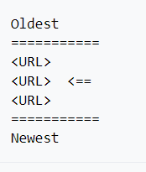
HITORY
Prints the current URL history to the screen
using the following format (the arrow points to the current URL):

Slide 22
Exit
Ends the program

Slide 23
Sample Run
Enter a command: NAVIGATE google.com
Enter a command: NAVIGATE ku.edu
Enter a command: NAVIGATE chess.com
Enter a command: HISTORY
Oldest
=========
google.com
ku.edu
chess.com <==
==========
Newest

Slide 24
Sample Run
Enter a command: BACK
Enter a command: BACK
Enter a command: NAVIGATE hackerrank.com
Enter a command: BACK
Enter a command: HISTORY
Oldest
========
google.com <==
hackerrank.com
========
Newest
Enter a command: EXIT

Slide 25
Extra 169 requirements
The user is required to enter URLs that start with 'https://’
(example: 'https://google.com'). Reject all non-secure URLs.
The user cannot navigate to the same URL twice in the same history.

Slide 26
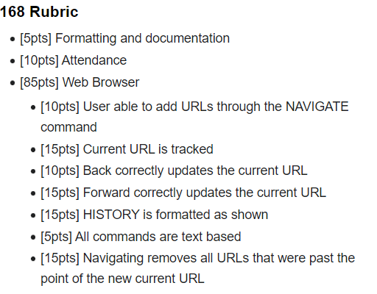
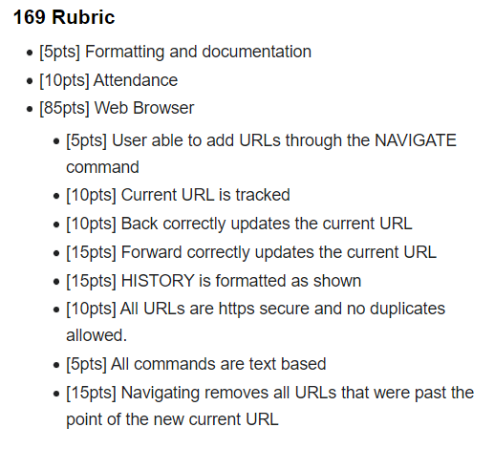
Rubric

