Slide 1
EECS 168 | Lab 5
Anahita Memar

Slide 2
Objectives
Practice File I/O
Practice using lists of lists

Slide 3

File I/O Basics
Python features the ability to read from and write to files with built-in functions. Whether you are reading, writing, or appending a file, you need to open the file first:

Slide 4
There are several modes you can choose from when opening a file. The ones we'll use the most are reading and writing.
"r" - reading from file
"w" - writing to file

Slide 5
Reading from a sample file
Assume we have a file, named "input.txt", that is sitting in the same folder as our python file and that it contains some data we want to read. Again, the file "input.txt" already exists and contains the data of interests
input_file = open("input.txt", "r")

Slide 6
Now that we have the file open we can read the contents is various ways:
input_file.read() - read in the entire contents of the file as one big string
input_file.readline() - read a line of the file. NOTE: this can be called multiple times to get the 2nd line, then the 3rd line, etc

Slide 7
If we want to easily and safely read in all the lines of a file one at a time we can do:
input_file = open("input.txt")
for line in input_file:
print(line, end="") #prints each line one at a time

Slide 8
After we are done with a file (regardless of reading or writing) we need to close it:
file_object.close()

Slide 9
NOTE
There is a best practice that is becoming the standard for using files that removes the need to close it. But it uses a keyword and a concept (exceptions) we haven't been able to explore yet. It would look like:
with open("some_file.ext", "mode") as file_object:
#use file_object

Slide 10
Writing to file
To write to a file you still have to open it, but you pick the write mode:
output_file = open("output.txt","w")

Slide 11

Since we are a writing to file, make sure to note:
If the file we open for writing does not exist it will be created
If the file already exists, it will be overridden, meaning its contents erased
To write something is simple enough (just make sure to write all characters you want there, even new lines!):

Slide 12
Closing a file
Whether you are reading or writing to a file, make sure to close it when you're done with it.
file_object.close()

Slide 13
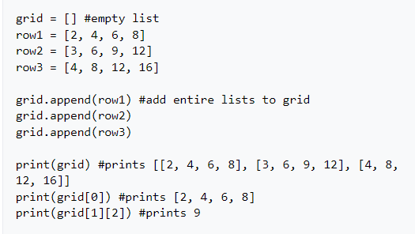
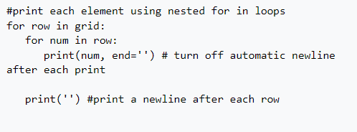
Lists of Lists
A list in python can contain any data type (or even a mix!) including lists. Here's some examples:

Slide 14
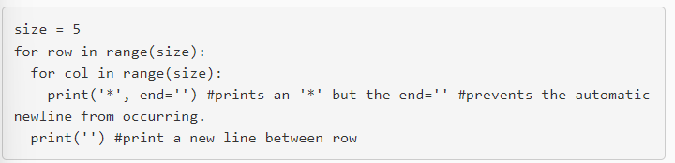
Exercise 1: Rook Path
Before we do an exercise with file I/O, let's make sure we have a good grasp on nested loops.
Some hints that might help. Let's look at how you might display an NxN grid of *'s.

Slide 15
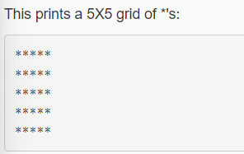
You will ask the user for the dimensions of an NxN board and a row, column coordinate indicating where a rook is on the board. You will then display the path the rook could take on the board

Slide 16
In the column, display the '|' character. This is known as the "pipe" which you can get to by doing SHIFT+\
In the row, display - (dashes)
In the exact position of the Rook, display a capital R
Display *s everywhere else.
Recall that Rooks can move vertically and horizontally from edge to edge on the board.
Example where n=5 and position of the Rook is (1,3)

Slide 17
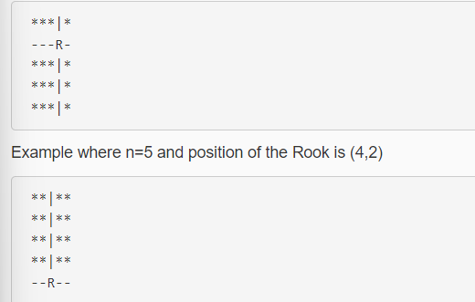

Slide 18
Exercise 2: Numeric File Analysis
Obtain a file name from the user, which will contain data pertaining to a 2D grid of numbers
Store the information from the file in a list of lists of floats
Create a file for each of the following:
averages.txt : contains the overall average of the entire array, then the average of each row
reverse.txt : contains the original values but each row is reversed
flipped.txt : contains the original values but is flipped top to bottom (first row is now the last row etc.)
If the dimensions of array are symmetric (NxN), create a diagonal.txt: contains the array mirrored on the diagonal

Slide 19

Example files
The input file will be formatted in the following way:

Slide 20
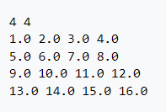
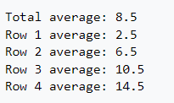
Sample file called "input.txt“
Output to averages.txt

Slide 21
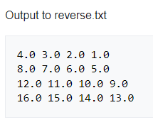
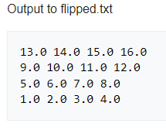

Slide 22
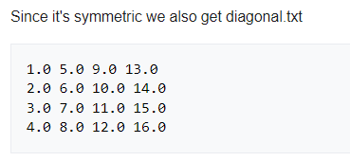

Slide 23
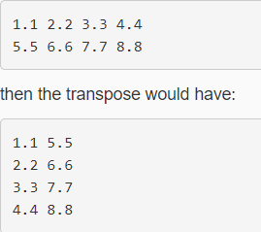
Final Exercise
Also create and save the transpose of the original 2D array to a file called transpose.txt.
This is done whether it's symmetric or not.

Slide 24
EECS 169 Exercise: Wheel! Of! Python!
For this program you will get to pick a 3 word phrase of your choice (e.g. "Better luck tomorrow"). You will obtain five letters from user, all on one line. You need to make sure they enter exactly five letters! You will reveal any of the letters they guessed correctly in the phrase, then let them make a single guess to get the entire phrase.
Quick notes:
The letters they enter should help them in a case-insensitive way, meaning if they enter 'D' then all Ds regardless of the case are revealed.

Slide 25
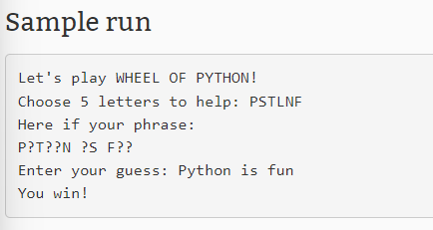

Slide 26
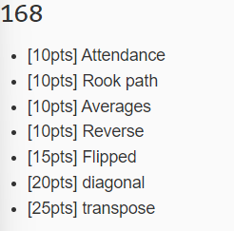
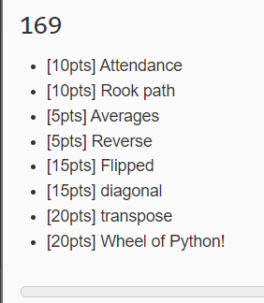
RUBRIC

