Slide 1
Lab 6
Anahita Memar

Slide 2
Objectives
Functions
Due Time
This lab is due one week from the start of your lab

Slide 3
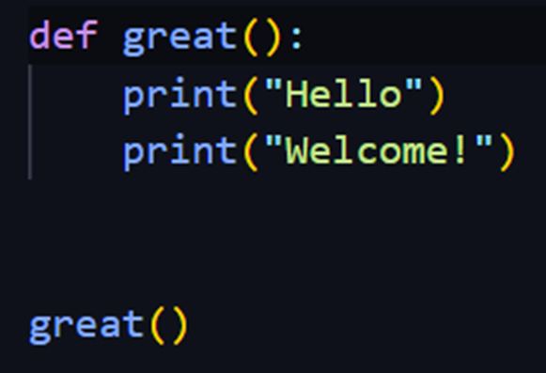

Functions
Functions are used to "bottle up," so to speak,
some piece of functionality or a specific algorithm so that we can run it whenever
we like and with whatever parameters we choose.
There are two parts to getting a function up and running.
Step 1 is to define the function:

Slide 4
Notes about functions:
You can use all the tools you know (e.g. if statements, loops, etc)
in your function body.
Returning a value is optional, for example you might want a function
to be in charge of printing a menu
A best practice is to include a "doc string“
which provides a brief description of what the function does

Slide 5
Including a "doc string": A docstring is a string literal that provides
a brief description of what a function or method does,
and any other relevant information about its usage or behavior.
Placing the docstring:
The docstring should be the first line(s) of the function body,
immediately following the function signature
(i.e. the name and parameters of the function).
Using triple double quotes:
The docstring should be enclosed in triple double quotes (""").

Slide 6
No blank lines: There should be no blank line either before or after the docstring.
Use imperative voice: The docstring should be written in the imperative
e voice, as a command that prescribes the function's effect
(e.g. "Return the number plus one"), rather than as a description.
Avoid repeating parameter names: The docstring should not repeat the
names of the function's parameters,
since this information can be obtained through introspection.
Don't do: """plus_one(num) --> int"""

Slide 7
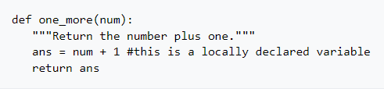
Here's an example of a function that takes a number and returns that number plus one:
You can do everything you already know how to do in your functions.
Loops, if statements, complicated math - whatever you want.

Slide 8
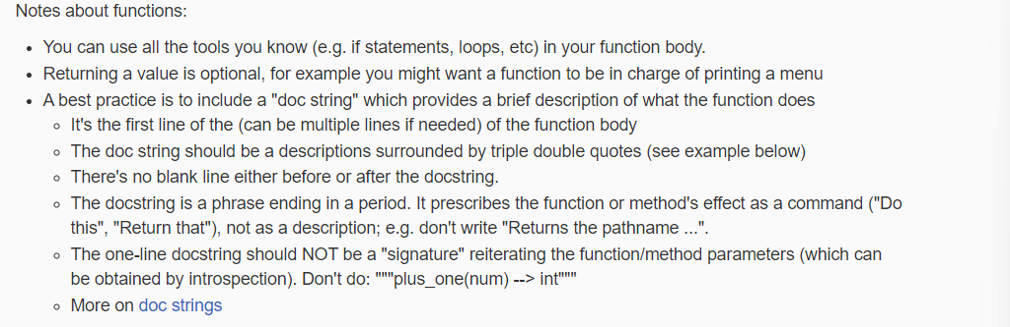

Slide 9
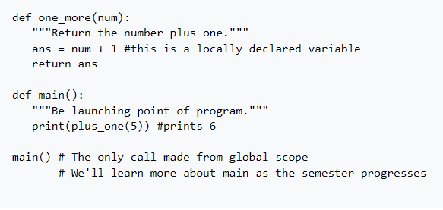
If you want to use a function you defined, you to call it. Moving forward,
we will have an "entry point" to our programs be a function called main which
will be the only function called from the global scope,
meaning it's the only function not called from another function.
Example :

Slide 10
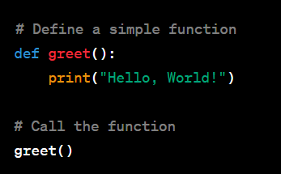
example
In this example, we define a function called greet() using the def keyword.
The function has no parameters (it takes no inputs) and consists of a single line of code that prints "Hello, World!" to the console.
We call the function by using its name followed by parentheses greet(), and it prints the greeting.

Slide 11
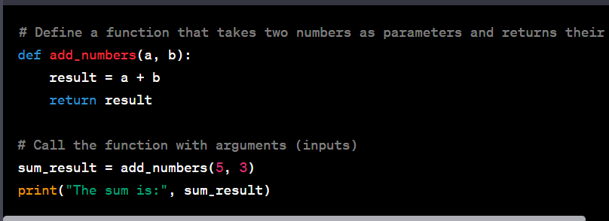
In this example, we define a function called add_numbers() that takes two parameters a and b.
Inside the function, it calculates the sum of a and b and returns the result using the return statement.
We call the function by providing two arguments (5 and 3) within parentheses, and it returns the sum which we store in sum_result and print.

Slide 12
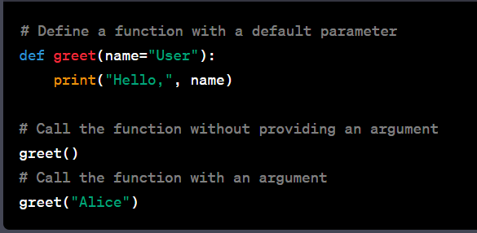
Here, we define a function greet() that takes a single parameter name, with a default value of "User" if no argument is provided.
We first call the function without an argument, and it uses the default value "User" to print "Hello, User."
Then, we call the function with the argument "Alice," and it uses the provided value to print "Hello, Alice."

Slide 13
When to return a value?
To decide if you need a void or non-void (e.g. a function that returns a value)
you must determine if your function is returning a value or not.
Decide whether these functions should have a return type or simply do work:
A function to find the cube of any int
A function that prints "Hello" 1000 times
A function that takes a string and a number and prints it took the screen that number of times
A function that calculates the nth fibonacci number
A function that takes a string called phrase and determines if the phrase
has the same words forwards and backwards

Slide 14
1. Return a value
2. This function will not return a value,
it will only print a message to the console.
3. This function will not return a value,
4. This function will likely return the value of
the nth Fibonacci number.
5. return a Boolean value indicating whether or not the
phrase has the same words forwards and backwards.

Slide 15
Requirements
In this lab you'll make a single large program that uses several function definitions.
Your main will be in charge of using the other functions you define.
What your program will do is present the user with the following menu:
1) Count digits
2) Sum digits
3) Is Palindrome
4) Reverse
5) Exit
Choice:

Slide 16
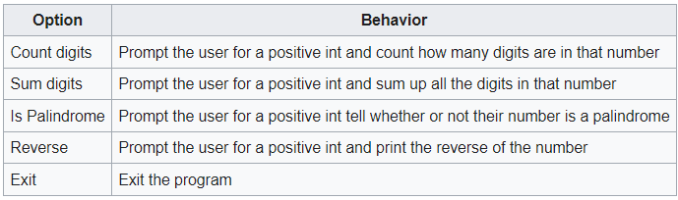
For all choices, you may assume good input.

Slide 17
Required Functions
You will write several functions that you will use in combination to complete this lab:
last_digit(num)
returns the last digit in n
example last_digit(123) returns 3
remove_last_digit(num)
returns the number n with the last digit trimmed off
example remove_last_digit(123) returns 12
when remove_last_digit is passed a 1-digit number, return 0

Slide 18
Required Functions
add_digit(current_num, new_digit)
returns the current_num with new_digit placed into the ones space
example add_digit(123, 4) returns 1234
reverse(num)
returns the reverse of num
example reverse(1234) returns 4321
this function should call other functions you've defined

Slide 19
Required Functions
is_palindrome(num)
returns true if num is a palindrome
example is_palindrome(12321) returns True, but is_palindrome(123) returns False
This should use reverse
count_digits(num)
returns the count of digits in num
example count_digits(123) returns 3
this function could be helped by remove_last_digit

Slide 20
Required Functions
sum_digits(num)
returns the sum of digits in num
example count_digits(123) returns 6
this function should use last_digit and remove_last_digit
print_menu()
prints the menu
This does NOT obtain user input, it only prints the menu

Slide 21
Required Functions
main
Until the user wants to quit, this main will print the menu,
obtain the user's choice, and call the appropriate functions to print the
desired results.

Slide 22
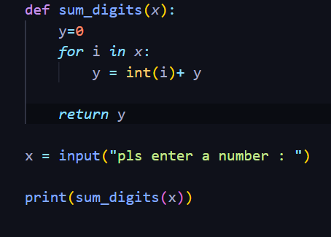


Slide 23
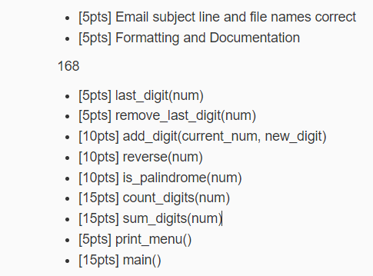
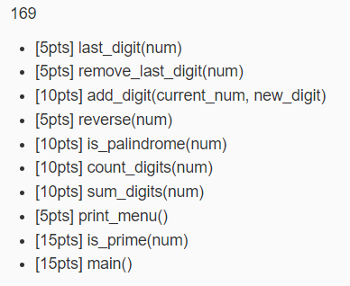
Rubric

