Slide 1
Lab 6
Anahita Memar

Slide 2
Objectives
Functions
Due Time
The week that we back from spring break.

Slide 3
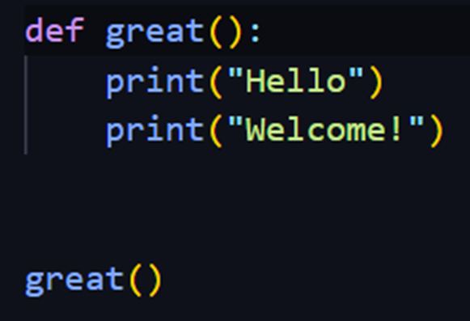

Functions
Functions are used to "bottle up," so to speak,
some piece of functionality or a specific algorithm so that we can run it whenever
we like and with whatever parameters we choose.
There are two parts to getting a function up and running.
Step 1 is to define the function:

Slide 4
Notes about functions:
You can use all the tools you know (e.g. if statements, loops, etc)
in your function body.
Returning a value is optional, for example you might want a function
to be in charge of printing a menu
A best practice is to include a "doc string“
which provides a brief description of what the function does

Slide 5
Including a "doc string": A docstring is a string literal that provides
a brief description of what a function or method does,
and any other relevant information about its usage or behavior.
Placing the docstring:
The docstring should be the first line(s) of the function body,
immediately following the function signature
(i.e. the name and parameters of the function).
Using triple double quotes:
The docstring should be enclosed in triple double quotes (""").

Slide 6
No blank lines: There should be no blank line either before or after the docstring.
Use imperative voice: The docstring should be written in the imperative
e voice, as a command that prescribes the function's effect
(e.g. "Return the number plus one"), rather than as a description.
Avoid repeating parameter names: The docstring should not repeat the
names of the function's parameters,
since this information can be obtained through introspection.
Don't do: """plus_one(num) --> int"""

Slide 7
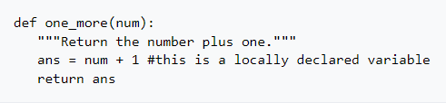
Here's an example of a function that takes a number and returns that number plus one:
You can do everything you already know how to do in your functions.
Loops, if statements, complicated math - whatever you want.

Slide 8
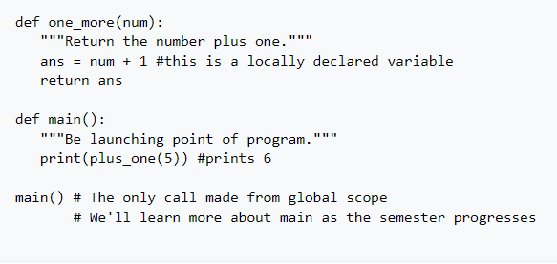
If you want to use a function you defined, you to call it. Moving forward,
we will have an "entry point" to our programs be a function called main which
will be the only function called from the global scope,
meaning it's the only function not called from another function.
Example :

Slide 9
In Python, a global scope refers to the area in the program where a
variable or function is accessible to all parts of the code, including functions
and classes, that are defined in the program after the variable or
function declaration.
When a variable is declared outside of any function or class, it is assigned
to the global scope. This means that the variable can be accessed from
anywhere in the program, including inside functions and classes.
However, if the variable is assigned to inside a function or class,
it will be considered as a local variable, and it will not be accessible outside
the function or class.

Slide 10
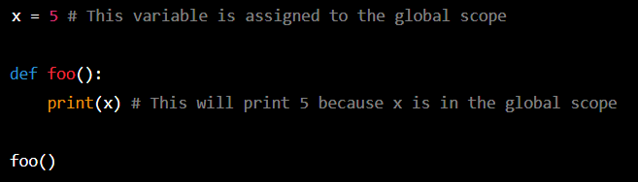
example:
In the above code, x is declared outside of any function,
so it is in the global scope. When the foo() function is called,
it can access x from the global scope and prints its value.

Slide 11
When to return a value?
To decide if you need a void or non-void (e.g. a function that returns a value)
you must determine if your function is returning a value or not.
Decide whether these functions should have a return type or simply do work:
A function to find the cube of any int
A function that prints "Hello" 1000 times
A function that takes a string and a number and prints it took the screen that number of times
A function that calculates the nth fibonacci number
A function that takes a string called phrase and determines if the phrase
has the same words forwards and backwards

Slide 12
1. Return a value
2. This function will not return a value,
it will only print a message to the console.
3. This function will not return a value,
4. This function will likely return the value of
the nth Fibonacci number.
5. return a Boolean value indicating whether or not the
phrase has the same words forwards and backwards.

Slide 13
Requirements
In this lab you'll make a single large program that uses several function definitions.
Your main will be in charge of using the other functions you define.
What your program will do is present the user with the following menu:
1) Count digits
2) Sum digits
3) Is Palindrome
4) Reverse
5) Exit
Choice:

Slide 14
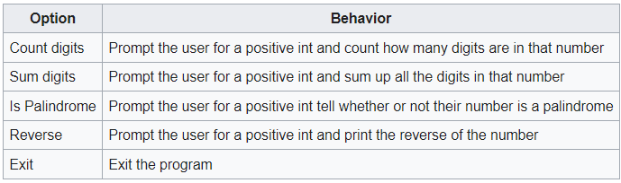
For all choices, you may assume good input.
Type Requirement
You must store the user's input as an int for the duration of the program.
You cannot use string methods to manipulate the digits.
You will not be responsible for number with leading or trailing zeroes, but zeroes can be in the middle (e.g. 12021)

Slide 15
Required Functions
You will write several functions that you will use in combination to complete this lab:
last_digit(num)
returns the last digit in n
example last_digit(123) returns 3
remove_last_digit(num)
returns the number n with the last digit trimmed off
example remove_last_digit(123) returns 12
when remove_last_digit is passed a 1-digit number, return 0

Slide 16
Required Functions
add_digit(current_num, new_digit)
returns the current_num with new_digit placed into the ones space
example add_digit(123, 4) returns 1234
reverse(num)
returns the reverse of num
example reverse(1234) returns 4321
this function should call other functions you've defined

Slide 17
Required Functions
is_palindrome(num)
returns true if num is a palindrome
example is_palindrome(12321) returns True, but is_palindrome(123) returns False
This should use reverse
count_digits(num)
returns the count of digits in num
example count_digits(123) returns 3
this function could be helped by remove_last_digit

Slide 18
Required Functions
sum_digits(num)
returns the sum of digits in num
example count_digits(123) returns 6
this function should use last_digit and remove_last_digit
print_menu()
prints the menu
This does NOT obtain user input, it only prints the menu

Slide 19
Required Functions
main
Until the user wants to quit, this main will print the menu,
obtain the user's choice, and call the appropriate functions to print the
desired results.

Slide 20
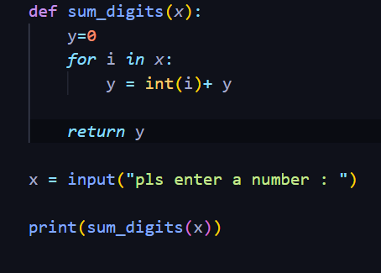


Slide 21
EECS 169 Exercise: Prime detector
You must add one additional menu item (before exit when printing) to
detect if the number given by the user is prime or not.
You must define and use a function called...
is_prime(num)
Determines if num is prime or not
NOTE:
there are not points for efficiency for this one.
In other words, I don't mean for this exercise to turn into a week long math
research project. (But if you got nothing else going on, feel free :) )

Slide 22
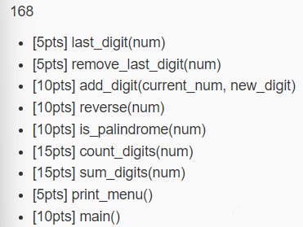
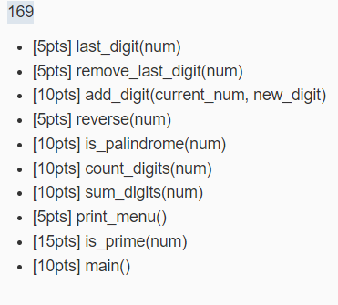
Rubric

