Slide 1

Lab 1 : Intro
Anahita Memar

Slide 2
TA : Anahita Memar
Email : amemar@ku.edu
Office : 3011
Office Hour : Tuesday 2:00 PM – 4:00 PM

Slide 3
Objectives
Get familiar with Python interactive shell
Learn to make .py files
Write and run a couple of simple programs
Learn how to clone and commit code to a GitHub repository
Submit your work via GitHub

Slide 4
Python
Live Shell
.py files
Running Files

Slide 5
Live Shell
Refers to an environment where python code is usually run line by line
To access the python shell on the lab computers use the command python3 in the terminal
Good for testing small amounts of code

Slide 6
You can launch the Python interactive shell by launching IDLE or in a terminal. All you do is open a terminal and type:$>python3
This will launch the interactive shell that we saw in lecture. Note: Just like in lecture, you won't do your lab work here. You'll need to create .py files that you can save.

Slide 7

Creating and running .py files
The interactive shell is great for really, really small snippets of code, but when we want to write a program with LOTS of instructions it's better to put all those instructions in a single file then execute that whole file.
Today we will create and run our first Python program. The source code for the program will look like this:

Slide 8
The first thing we need to do is to save the above source code to a file. The name of the file must can be hello.py. To create our source file, we will use a text editor. A text editor creates a file that contains nothing but plain text. Note that this is different from a word processor, which specializes in files that contain data for formatting, font choices, and other mark-ups that are unnecessary for source code (in fact, any non-text mark-up will prevent your code from compiling).

Slide 9
Note: When you are printing text (also called strings) to the screen, you can use some special characters to affect your output. For example, try inserting the tab character in an output string to see the affect. You just need to put "\t" any place you want a tab. Try it out, but don't leave it in for now. We will use it in Exercise 2 later.

Slide 10
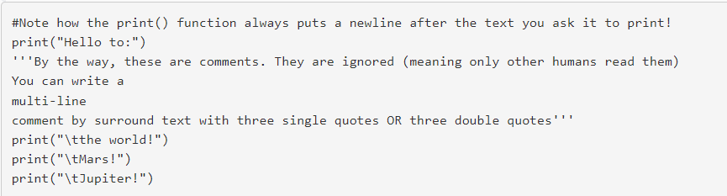

Slide 11
VIM
You can use whichever editor you want.
To create a python file in vim use the command vim <file name>
When you have entered vim press i to enter insert mode and begin typing.
To save and exit vim press esc and type :wq
The : means it’s a command and wq means write and quit

Slide 12
“nano”
Make a new file called hello.py to do this type the following command:
nano hello.py
Exit: CTRL+X
Save: CTRL+O
The right text

Slide 13

Running your code
Now we are ready to run our program. The steps to run it are:
In the IDLE shell (or whichever IDE your using) select the "Run" command
Check the output of your program and see if it's doing what you expected
Fix any errors and/or bugs that come up
Repeat until it does what it's supposed to
If you want to run your code in terminal you simply type:

Slide 14
GIT
What is Git
What is GitHub
Using GitHub

Slide 15
Git
Git is a piece of version control software that is free, open source, and used by millions of people every day
A brief aside on software engineering and why we’re using git

Slide 16
Github
Github is a hub for git repositories or repos
Allows for relatively easy use of git over the internet
For this class we will be using github classroom

Slide 17
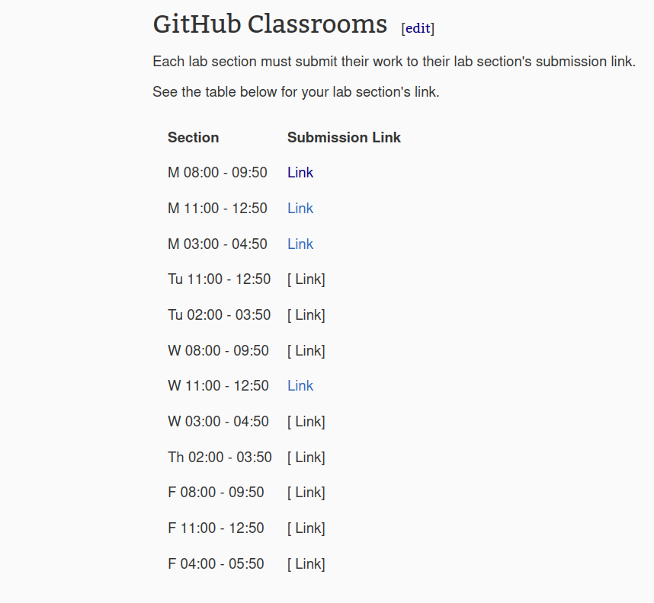
Exercise 0 (Using Github)
Create a GitHub account
Go to the class wiki and click the link for your class time
Clone the repo on a local device
Begin coding

Slide 18
Cloning your personal repository for local work
Now, you should a new page with a LOT of different links and buttons. Don't worry. You should see a big green button labeled "Code" which you can do one of two things with
Copy the URL which you can use to "clone" the repository to your lab machine. See below for cloning instructions.
click and select the option to open with "GitHub Desktop Client" if you're working on your laptop. This creates a clone of the repository on your local machine and you can begin creating files in it.

Slide 19

Cloning via terminal
Copy the URL (same URL from previous steps)
Create a folder on your local machine that you want to store this weeks lab in
Right-click on that folder and choose "Open in Terminal"
Type this command in terminal:

Slide 20
Exercise 1 (Using Github cont)
Create a python script to print the line “This is my first lab exercise!“ to the terminal
Then upload it to git using the commands
git add <file name>
git commit -m “< meaningful message>“
git push

Slide 21

Making commits and pushes via terminal
Save your file(s)
Add the changed files to git's "staging area" by typing:

Slide 22

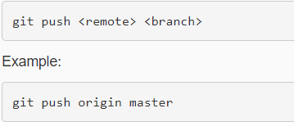
Commit the changes to your local repository by typing:
We have just added a remote to our repository. Now we will push our changes repository to github.

Slide 23
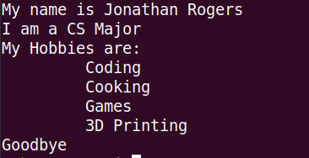
Exercise 2
Create a program to display your name, major, and hobbies. Print each statement on its own line. Your output should be similar to the output below. Remember to use "\t" in your output String to cause it to indent.

Slide 24
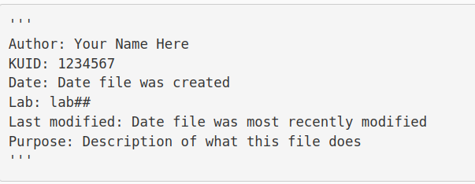
Rules for Homework
All programs must have a comment header
All programs must run
Attendance is 10% of your grade

Slide 25
Rubric
[10pts] Attendance
[20pts] Exercise 0 / Correct submission to GitHub classroom repo
[30pts] Exercise 1
Displays as directed
[30pts] Exercise 2
[15pts] Name, major, and hobbies displayed on separate lines
[15pts] Use of tab character
[10pts] Documentation
Name, date, file description at the top of every .py file

