Slide 1
Lab 2: Booleans
Anahita Memar

Slide 2
Learning Objectives
Learn and use numeric opperations
Using if statements
Learn and use the // and % operators

Slide 3
Numeric Operators
PEMDAS
() Parentheses
** Exponents
* Multiplication
/ Division
+ Addition
- Subtraction

Slide 4
New Operators
// Integer division
7//3 = 2
Will only keep the integer portion from division
% Modulus
7%3 = 1
Returns the remainder of integer division

Slide 5
Boolean Operators
< less than
> greater than
<= less than or equal to
>= greater than or eqaul to
== equal
!= not equal

Slide 6
Boolean Operators
And
Operates on two logical expressions
Results in True only if both its arguments are True
Or
Operates on two logical expressions
Results in True only if either of its arguments are True

Slide 7
Not
Operates on two logical expressions
Results in True only if either of its arguments are True

Slide 8
Example:
3<7
7<3
5!=5
'a'=='A'
5.5>=(10.5+3.1)

Slide 9
Control Flow
Sequential Program
Non Sequential Program
Code
Code
Code
Code
Code

Slide 10
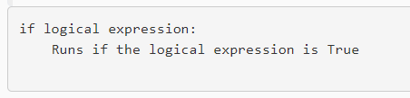
If Statements
A stand-alone if:
if logical expression :
<code>
if child_in_front_of_car :
stop()

Slide 11
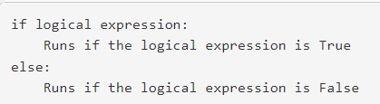
If Else Statements
if logical expression :
<code>
else:
<code>
if person_in_crosswalk:
stop()
else:
go_speed_limit()

Slide 12
If Elif Statements
if logical expression 1:
Runs if the logical expression 1 is True
elif logical expression 2:
Runs if the logical expression 1 is False and logical expression 2 is True
elif logical expression 3:
Runs if the logical expressions 1 & 2 are False and logical expression 3 is True
else:
Runs if all logical expressions are False
if light_red:
stop()
elif light_yellow:
slow_to_stop()
elif light_green:
go()
else:
stop_4way()

Slide 13
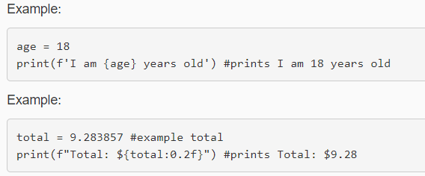
Formatted Strings
Python offers standard strings, just stuff under quotes, and there are also formatted string which allow you to inject variables directly into strings and format numeric output if you wish. All you have to do is...:
put a lower-case f in front of the opening quote
put any variables you want embedded in the string inside curly braces, {}

Slide 14
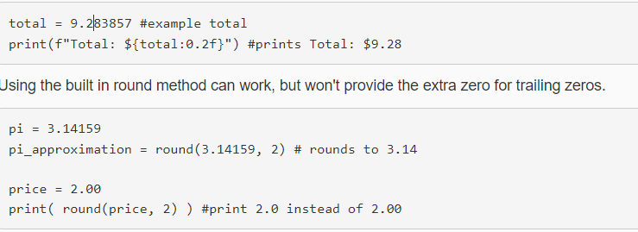
Formatted Strings
NOTE: There is a built in round() function, but it can do some undesirable stuff when it comes to formatting. See below.

Slide 15
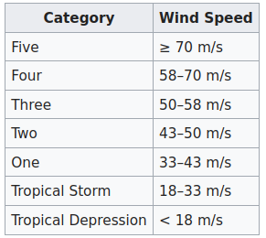
Exercise 1: Saffir–Simpson Scale
Obtain a wind speed from the user and tell them either what category or type if it's just a tropical storm. If the wind speed is invalid, print an error.

Slide 16
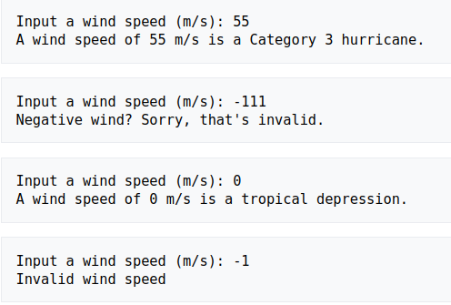

Slide 17
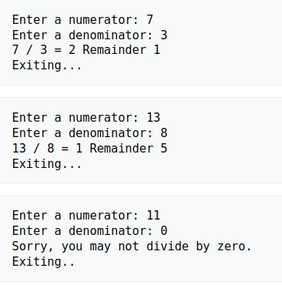
Exercise 2: Long Division Printer
Obtain a numerator and a denominator from the user.
Display the result of long division from the user.
You may assume integers as input, but you must prevent the user from crashing the if they want to divide by zero!

Slide 18
Exercise 3: Soda Packing
Create a program (without using if statements or loops) that takes a number of sodas and then tells the user how many Fridge Cubes, six packs, and single sodas it will be packages as.
Fridge Cubes hold 24 sodas
Six packs hold 6 sodas
Singles hold 1 soda

Slide 19
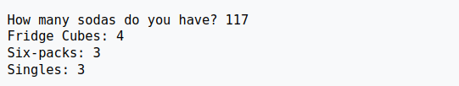
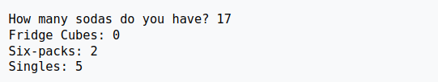
Exercise 4: Soda Packing

Slide 20
Exercise 4: Restaurant
Display a cost per item (before any discounts), a subtotal (before any discounts), a tax amount, a discount amount, and a grand total
Tax is 8%
Subtotal Includes tax

Slide 21
EECS 169 Exercise 4: Restaurant
You will open a restaurant that sells three items: Cold Pasta, Grilled Cheese, and Pie. Your restaurant will do the following:
Ask the user if they want Cold Pasta, Grilled Cheese, and Pie
In all cases, you are prompting them for a yes/no answer. For yes they can type 'y' or 'Y', and for no they can type 'n' or 'N'
If they want an item, find out how many
The user must not be allowed to order less than zero of an item, if they do, simply set the amount they order to zero.

Slide 22
Exercise 4: Restaurant
Ask them for their age, this will affect the discount
Anyone 55 or older gets a 55% senior citizen discount off the total cost (After tax is applied)
Anyone 5 or younger gets all the pie they want for FREE (should not be in total nor taxed)!
Display a cost per item (before any discounts), a subtotal (before any discounts), a tax amount, a discount amount, and a grand total
Tax is 8%

Slide 23
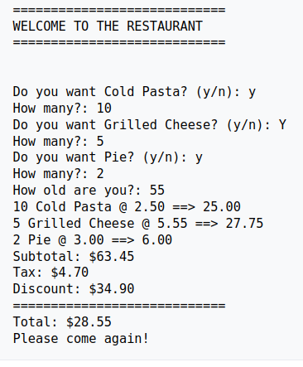
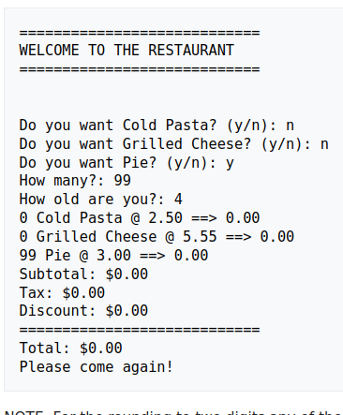
Exercise 4: Restaurant

Slide 24


Exercise 4: Restaurant
Python has multiple ways to round numbers to a significant digit
Use which ever you prefer.

Slide 25
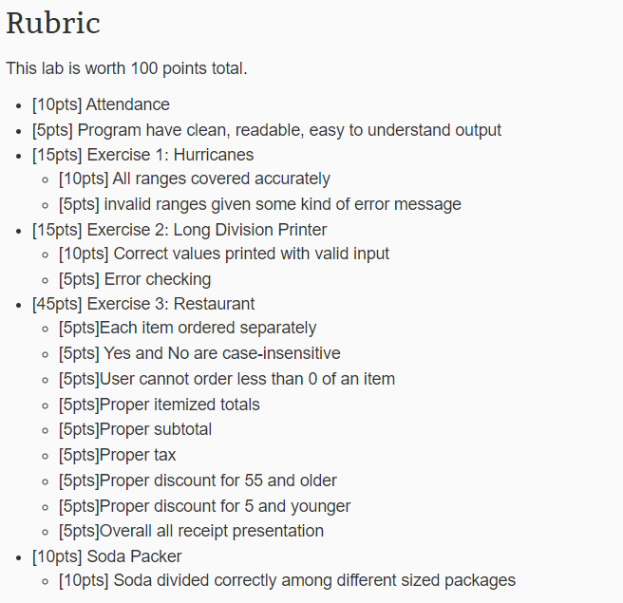
Rubric

