Slide 1
Lab 4: Lists and Files
Anahita Memar

Slide 2
Learning Objectives
Keep using while and for in loops
Keep using strings
Start using Lists

Slide 3
Creating Lists
Just like a variable
  my_list = [] #creates an empty list
  my_list = [1,2,3,4]
  my_list = [‘mint’, ‘ubuntu’,’arch’]
  my_list = [‘A’, 1, ‘String Cheese’, 3.14]
  my_list = list(‘taco’)

Slide 4
Useful List Methods
my_list.append() Adds item to the end of list
my_list.pop() Removes item at the index.
my_list.pop() If index isn't provided,it removes the last element of the list

Slide 5
my_list.insert(index,item) Inserts item at the index my_list.index(target_value) Returns the index of the target value.
WARNING: This will cause an error that ends your program if it is not in the list

Slide 6
Notes:
Lists are iterable, so they can be used in for-in loops
List are indexable, meaning you can access indices 0 to len-1 (examples: my_list[0])
List are mutable, so you can edit them at an index (example: my_list[index] = new_value)
You can check a list's length by using len(my_list) just like strings

Slide 7

List items are ordered, changeable, and allow duplicate values.
List items are indexed, the first item has index [0], the second item has index [1] etc.
Also, To determine how many items a list has, use the len() function:

Slide 8
String and List Operations
Read Index # var[index]
Slice # var[start:stop:step]
Temporary Reverse # var[::-1]
Keyword in # value in var
For in loops # for element in var
len() function # works just like a string

Slide 9


Read Index
Lists :
Strings:

Slide 10

Slice var[start:stop:step]
Lists:
Strings:

Slide 11

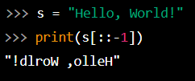
Temporary reverse var[::-1]
Lists:
Strings:

Slide 12


Keyword in value in var
Lists:
Strings:

Slide 13


Concatenate with + var1 + var2
Lists:
Strings:

Slide 14

Write to index var[index]
Lists:

Slide 15
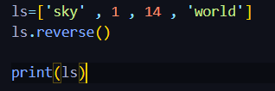
In place reverse var.reverse()
Lists:

Slide 16
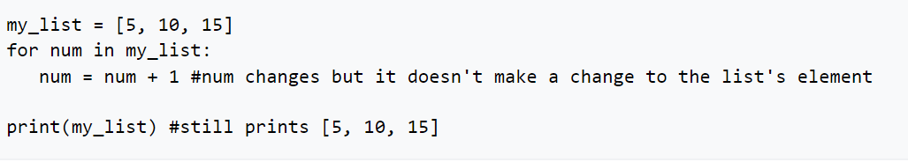
for in loops : for element in var:
Lists:
In short, for in loops are great for looking at values, but if we want to edit the list, we need to get to the index.
With what we know right, we can use ranges.

Slide 17
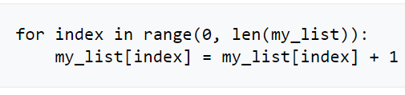
WARNING:
Although lists are compatible with for in loops, please note you should NOT add or remove items to/from a list during a for in loop. It's legal, but can cause unexpected behavior. Changing values is fine, but you shouldn't do anything that changes the length of the list.

Slide 18
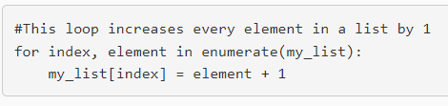
Will eventually learn enumerate, which you're allowed to use if you want, but it won't be expected until we learn about tuples.

Slide 19
For in loops and lists
Don’t edit a list during a for in loop
  It won’t work
  It could be infinite
For now we’ll use ranges and indices
  for index in range(0,len(my_list)):
    my_list[index] = my_list[index] + 1
To edit by element requires enumerate which we’ll get to later

Slide 20
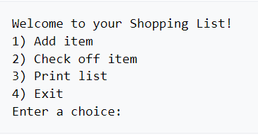
we're going to write a program to help the user make a grocery list, check off things they've grabbed, as well as get some practice making a text-based menu.
Let's start by looking at the menu the user will see:

Slide 21
Exercise 1: Grocery Lists
  Add item
    Let the user enter an item to add to the list
  Check off item
    Prompt user for the index of an item
    Note output starts at 1, the list starts at 0
    Replace the string with dashes except the first and last letter
    banana → b----a

Slide 22
Print List
  Print the list in the correct format
Exit
  Ends the program

Slide 23
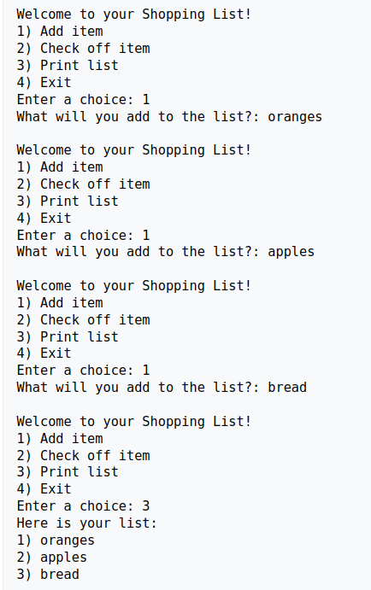
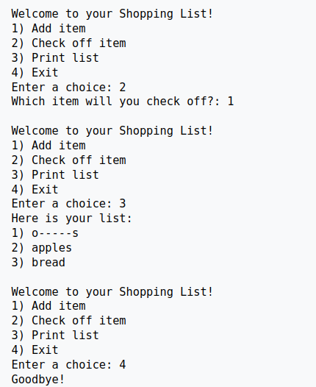
Exercise 1: Grocery Lists

Slide 24
Exercise 2: List Comparisons
In this program you will let the user fill two different lists with as many values as many integers as they want. Assume an individual list will not have any repeat values. Once the lists are filled, you will then print the following stats:
Which list has the larger sum and what that value is
Which list has the larger average and what that value is
How many values appear in both lists
Whether or not the lists are palindromes

Slide 25
Which list has the larger sum and what that value is
Which list has the larger average and what that value is
How many values appear in both lists
Whether or not the lists are palindromes

Slide 26
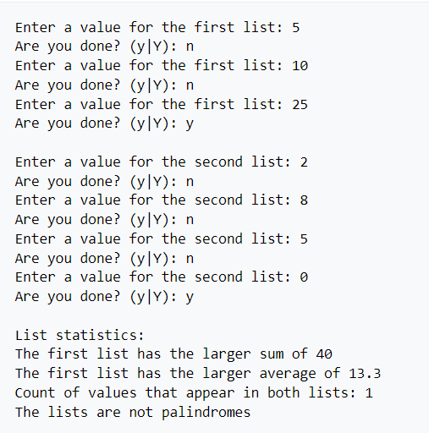

Slide 27
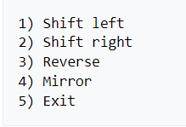
Exercise 3 (169 only): String shifter
Create a program that allows the user to enter a string then manipulate that string in various ways.
Here's the menu the user will see:

Slide 28
After each action is taken (minus exit) print the resulting string. The string should stay in the modified state!
Here's a break down of what each option does:
Shift left
All characters in the string are slid one spot to the left, wrapping around as needed.
Example: Shifting "candle" left would result in "andlec“
Shift right
All characters in the string are slid one spot to the right, wrapping around as needed.
Example: Shifting "candle" left would result in "ecandl"

Slide 29
Reverse
The string is reversed. Example: "candle" would become "eldnac"
Mirror
The string is mirror across the middle. Example: "candle" becomes "cannac". The string "rat" becomes "rar"

Slide 30
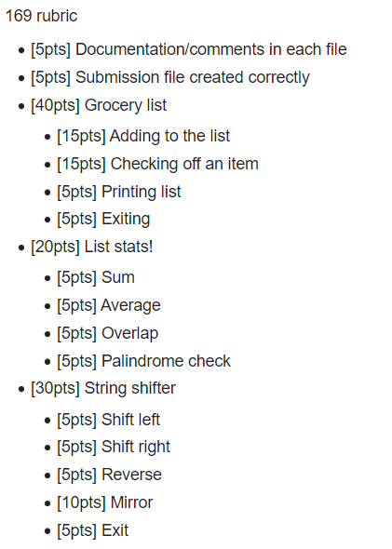
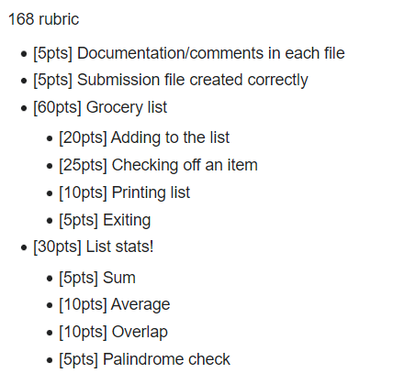
Rubric

