Slide 1
Lab 7: Dictionaries
Anahita Memar

Slide 2
Topics
Dictionary Fundamentals

Slide 3
Due Time
This lab is due one week from your lab's start time.

Slide 4
Dictionaries
A data structure of key-value pairs
A dictionary consists of key-value pairs in which the key is used to read or write the values.
Conceptually it’s a list that uses arbitrary indices instead of numbers
A dictionary is a collection which is ordered, changeable and do not allow duplicates.

Slide 5
Dictionaries
grades = {} # empty dictionary
grades = {‘Chara’:97} # Create a dictionary with an entry
grades[‘Billy’] = 92 # Add an element to the dictionary

Slide 6
Dictionaries
grades['Billy'] = 92
grades['Sally'] = 97
grades['John'] = 55
print(grades)
grades[‘Billy’] = 92
Print(grades)
This creates a dictionary that has three key-value pairs.

Slide 7
Keys
Keys are an arbitrary value
It's used instead of an index
Keys are immutable (e.g. strings, numbers, tuples)
Every key must be unique, values do not have to be unique
A key should be meaningful (it's kind of the whole reason we're using dictionaries instead of lists.)

Slide 8
There are three iterables a dictionary can produce:
my_dict.keys()
  A list of keys
my_dict.values()
  A list of values
my_dict.items()
  A list of key-value pairs (a list of tuples, where each tuple contains (key, value))

Slide 9
Dictionary Methods
grades.keys()
  Returns a “list” of keys
grades.values()
  Returns a “list” of values
grades.items()
  Returns a “list” of key value pair tuples

Slide 10

Removing from a dictionary
Dictionaries have a built-in pop() method that takes a key and removes the corresponding key-value pair.
The method pop also returns the value that the key corresponded to should it be of interest.
grades.pop(key)
  Pops the key and returns the value

Slide 11
Warning and Notes
Dictionaries are iterable
You are not allowed to add or remove entries from a dictionary while iterating it.
This goes for any iterable; you cannot changed the length of an iterable while in a for in loop using that iterable.
  Iterables can’t add or remove entries in a for-in loop.
You can modify the values in a for-in loop
Make sure you only try to access keys that are in the dictionary
An easy way to check if a key exists is key in my_dict.keys()

Slide 12
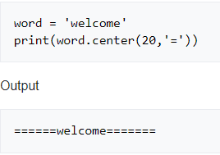
More String Methods
.lstrip() .rstrip() .strip()
  Removes white space in a string from a left, right, or both sides
.replace(old,new)
  Replace all occurrences of old with new permanently.
.center(width,fillchar) Creates a string with the original string centered in the provided length and surrounded by the fill characters

Slide 13
Requirements
For this lab we will do some string processing on the US constitution
Download is available through the lab wiki
  For Linux users the command will automatically download the file

Slide 14
In this program it will be helpful to define the following functions:
build_count(text)
  returns a dictionary with every word in the text and the count of how many times that words appeared in the text
  Words should be cleaned
clean_words(word)
  returns the word with the following changes:
    converted to all lower-case
    all occurrences of '!', '?', ':', ';', ',', '|', '.', '[', ']' ,’(‘,’)’and '--' (those are two dashes side-by-side) are removed
    all leading and trailing whitespace is removed

Slide 15
unique_words(word_counts)
  takes in a dictionary of words and their counts and returns a list (not a dictionary) of all words that have a count of exactly 1
main()
  In charge of printing a welcome message
  Obtains file name of input file (e.g. us_constitution.txt) from user
  Creates the following output files:
    word_data.txt - contains the words and their corresponding counts
    unique_words.txt - contains a listing (no counts) of all words that appear exactly once

Slide 16
Notes
Output does NOT need to be sorted (either alphabetically or by count)
There are some trickier to deal with words that I'm not holding you responsible for handing, such as words that are surrounded with single quotes.

Slide 17
EECS 169
You know how I just said you don't have to handle words that begin and end with single quotes? Well, if you're in 169, then I lied.
You have to detect any words that begin and end with single quotes and remove the quotes from the words.
NOTE: You must not remove single quotes from words that are using them as contractions.
And for this portion, you'll be processing a new data file, the entire play Romeo and Juliet

Slide 18
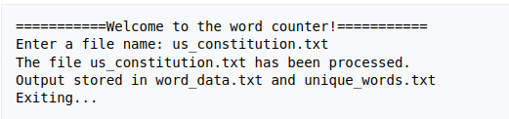
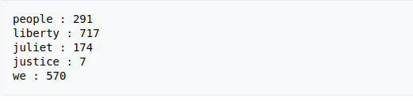
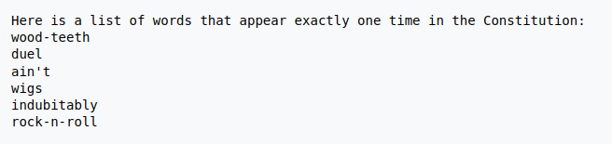
Sample Run
Your word_count.txt would contain something like the following (counts here are not the real ones):
Your unique_words.txt would contain something like the following (example words are made up):

Slide 19
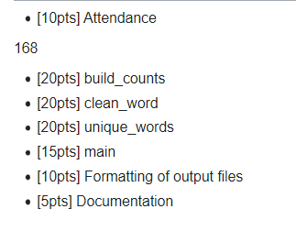
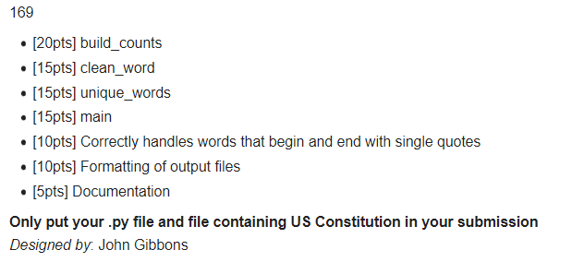
Rubric

