Slide 1
Ray Tracing in Entertainment Industry
Tanaboon Tongbuasirilai
Dept. Computer Science
Kasetsart University
Week 2
Ray tracing components

Slide 2
Ray tracing components
Cameras
Ray-object intersections
Light sources
Visibility
Surface scattering
Indirect light transport
Ray propagation

Slide 3
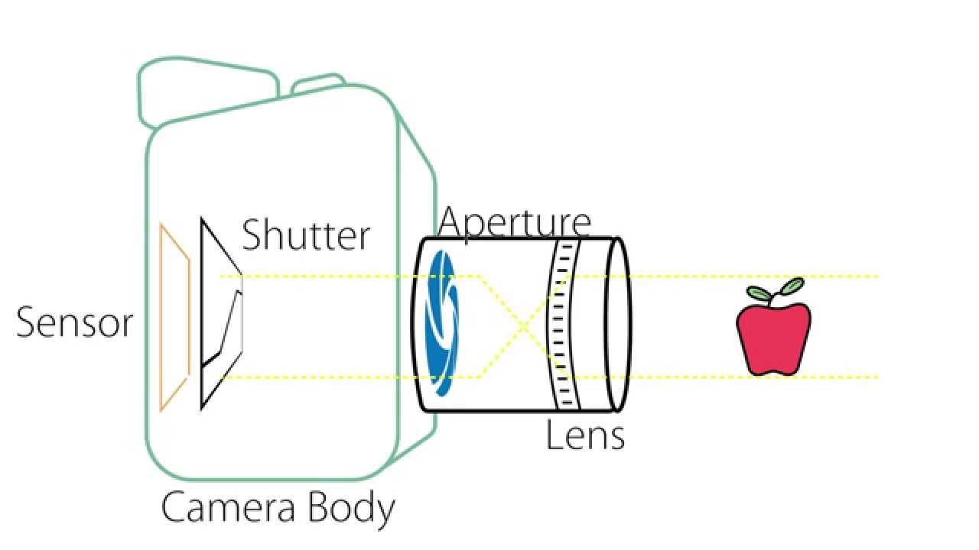
1. Cameras
Image plane, sensor
Shutter
Aperture
Lens
Image plane, sensor
Shutter
Aperture
Lens
https://www.youtube.com/watch?app=desktop&v=gB1IrjFQArk

Slide 4
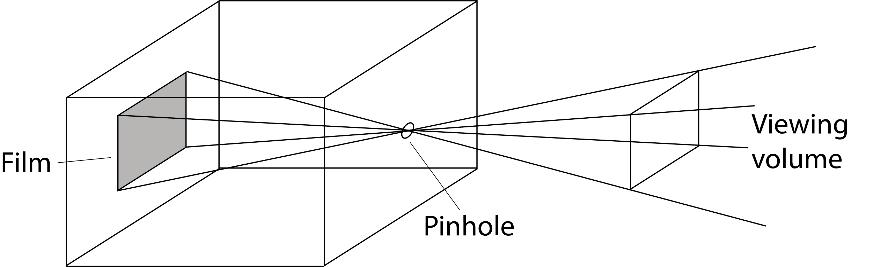
A camera model
Pinhole camera
https://pbr-book.org/3ed-2018/Introduction/Photorealistic_Rendering_and_the_Ray-Tracing_Algorithm

Slide 5
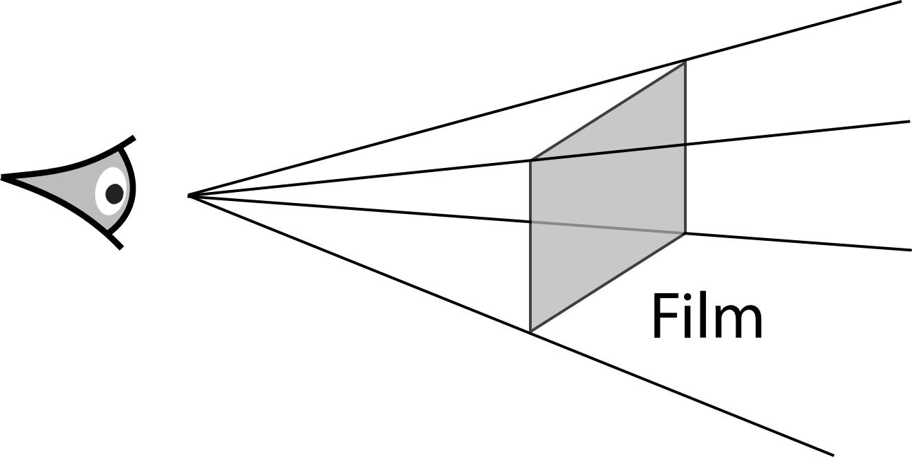
A simplified pinhole camera
Near plane
Pinhole
https://pbr-book.org/3ed-2018/Introduction/Photorealistic_Rendering_and_the_Ray-Tracing_Algorithm

Slide 6
Camera parameters
Near plane / View port
v_{w}
y
z
Camera origin
v_{h}
d
x

Slide 7
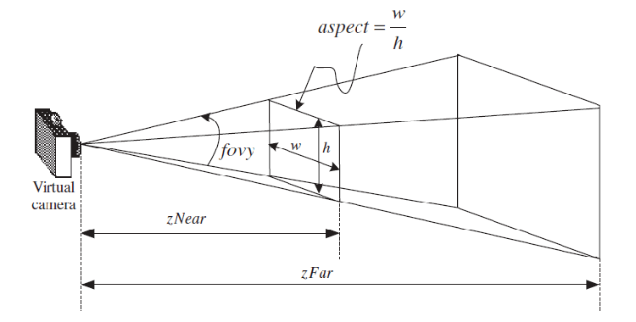
Far plane
A semi-physical simulation system for binocular vision guided rendezvous, Conference: Control Automation Robotics & Vision (ICARCV), 2012, DOI:10.1109/ICARCV.2012.6485269.

Slide 8
Lens
Types of Lens
Thin lens
Concave lens
Adding lens to the camera can perform some effects.
Bokeh
Depth of field
Blurred images
https://blog.demofox.org/2018/07/04/pathtraced-depth-of-field-bokeh/

Slide 9
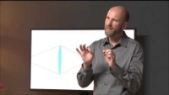
Depth of Field (DOF)

Slide 10

2. Ray-object intersections
Ray equation in a parametric form :
Parametric value
Direction vector
Camera origin
(Ray origin)

Slide 11
Parametric equations
Definition
Parametric equations are a set of equations that express a set of quantities as explicit functions of a number of independent variables, known as "parameters.“
Note that parametric representations are generally nonunique, so the same quantities may be expressed by a number of different parameterizations. A single parameter is usually represented with the parameter t, while the symbols u and v are commonly used for parametric equations in two parameters.
https://mathworld.wolfram.com/ParametricEquations.html

Slide 12
A parametric form of a circle
A circle is typically defined on the cartesian coordinates.
f(t) = f(x(t), y(t))
x(t) = r₁ cos t
y(t) = r₁ sin t
https://mathworld.wolfram.com/ParametricEquations.html

Slide 13

Ray-sphere intersection
substitute

Slide 14
Ray-sphere intersection solution
Solving a quadratic equation to obtain where the ray hits the sphere.
When there is a solution, there is a hitting point ( the least positive value ).
Otherwise, the ray misses the sphere.

Slide 15
Ray-object intersections
Plane, rectangle
Triangle
Ellipsoid
Cylinder
Cone

Slide 16
3. Light sources
Light is the source of photon distributions in a rendered scene.
Some materials can act as light sources. It can emit light under some conditions.
Light sources have properties such as intensity, color, size and shape.
Light can be measured by using special devices to capture radiance distribution under the environment (advanced topic).

Slide 17
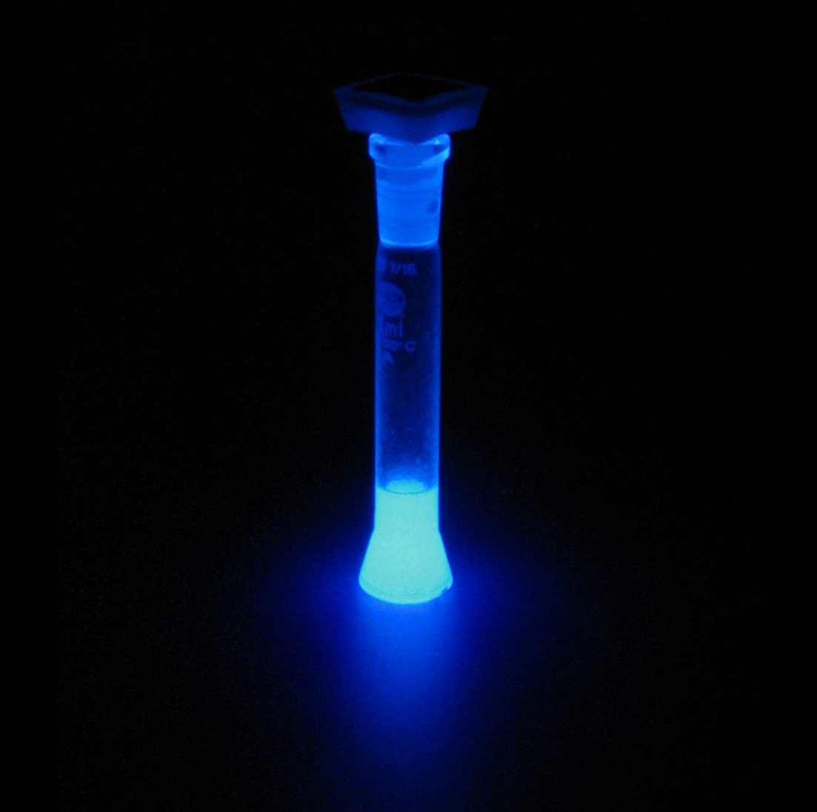
Luminescence
Luminescence is the emission of light by a substance as a result of a chemical reaction (chemiluminescence) or an enzymatic reaction (bioluminescence).
https://www.moleculardevices.com/technology/luminescence
https://www.leica-microsystems.com/science-lab/life-science/basic-principles-of-luminescence/

Slide 18
Light-emitting materials
Phosphorescent materials
The light emission continues for a period of time (which can be considerable) after the X-ray absorption has taken place.
Fluorescent materials
The emission of light is so quickly completed following the X-irradiation that it can be regarded as instantaneous.
Thermoluminescent materials
This light emission is associated with heating.
https://www.sciencedirect.com/topics/biochemistry-genetics-and-molecular-biology/luminescent-material

Slide 19
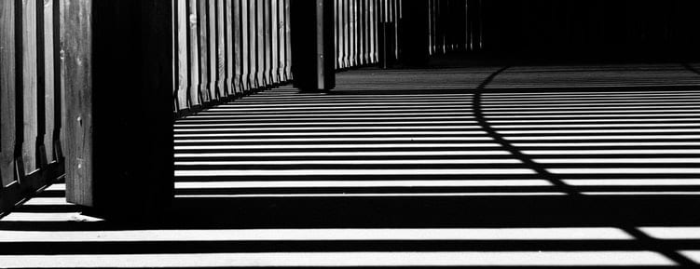
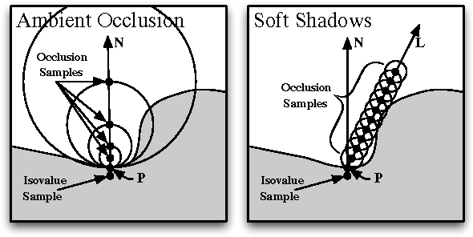
4. Visibility
Shadow
Occlusion
Indirect lighting

Slide 20
Visibility types
Object – Object
Object – Light
Camera – Object, Light

Slide 21
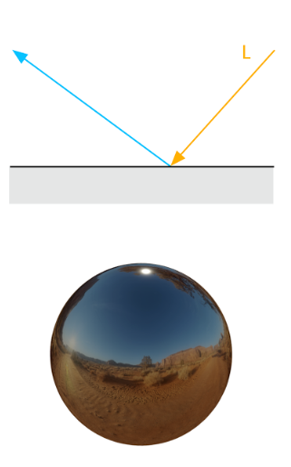
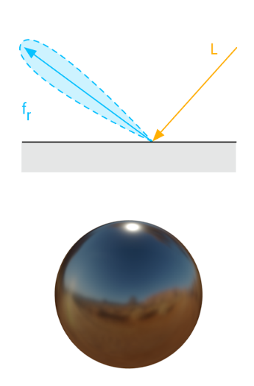
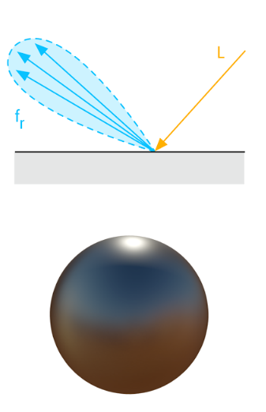
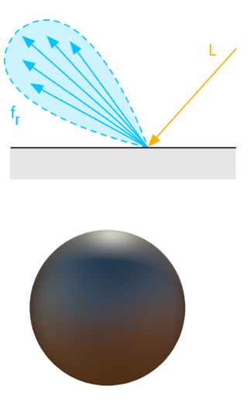
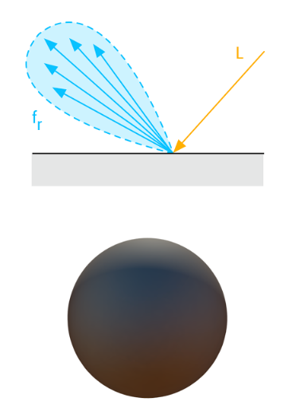
5. Surface scattering
How light interacts with surface materials.

Slide 22
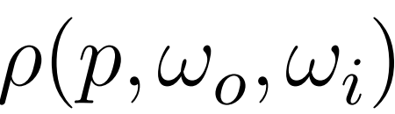



Bidirectional Reflectance Distribution Function (BRDF)

Slide 23
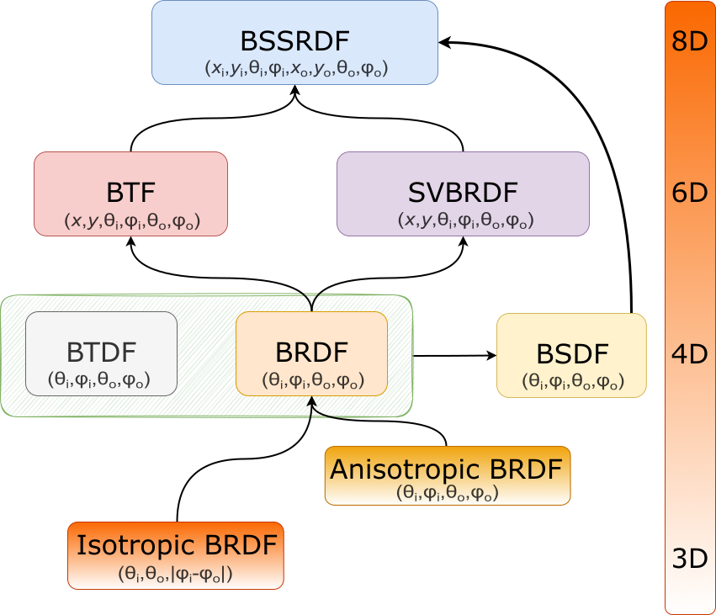
Taxonomy of scattering functions

Slide 24
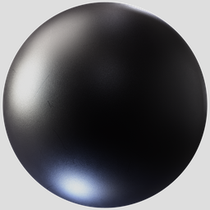
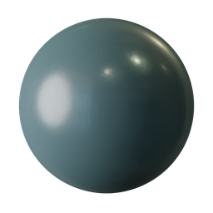
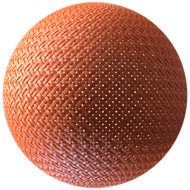
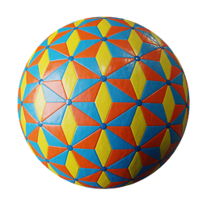
Examples
https://www.blenderkit.com/asset-gallery-detail

Slide 25
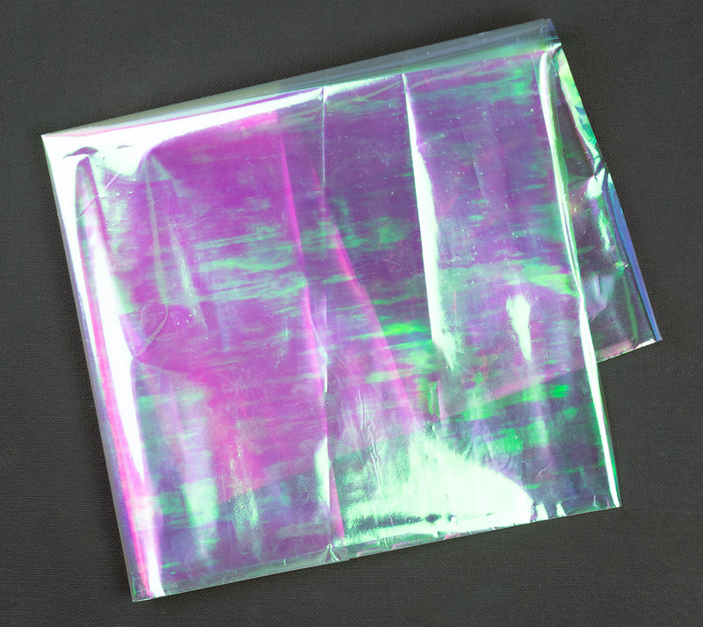
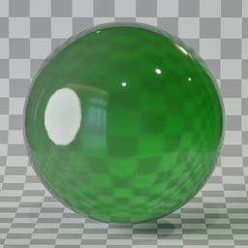
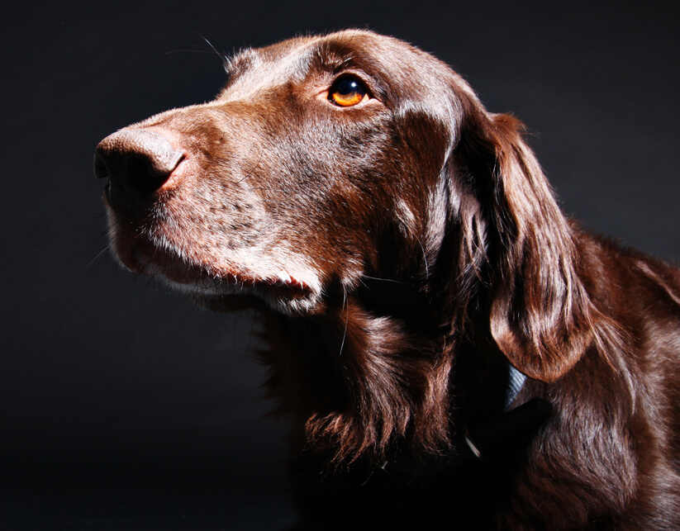
More examples

Slide 26
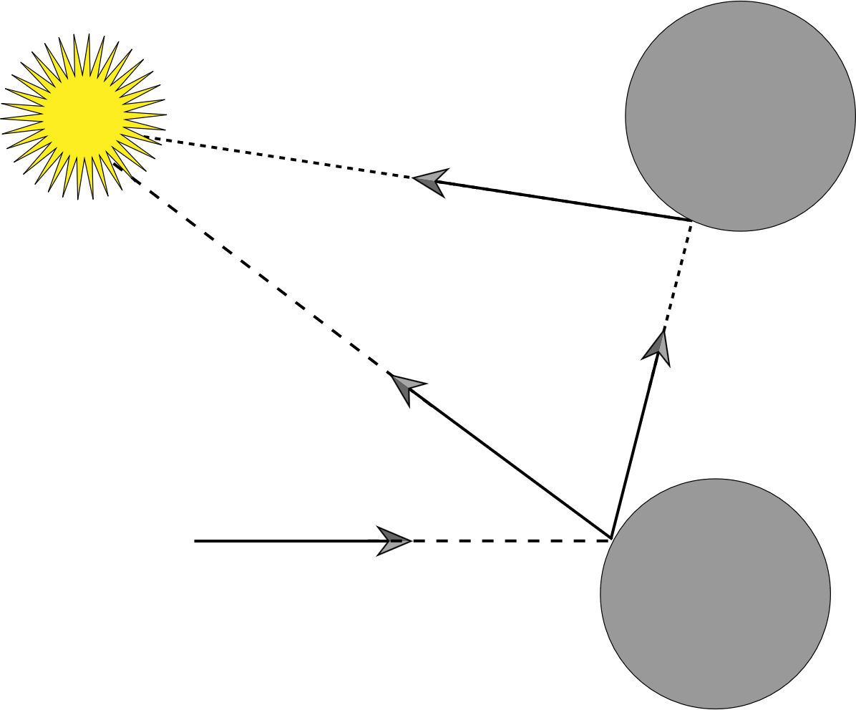
6. Indirect light transport

Slide 27
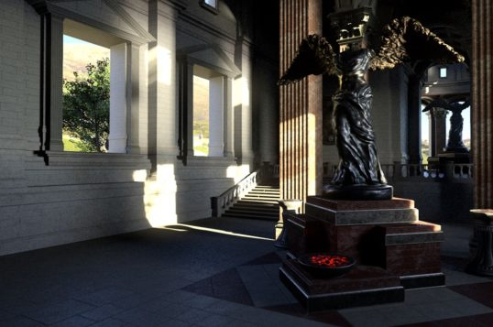
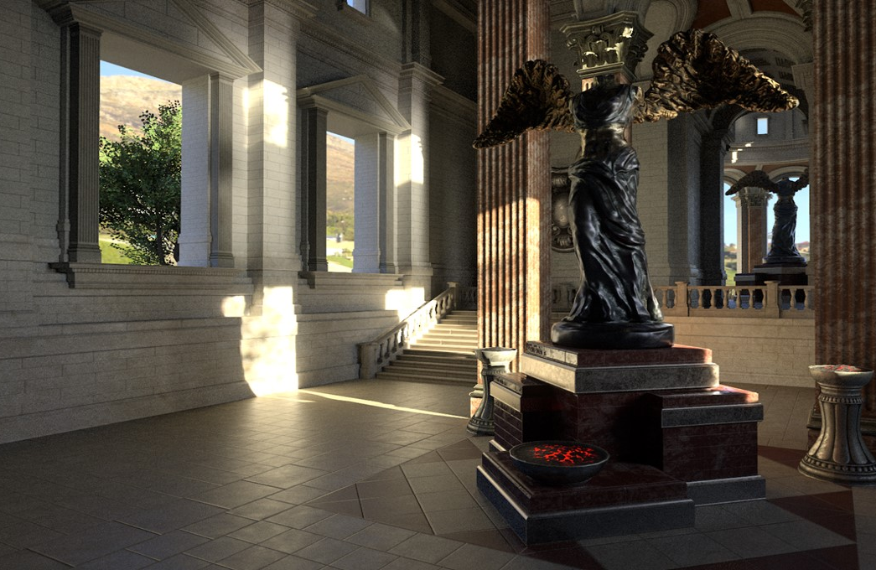

Indirect lighting effects
https://blogs.nvidia.com/blog/2022/08/04/direct-indirect-lighting/

Slide 28
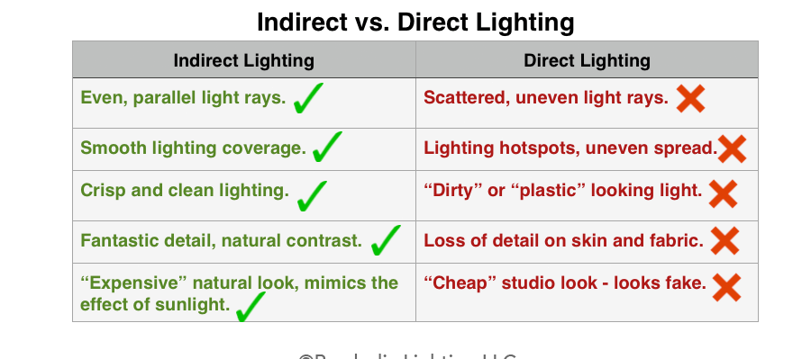
Photography perspectives
https://www.parabolixlight.com/indirect-vs-directlighting

Slide 29
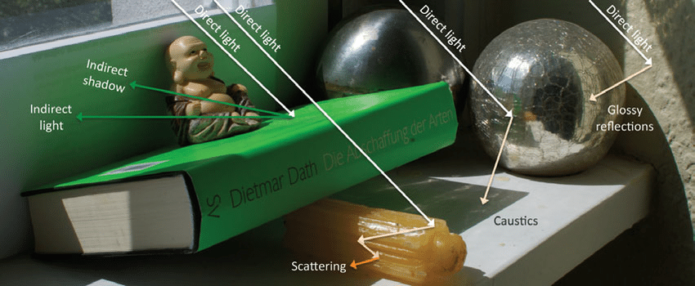
Lighting effects
Rauwendaal, Randall. (2013). Voxel Based Indirect Illumination using Spherical Harmonics. 10.13140/2.1.1300.6403.

Slide 30
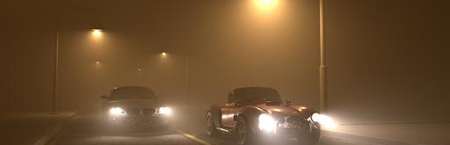
7. Ray propagation
How light travels and is distributed through out the scene.
Light attenuation along the distance.
Light travels through participating medium.
Attenuation
Multiple scattering
Light propagates in a straight direction or wave directions.
http://graphics.ucsd.edu/~henrik/papers/radiance_caching/

Slide 31
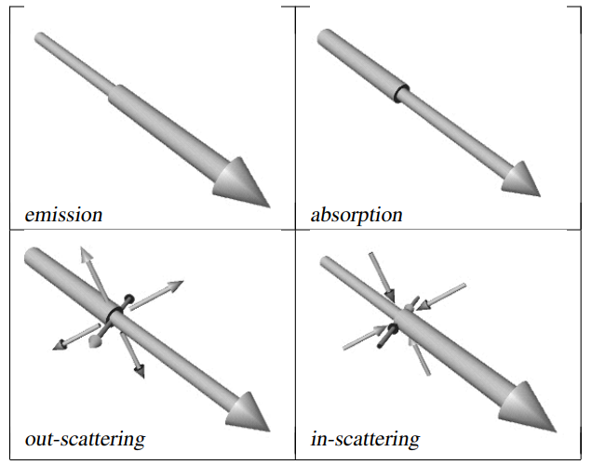
Light interactions in a participating medium
https://inria.hal.science/inria-00510151/file/cerezo.pdf

Slide 32
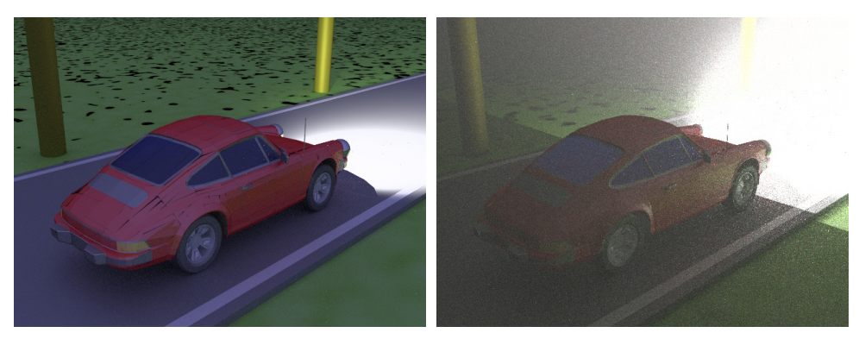
Example

Slide 33
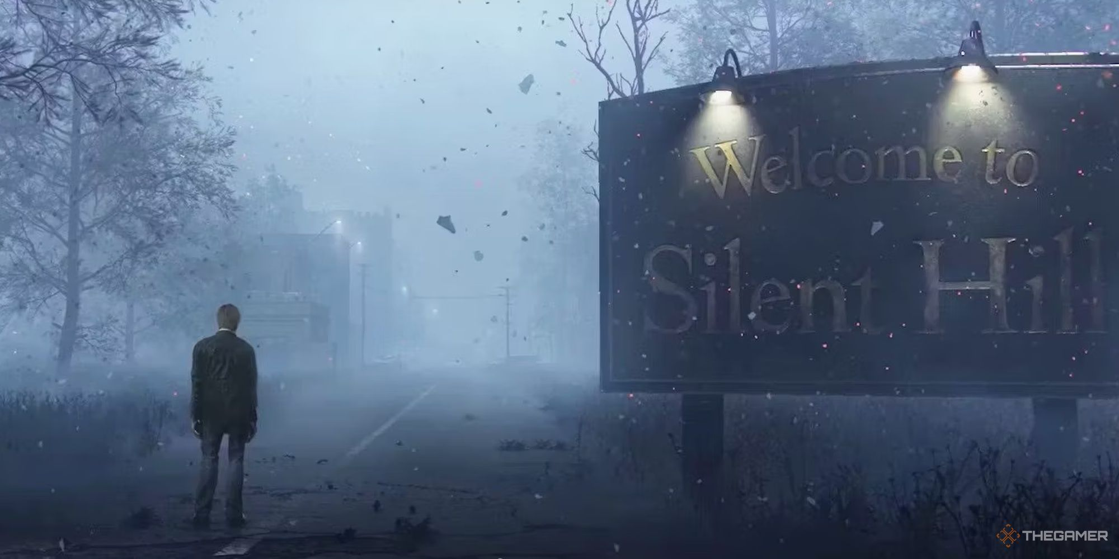
Fog

Slide 34
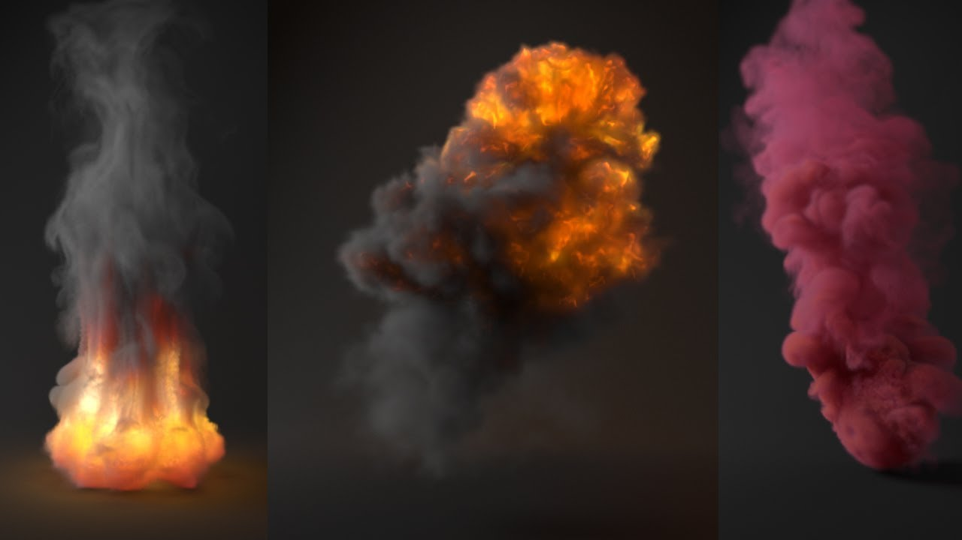
Smoke and Fire

Slide 35
The ray tracing rendering pipeline
Renderer
Integrator
Object
Shape – Geometry
Appearance – Material properties
Light
Camera

Slide 36
Ray tracing pipeline
Camera
Renderer
Scene
Integrator
Light
Material

Slide 37
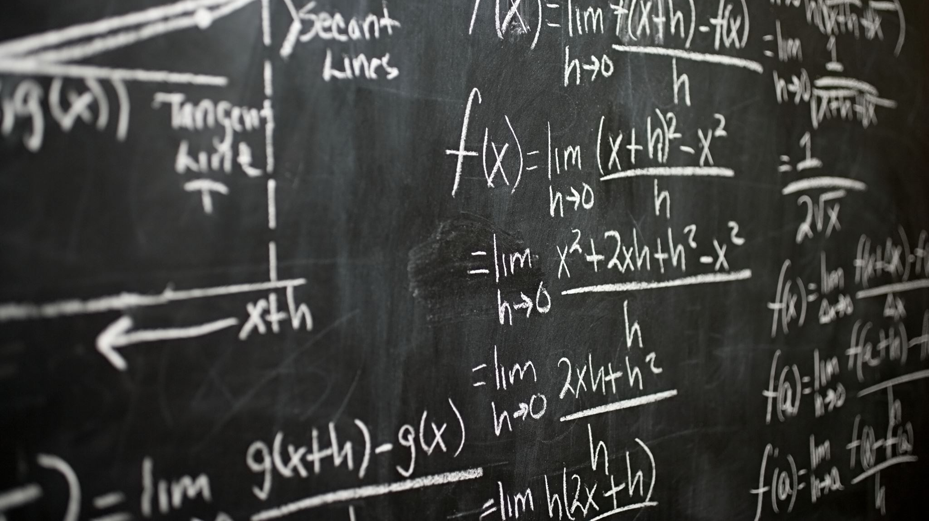
Class diagram of ray tracing

