Slide 1
Ray Tracing in
Entertainment Industry
Tanaboon Tongbuasirilai
Dept. Computer Science
Kasetsart University
Week 10

Slide 2
Simple visual effects
Depth of Field (DoF)
Motion blur
Notes:
Dof → found in many film / movie / game productions
Related to human eyes
Motion blur → giving clues of moving objects

Slide 3
Depth of Field (DoF)
Depth of field is the effect in which objects within some range of distances in a scene appear in focus, and objects nearer or farther than this range appear out of focus.
Depth of field is frequently used in photography and cinematography to direct the viewer's attention within the scene, and to give a better sense of depth within a scene.
https://developer.nvidia.com/gpugems/gpugems/part-iv-image-processing/chapter-23-depth-field-survey-techniques
Notes:
definition

Slide 4
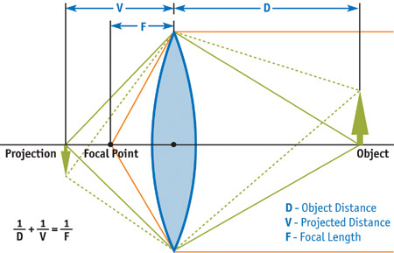
Thin Lens
https://developer.nvidia.com/gpugems/gpugems/part-iv-image-processing/chapter-23-depth-field-survey-techniques
Notes:
Many parameters involve to focus.
This image is a typical focus scenario =
Sharp projection (projection in the focus) is at V
The equation shows sharp focus.

Slide 5
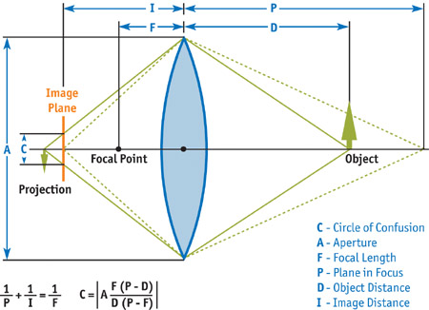
Circle of Confusion
When the CoC is smaller than the size of a pixel, that pixel is in focus while a CoC larger than a pixel will be out of focus and cause blurring
Sharp focus line is depicted by green dashed lines.
Notes:
What if the object is moved out of the focus.
Image plane = where sensor lies
Focus scenario = dashed lines
DOF scenario = green lines
Class discussion
What parameters affect to circle of confusion ?
A – aperture → affect to DOF ?

Slide 6
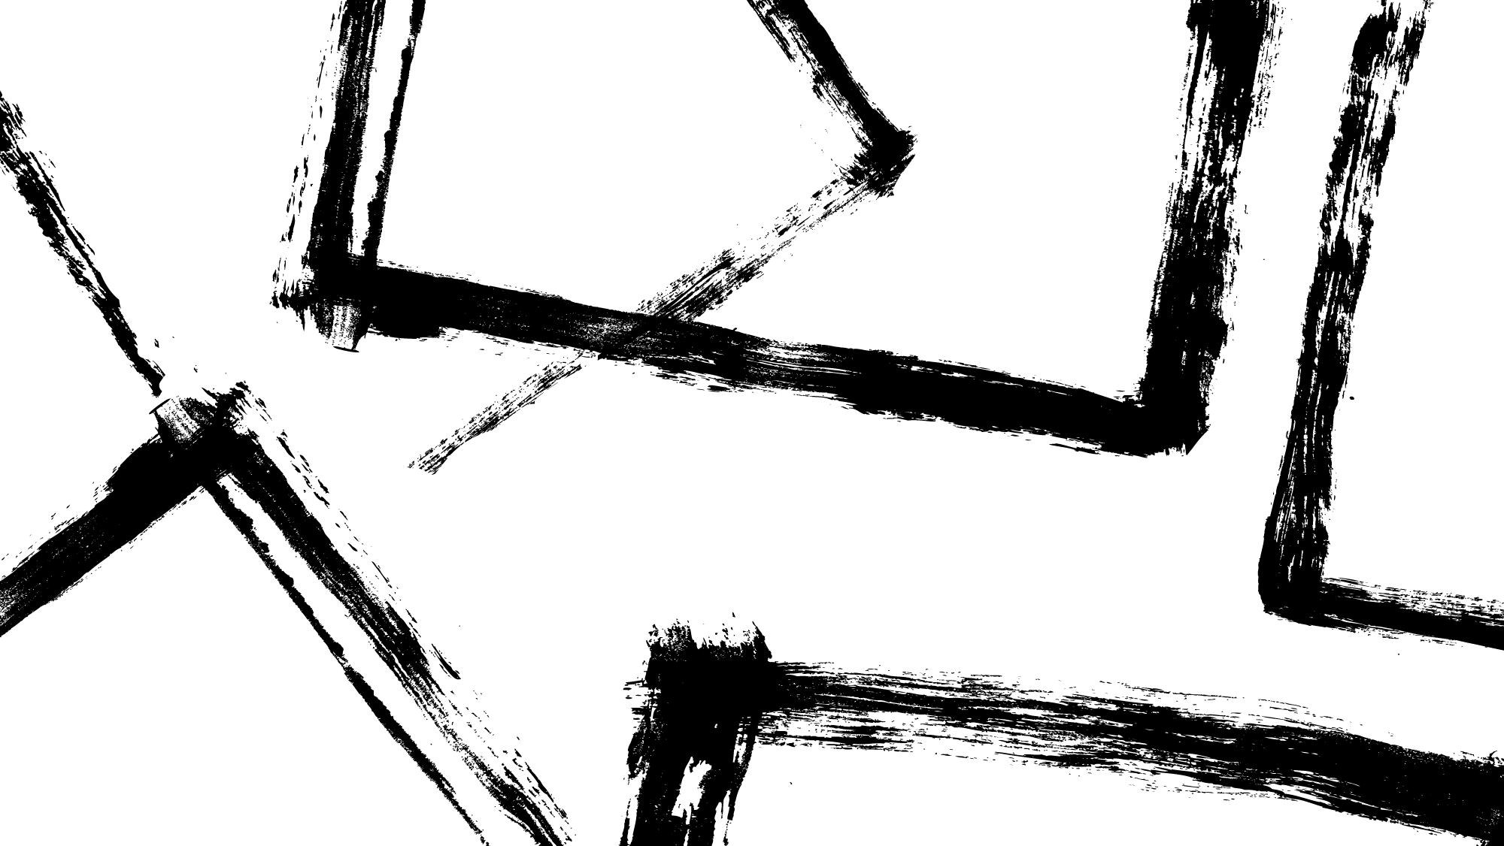
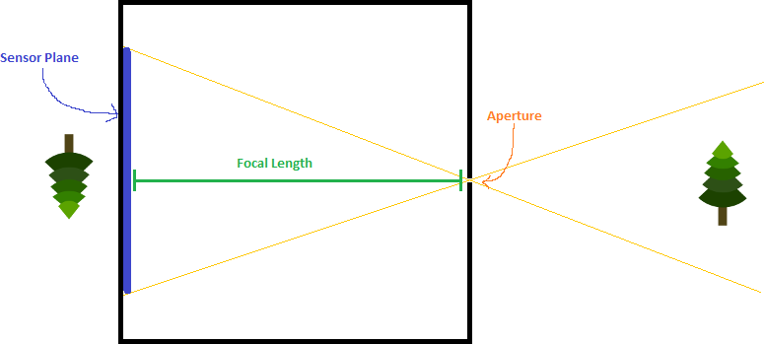
A tricky camera model
Center of the camera.
So far, we simulate this kind of pinhole camera model.
Notes:
We put a camera at the pinhole.
Aperture = camera

Slide 7
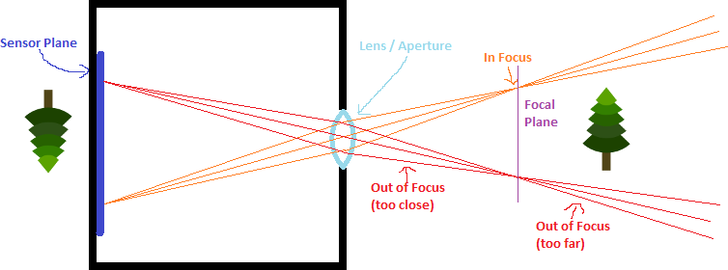
Adding Lens to the pinhole
Notes:
Now add lens to the pinhole = aperture added = circle of confusion created

Slide 8
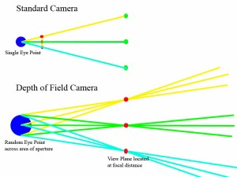
Comparison
Do sampling at the center of the lens.
- Lens has its radius.
- Do sampling inside lens radius.
- Take the average of sampled rays.
https://steveharveynz.wordpress.com/2012/12/21/ray-tracer-part-5-depth-of-field/

Slide 9
Lens radius can be found by using Focus distance and Defocus angle.
- Virtual film
- Focus plane
Radius
Defocus angle
Focus distance
Notes:
2 parameters can be used to infer another one.

Slide 10
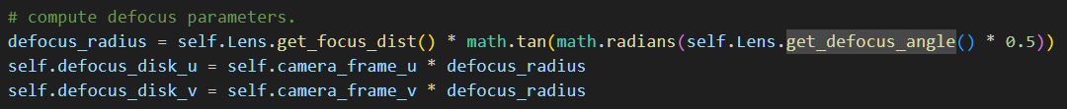
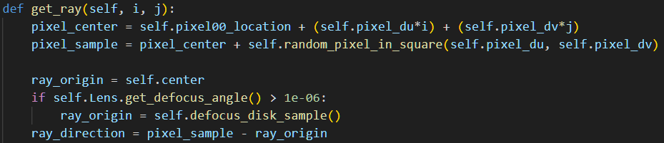
Add DoF in our code
Notes:
(old) Ray origin = camera origin
(new) Ray origin = random inside a virtual lens (DoF applied)

Slide 11
Motion Blur
“Motion blur is an effect that manifests as a visible streak generated by the movement of an object in front of a recording device. It is the result of combining apparent motion in the scene and an imaging media that integrates light during a finite exposure time. This relative motion can be produced from object movement and camera movement and can be observed both in still pictures and image sequences. In general, sequences containing a moderate amount of motion blur are perceived as natural, whereas its total absence produces jerky and strobing movement”
https://graphics.unizar.es/papers/Navarro_motionblur.pdf
Notes:
definition

Slide 12
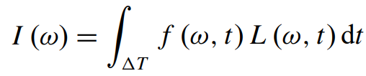
Origin of the phenomenon
When taking a picture, scene radiance is captured by a camera. Additionally, intrinsic parameters of the capturing device influence to natural effects such as motion blur.
Radiance information of an image
Time is one of the most important parameters.
Radiance
Relevant parameters such as optics, shutter, aperture and film.
Notes:
Taking a picture = capturing radiance + intrinsic parameters of the capturing device
Integrating over time domain if radiance changed over time or other parameters changed.

Slide 13
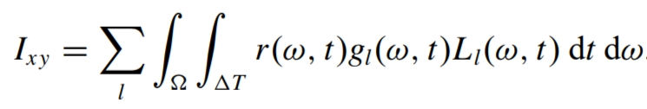

Formalized equation
Spatio-temporal relationship
Geometric term (Occlusion term, Visibility term)
Temporal term
Spatial term

Slide 14
Time interval
Time Interval Ray Tracing for Motion Blur (TVCG 2017) (youtube.com)

Slide 15
A simplified Space-Time ray tracing for motion blur
An object is allowed to be moved.
A ray has a time parameter.
Key idea : A random time sample captures a moving object independently.
Notes:
Explain a bit about motion blur
Moving object -> space parameter(according to time)
Time -> time parameter

Slide 16
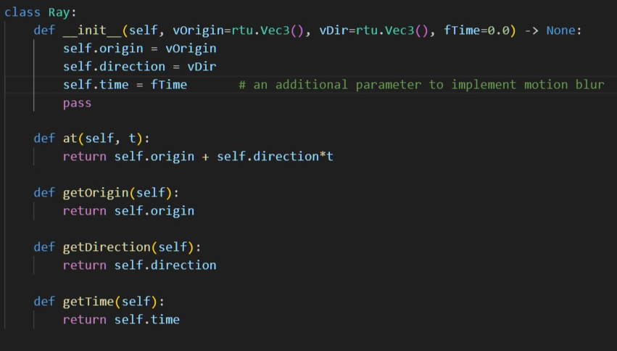
Updating Ray class

Slide 17
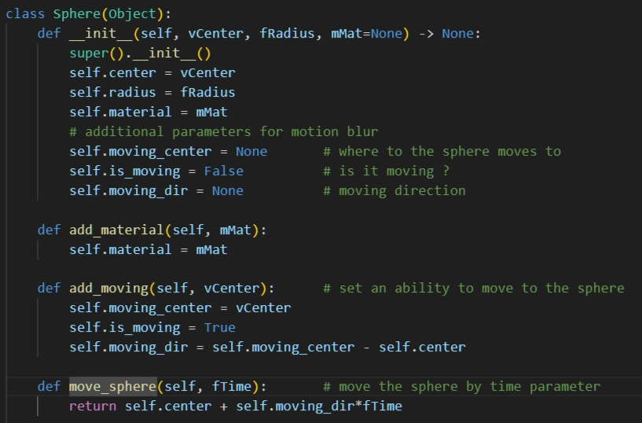
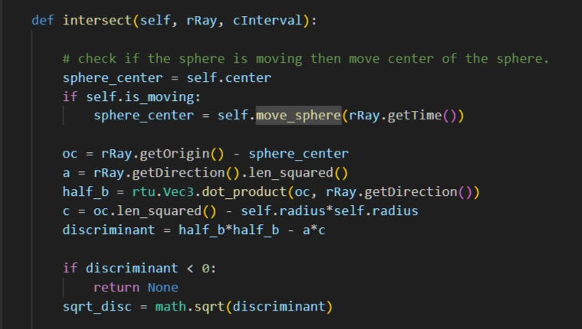
Updating an object class
Notes:
Enough ?

Slide 18
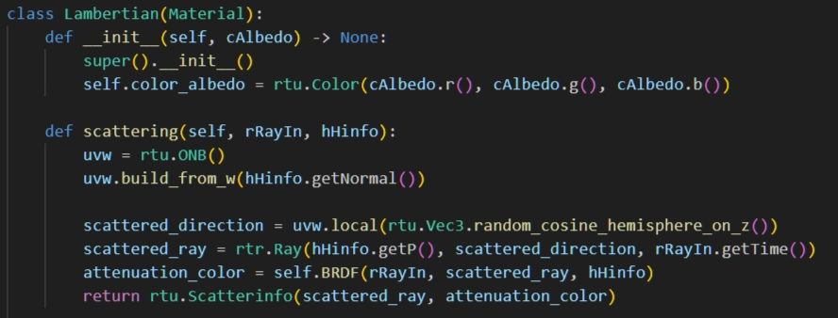
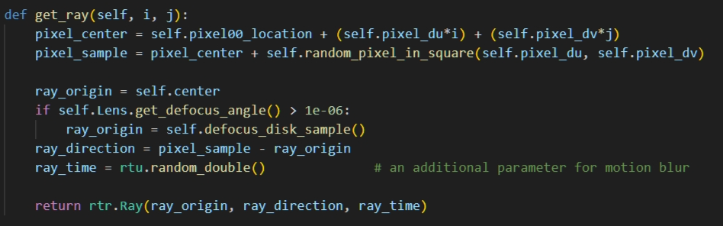
Updating scattering behavior !
A material class
The camera class

Slide 19

Codes and class assignment !
Github : RT-python-week10
  https://github.com/KUGA-01418283-Raytracing/RT-python-week10

