Slide 1
Ray Tracing in Entertainment Industry
Tanaboon Tongbuasirilai
Dept. Computer Science
Kasetsart University
Week 3
Image formation and rays

Slide 2
Image formation and rays
Camera and Lens classes
Ray class
Utility class

Slide 3
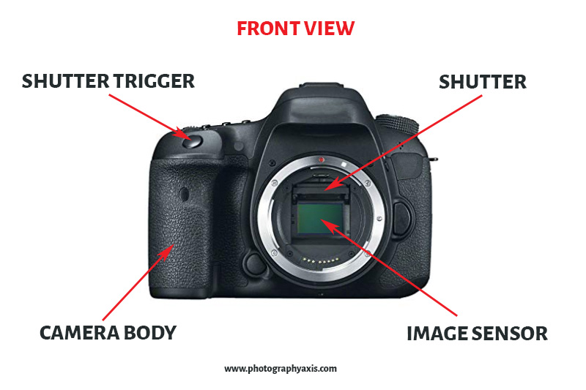
1. Recapped – Basic camera
Image plane, sensor
Shutter
Aperture
Lens

Slide 4
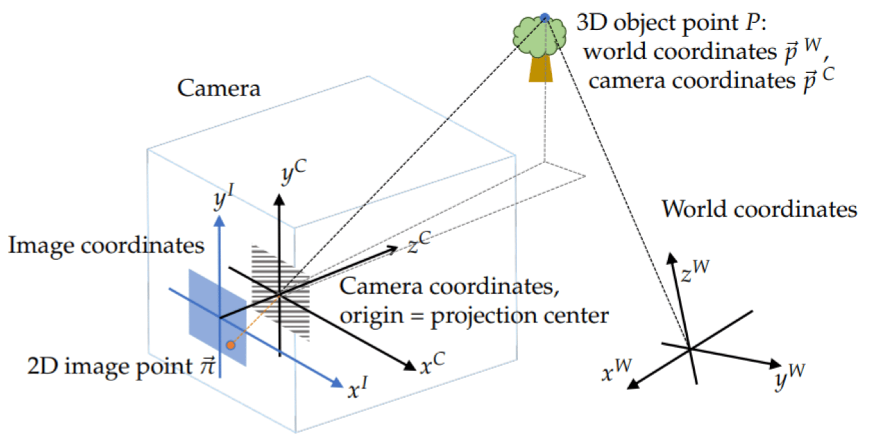
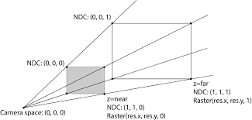
Camera class
Attributes
Image width and height
Aspect ratio
Field of view
Camera center or look from (position)
Camera look at (position)
Camera Lens
Viewport width and height
Camera frame coordinates
Delta pixel (spacing between each pixel)
Film or image sensor

Slide 5
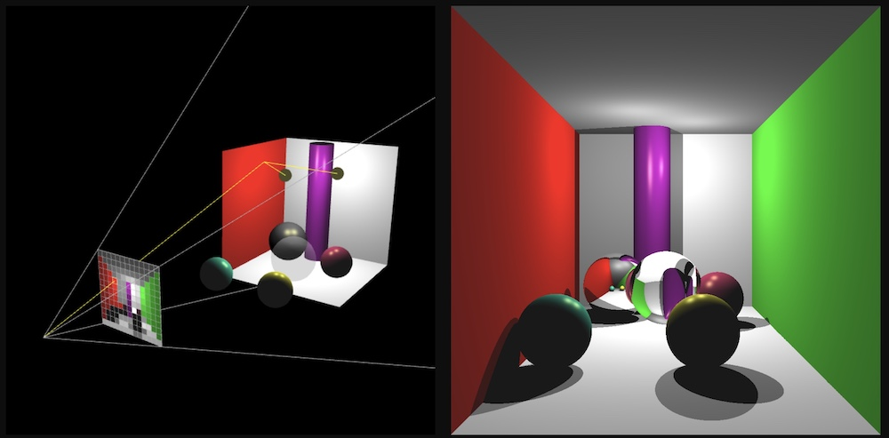
Camera class (cont.)
Methods
Lens setup
Camera setup
Ray shooting
Film writing

Slide 6
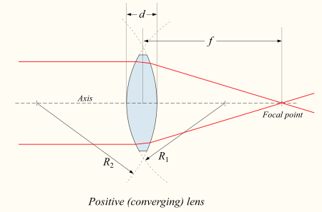
Lens class
This Lens approximation
Attributes
Defocus angle
Focus distance
Methods will be later explained in a late chapter.

Slide 7
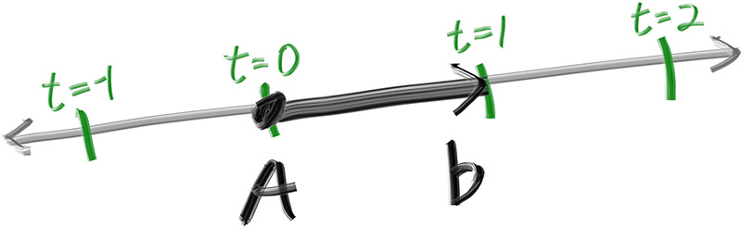
Ray class
Attributes
Origin
Direction
Methods
Ray at t

Slide 8
Utility classes
Vector class
Define cartesian coordinates
Color class
Define color spectrum (RGB or multi spectrum)
Interval class
Handle a value in a specified range.
Hit info class
Keep information of the ray intersection.

Slide 9
Vector class
Name : Vec3
Attributes
Array e[3]
Methods
Coordinate values : x(), y(), z()
Length of a vector
Unit vector / normalize
Dot product
Cross product
Mathematical binary operations : + - * / (add, minus, multiply, div)
Unary operation : - (negation)

Slide 10
Color class
Vec3 as a base (parent) class
Color is a child class of Vec3
Attributes
Array e[3] (derived from Vec3)
Methods
RGB color : r(), g(), b()
Binary operations : + - * /
Unary operation : negation
Conversion : ex. [0,1) --> [0, 255]

Slide 11
Interval class
Limit any arbitrary scalar value in the range.
Attributes
Min value
Max value
Methods
Is the value inside ?
Is the value bounded ?
Is the value near zero ?
Clamping the value
Empty interval
Unlimited interval

Slide 12
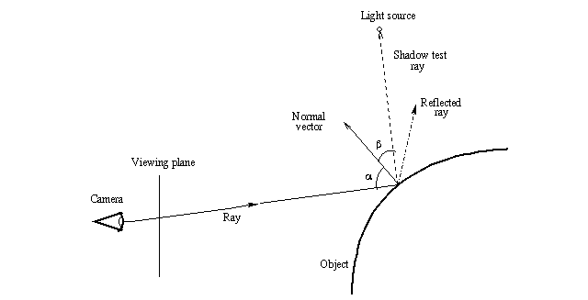
Hit info class
Point of intersection.
When the intersected ray hits.
Surface normal at the intersection point.
What material is hit.
Is it front face or back face ?

Slide 13
Static method
A static method is a class method which can be called without instantiating.
A non-static method is a class method which can be called from instances of the class.

Slide 14
Image writer (python)
Python imaging library (PIL)
https://pypi.org/project/Pillow/
Example (python)
from PIL import Image as im
png_film[y,x,color] = color
data = im.fromarray(png_film.astype(np.uint8))
data.save(strPng_filename)

Slide 15
8-bit color
Each color channel has 256 values.
8-bit RGB color ~ 16m colors.
Color ranging from [0,1] --> [0,255].
Clamping is sometimes needed.

Slide 16

Shooting a ray (Class assignment (3.))
Shoot
Shoot a ray at the center of the pixel.
get_center_ray()
Shoot
Shoot a ray at a random location inside the pixel.
get_ray()

Slide 17
Shoot a ray at a random location
Random a location inside a rectangle.
Method : random_pixel_in_square(vDu, vDv)
Pixel center is at (0,0)
Pixel corners are (-0.5,-0.5) (-0.5,0.5) (0.5,-0.5) (0.5,0.5).
(0.5,0.5)
vDu = Width scaling vector
(-0.5,-0.5)
vDv = Height scaling vector

Slide 18
Renderer class
Regarding the class diagram, the renderer defines how we combine all ray tracing components.
For now, it includes the following instances
Camera
We also need to implement some functions to manage
Background color
Ray color
Simple ray intersection
See RT_renderer.py

Slide 19

Codes and class assignment!
Github : RT-python-week03
https://github.com/KUGA-01418283-Raytracing/RT-python-week03

