Slide 1
Ray Tracing in Entertainment Industry
Tanaboon Tongbuasirilai
Dept. Computer Science
Kasetsart University
Week 9
Sampling techniques and reconstruction
Notes:
Solving rendering equation is not easy.
So many factors need to be considered.
Discrete math, randomness, math transformations

Slide 2
Sampling techniques and reconstruction
What sampling techniques do we have so far ?
Random sampling of a 3D vector : random_vec3()
Random unit vector in a unit disk : random_vec3_in_unit_disk()
Random unit vector in a unit sphere : random_vec3_unit ()
Random directions in scattering()
Random locations in a pixel
How random samples impact to the ray tracer ?
Camera
Material
Light
Integrator

Slide 3
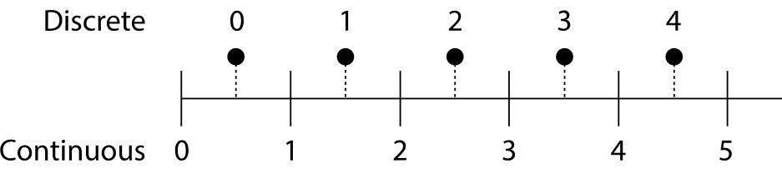
Why do we need sampling ?
Discrete vs. Continuous
Image with different resolutions
Functions is defined on Real (continuous) domain.
We would like to represent continuous functions in an efficient way.
Notes:
Show example of linear plot of a gradient color.
Sampling with different pixel resolution.

Slide 4
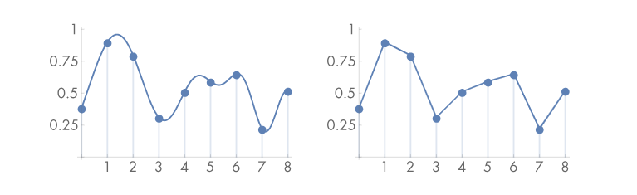


Sampling and reconstruction
Samples
Reconstruction, Approximation, Estimation
Notes:
ซ้าย – มีฟังก์ชัน จะ sampling ยังไงให้เหมาะสม
ขวา – มี sampling จะ recover ฟังก์ชันยังไงให้เหมาะสม
Class discussion – เห็นอะไรใน 2 รูปนี้บ้าง

Slide 5
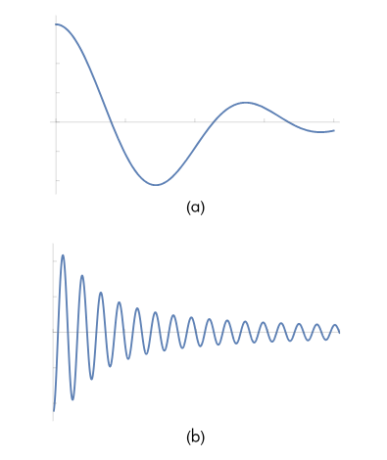
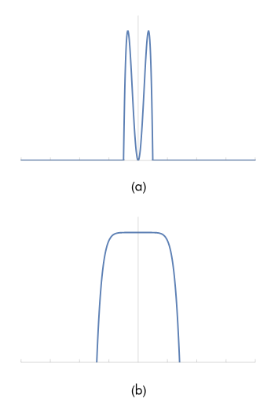
High-frequency vs. Low-frequency
Spatial domain
Frequency domain
Notes:
frequency of signals
Frequency domain – fourier

Slide 6
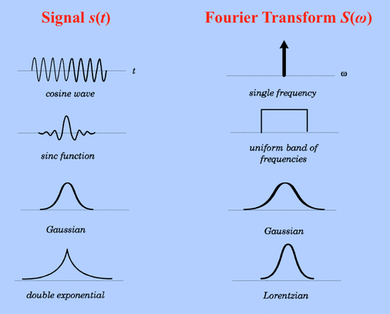
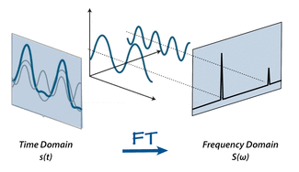
Fourier transform
mriquestions.com/fourier-transform-ft.html

Slide 7


Fourier transform of a 1D function
Fourier transform
Inverse Fourier transform
Notes:
Class discussion
เห็นอะไรใน 2 สมการนั้น
------ แปลงกลับไปกลับมาด้วยสมการเดียวกัน

Slide 8
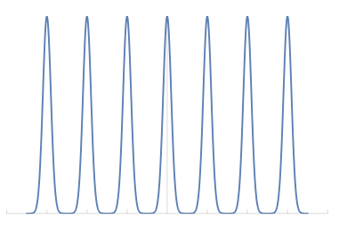
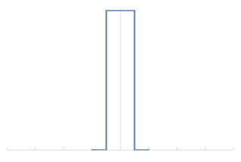
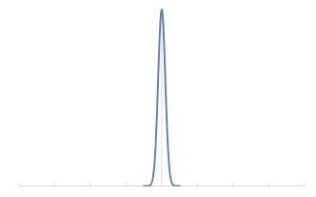
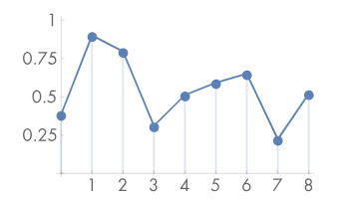
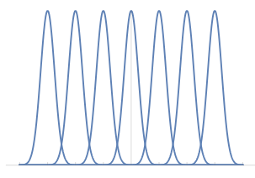
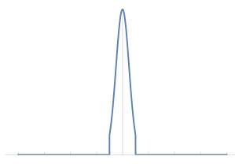
Aliasing
F(w) = Fourier transform of f(x)
High-frequency
f(x)
Convolutions of F(w)
A box function
Low-frequency
Notes:
Different sampling frequency leading to aliasing.
Upper = high sampling
Lower = low sampling
Box function = filtering
.
Benefit of Fourier transform

Slide 9

What it means to image synthesis.
We would like to reconstruct the function representing the 3D scene.
Aliasing occurs naturally for such problem and there are many parameters involving in this issue.
What to write in the image plane.
Radiance contribution at the location (x,y).
What we consider in sampling.
- Image resolution
- Time
- Lens
- etc.
Notes:
f(x,y) is a function of an image given that a location of the image plane.
Two parts in consideration.
Radiance contribution at a given location (x,y)
What factors are used to formulate the image.
sampling → camera
sampling → scene (objects, materials, etc..)

Slide 10
Antialiasing techniques
Nonuniform sampling
Nonuniform sampling tends to turn the regular aliasing artifacts into noise, which is less distracting to the human visual system.
Adaptive sampling
If we can identify the regions where they need more samples, it will be less expensive than taking more samples in every region.
Prefiltering
Filtering can be used to mitigate aliasing by lower frequencies so that the current sampling rate cannot capture the aliasing.
Notes:
Remember the very first assignment about jaggy rectangles.
Image synthesis → solving rendering equation + antialiasing techniques

Slide 11
Sampling over image plane
Notes:
Image part

Slide 12
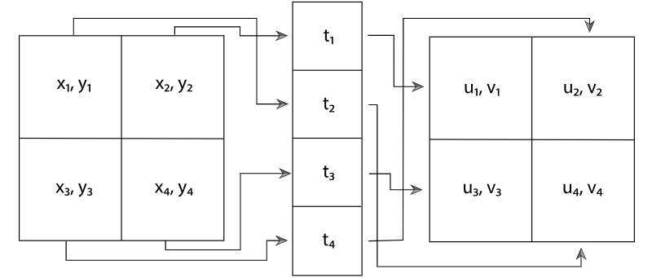
Stratified sampling
Subdividing region into smaller sub regions.
Each sub regions is called strata.
The more sub regions there is, the higher the sampling rate is.
Each sample variable is drawn independently to each other in high-dimensional space.
This turns the aliasing problem into a noisy pattern.
The drawn samples can cover the sample space without excessive computation.

Slide 13
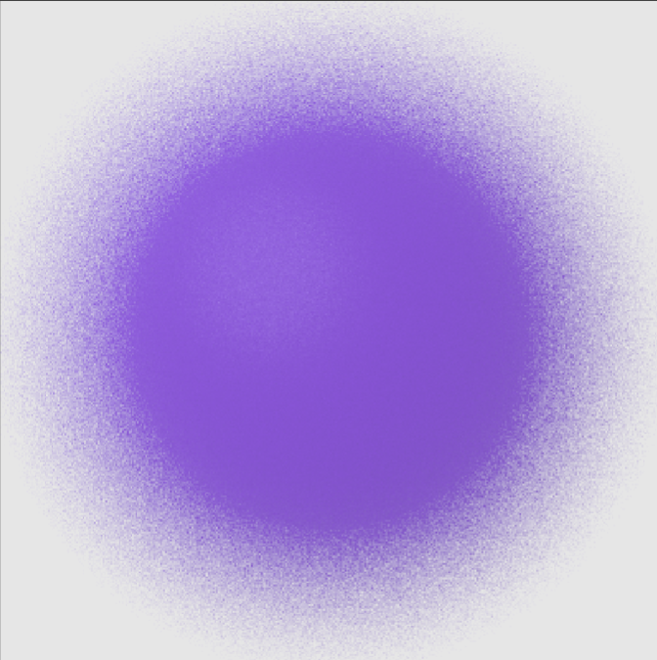
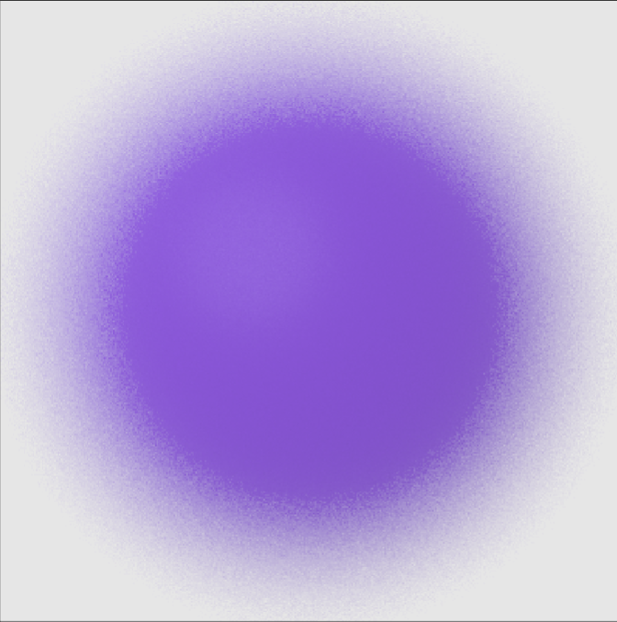
Comparison
Random
Stratified

Slide 14
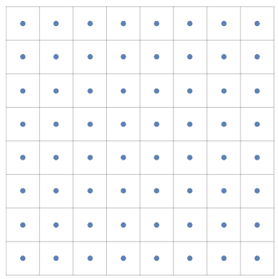
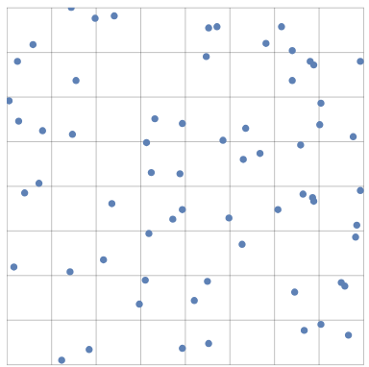
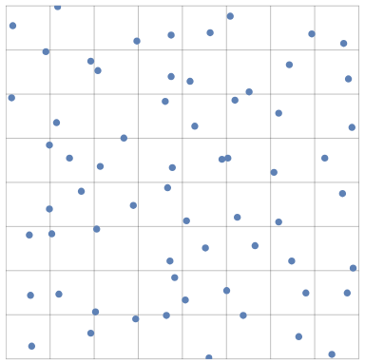
Comparison
Uniform stratified pattern
Uniform random pattern
A stratified jittered pattern
Notes:
Left → subdividing regions but still uniform sampling
Mid → uniform random the whole region
Right → subdividing regions and jiterring each subregion

Slide 15
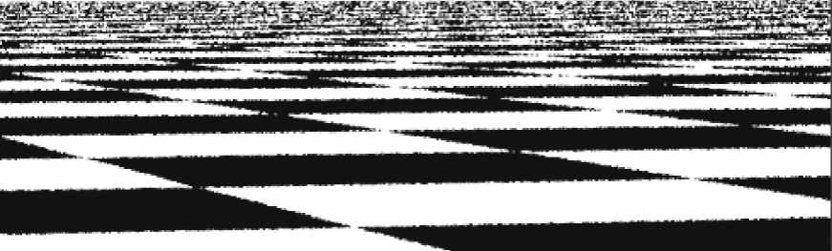
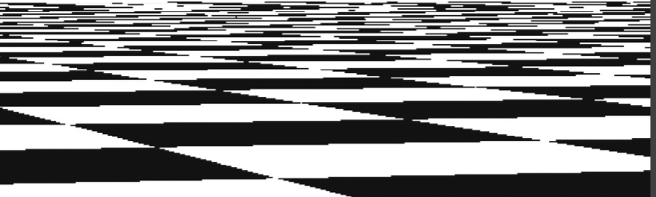
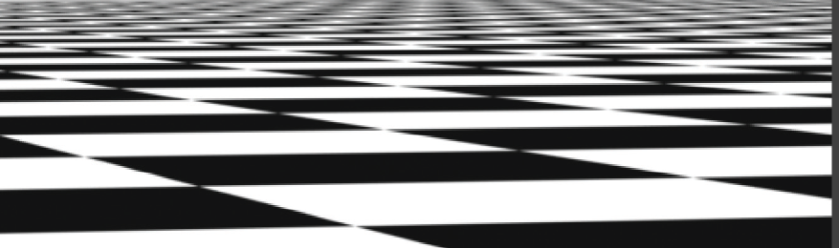
Jittered vs. Unjittered
Notes:
Class discussion – which one is the result from the sampling pattern
Left → uniform stratified
Right → uniform random
Mid -> jittered + stratified

Slide 16
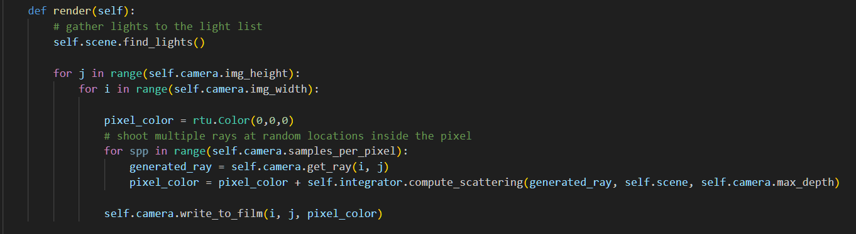
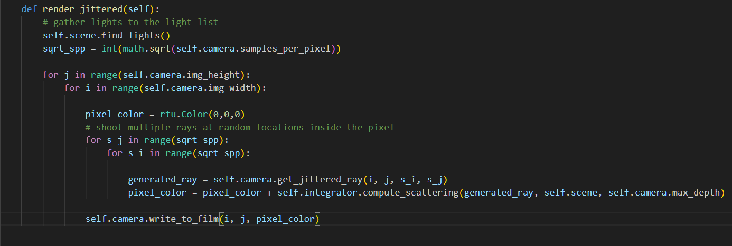
Coding Renderer
Notes:
First factor → renderer

Slide 17
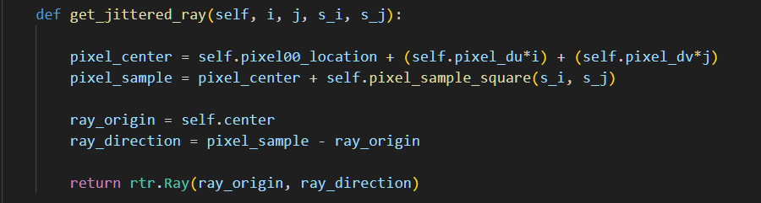
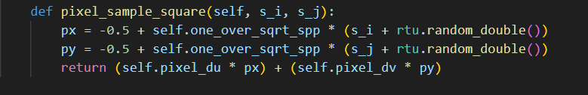
Coding Camera
Notes:
Second factor → camera

Slide 18
Sampling over directions
Notes:
Radiance calculation part

Slide 19
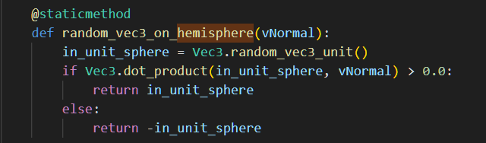
Sampling a direction on hemisphere
It might take a long time to get the correct result.
A Las Vegas algorithm is a randomized algorithm that always gives correct results.
A Monte Carlo algorithm is a randomized algorithm whose output may be incorrect,
but it will improve when the samples are increased.
yourbasic.org/algorithms/las-vegas/

Slide 20
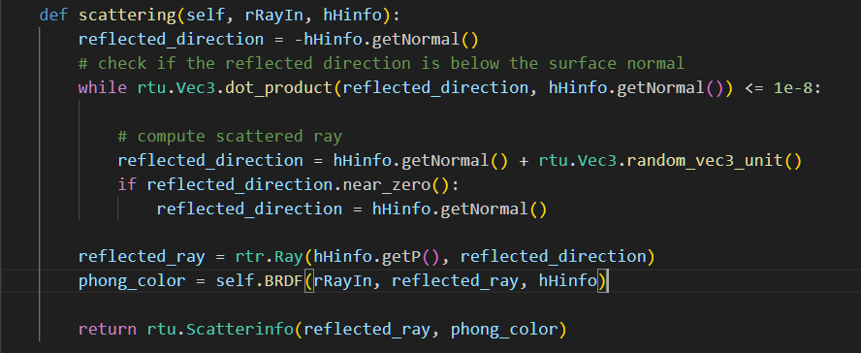
Scattered directions
This may drop our sampling performance.

Slide 21
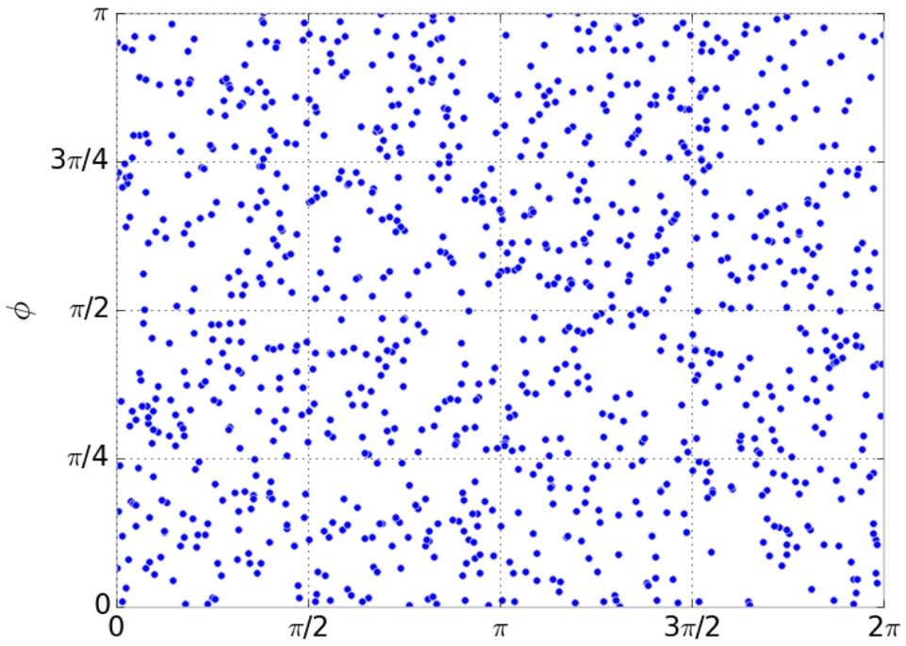
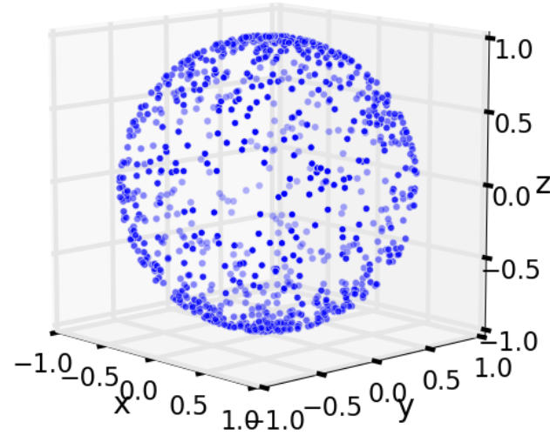
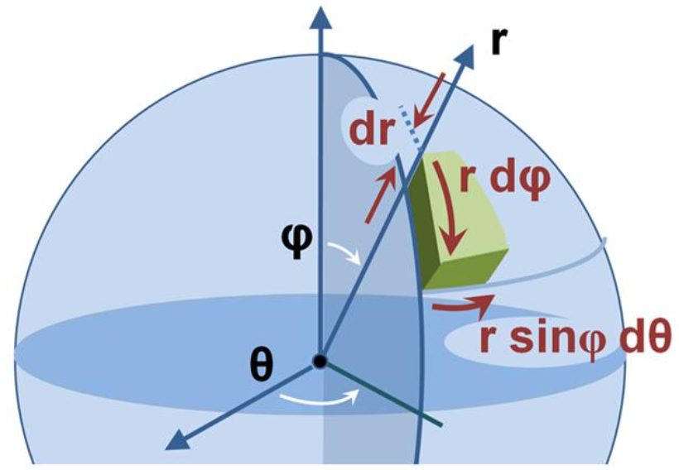
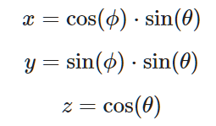

Generating random directions relative to the Z axis
$$θ ∈\left(0,90\right) \\ φ ∈(0,180)$$
A direction from spherical coordinate to cartesian coordinates
The issue is the differential surface.
corysimon.github.io/articles/uniformdistn-on-sphere/
Notes:
A problem occurs when mapping to sphere. It’s not a uniform sampling

Slide 22
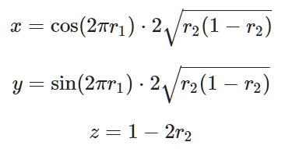
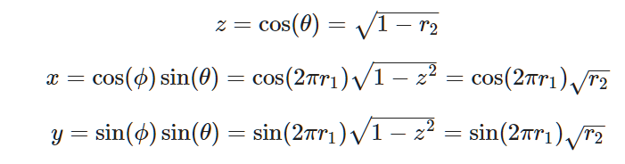


Uniform sampling on …
Sphere
hemisphere
$$r1 ∈\left[0,1\right]$$
$$r2 ∈[0,1]$$
$$r1 ∈\left[0,1\right]$$
$$r2 ∈[0,1]$$
Notes:
The solution…

Slide 23
Before we continue further on sampling, Let me introduce you a useful tool for handling a change of coordinate system.

Slide 24
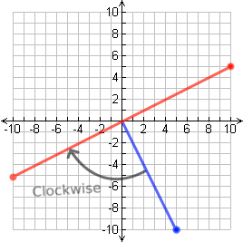
Orthonormal bases
Two important properties for this.
Orthogonality
The vectors are all pairwise perpendicular, meaning their dot product is zero.
Normality
Each vector has a magnitude (length) of 1.
Notes:
Cartesian coordinates = orthonormal bases

Slide 25
Why ?
Scene, objects, rays, cameras must be aligned in the same coordinate system.
Cartesian coordinate system (x, y, z) is an example of a subset of orthonormal basis.
Sometimes it is difficult to do operations on the original coordinate system, like Cartesian coordinate system.
Generating an orthonormal basis is a way to handle arbitrary points on the original coordinate system.

Slide 26


Relative coordinates
Point of origin
Relative point to the origin
A point with coefficients (u,v,w) on U,V,W coordinate system relative to the origin O’.

Slide 27
Generating an orthonormal basis
Pick an arbitrary axis, a, not parallel to the normal, n.
Find a vector s perpendicular to a and n.
Find a vector t perpendicular to s and n.
A vector (x,y,z) relative to the z axis is :

Slide 28
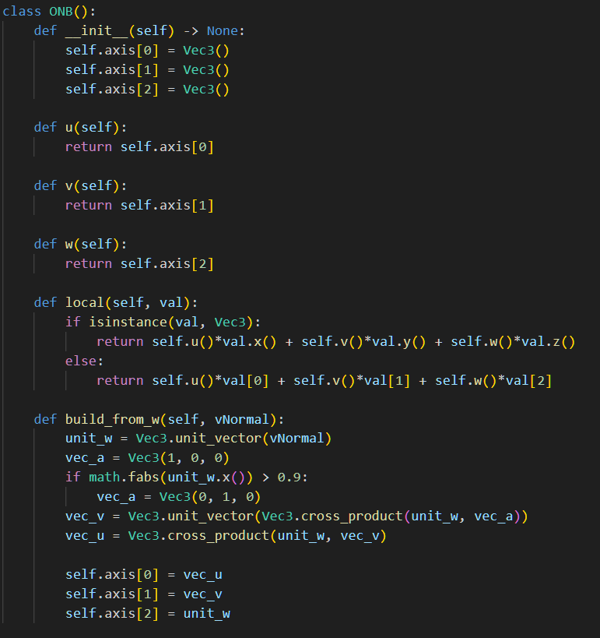
The ONB class

Slide 29
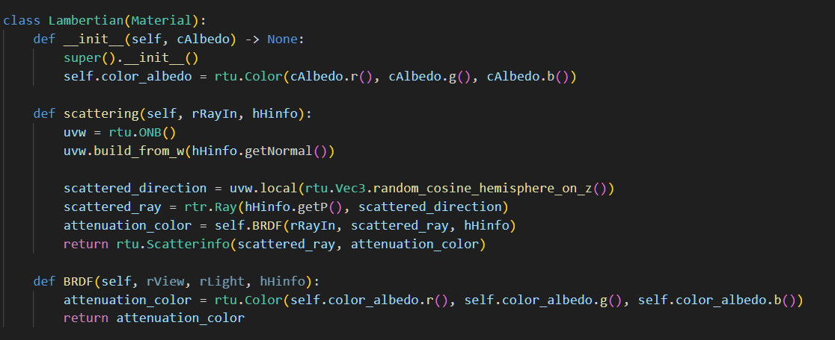
Replace the scattering

Slide 30
Image reconstruction
In ideal reconstruction, the uniform sampling is required.
For image sampling, nonuniform sampling is widely used as a trade-off between noise and aliasing.
The reconstruction techniques have been shifted towards minimizing errors.

Slide 31

Codes and class assignment !
Github : RT-python-week09
https://github.com/KUGA-01418283-Raytracing/RT-python-week09

