Slide 1
Ray Tracing in Entertainment Industry
Tanaboon Tongbuasirilai
Dept. Computer Science
Kasetsart University
Week 5
Lighting and shadows

Slide 2


Lighting and shadows
What happens when the background color is changed ?
It does not affect to the material reflection (color).

Slide 3
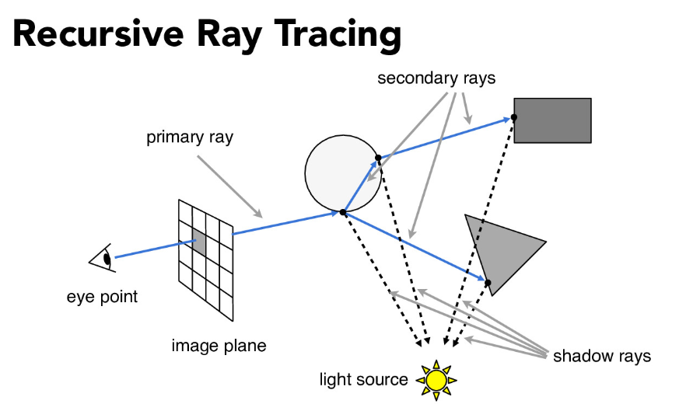
Background color as a light source
When the shot ray hits an object, the ray is scattered according to the material properties.
The ray is recursively scattered in the scene.
cs184.eecs.berkeley.edu/sp21/lecture/9-14/ray-tracing

Slide 4
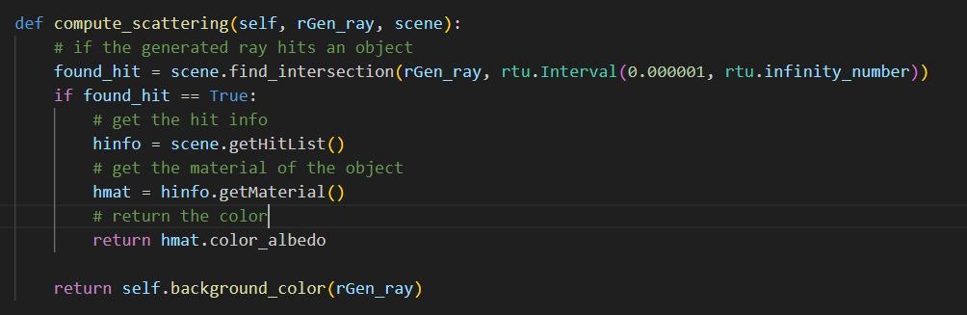
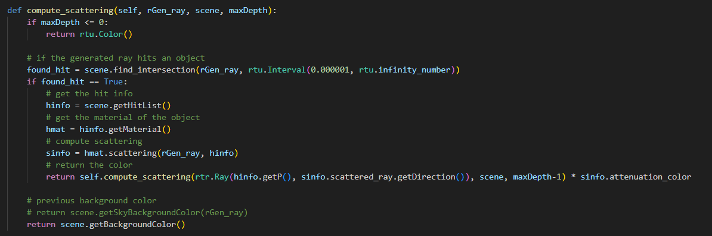
Implement recursive call of compute_scattering() method
Notes:
อธิบาย recursive call of compute_scattering()

Slide 5
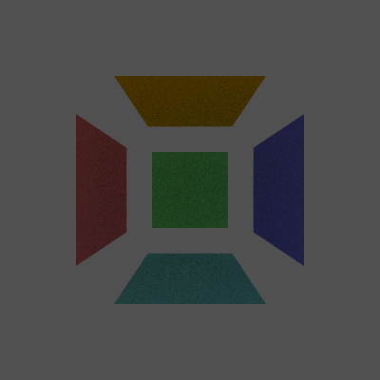
Comparison
Notes:
Background color สีเดียวกัน ?
Optical illusion
Why noisy ?

Slide 6
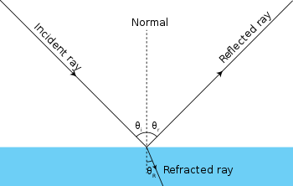
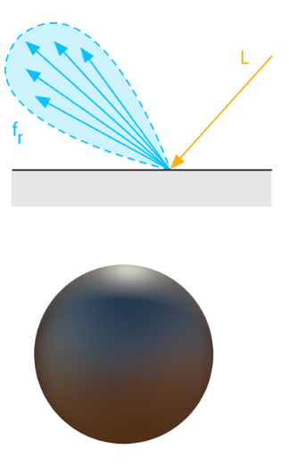
How are rays scattered on (interacted with) objects (materials) ?
Geometric optics
BRDF (Bidirectional Reflectance Distribution Function)
Notes:
What effects do we obtain from each of the scattering behaviors ?

Slide 7
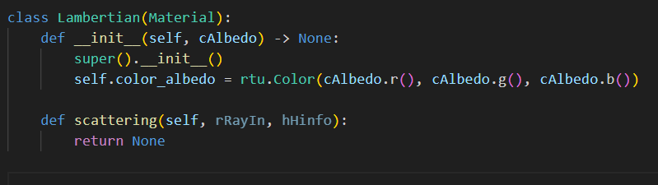
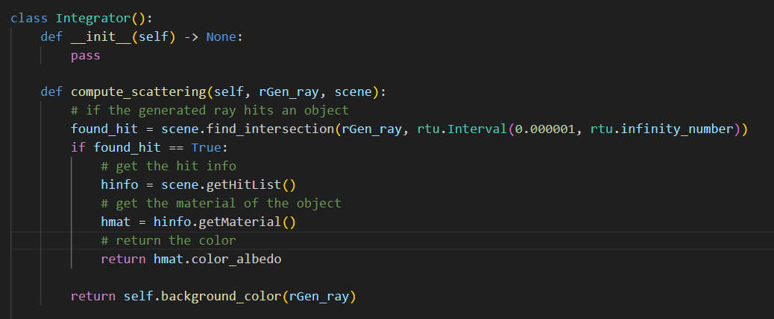
Material class (previous week)
Notes:
None is implemented in material scattering method previously.

Slide 8
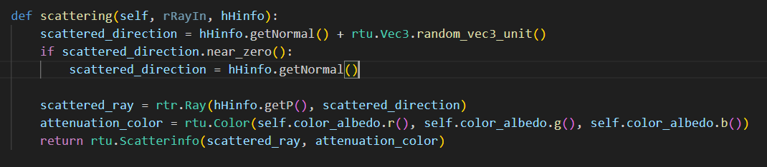
Update material class
Normal
Notes:
What does it do ?

Slide 9
Light class
An object that can emit light (L_{e}) is a source of light.
A design choice for light source is a special kind of material.
The Light class is derived from the Material class.
Attributes
Light color
Methods
Is this material a light source ?
Light emitting

Slide 10
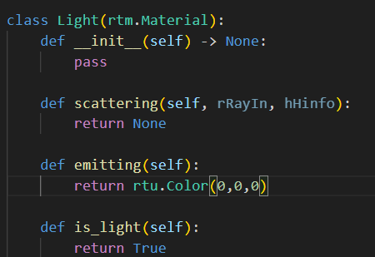
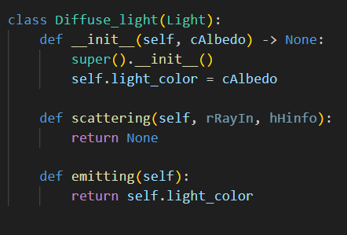
A simple light source
Check if this material is light.
It tells the integrator that this is a light source and no scattering needed.

Slide 11
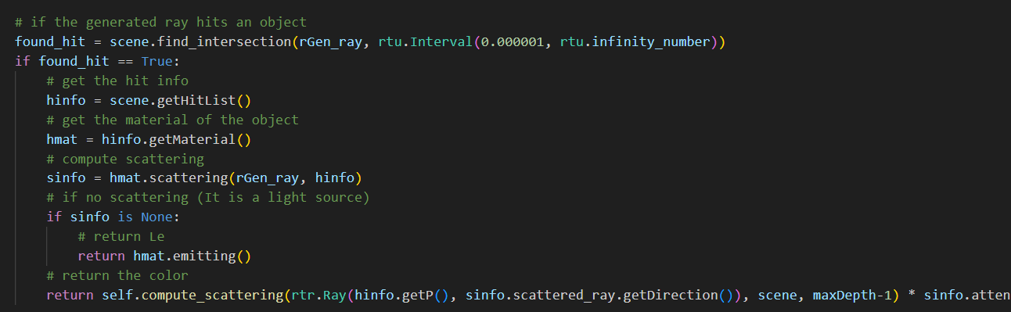
Updating the integrator
Add Le when the ray hits a light source.

Slide 12
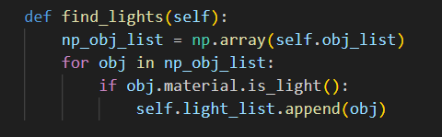
A useful method for future
Update the Scene class
Find light objects in the scene.
Notes:
Why do we need this ?

Slide 13
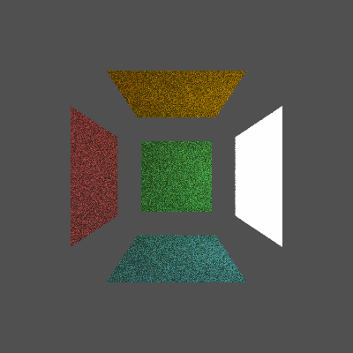
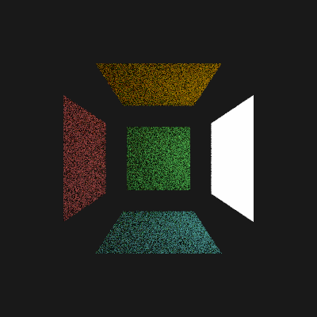
Now we can turn a quad into a light source.
10 spp, 8 max depth

Slide 14
Why we see this Lighting effect.
Notes:
Direct or indirect lighting or both ?

Slide 15
Current technology (RTXDI)
NVIDIA RTXDI | NVIDIA Developer
RTX Direct Illumination (RTXDI)
Imagine adding millions of dynamic lights to your game environments without worrying about performance or resource constraints. NVIDIA RTX™ Direct Illumination (RTXDI) figures out the most important light samples in a scene and renders them physically accurate. Geometry of any shape can emit light, cast appropriate shadows, and move freely and dynamically.

Slide 16
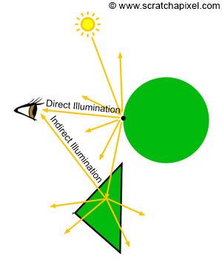
Direct lighting
In ray tracing, direct lighting describes the radiance accumulation at the surface point when light can be traced directly without occlusion.
This can enhance realism by adding L_{e} to the integrator.
So far we don’t have any L_{e} term yet. By adding this term, it add more complications to the codes.
Hence, for simplicity, we implement a point light instead.
www.scratchapixel.com/lessons/3d-basic-rendering/ray-tracing-overview/light-transport-ray-tracing-whitted.html

Slide 17
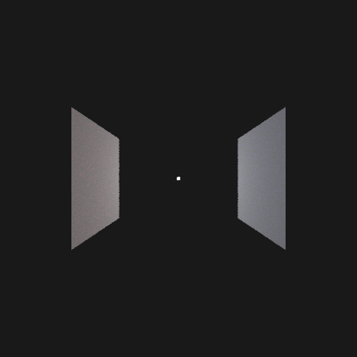
Point light
An object that emit diffuse light.
A point light can be defined by a tiny sphere (very small radius).
Generating a sphere instance and add ‘diffuse_light’ as its material.

Slide 18
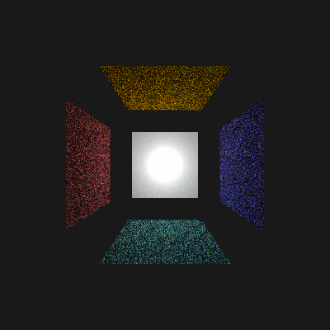
Implement direct lighting by point light

Slide 19
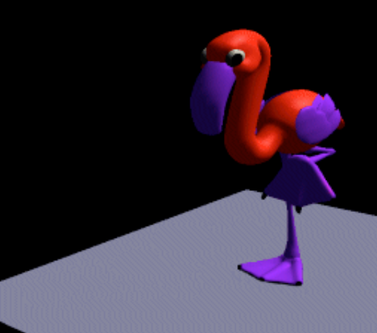
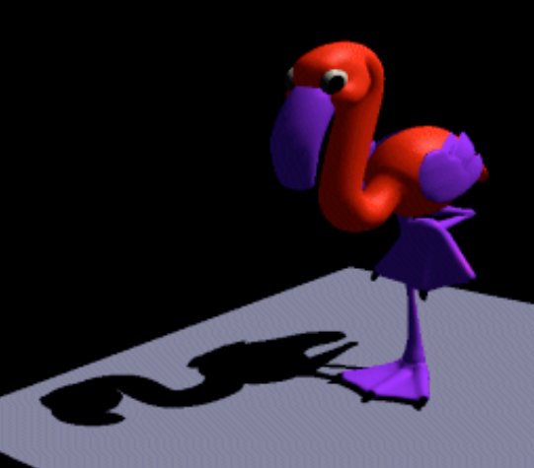
Shadows
Why do we need a shadow ?
Enhance realism
Additional clues for shape and positions of 3D objects
web.cse.ohio-state.edu/~shen.94/681/Site/Slides_files/shadow.pdf

Slide 20
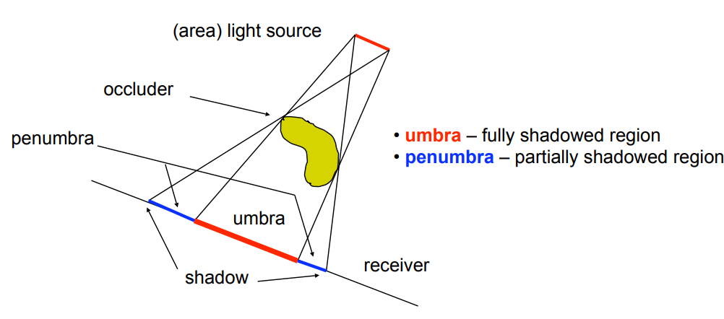
Terminology
web.cse.ohio-state.edu/~shen.94/681/Site/Slides_files/shadow.pdf

Slide 21
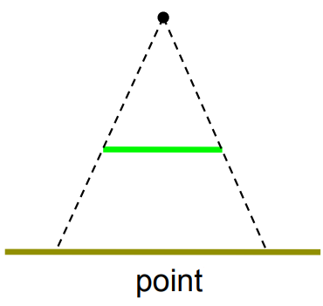
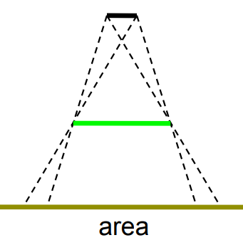
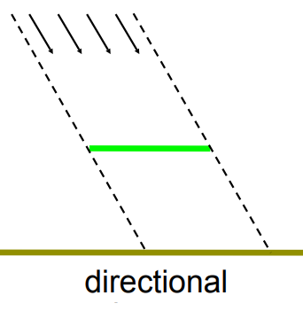
Hard and Soft shadows
web.cse.ohio-state.edu/~shen.94/681/Site/Slides_files/shadow.pdf

Slide 22
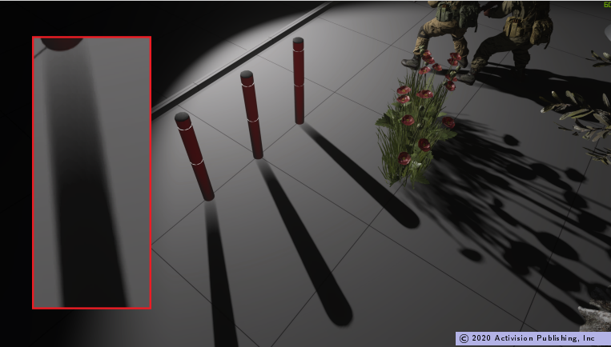
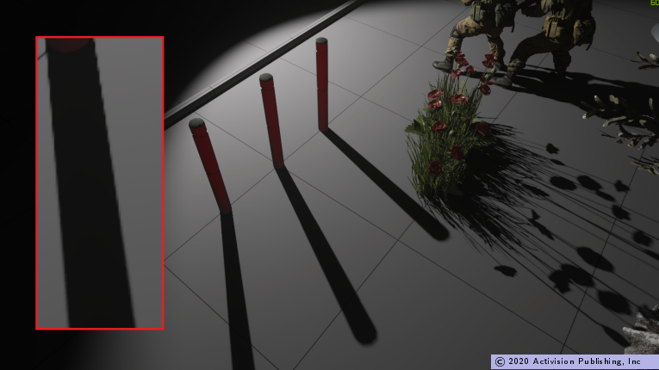
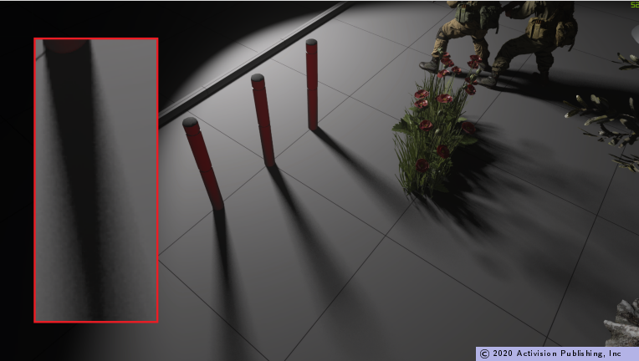
Call of Duty – Ray traced shadows vs Shadow maps
Shadow maps
Ray traced shadows
Ray traced shadows –
sphere light + denoising + blur
www.activision.com/cdn/research/Raytraced_Shadows_in_Call_of_Duty_Modern_Warfare.pdf

Slide 23

Codes and class assignment !
Github : RT-python-week05
https://github.com/KUGA-01418283-Raytracing/RT-python-week05

