Slide 1
Ray Tracing in Entertainment Industry
Tanaboon Tongbuasirilai
Dept. Computer Science
Kasetsart University
Week 6
Geometric optics

Slide 2

Geometric optics
Definition
A model of optics describing how light propagates in terms of rays.
We can utilize this model to create several material appearances.
Physical properties
Reflection
Refraction

Slide 3
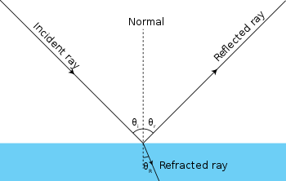
Revisit

Slide 4
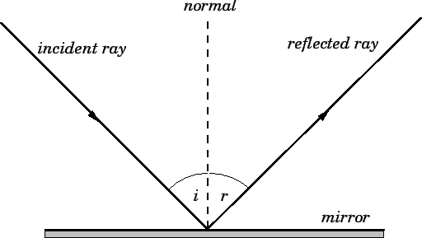
What is reflection ?
A change in light direction when it hits the surface (medium) then the light ray bounces off the surface in another direction.
The law of reflection governs the very smooth surfaces.
Laws of reflection
The incident ray, the reflected ray and the normal to the reflection surface at the point of the incidence lie in the same plane.
The angle which the incident ray makes with the normal is equal to the angle which the reflected ray makes to the same normal.
The reflected ray and the incident ray are on the opposite sides of the normal.

Slide 5
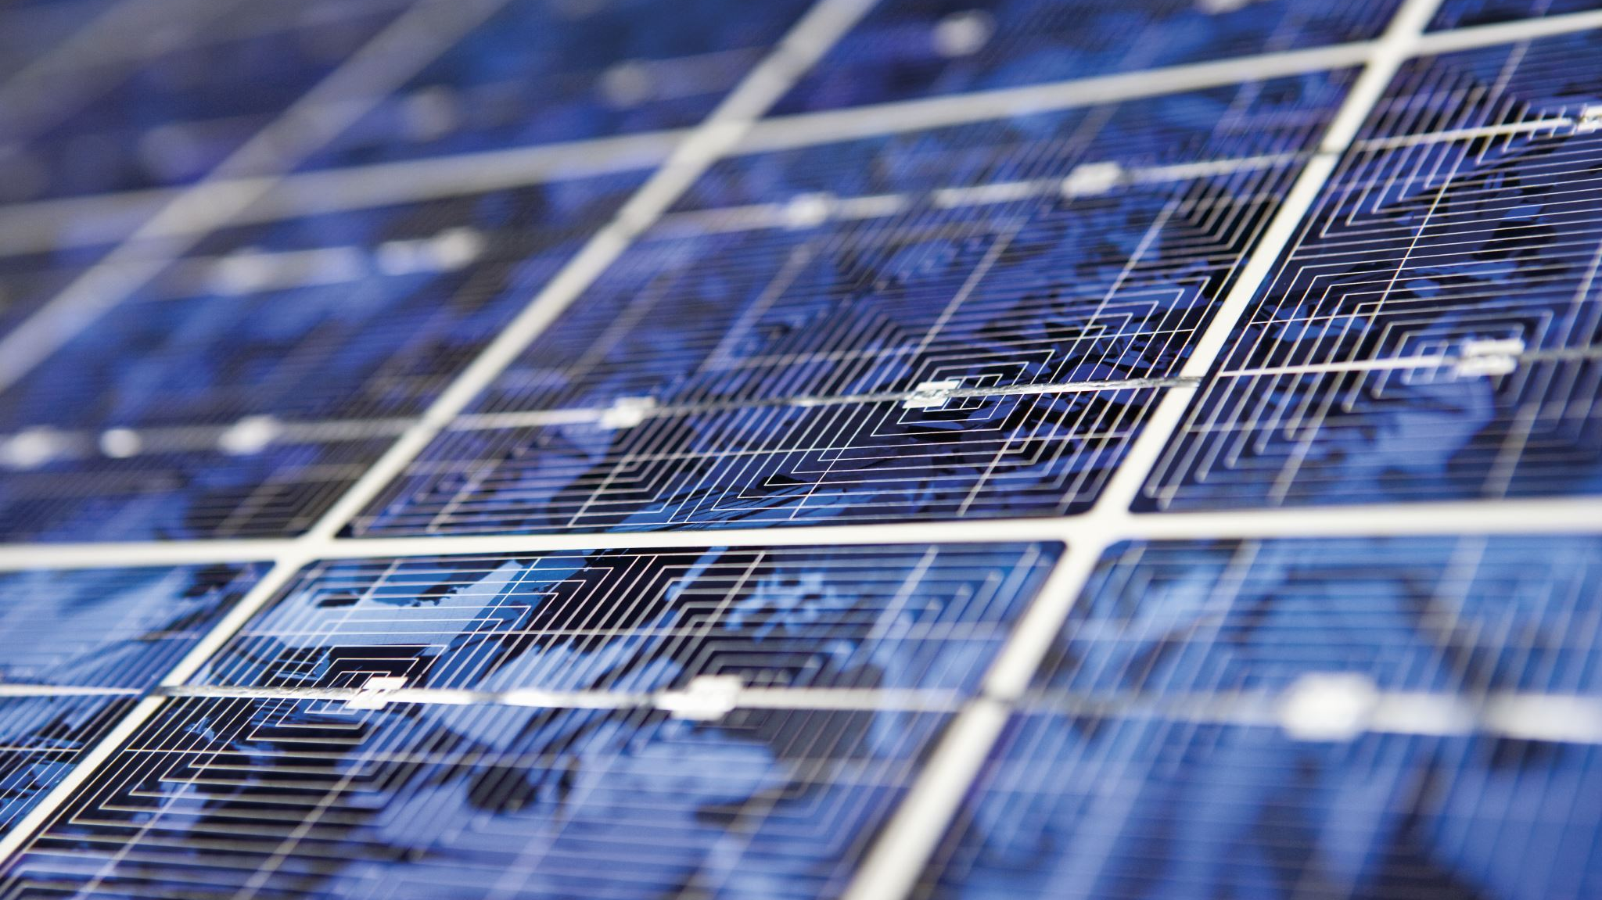
Reflections of light
Perfect reflection
Diffuse reflection
Specular reflection
Retro reflection

Slide 6
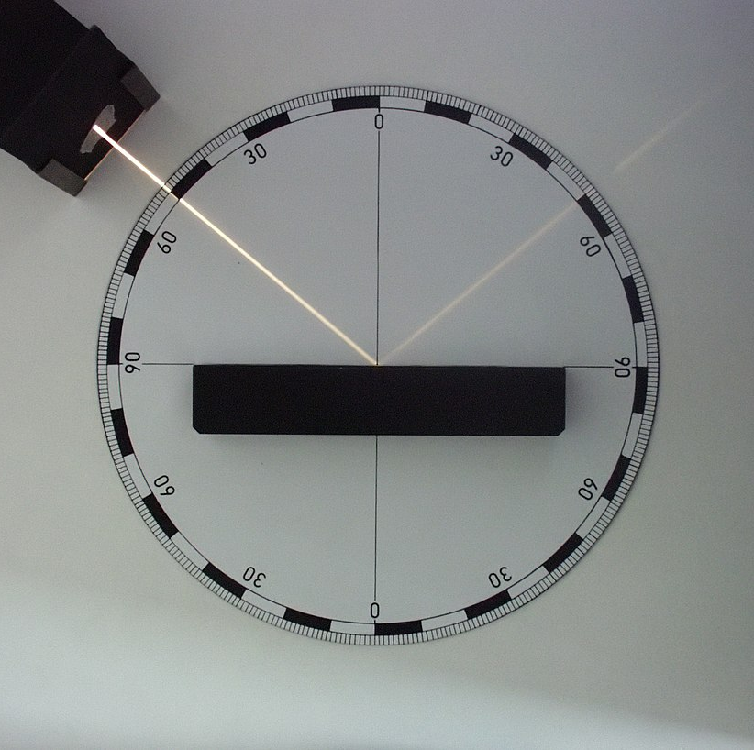
Perfect reflection
Examples ?
en.wikipedia.org/wiki/Reflection_(physics)
Notes:
Columated beam generator
Energy absorption ?

Slide 7
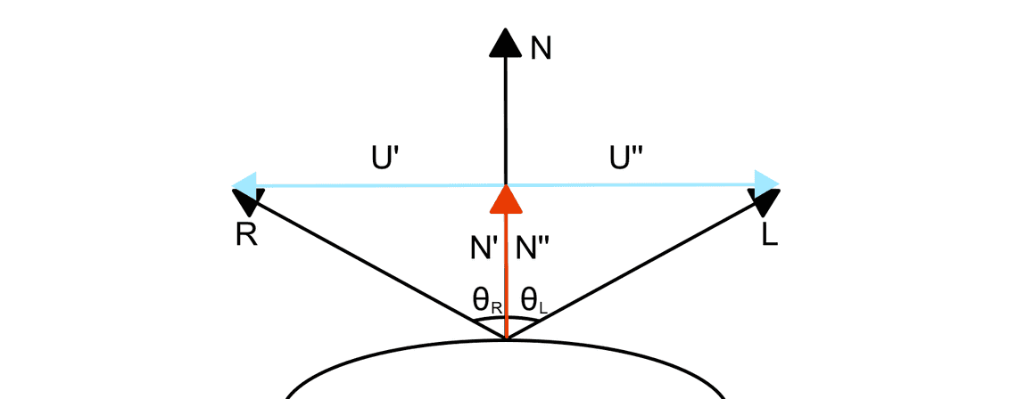

Perfect reflection direction
www.fabrizioduroni.it/2017/08/25/how-to-calculate-reflection-vector/

Slide 8

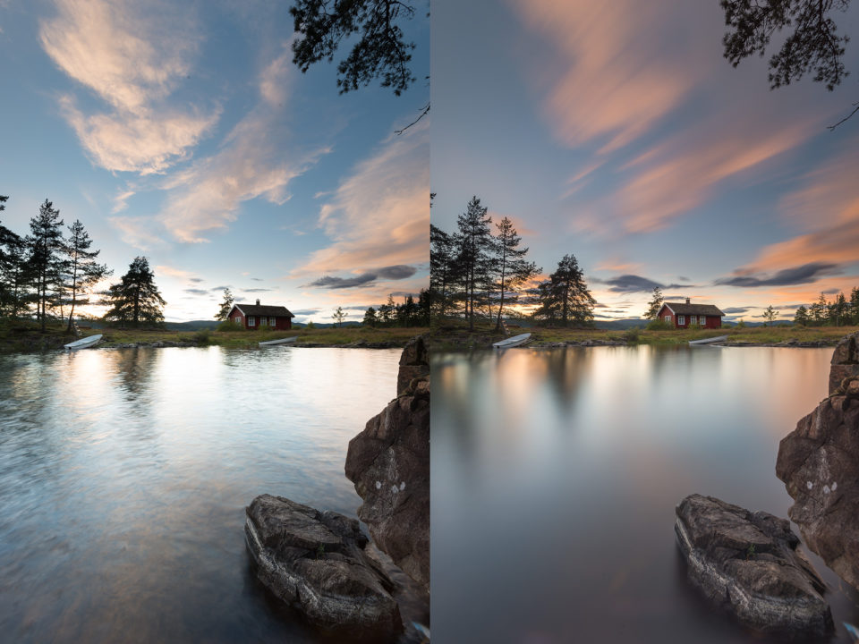
Perfect reflection ?

Slide 9
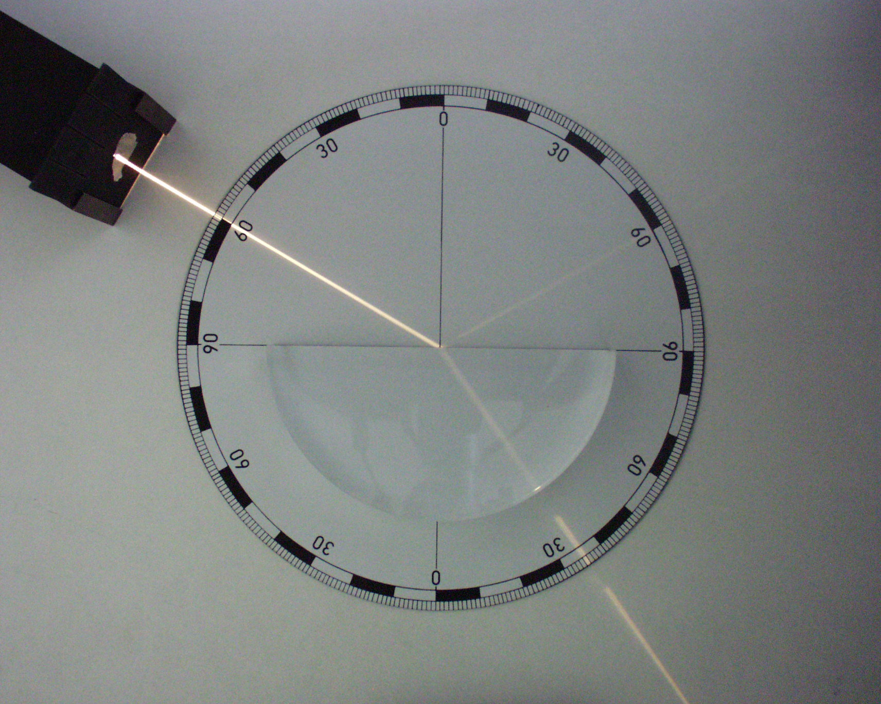
A dielectric material
viclw17.github.io/2018/08/05/raytracing-dielectric-materials

Slide 10

Examples of dielectric materials
Refractive index = $\frac{speed of light in vacuum}{speed of light in the medium}$
- It determines how much light is bent when travels through the medium.
- Snell’s law of refraction can be used to describe this light propagation.
Material | Refractive index
Vacuum | 1
Air | 1.000293
Water | 1.333
Ice | 1.31
Window glass | 1.52
Diamond | 2.42
Notes:
What else can we model from dielectric materials ?
https://creativecloud.adobe.com/learn/substance-3d-designer/web/the-pbr-guide-part-1

Slide 11
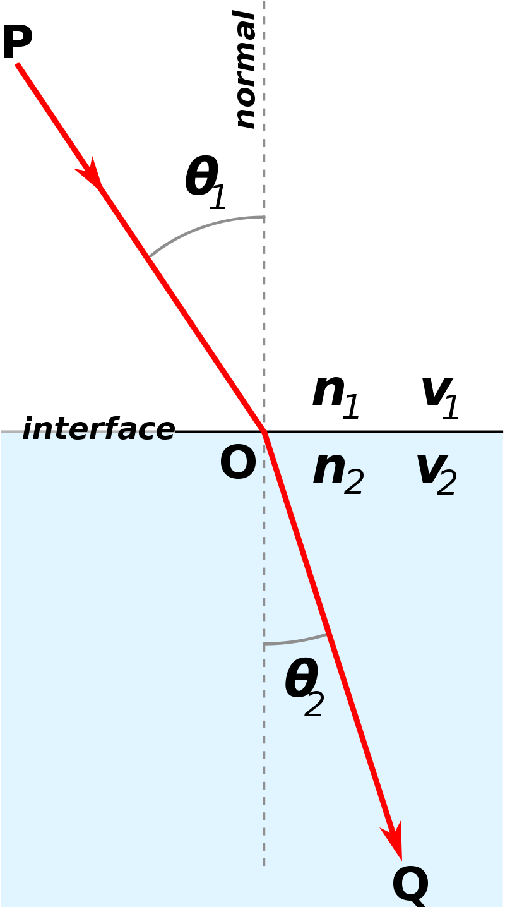
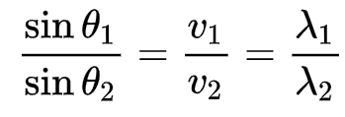
Snell’s law of refraction
- Snell's law describes the relationship between the angles and velocities of waves.
- It states that the ratio of the angle of incidence to the angle of refraction of a wave as it travels through a boundary between two media is a constant termed the refractive index.
en.wikipedia.org/wiki/Snell%27s_law

Slide 12
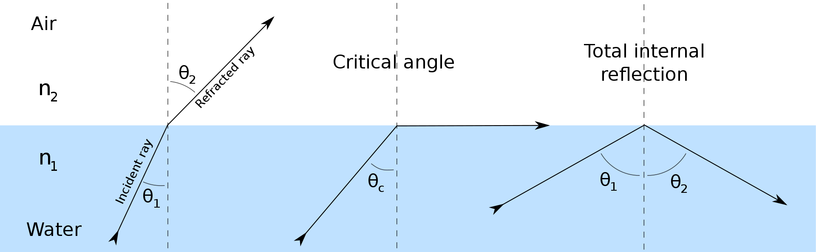
Refraction of light at the interface between two media

Slide 13
Refractometer
When measuring refractive index:
A light-emitting diode or LED serves as the light source and emits a light beam. The LED beam that is emitted then passes through:
The polarization filter,
The interference filter, and
The focal lens. After filtering, the LED beam then reaches:
The sample held by the sapphire prism.
Light is reflected and deflected via a lens in the sapphire prism to
The optical CCD sensor, which measures the critical angle.
Additionally, a modern digital refractometer controls the temperature at the prism/sample boundary automatically, further enhancing measurement accuracy.
www.mt.com/th/th/home/applications/Application_Browse_Laboratory_Analytics/Refractive_index/definition_and_measurement/snells-law.html

Slide 14
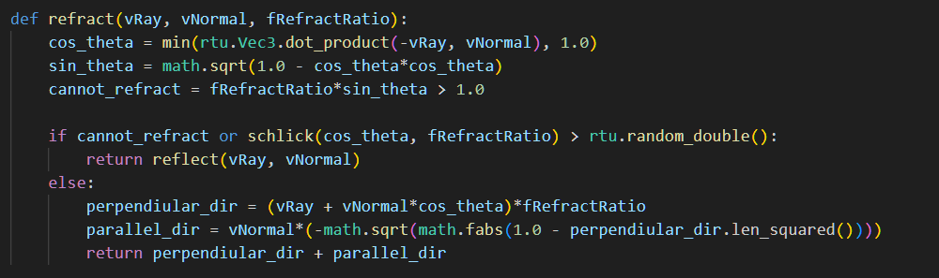
Refraction direction
Calculate refraction
Fresnel effect
Generate only reflected ray when it cannot refract,
or the Fresnel coefficient meets a condition.
If refracted ray occurs, calculate the refracted direction.

Slide 15
Refraction and reflection

Slide 16

Codes and class assignment !
Github : RT-python-week06
github.com/boonta/RT-python-week06

