Slide 1
Ray Tracing in Entertainment Industry
Tanaboon Tongbuasirilai
Dept. Computer Science
Kasetsart University
Week 4
Basic shapes and intersections

Slide 2

Basic shapes and intersections
Sphere
Quad
Triangle (not available)

Slide 3
More ray tracing components (classes)
Scene class
Handle scene objects and events.
Integrator class
Solve the rendering equation.
Material class
Fancy color ! - make objects colorful.
Object class
Implement shapes and their ray-intersection method.

Slide 4
Scene class
Hold objects (sphere, quad, triangle, etc.) to setup a scene
Attributes
A list of objects
A list of hit objects
Methods
Add an object
Find an intersection by given a ray shot in the scene
Get a list of hit objects

Slide 5
Method : find_intersection()
Input
A generated ray from the camera.
An interval of parameter 't'.
Pseudocode
Initialize the closet maximum of t.
For each object in the given scene.
Get the hit info from the intersection between an object and the given ray.
If the object is hit by the given ray.
Update the closet maximum of t.
Update the hit list.
Return if found any hit or not.

Slide 6
Illustration of the method
tmax
t3
tmax
Pseudocode
Initialize the closet maximum of t.
For each object in the given scene.
Get the hit info from the intersection between an object and the given ray.
If the object is hit by the given ray.
Update the closet maximum of t.
Update the hit list.
Return if found any hit or not.
t2
t1
t5
t4
t0
tmax
tmin

Slide 7

Integrator class
Compute the radiance information of a generated ray given the scene.
Attributes
None
Methods
Compute scattering

Slide 8
Method : compute_scattering()
Input
A generated ray
The scene
Pseudocode
If the generated ray hits an object.
Get the hit info.
Get the material of the object.
Return the color.

Slide 9
Material class
Appearance information (color and how the ray interacts with the object.)
It is a base class.
Attributes
None
Methods
Virtual method : scattering()

Slide 10

A simple material
Lambertian class
It is derived from the 'material' class.
It returns the color of the object.
Attributes
Object's color --> called albedo
Methods
Scattering()

Slide 11
Creating an object
Define an object base class
Attributes
None – each children has its own parameters.
Methods
Virtual method : intersect() - for handling ray-object intersection
The object class is then derived to child classes.
Sphere
Quad
Triangle
etc.

Slide 12
Object class
An interface class to be derived.
It contains the following virtual methods.
intersect()

Slide 13
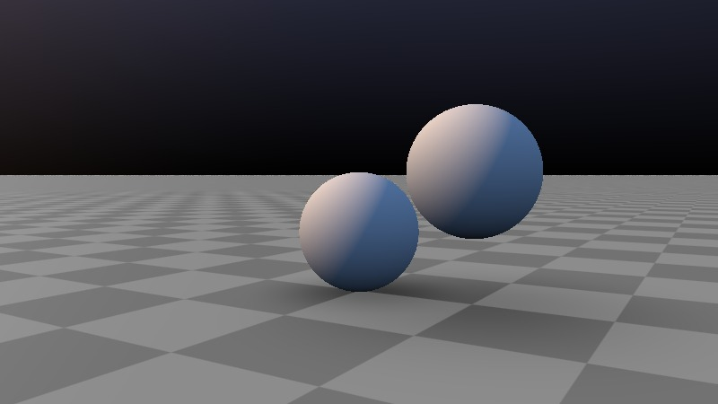
Sphere class
Attributes
Center
Radius
Material
Methods
Add material
intersect()
www.shadertoy.com/view/ltBSzK

Slide 14


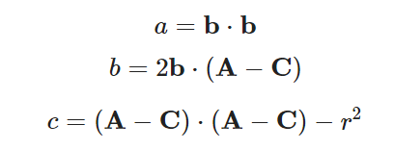

How a ray intersect a sphere ?
Quadratic solution :
raytracing.github.io/books/RayTracingInOneWeekend.html

Slide 15
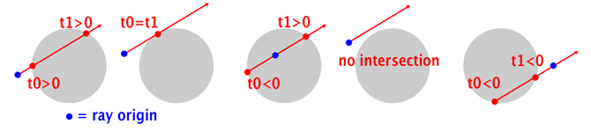
Roots of the ray-sphere intersection
www.scratchapixel.com/lessons/3d-basic-rendering/minimal-ray-tracer-rendering-simple-shapes/ray-sphere-intersection.html

Slide 16

Quadrilateral
Definition
A quadrilateral, sometimes also known as a tetragon or quadrangle is a four-sided polygon. If not explicitly stated, all four polygon vertices are generally taken to lie in a plane. (If the points do not lie in a plane, the quadrilateral is called a skew quadrilateral.)
Implicit form of a plane
mathworld.wolfram.com/Quadrilateral.html

Slide 17


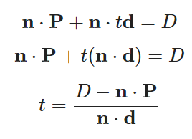
Ray-plane intersection
Given n is the normal perpendicular to the plane.
And v is any point lying on the plane.
Solution where any parametric ray intersects the plane.

Slide 18
Defining a quad
Q = a corner of the quad
u, v are vectors forming two sides of the quad
Q + u + v
u
Q
v

Slide 19


Substituting values
What is n (normal) ?
What is D ?
What if the denominator is zero ?
Division by zero is undefined. That means the ray is parallel to the plane.

Slide 20
Quad class
Attributes
A point at a corner
Vectors representing two sides from the defined corner
Material
Normal of the quad
Methods
Add material
intersect()

Slide 21

What is the ray-quad intersection solution ?
Adding a constraint to the solution.
A quad can be defined by adding boundaries of the plane.
One simple constraint is as follows.

Slide 22
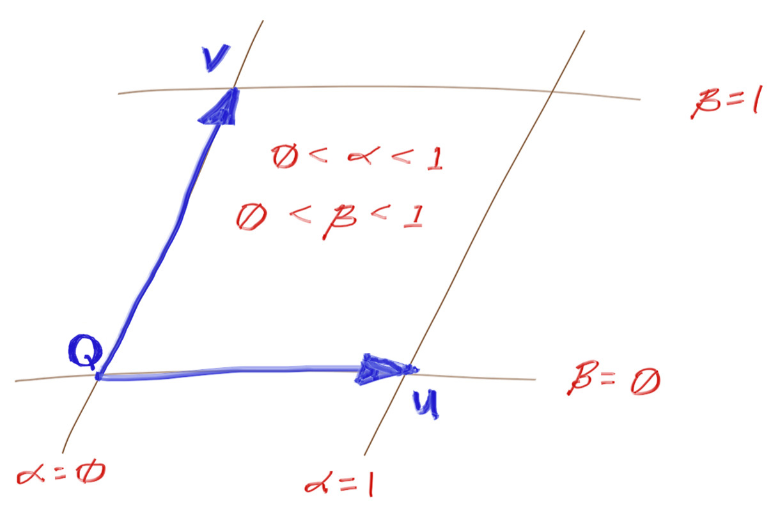
Illustration of the constraint
raytracing.github.io/books/RayTracingTheNextWeek.html

Slide 23
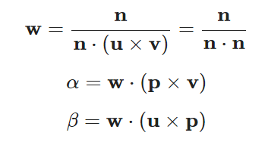
Calculating alpha and beta parameters
These normal are UxV.

Slide 24

Codes and class assignment !
Github : RT-python-week04
github.com/boonta/RT-python-week04

