Slide 1
Ray Tracing in Entertainment Industry
Tanaboon Tongbuasirilai
Dept. Computer Science
Kasetsart University
Week 7
Texture and reflection models

Slide 2
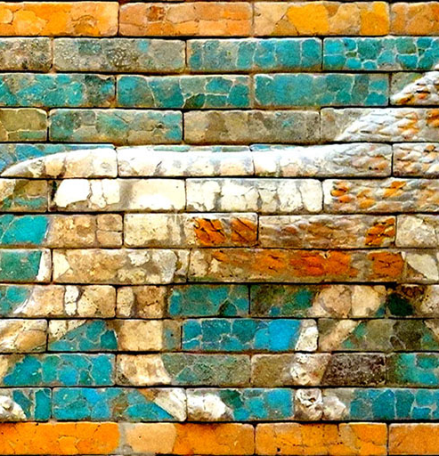
Texture and reflection models
Why texture ?
In most cases, we need a man-made appearance requiring artistic skills for representing a material.
It can add natural and/or unnatural effects to the materials.
It’s easier to imitate material appearance with artistic skills.
Why reflection models ?
Geometric optics and image texture do not account for how much light is scattered on a surface.
We would like to model light quantity related to the material scattering properties. [accuracy, efficiency]
mc.dean.lsa.umich.edu/threejs/manual/en/textures.html
Notes:
When to use texture and when to use reflection models ?

Slide 3
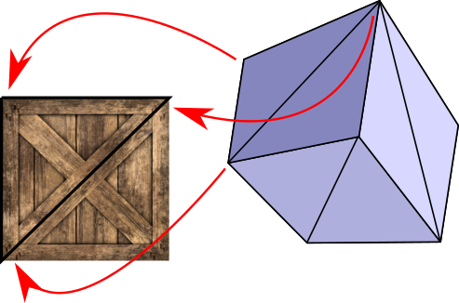
Texture
A texture, in general, is some sort of variation from pixel to pixel within a single primitive.
We will consider only one kind of texture: image textures.
An image texture can be applied to a surface to make the color of the surface vary from point to point, something like painting a copy of the image onto the surface
math.hws.edu/graphicsbook/c4/s3.html
gabrielgambetta.com/computer-graphics-from-scratch/14-textures.html

Slide 4
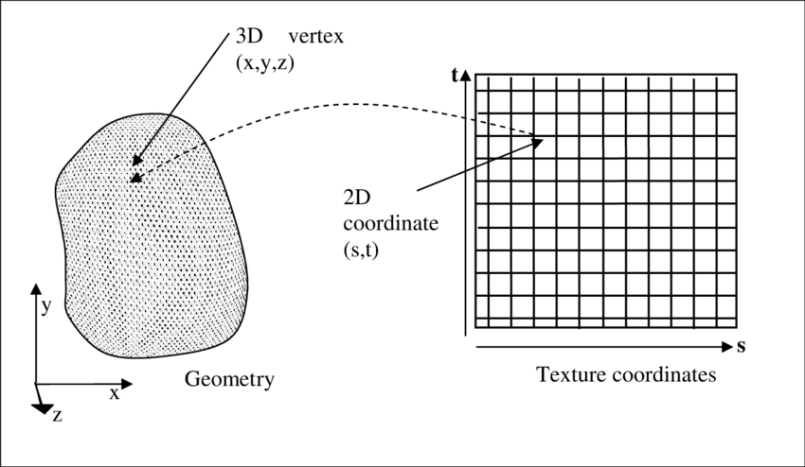
Texture mapping
Texture coordinates
Defined by 2 parameters : (u,v)
Object coordinates
Defined by a 3D point : (x,y,z)
Texture mapping
A function to map from a 3d point to a uv point.
T : (x,y,z) → (u,v)
www.researchgate.net/publication/228394843_Using_Haptics_in_a_Networked_Immersive_3D_Environment

Slide 5
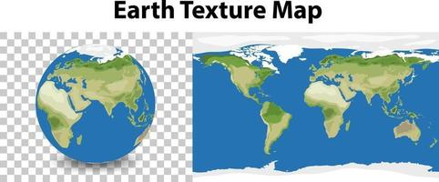
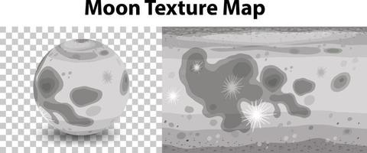
Spherical mapping
www.vecteezy.com/vector-art/2785881-earth-planet-with-earth-texture-map
Notes:
One example of a texture mapping.

Slide 6
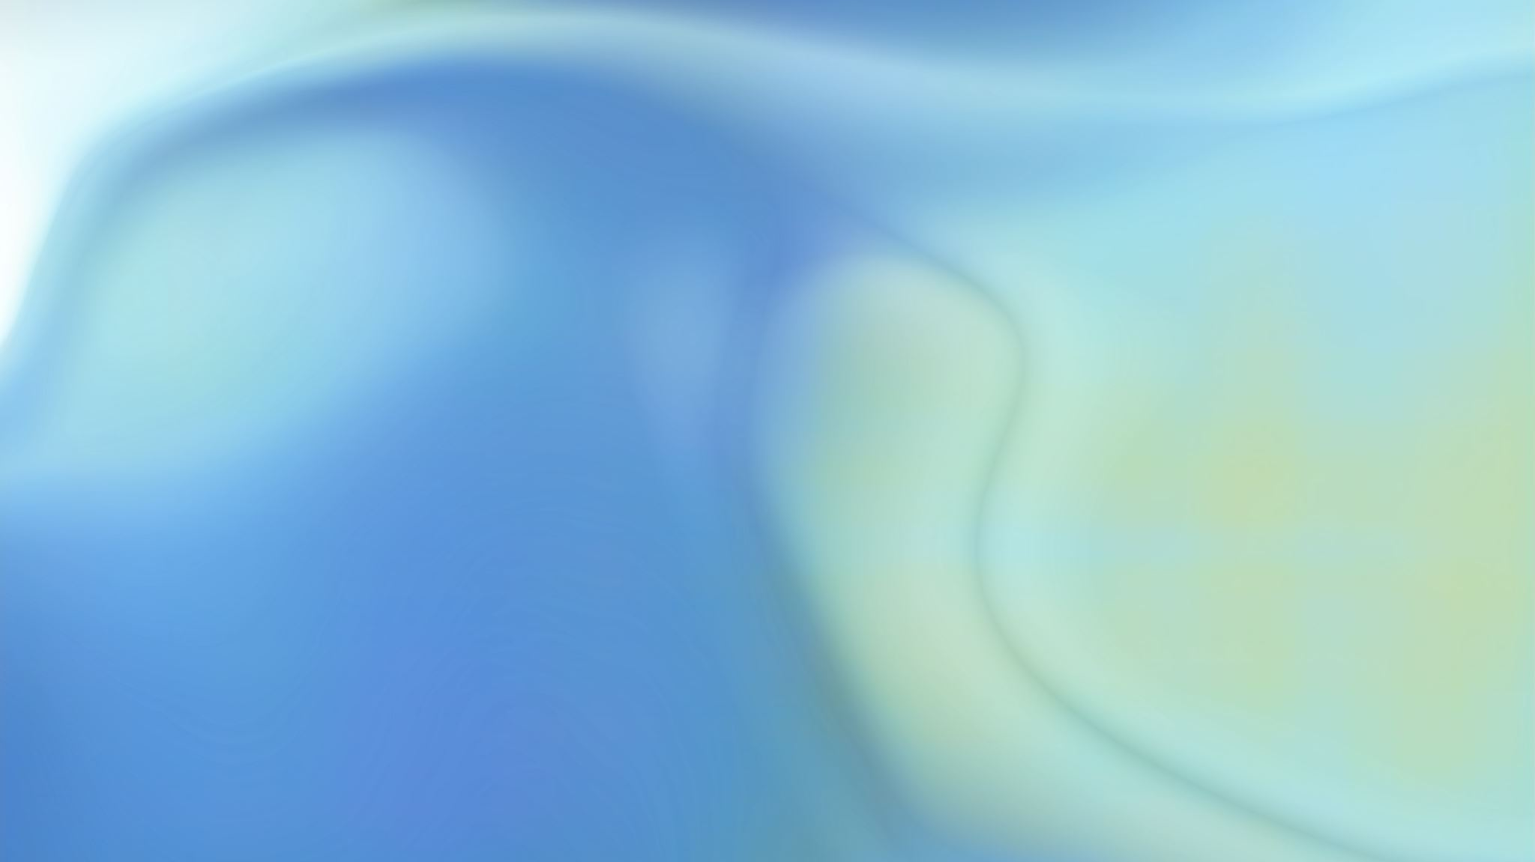
Texture mapping in ray tracing
Update Hitinfo class
1
Declare : u and v parameters
Methods to set and get uv parameters.
Update all Object classes
2
Only update ‘intersection()’ method of each object class.
Once a ray hits an object, we compute the uv coordinates to texture.
Implement Texture classes
3
Parent class : Texture
Method – tex_value() : return texture value at a specified (u,v) coordinate.
Child classes
Solid color – return only its color
Procedural texture – return procedural texture
Image texture – load up a rectangle image and use it as a texture

Slide 7
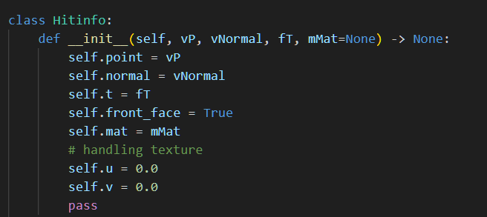
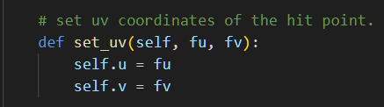
Update Hitinfo

Slide 8
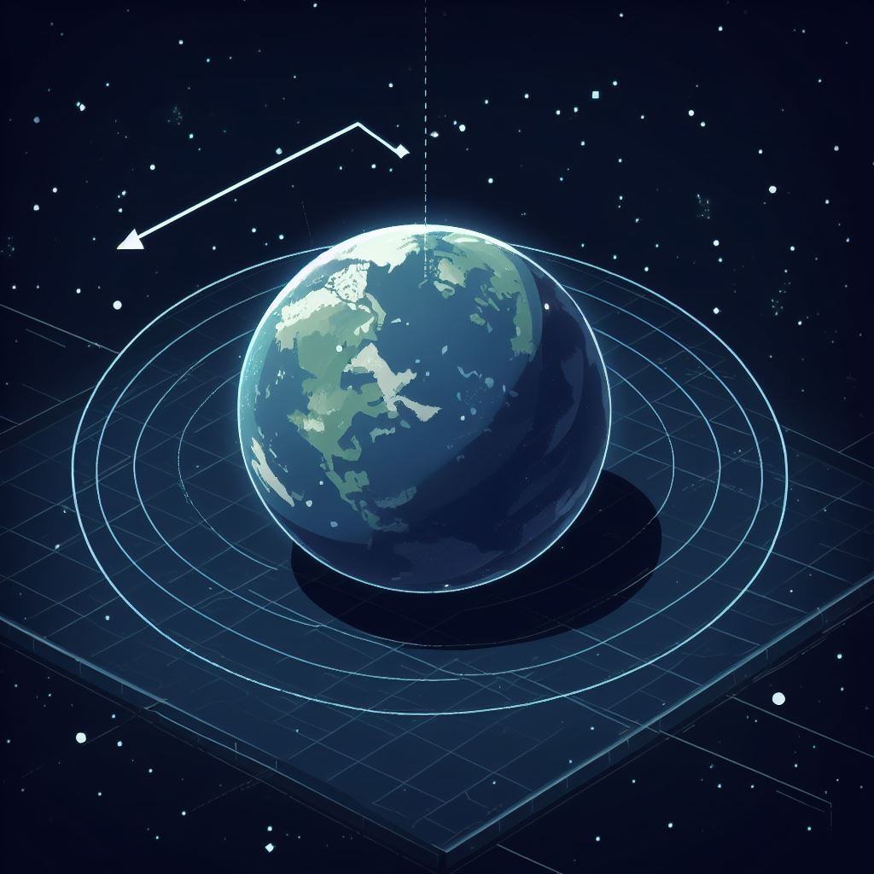
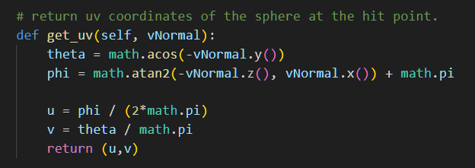

Update intersect()
Sphere class
Compute theta and phi of the intersection point.
Don’t forget to add (u,v) coordinates.
normalize

Slide 9
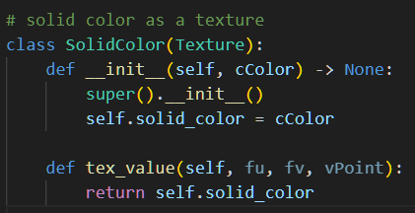
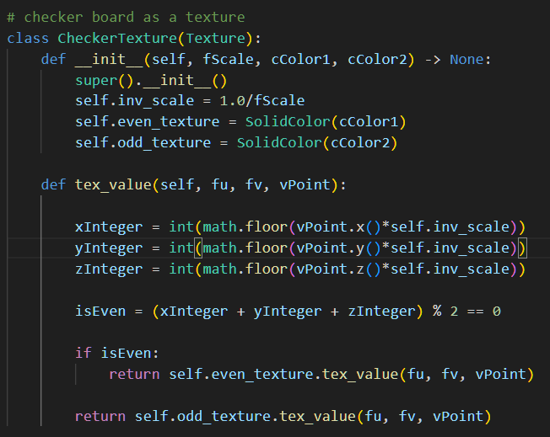
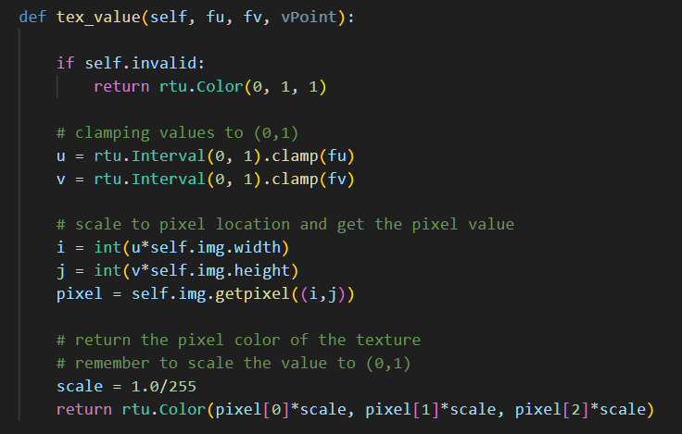
Texture class
Solid color
Image as a texture
Checkboard

Slide 10
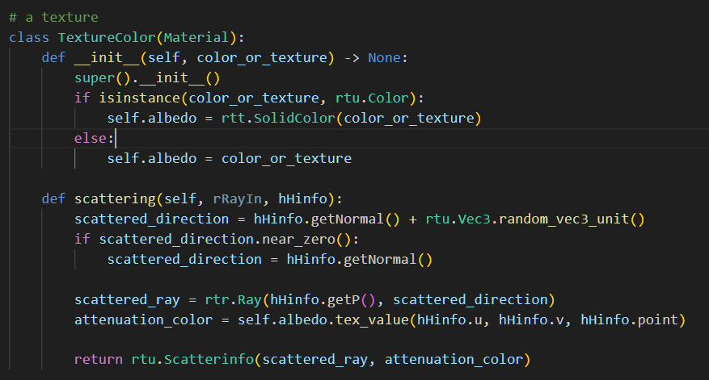
A little more work to finalize texture mapping

Slide 11
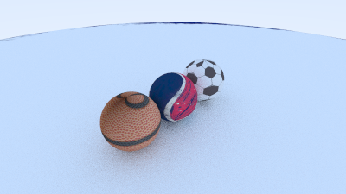
Example

Slide 12
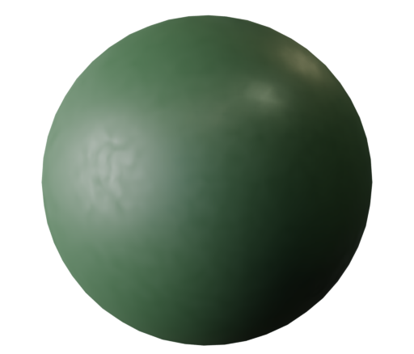
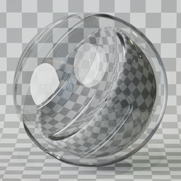
Reflection models
Previously, we studied how light changes its direction on a variety of materials.
Matte plastic (dull-looking materials)
Mirror
Transparent medium (dielectric materials)
www.blenderkit.com/asset-gallery-detail/cb48a41d-6fc7-47b3-bd08-45275cfed0c2/

Slide 13
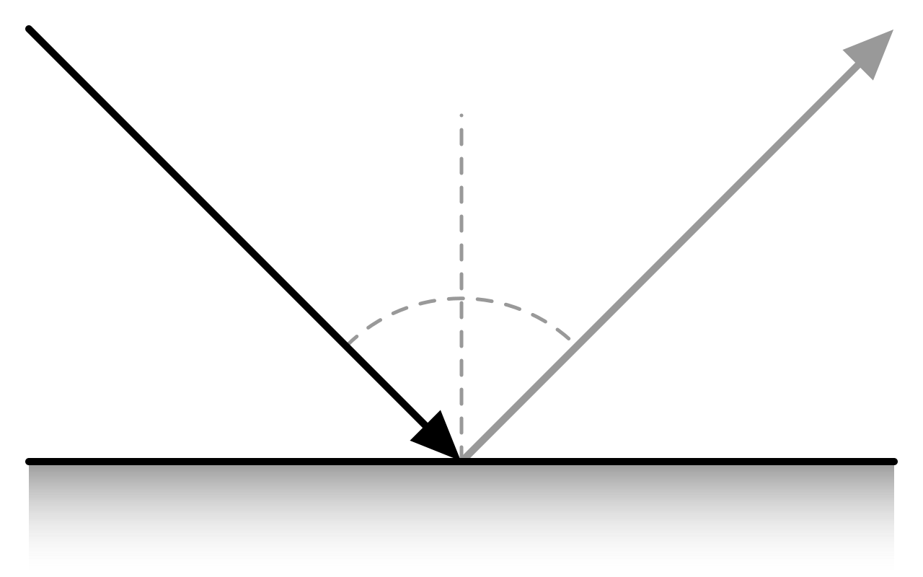
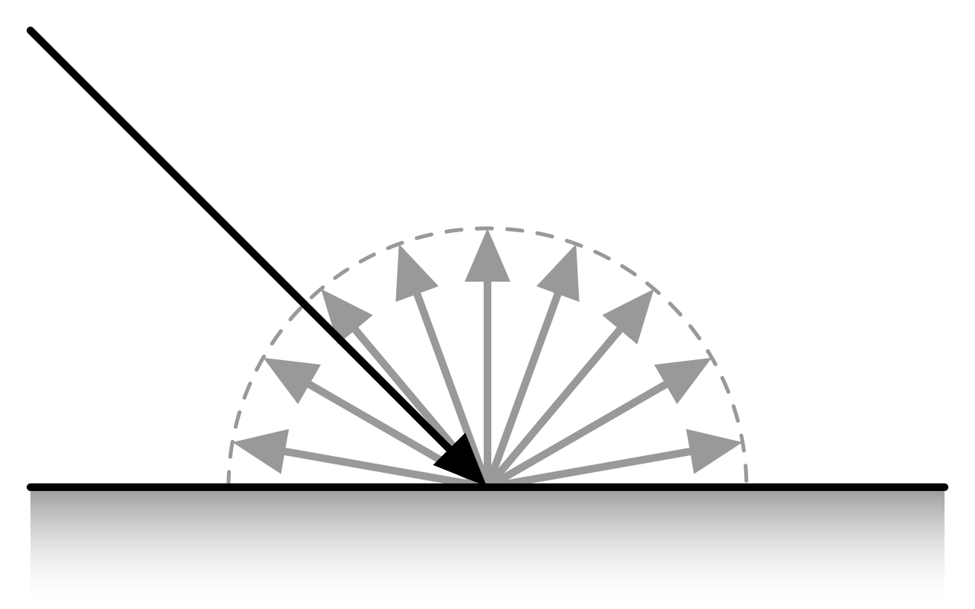
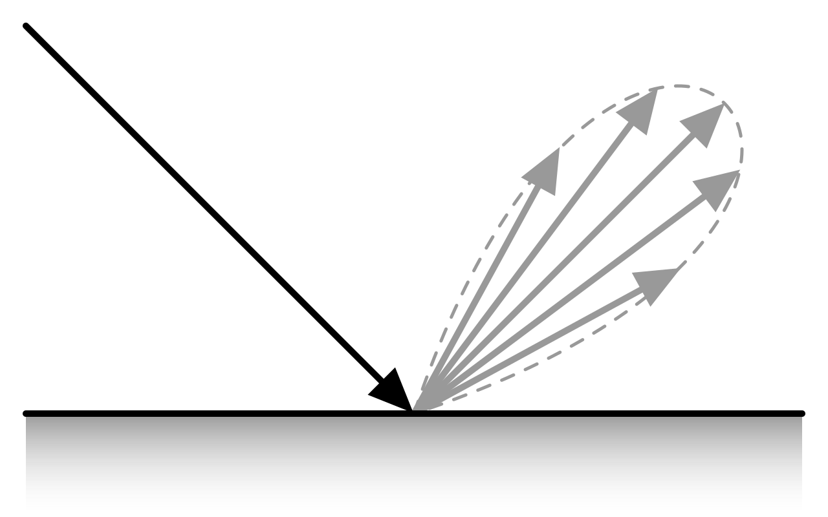
Types of reflection (Recap)
mirror
diffuse
glossy
Diffuse reflection
Equally scattered ray in all directions.
Specular reflection
Weighted scattered ray based on the surface parameters.
en.wikipedia.org/wiki/Bidirectional_reflectance_distribution_function

Slide 14
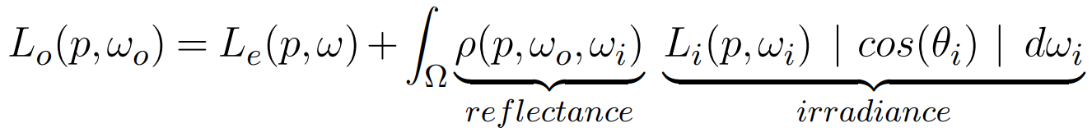
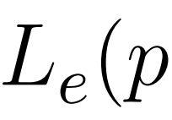
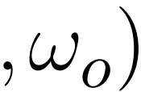
How much light is scattered ?
- Integration over all possible scattered rays.
- We implemented this part as scattering properties of materials.
- The quantity that light scatters in the direction.
- This parameter can be represented by reflection models.

Slide 15
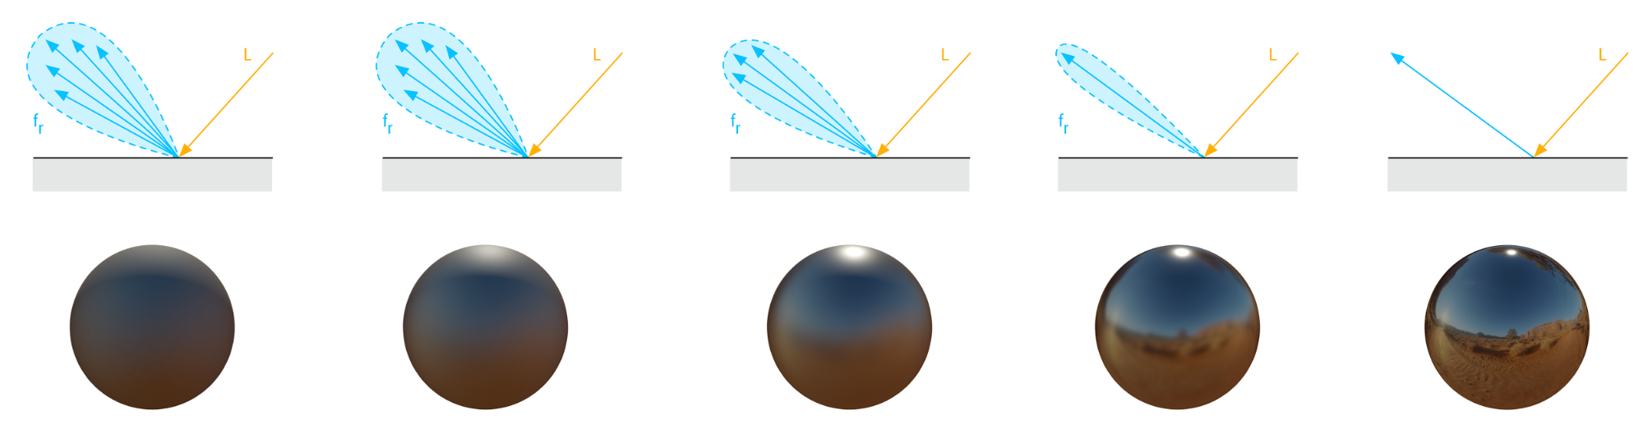
Bidirectional Reflectance Distribution Function
BRDF is a function describing how much light scatters for a given pair of directions.
A pair of directions is defined by incoming light direction and outgoing (exitance) viewing direction.

Slide 16
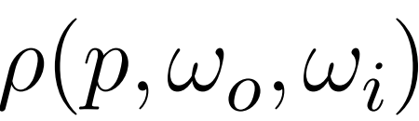



Illustration - BRDF

Slide 17
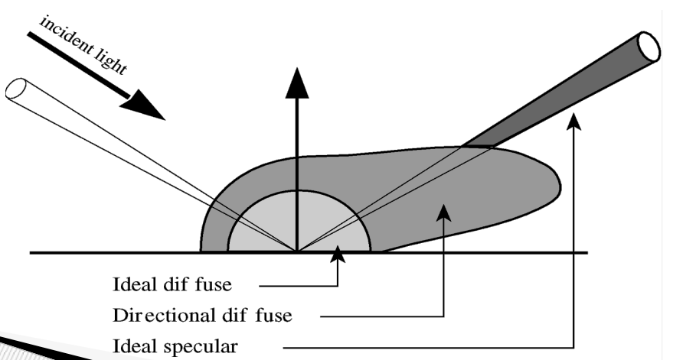
BRDF lobes
maverick.inria.fr/Members/Nicolas.Holzschuch/cours/Slides/1b_Materiaux.pdf

Slide 18
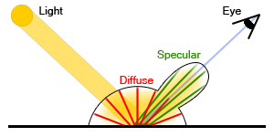
A metal class
This material exhibits some specular reflection depending on a roughness parameter.
Attributes
Color
Roughness
Methods
scattering()

Slide 19
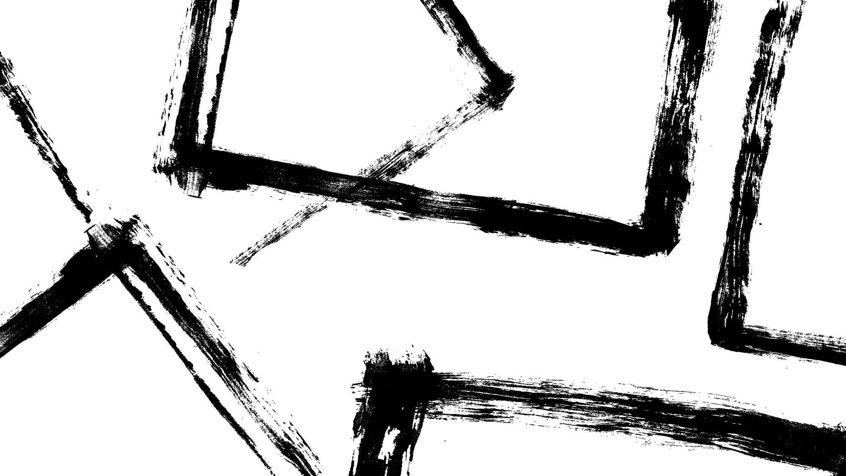
Specular reflection
- A random unit vector around the perfect reflection vector.
- The size of the random vector depends on the roughness parameter.
N
L
R

Slide 20

Codes and class assignment !
Github : RT-python-week07
https://github.com/KUGA-01418283-Raytracing/RT-python-week07

