Slide 1

Working with 2d Graphics 2nd Week
Lecturer : Tanaboon Tongbuasirilai
Course : ICCS404
Week 2 : 2D Graphics

Slide 2
Advanced 2D graphics
Hierarchical modeling
HTML canvas graphics
A scene description langauge

Slide 3


Hierarchical Modeling
Hierarchical modeling is a technique used in computer graphics and computer-aided design (CAD) to organize and manage complex structures by representing them as a hierarchy of interconnected parts. Each part or component in the hierarchy can have its own transformation (such as translation, rotation, and scaling) relative to its parent component. This technique is widely used in 3D modeling, animation, and simulation systems.
Objects are positioned using modeling transformations such as scale, rotate, and translate.
This method enables building intricate structures by combining simpler components through transform stacks.

Slide 4

Previously on modelling transform
Modeling Transformations - Essential transformations such as scale, rotate, and translate applied to individual objects.
Transform Stacks - Utilized to manage nested transformations, ensuring proper hierarchical structure.
Reusable Components - Allows complex scenes to be constructed from reusable and individually manageable simple shapes.
Scene Organization - Facilitates organized and structured scene creation by defining object relationships and dependencies.

Slide 5
Important points of hierarchical modeling
Parent-Child Relationships
Objects are organized in a tree-like structure, where transformations applied to a parent affect all its children.
It allows us to organize complex objects into manageable parts or components.
Local Coordinate Systems
Each object can have its own local coordinate system, making transformations more intuitive and modular.
By breaking down objects into hierarchical structures, it becomes easier to edit and modify specific parts without affecting the entire object. For instance, you can rotate or scale individual components without altering the rest of the model.
Animation
Child objects inherit transformations from their parent objects, simplifying complex transformations.
It enables us to animate complex movements by manipulating the transformations of individual components.
Reusability
Components in a hierarchical model can be reused across different scenes or projects.
Promotes reuse of objects and transformations, leading to more efficient and manageable code.
Scalability
Easily scalable for both simple and complex scenes due to the hierarchical structure.
Since transformations are applied locally to each component, the rendering system can optimize calculations and reduce computational overhead.
Notes:
Organization: Hierarchical modeling allows us to organize complex objects into manageable parts or components. For example, in a 3D model of a car, each part (wheels, body, doors, etc.) can be represented as a separate component within the hierarchy.
Ease of Editing: By breaking down objects into hierarchical structures, it becomes easier to edit and modify specific parts without affecting the entire object. For instance, you can rotate or scale individual components without altering the rest of the model.
Animation: Hierarchical modeling is essential for creating animations. It enables us to animate complex movements by manipulating the transformations of individual components. For example, in character animation, each body part (arms, legs, head) can be animated separately within the hierarchical structure.
Efficiency: Hierarchical modeling improves efficiency in rendering and processing. Since transformations are applied locally to each component, the rendering system can optimize calculations and reduce computational overhead.
Reusability: Components in a hierarchical model can be reused across different scenes or projects. For instance, a 3D model of a tree can be reused in multiple environments by simply adjusting its position, rotation, and scale within the hierarchy.
Flexibility: Hierarchical modeling provides flexibility in creating variations of complex objects. By rearranging or adding/removing components within the hierarchy, we can generate different versions or configurations of the same object.

Slide 6
Benefits of Hierarchical Modeling
Efficiency - Reduces computational overhead by allowing group transformations, minimizing the need to apply individual transformations to each object.
Organization - Helps in maintaining a clean structure, making complex scenes more understandable and easier to manage.
Flexibility - Facilitates easy modifications and adjustments to parts of a scene without affecting the entire composition.
Animation - Simplifies the animation process by allowing hierarchical movements and transformations.
Reusability - Promotes reuse of objects and transformations across different scenes and projects.

Slide 7
Scene Graphs
A scene graph is a data structure commonly used in computer graphics, particularly in 3D applications and vector-based graphics editing software. It provides a hierarchical organization for representing the elements within a scene.
Components of a scene graph
Nodes - These represent individual objects or elements in the scene. They act like the building blocks of your scene. Here's a breakdown of a typical scene graph node
Geometry: This defines the shape of the object, often stored using 3D mesh data (triangles, polygons) for 3D graphics or paths for 2D vector graphics.
Material: This defines the surface properties of the object, such as color, texture, transparency, and how light interacts with the surface.
Transform: This specifies the object's position, rotation, and scaling within the scene. By modifying these transformations, you can move, rotate, and resize objects in the scene.
Additional Attributes: Nodes can also hold additional information relevant to the object, such as animation data, collision detection properties, or unique identifiers.
Edges (Connections): These define the relationships between nodes in the scene graph. They typically represent a parent-child hierarchy, where
Parent Node: A higher-level object in the scene hierarchy.
Child Node: A lower-level object nested within the parent node.

Slide 8

Keys of Scene Graphs
Scene Graph Structure - Represents hierarchical relationships between objects, managing complexity in rendering scenes.
Nodes and Edges - Nodes represent objects or transformations; edges define parent-child relationships.
Efficient Transformations - Allows for efficient computation of transformations and renderings by propagating changes from parent to child.
Reusability - Objects defined once can be reused in multiple locations with different transformations.
Modular Design - Facilitates a modular approach to designing and managing complex scenes, improving clarity and maintainability.

Slide 9
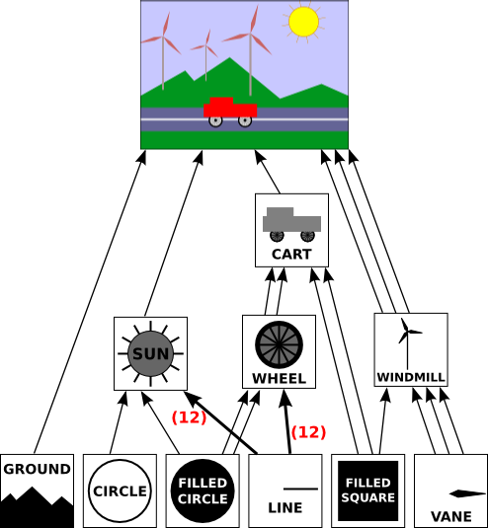
Illustration
Objects and Sub-objects - The drawing is built using a hierarchy. Simple shapes (filled square, filled circle, line) are sub-objects used to create more complex objects (cart, windmill, sun, wheel).
Reusing Sub-objects - A sub-object can be used multiple times within different parent objects (e.g., filled square used in both cart and windmill).
Transformations - Each connection between a sub-object and its parent represents a transformation (scaling, rotation, positioning) applied to create the final appearance within the parent object.
Unique Transformations for Copies - When a parent object has multiple instances of the same sub-object (e.g., two red rectangles in the cart made from squares), each connection has a unique transformation to achieve the desired position and size.
Notes:
this demonstrates a basic principle of hierarchical modeling: breaking down complex objects into simpler components and defining how these components are positioned and modified within the larger structure. This approach allows for efficient creation and manipulation of complex scenes while maintaining reusability of sub-objects.
Here's how these components work together:
A scene graph starts with a root node, the topmost element in the hierarchy.
Child nodes are connected to parent nodes, forming a tree-like structure.
Each node contains information specific to the object it represents.
The connections between nodes define how objects are positioned and related to each other in the scene.

Slide 10
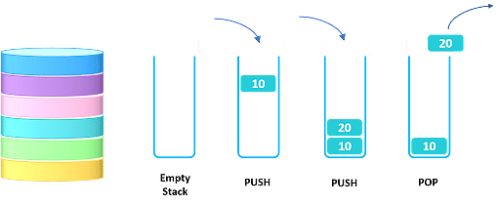
The transform stack
A data structure used in computer graphics, particularly for hierarchical modeling. It's essentially a list that follows a "Last In, First Out" (LIFO) principle.
Challenge of Nested Subroutines - When drawing complex objects with subroutines, each subroutine might need to save its own transformation for proper positioning.
Stack as a Solution - A stack data structure offers the perfect solution for managing these transformations.
Manages transformations (like scaling, rotation, translation) applied to objects in a scene.
Ensures proper positioning of objects within a hierarchical structure (complex objects built from simpler ones).

Slide 11
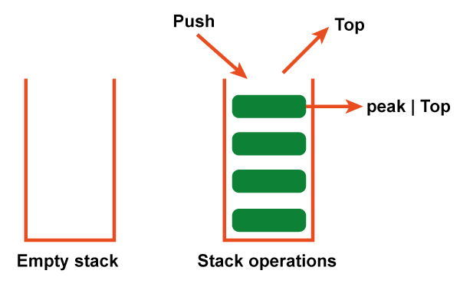
Structure
Pushing: When drawing an object, its current transformation is saved (pushed) onto the stack. Imagine adding a new plate on top of the stack.
Popping: After drawing is complete, the saved transformation is retrieved (popped) from the stack, restoring the previous state. Think of removing the top plate from the stack.

Slide 12
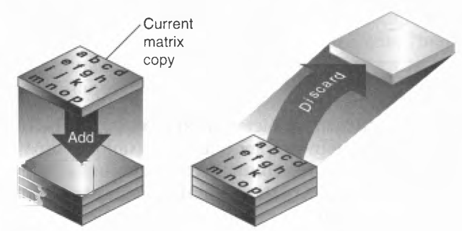
Benefits
Tracks Multiple Transformations – It allows for saving and restoring transformations for multiple nested subroutines drawing different parts of a complex scene.
Maintains Order - Guarantees that the most recently saved transformation (relevant to the current object) is retrieved when needed.

Slide 13
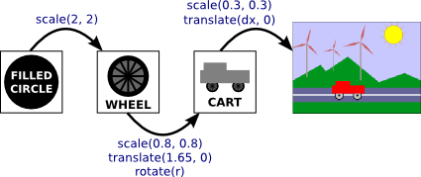
Example with Scene Graph
Cart - Root object with its own transformation (scale and translation).
Wheel - Child of the cart, has its own transformation relative to the cart.
Filled Circle - Child of the wheel, has its own transformation relative to the wheel.
Notes:
The transform stack allows for efficient management of transformations in hierarchical scenes. It simplifies the process for developers by enabling them to focus on individual objects and transformations, while the computer handles the complexities of combining them for the final scene rendering.

Slide 14
Drawing with Transform Stack
Start - The drawing begins with the identity transform (no transformation applied).
Cart
Pushes the identity transform onto the stack.
Applies cart's transformation (scale and translate).
Wheel
Pushes the current transform (cart's transformation) onto the stack.
Applies wheel's transformation relative to the cart.
Filled Circle
Pushes the current transform (wheel's transformation) onto the stack.
Applies circle's transformation relative to the wheel.
Drawing the Circle
The circle is drawn using the combined transformation of all three levels (circle, wheel, cart).
Popping the Stack
After drawing the circle, the wheel's transformation is retrieved (popped) from the stack.
Similarly, after drawing the wheel, the cart's transformation is popped.
Finally, the identity transform is retrieved when the cart is finished.

Slide 15

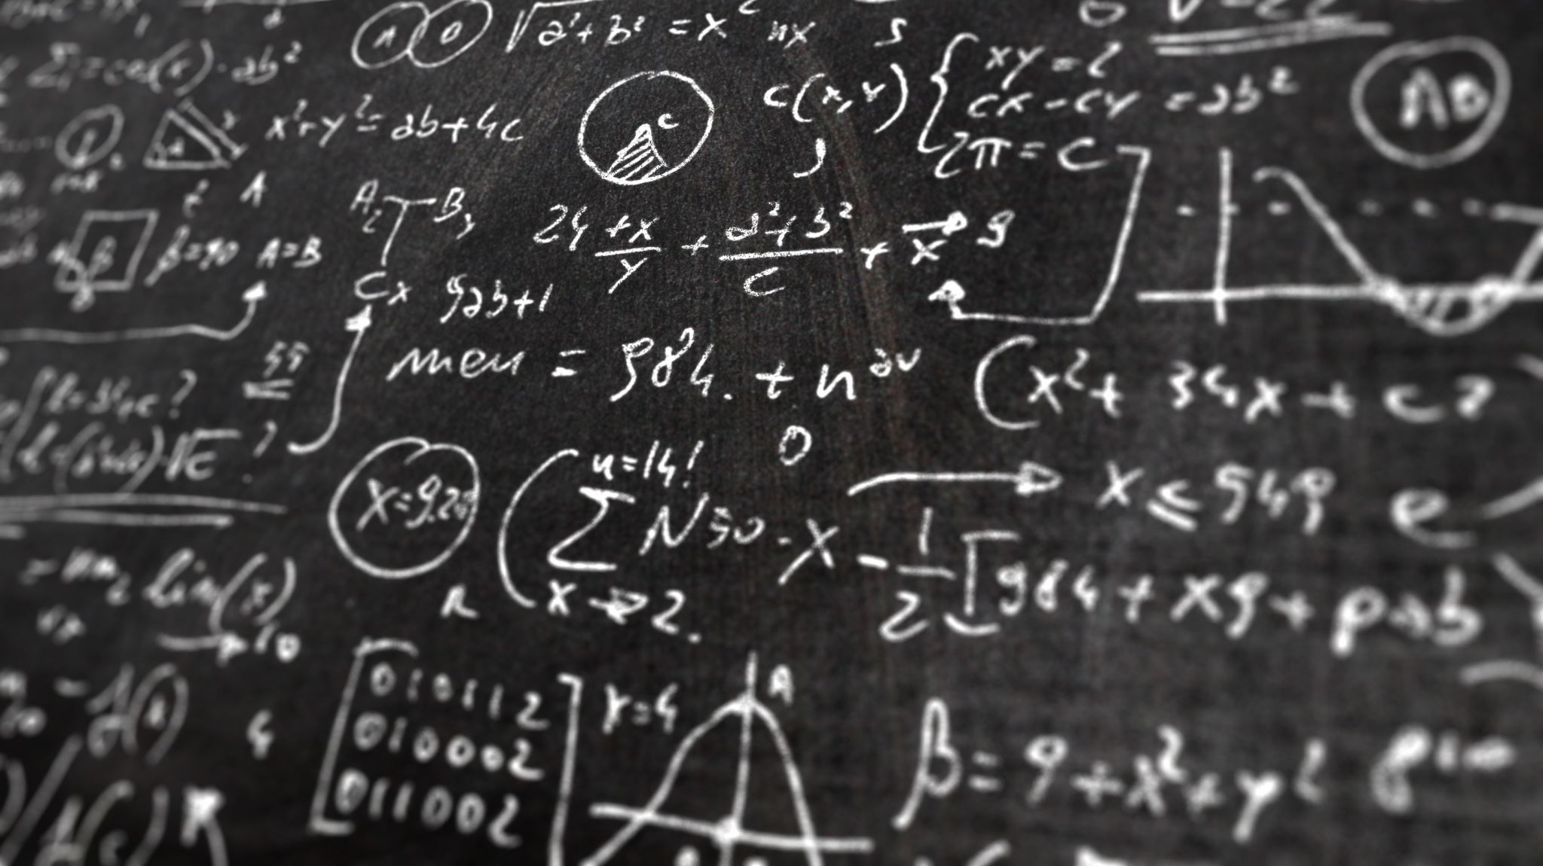


Languages and tools for 2D graphics

Slide 16
HTML Canvas Graphics
HTML5 Canvas is an immediate mode bitmapped area of the screen that can be manipulated with JavaScript. Immediate mode refers to the way the canvas renders pixels on the screen. HTML5 Canvas completely redraws the bitmapped screen on every frame using Canvas API calls from JavaScript.
The HTML5 Canvas 2D context is a display API used to render graphics on a bitmapped area. By adding cross-browser-compatible JavaScript functionality for keyboard and mouse inputs, timer intervals, events, objects, classes, sound, math functions, etc., you can learn to take HTML5 Canvas and create stunning animations, applications, and games.
https://www.oreilly.com/library/view/html5-canvas/9781449308032/ch01.html

Slide 17
Multimedia 2D graphics frameworks
Adobe Flash
https://en.wikipedia.org/wiki/Adobe_Flash
Microsoft Silverlight
https://en.wikipedia.org/wiki/Microsoft_Silverlight

Slide 18





HTML canvas reference
https://www.w3schools.com/tags/ref_canvas.asp

Slide 19

HTML canvas tutorial
https://www.w3schools.com/graphics/canvas_intro.asp

Slide 20
HTML canvas demo
Transformation
https://www.w3schools.com/graphics/canvas_transformations.asp
Animation
https://math.hws.edu/graphicsbook/source/canvas2d/AnimationStarter.html
Event handling
https://math.hws.edu/graphicsbook/source/canvas2d/EventsStarter.html

Slide 21

A Scene Description Language
A scene description language is a specialized programming language or formalized syntax used to describe the components and properties of a graphical scene. This includes defining objects, their attributes, transformations, and the hierarchical relationships between them.
Scene description languages are used to create complex scenes in computer graphics, animations, and simulations by providing a high-level abstraction for specifying what should be rendered and how it should be arranged.

Slide 22
What is SVG?
SVG stands for Scalable Vector Graphics.
SVG is used to define vector-based graphics for the Web.
SVG defines graphics in XML format.
Each element and attribute in SVG files can be animated.
SVG is a W3C recommendation.
SVG integrates with other standards, such as CSS, DOM, XSL and JavaScript.
https://www.w3schools.com/html/html5_svg.asp

Slide 23

Is SVG a scene description language ?
SVG (Scalable Vector Graphics) from W3C is considered a scene description language because it provides a formalized way to describe the structure, appearance, and layout of 2D graphics and visual elements using a text-based format.
SVG is primarily designed for creating and manipulating 2D vector graphics. It lacks the capabilities to define complex 3D object geometry, lighting, and camera settings that are key features of scene description languages.

Slide 24
SVG tutorial & reference
https://www.w3schools.com/graphics/svg_intro.asp
https://www.w3schools.com/graphics/svg_reference.asp

