Slide 1
Some Progress
From ITL on SERS

Slide 2
Questions
Small frequency difference between the reference spectrum and the other measurements. The total difference is 0.02 so no big deal. Correct?
Laurenzian fitting of the peaks has large tails: perhaps Gaussian fitting of the peaks is better?
No pattern in the spatial response: is there really no correlation among spatially close points?
What’s the noise model over the space? Noise variance changes randomly over the space?

Slide 3
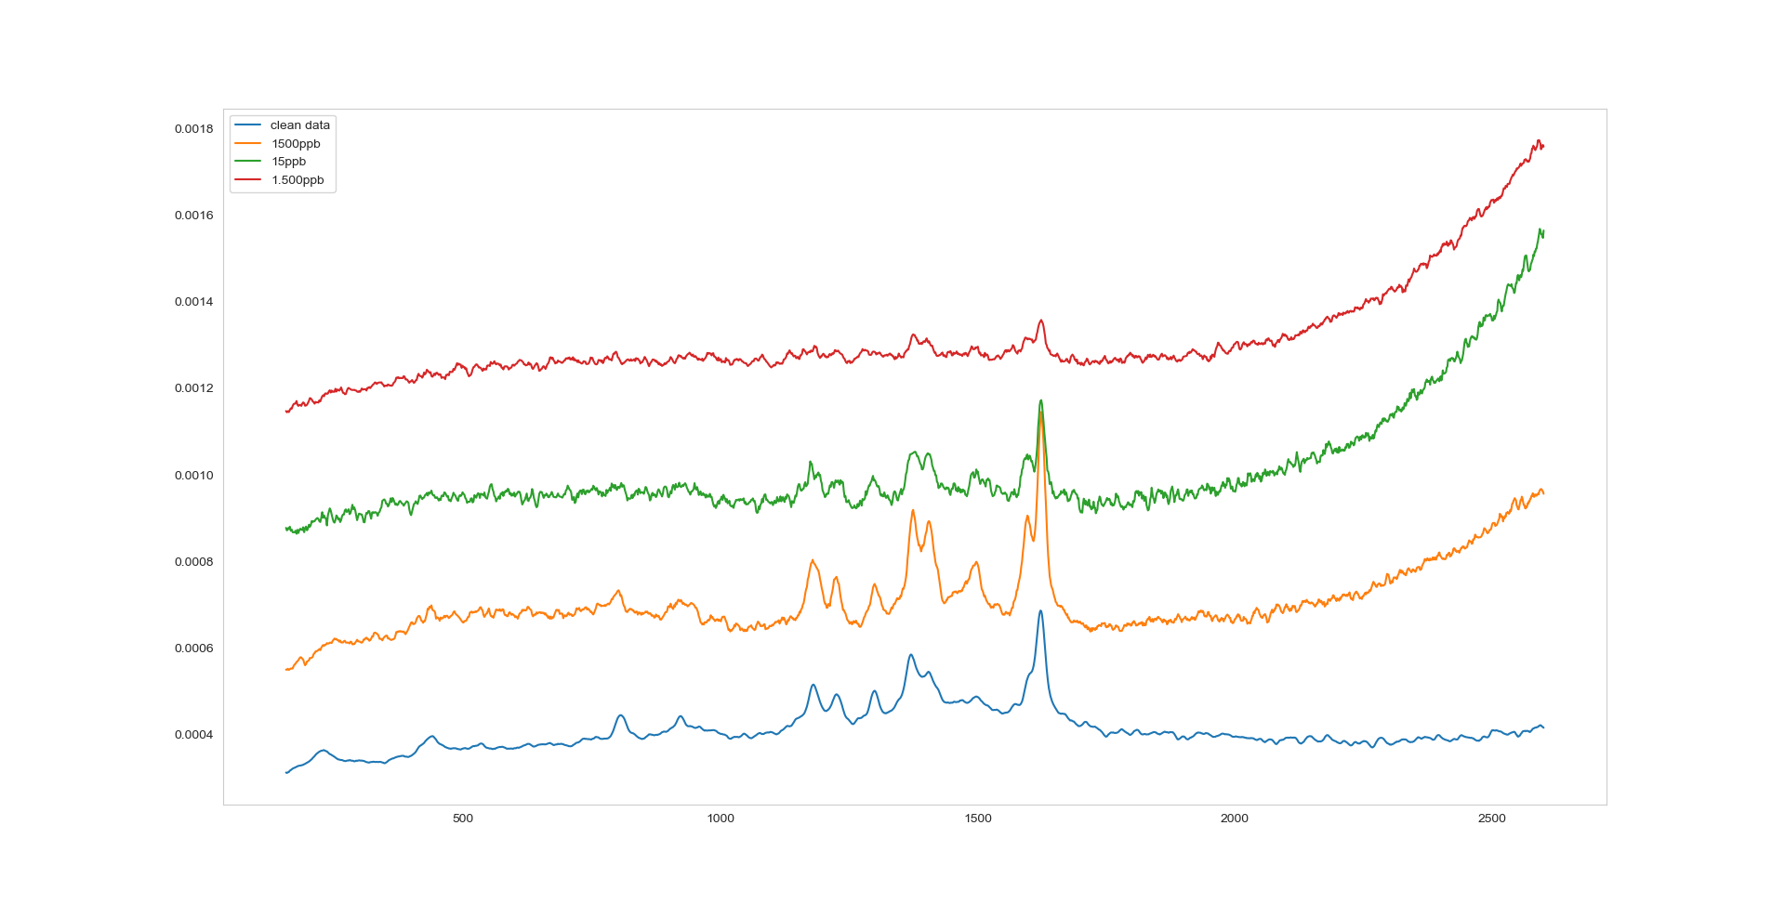
Step 0: just plot the mean
Average over the space

Slide 4
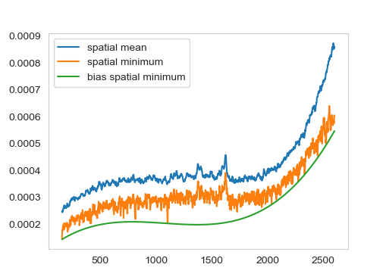
First step: remove the bias
How we do it:
Take the minimum value over the 10X10 grid
Interpolate using a cubic polynomial
Take a loss function which only allows the interpolating polynomial to be below the target curve (neat trick)
Figure for 1.5 ppb:

Slide 5
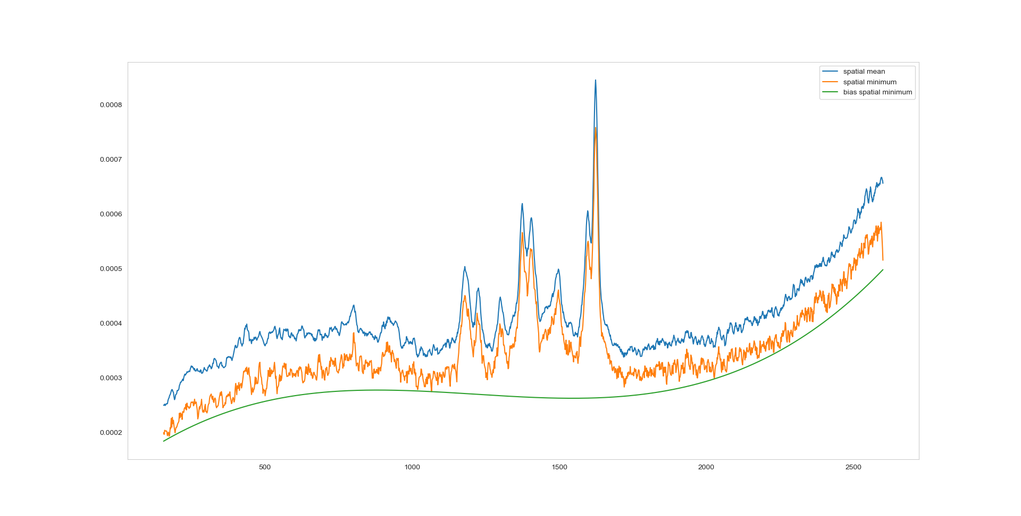
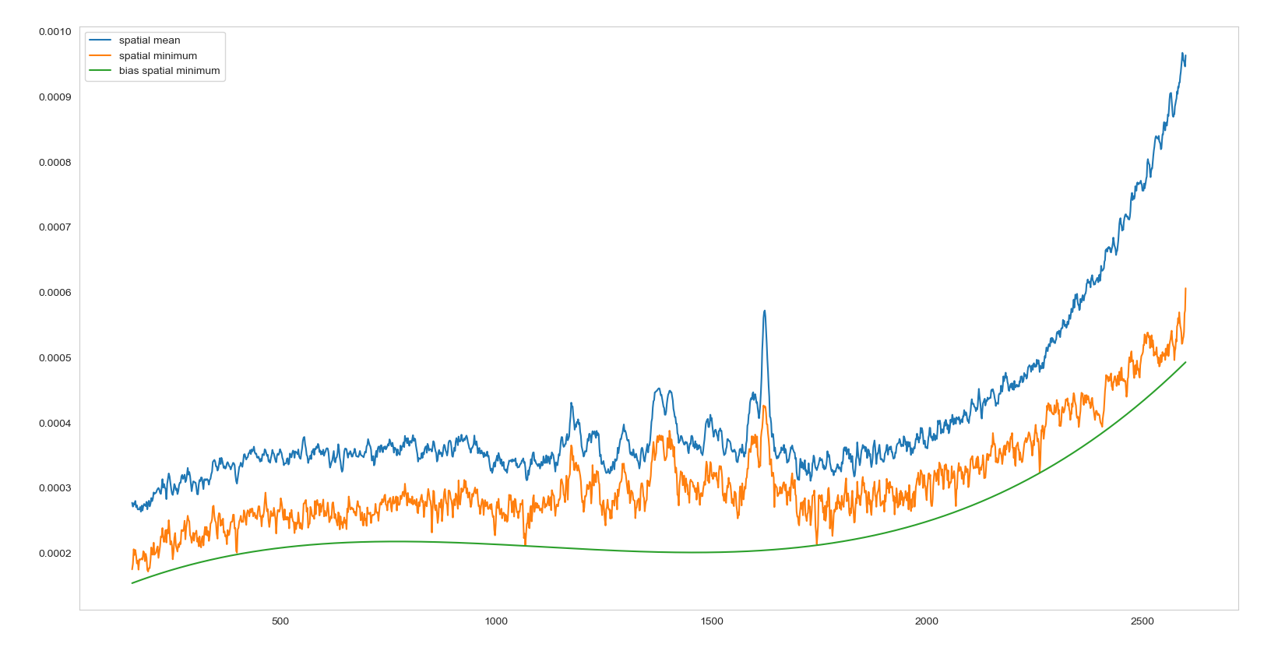
1500ppb
15ppb

Slide 6
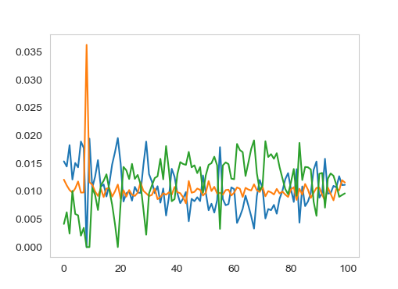
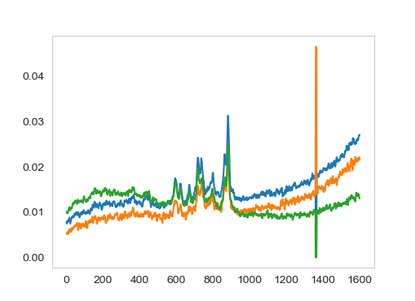
Step 2: Check the NMF
We look at the non-negative matrix factorization of the data to see if there is some undetected component
No other signal seems to be present

Slide 7
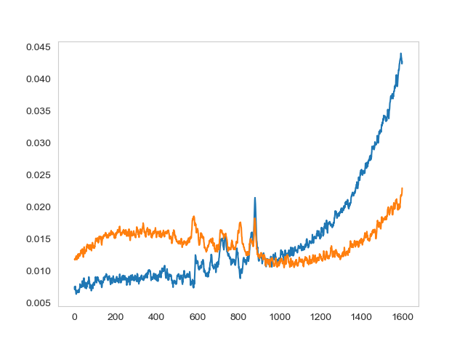
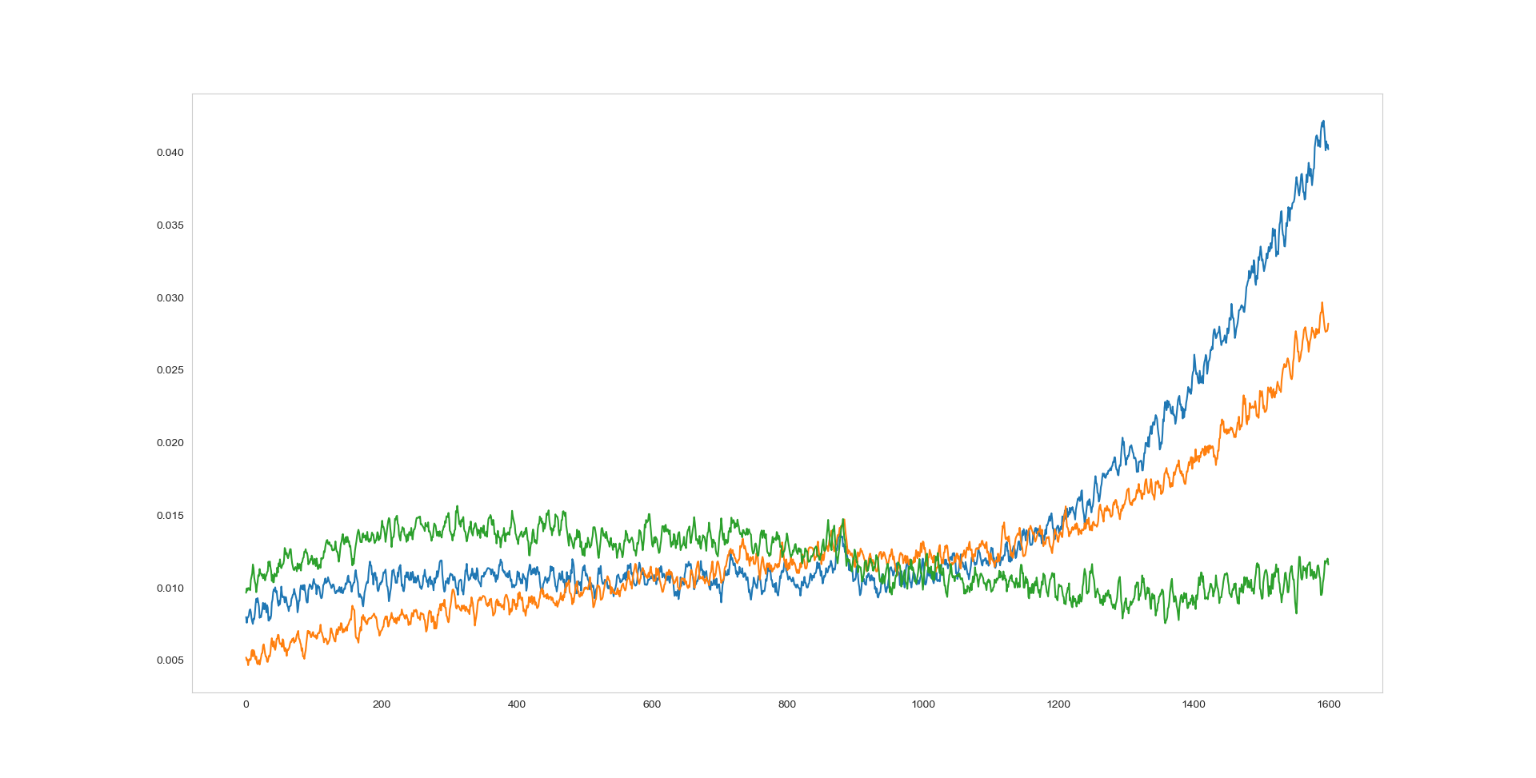
For the 15ppb, we see the florescence emerge as a separate signal, but only slightly
For 1.5 ppb we see more florescence

Slide 8
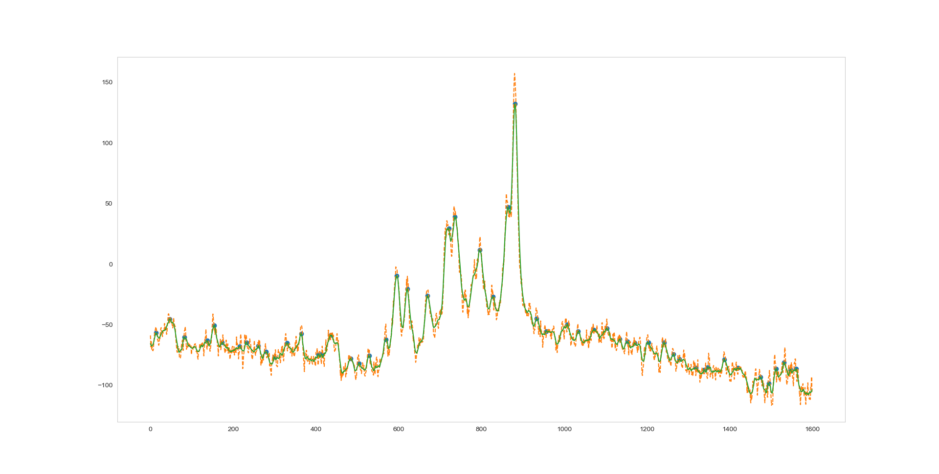
Step 3: Model the spectrum
Use the autocorrelation of the clean spectrum to decide an averaging window for the signal

Slide 9
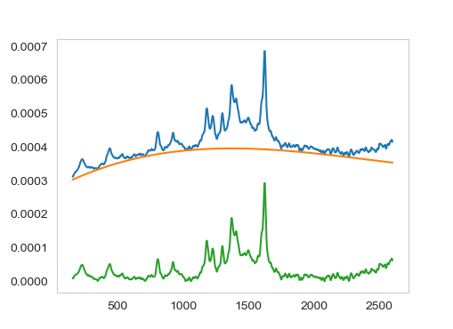
Step 3.2: Remove the bias
Again: use a degree 3 polynomial

Slide 10
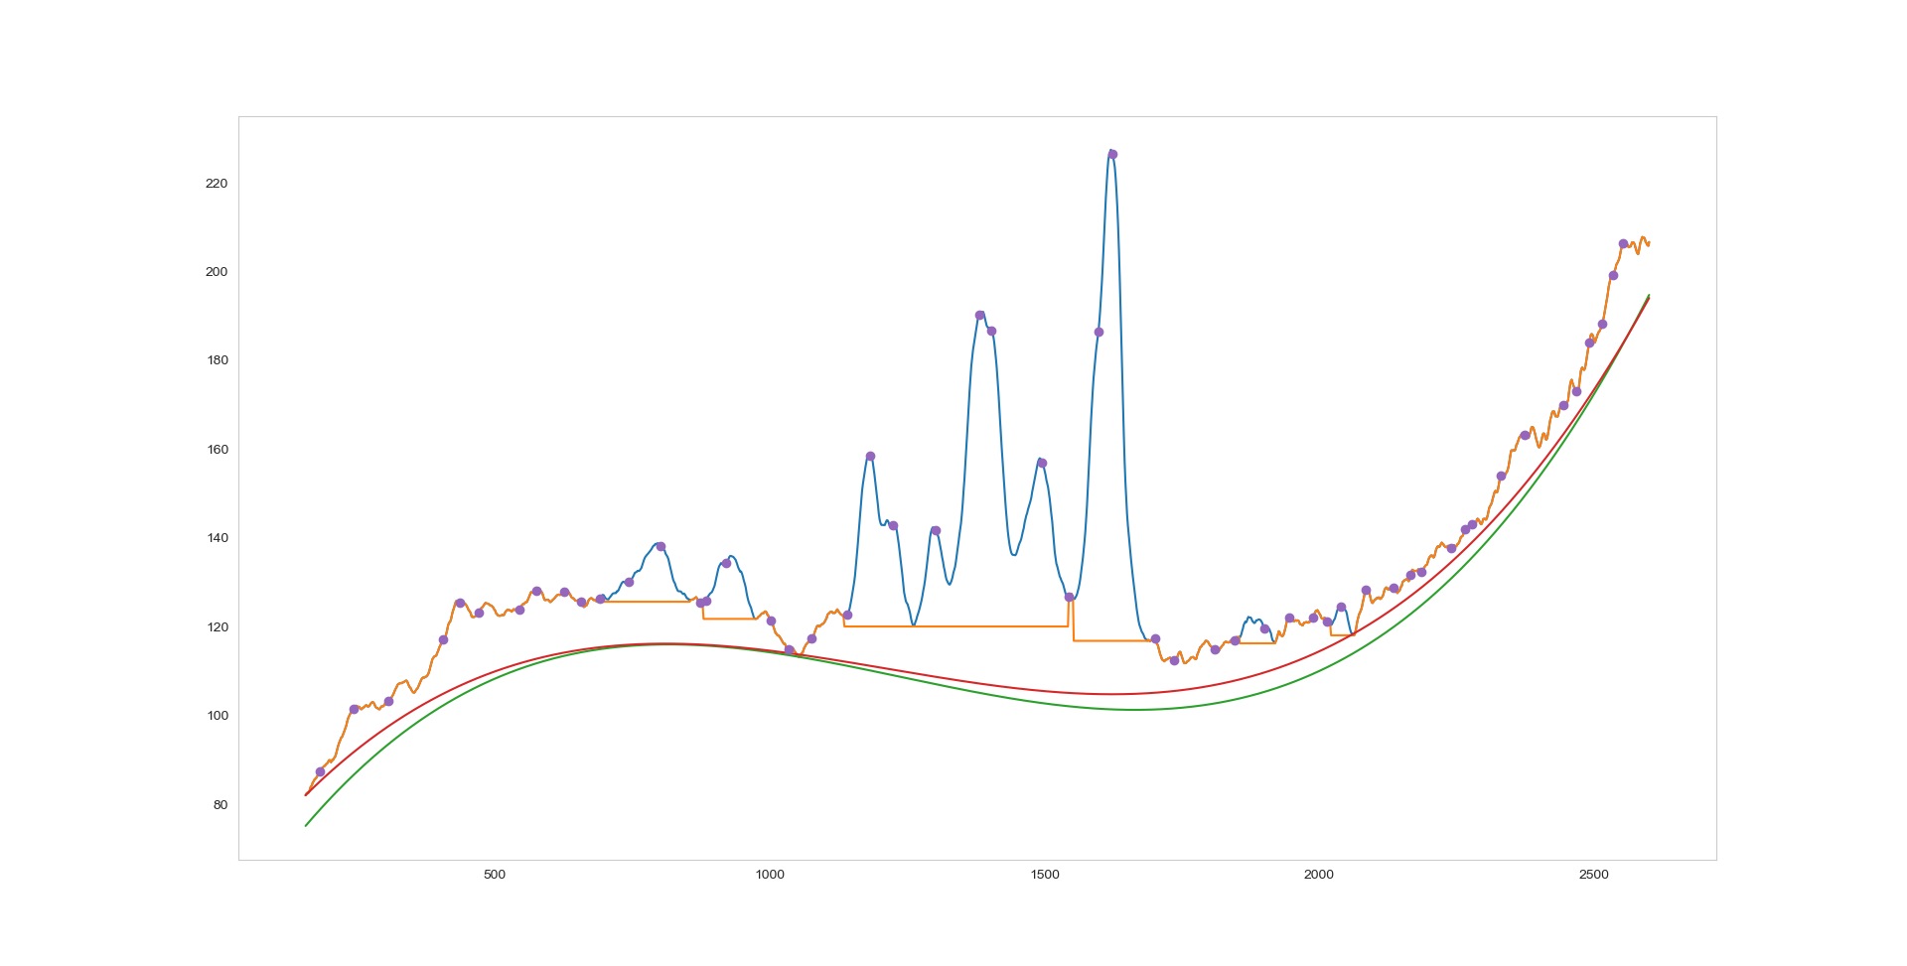
Step 3.2 …bias again
Try various techniques to detect the part of the spectrum where we have peaks

Slide 11
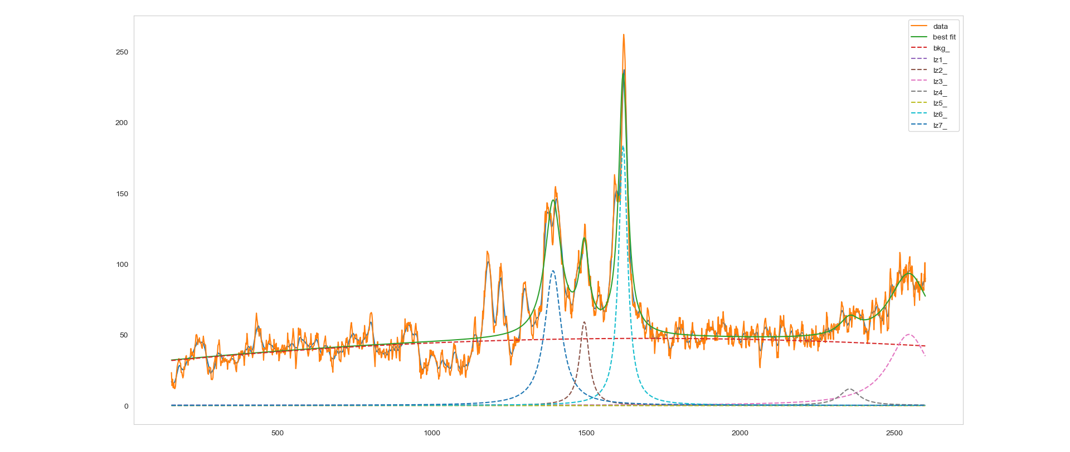
Step 3.3
Interpolate with a quadratic model plus lorenzian peaks
Fit 5 peaks:

Slide 12
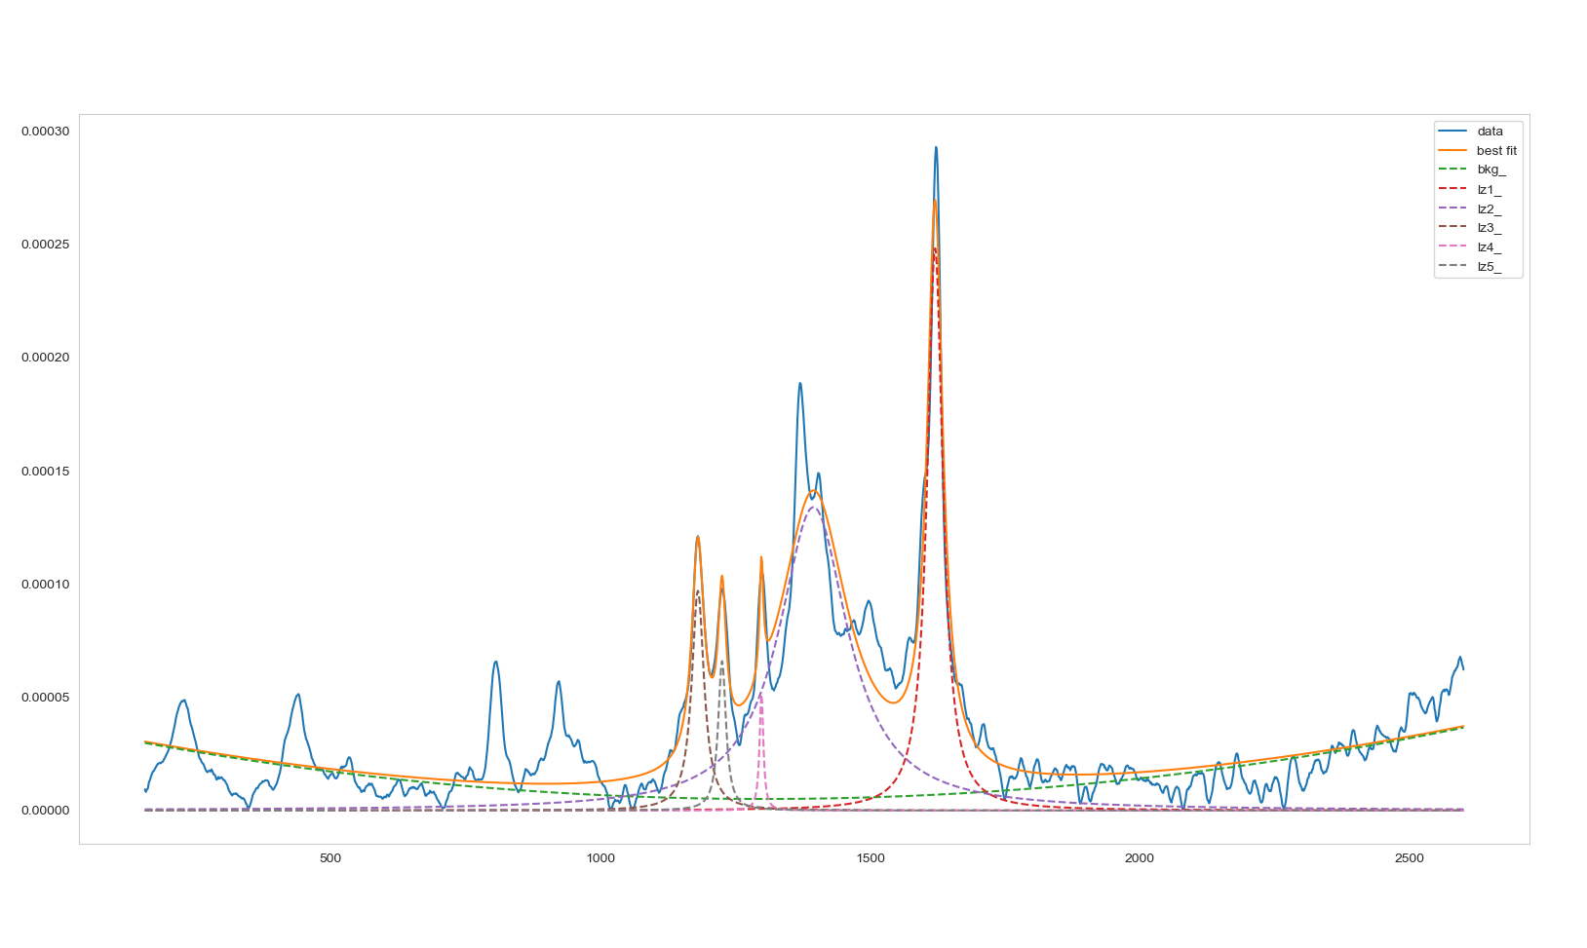
Fit 7 and 15 lorenzians

Slide 13
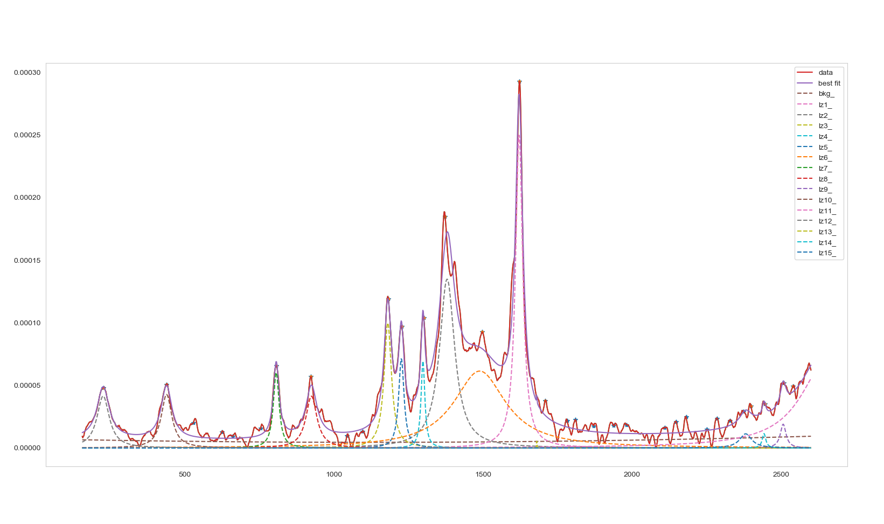
Fit with 15

