Slide 1

LIS: General introduction
September 23rd 2025
Michel Bechtold
michel.bechtold@kuleuven.be

Slide 2
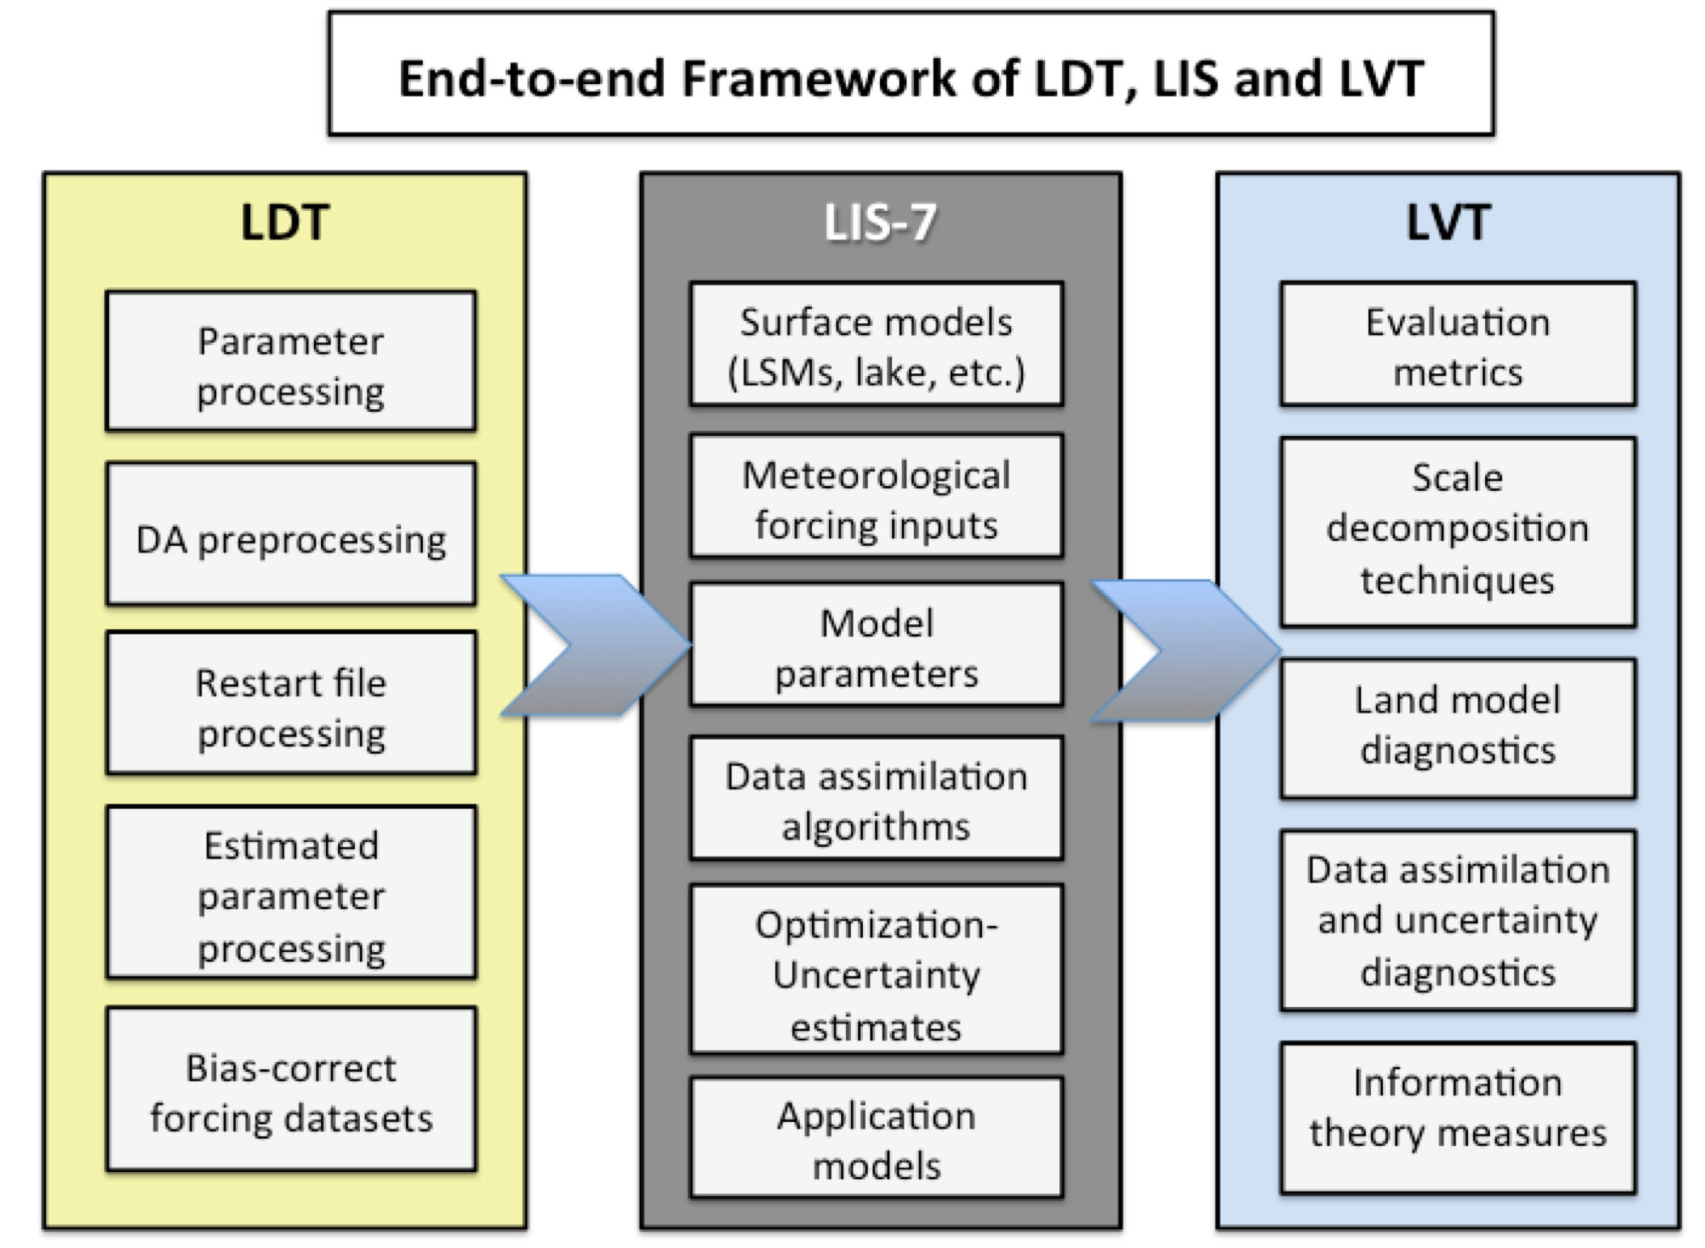

Workflow
pylis
https://github.com/KUL-RSDA/pylis
onenc file
Multiple nc files

Slide 3
LDT, LIS, LVT → pylis
Preprocessing: Land Data Toolkit (LDT)
Prepares required input data for LIS.
Converts heterogeneous data (elevation, soil, landcover, vegetation, etc.) into a homogenized NetCDF file.
Ensures consistent spatial extent and resolution across datasets.
RSDA group uses additional preprocessing with pylis (GitHub link)
Land Information System (LIS)
Core system of the framework.
Runs Land Surface Models (LSMs).
Integrates Data Assimilation (DA) tools.
Postprocessing: Land Verification Toolbox (LVT)
Tool for analyzing LIS output data.
Enables evaluation of model results against satellite observations (e.g., SMOS, SMAP).
Provides evaluation metrics for performance assessment.
Not used in the RSDA group — replaced by pylis (GitHub link)

Slide 4
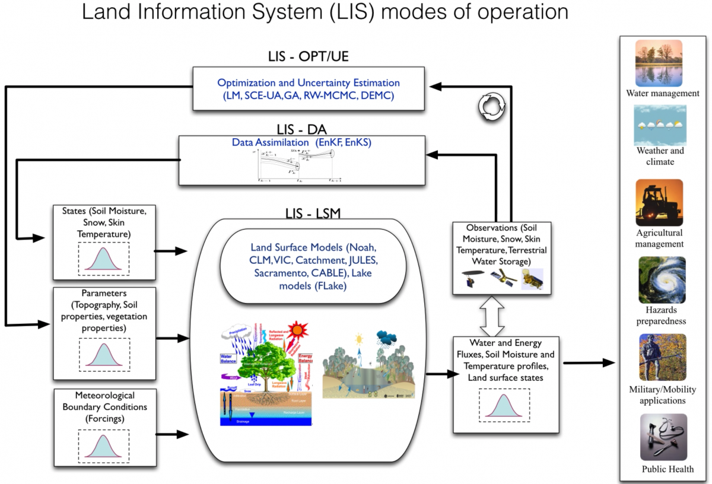
LIS

Slide 5
Hands on
Compile code (ldt and lis), see our LIS documentation how to retrieve and compile the code → https://github.com/KUL-RSDA/documentation/blob/master/LIS/LIS_on_HPC.md
Follow LIS walkthrough tutorial, KUL specific guidance and the link is provided on our documentation page. Learn working with LDT/ldt.config and LIS/lis.config with the documented walkthrough example.
Learn how to analyze output with pylis, tutorial provided in the repository → https://github.com/KUL-RSDA/pylis/
Continue with further testcases that are relevant for your research, e.g. the AquaCrop testcase (see our LIS documentation for the link to the AquaCrop testcase. The documentation is kept up to date)

