Slide 1

DEPARTMENT OF COMPUTER SCIENCE &ENGINEERING GRAPHIC ERA HILL UNIVERSITY, BHIMTAL CAMPUS SATTAL ROAD, P.O. BHOWALI DISTRICT- NAINITAL-263132 2021 – 2022
MINI PROJECT
MINI PROJECT
TRANSFORMING DREAMS INTO REALITY

Slide 2


contents
Introduction
Methodology/Process description
Resource and Limitations
Objective and Scope
Program code
Bibliography/references
Conclusion
GRAPHIC ERA HILL UNIVERSITY, BHIMTAL CAMPUS

Slide 3

introduction
This project is made to make a student database management system using C language to perform basic tasks like add a new record, view record, search record, modify record , delete record and exit. The program achieves this by printing a list on the screen listing all the operations the user can perform in this program.
GRAPHIC ERA HILL UNIVERSITY, BHIMTAL CAMPUS

Slide 4

introduction
The user will be able to choose ant one of them using specific keys made for them. The primary aim of this “Student Database Management System” is to provide an improved design methodology, which envisages the future expansion, and modification, which is necessary for a core sector like database management.
GRAPHIC ERA HILL UNIVERSITY, BHIMTAL
GRAPHIC ERA HILL UNIVERSITY, BHIMTAL CAMPUS

Slide 5

necessity
The design to be expandable and modifiable and so a modular approach is used in developing the application software. Anybody who is a student in the corresponding organization has a data stored in the system can access his/her data using name . He has to first enter his/her data in the management system
GRAPHIC ERA HILL UNIVERSITY, BHIMTAL
GRAPHIC ERA HILL UNIVERSITY, BHIMTAL CAMPUS

Slide 6
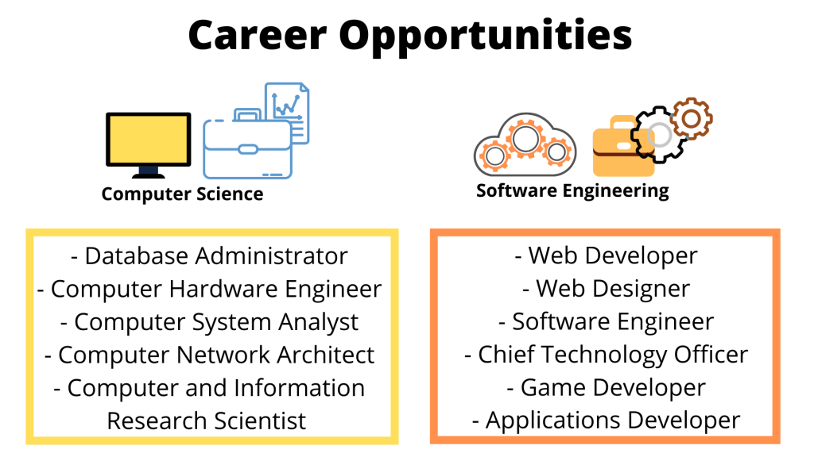
OBJECTIVE AND SCOPE
The user will be able to choose ant one of them using specific keys made for them. The primary aim of this “Student Database Management System” is to provide an improved design methodology, which envisages the future expansion, and modification, which is necessary for a core sector like database management.
GRAPHIC ERA HILL UNIVERSITY, BHIMTAL
GRAPHIC ERA HILL UNIVERSITY, BHIMTAL CAMPUS

Slide 7
OBJECTIVE AND SCOPE
The code in itself will be very easy to understand and will reduce the problems faced during debugging or solving errors which were not sorted out in the time of development of the code. The User Interface will be clean and easy to understand even for a basic level user and provide all options on the fingertips of the user.
GRAPHIC ERA HILL UNIVERSITY, BHIMTAL
GRAPHIC ERA HILL UNIVERSITY, BHIMTAL CAMPUS

Slide 8
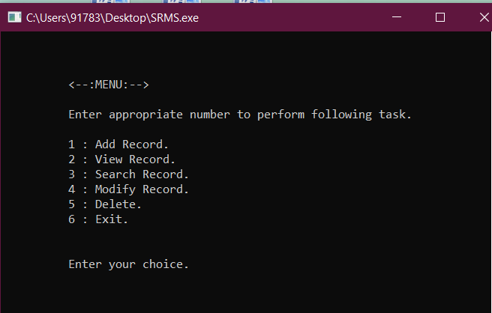
Process description
The program contains 8 functions a structure to hold all the information of a student which includes Name, mobile number, roll number, course, branch. The program begins with the main function printing out "<--:Student Record Management System:-->" and "Press any key to continue."
GRAPHIC ERA HILL UNIVERSITY, BHIMTAL
GRAPHIC ERA HILL UNIVERSITY, BHIMTAL CAMPUS

Slide 9
Process description
Here the list of actions presented to the user is as follows :-
1. Add record
2. View record
3. Search record
4. Modify record
5. Delete record
6. And exit
After the list switch case function is used to move the control flow of the program to the corresponding functions for performing a specific task.
GRAPHIC ERA HILL UNIVERSITY, BHIMTAL
GRAPHIC ERA HILL UNIVERSITY, BHIMTAL CAMPUS

Slide 10
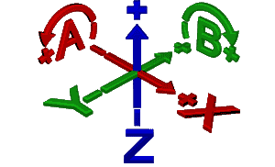
Process description
The first function is add which is used to add new data to the record.
The second function is called view. This is a function to view all the records present in the file
The third function is Search this function is used to search a particular entry in the file containing all the data of the students
GRAPHIC ERA HILL UNIVERSITY, BHIMTAL
GRAPHIC ERA HILL UNIVERSITY, BHIMTAL CAMPUS

Slide 11
Process description
The fourth function is modify this function is used to modify existing data in the file this after the normal check for the legibility and existence of the file containing all the data of the students.
The fifth function is delete this function is used to completely remove a particular record from the file, after the normal check for legibility and existence of the file the code asks the user the name of the student whose data the program has to remove from the file after this the control of the program jumps back to the switch statement.
GRAPHIC ERA HILL UNIVERSITY, BHIMTAL
GRAPHIC ERA HILL UNIVERSITY, BHIMTAL CAMPUS

Slide 12


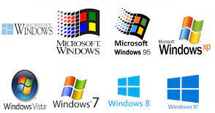
resource
Hardware :
Keyboard
Monitor
Cabinet (CPU/ALU/MU)
Software :
Windows Operating System(64 bit)
Dev cpp portable
GRAPHIC ERA HILL UNIVERSITY, BHIMTAL
GRAPHIC ERA HILL UNIVERSITY, BHIMTAL CAMPUS

Slide 13

limitations
Only compatible for windows operating system.
Only keyboard interface is implemented.
It doesn’t include various other student information fields like attendance, marks, and fees record.
GRAPHIC ERA HILL UNIVERSITY, BHIMTAL
GRAPHIC ERA HILL UNIVERSITY, BHIMTAL CAMPUS

Slide 14

conclusion
Benefits of Student Record Management System:
This includes areas such as fee records, examination records of the students, hostel records, transport records, offered by the institutes.
Student record management system can be stored in and viewed from multiple devices, so there are less chances of data loss.
GRAPHIC ERA HILL UNIVERSITY, BHIMTAL
GRAPHIC ERA HILL UNIVERSITY, BHIMTAL CAMPUS

Slide 15

conclusion
Benefits of Student Record Management System:
It helps institution to modify and search for a student’s
credentials and follow the student’s progress.
Student record management is even better when online, as it
aids students from the luxury of their homes.
GRAPHIC ERA HILL UNIVERSITY, BHIMTAL
GRAPHIC ERA HILL UNIVERSITY, BHIMTAL CAMPUS

Slide 16

conclusion
Benefits of Student Record Management System:
Online student record management system allows you to watch your attendance on a daily basis
It also keeps you updated about your fees and finances, and your performance in previous semesters and examinations
GRAPHIC ERA HILL UNIVERSITY, BHIMTAL
GRAPHIC ERA HILL UNIVERSITY, BHIMTAL CAMPUS

Slide 17



reference
Geeksforgeeks.org
youtube.com
wikipedia.org
GRAPHIC ERA HILL UNIVERSITY, BHIMTAL
GRAPHIC ERA HILL UNIVERSITY, BHIMTAL CAMPUS

Slide 18
Thank you
GRAPHIC ERA HILL UNIVERSITY, BHIMTAL
GRAPHIC ERA HILL UNIVERSITY, BHIMTAL CAMPUS

